Slide 1
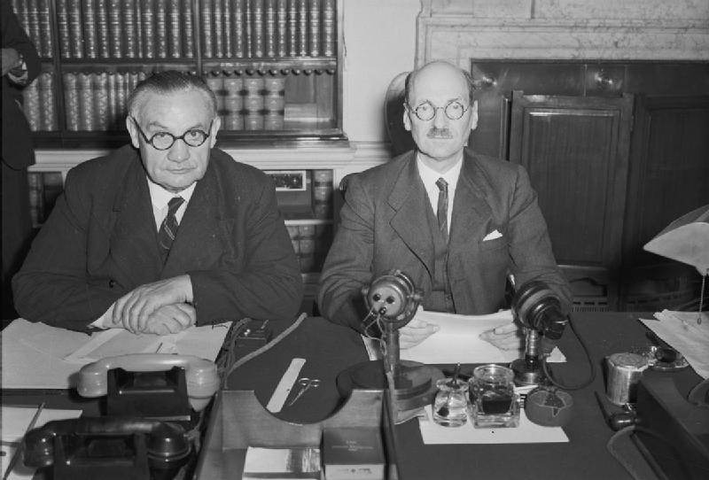
Enquiry 8
How did Britain respond to the Korean War?
An evidential and historiographical approach
Notes:
Image: © IWM H 42138, https://www.iwm.org.uk/collections/item/object/205194906

Slide 2
Enquiry 8 overview:
How did Britain respond to the Korean War?
An evidential and historiographical approach
Lesson 8.1
What was the response of the Labour and Conservative governments
1950–53 to the
Korean War?
Lesson 8.2
What was response of the Civil Service and the military to the outbreak of the Korean War?
Lesson 8.3
How do specialist historians approach the responses of the British elites to the Korean War?

Slide 3
Lesson 8.1 Overview
Lesson 8.1
What was the response of the Labour and Conservative governments 1950–53 to the Korean War?
Content covered in this lesson:
The outbreak of the Korean War
Timeline of British involvement
Responses of the Labour and Conservatives governments 1950–53 to the Korean War
An historian’s interpretation regarding British foreign policy in this period

Slide 4
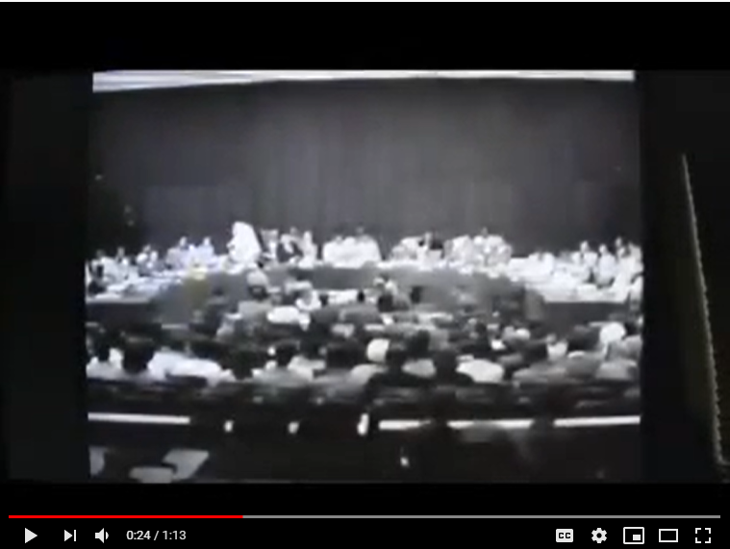
The outbreak of the Korean War
Starter
Watch the video clip about the start of the Korean War.
It recaps what you probably already know, but make notes of any new information that it gives you.
Notes:
Video: https://youtu.be/ItK2cG3qODE?t=22

Slide 5
Timeline of British involvement in the Korean War
June 1950: The United Nations (UN) Security Council declared North Korea the aggressor in the internal Korean conflict; later that month, a largely American UN force arrived in Korea and the British government deployed the Far East Fleet in support.
3 July: Seafire and Firefly aircraft took off from HMS Triumph to attack the North Korean airfield at Haeju.
6 July: Cabinet decided against sending further military forces to Korea; decision reversed on 25 July.
29 August: The first British ground force, 27 Brigade, arrived to defend the Pusan Perimeter, soon joined by 3rd Battalion and the Royal Australian Regiment , and the Brigade was renamed 27 Commonwealth Brigade. Meanwhile, Royal Navy ships engaged in a counter-offensive, with amphibious raids mounted by Royal Marines.
16 September: In the south, 27 Commonwealth Brigade advanced through North Korea.
November: A second and much stronger British force arrived.
April 1951: Battle of Imjin River – three days of fighting saw the Gloucestershire Regiment destroyed by a Chinese attack. By 25 April, the remaining three battalions of 29 Brigade, along with the supporting arms, withdrew. On 26 April, 29 Brigade was relieved by American units.
In later stages of the conflict, British brigades retreated to a new defensive position covering Seoul.
The front settled into a line that remained essentially unchanged until the 1953 Armistice. British and Commonwealth naval forces were formed into the West Korean Support Group.

Slide 6
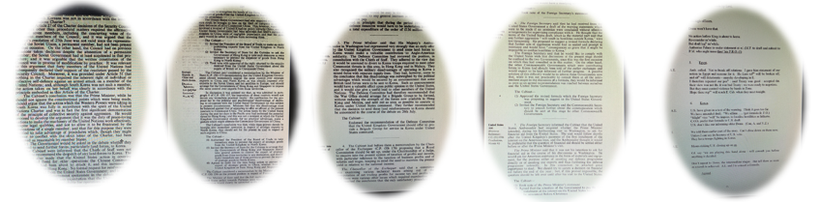
Responses of the Labour and Conservative governments 1950–53 to the Korean War
Document 1: Labour government minutes 1950 supporting intervention
Document 2: Labour government minutes 1950 supporting intervention
Document 3: Labour government minutes 1950 on sending ground troops
Document 4: Conservative government minutes 1951 on Britain’s continued involvement
Document 5: Conservative government minutes 1951 on Britain’s continued involvement
Activity 1
Working in groups, use these five documents to complete the data capture table on the next slide.
Notes:
All documents used under the Open Government Licence: http://www.nationalarchives.gov.uk/doc/open-government-licence/version/3/
Document 1: CAB 128/18/1 Labour cabinet minutes 03/07/50
Document 2: CAB 128/18/2 Labour cabinet minutes 04/07/50
Document 3: CAB 128/18/10 Labour cabinet minutes 25/07/50
Document 4: CAB 128/23/16 Conservative cabinet minutes December 1951
Document 5: CAB 128/23/16 Conservative cabinet minutes December 1951

Slide 7
Activity 1
1. Data capture: Work with transcripts (Resource sheet 8.1A) or facsimiles (8.1B) to fill in the data capture table (8.1C).
2. Then use your completed table to work out:
What do the documents suggest motivated Labour and Conservative support for US/UN action in Korea?
What do the documents suggest motivated these governments in supporting the sending of British combat troops to Korea?
How different do the Labour and Conservative positions appear
to be?
Doc. | What does the document suggest are the reasons for British involvement in the Korean War? | Has the British government’s reasoning changed from the previous document? (Y/N) | If the reasoning has changed, why is this?
1
2
3
4
5

Slide 8
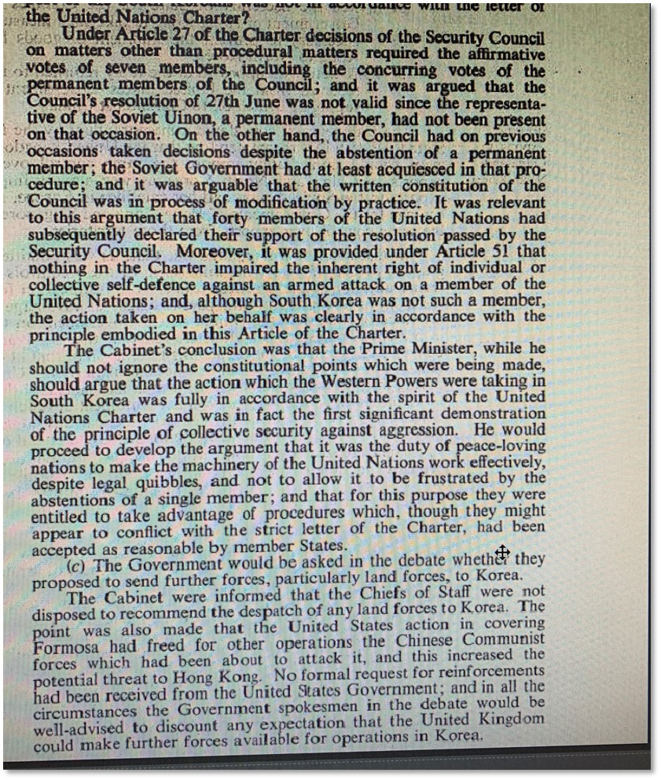
Document 1
CAB 128/18/1
Labour cabinet minutes 03/07/50
Notes:
Document 1: CAB 128/18/1, Labour cabinet minutes, 03/07/50

Slide 9
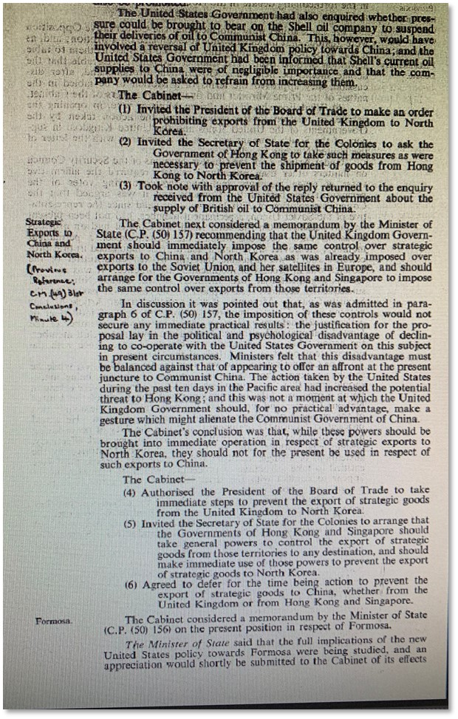
Document 2
CAB 128/18/2
Labour cabinet minutes 04/07/50
Notes:
Document 2: CAB 128/18/2, Labour cabinet minutes, 04/07/50

Slide 10
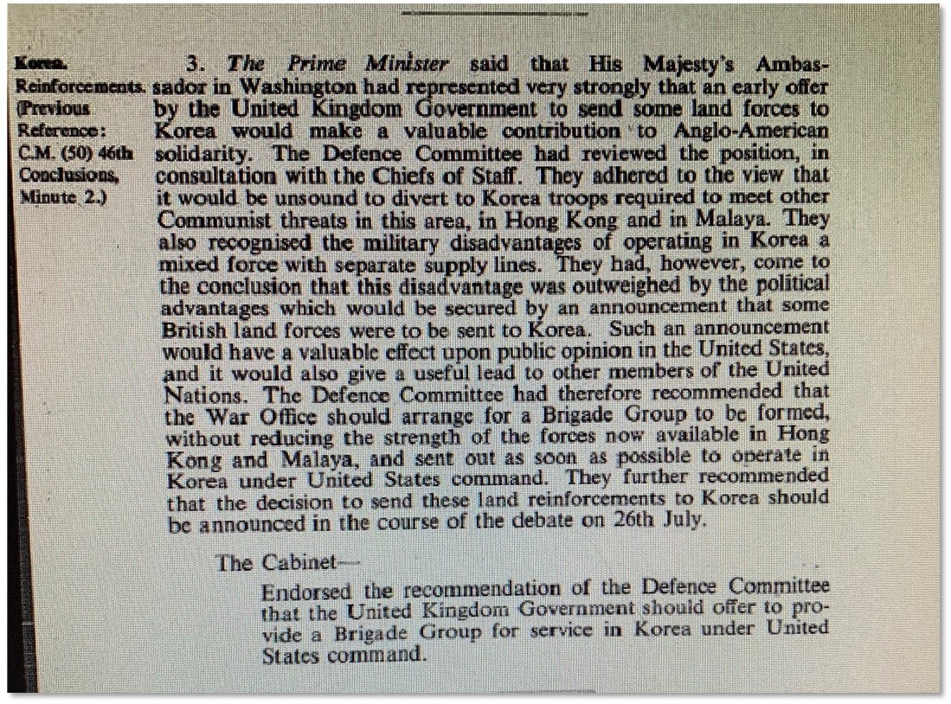
Document 3
CAB 128/18/10
Labour cabinet minutes 25/07/50
Notes:
Document 3: CAB 128/18/10, Labour cabinet minutes, 25/07/50

Slide 11
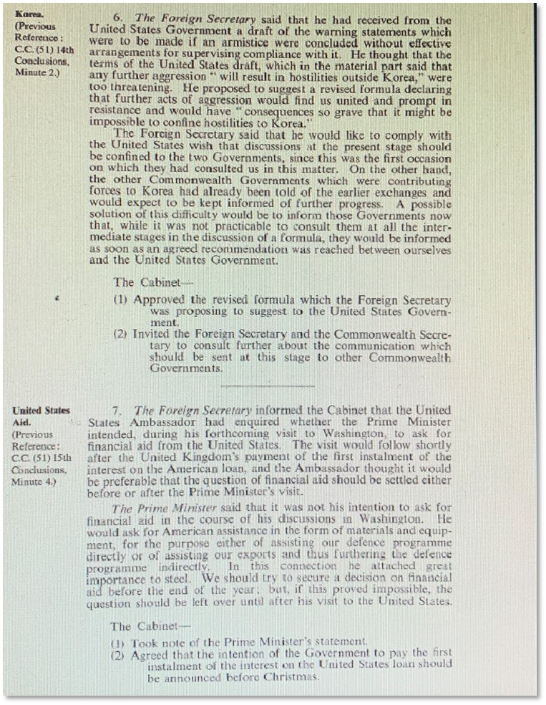
Document 4
CAB 128/23/16
Conservative cabinet minutes December 1951
Notes:
Document 4: CAB 128/23/16, Conservative cabinet minutes, December 1951

Slide 12
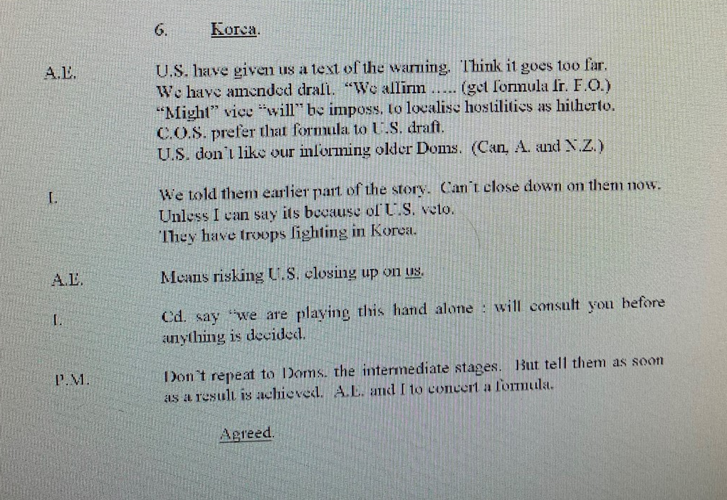
Document 5
CAB 128/23/16
Conservative cabinet minutes December 1951
Notes:
Document 5: CAB 128/23/16, Conservative cabinet minutes, December 1951 – as above

Slide 13
Plenary
An historian’s interpretation of British foreign policy post-WWII
‘The view has long been held that Britain “has lost an empire and not yet found a role”, in the famous words of US Secretary of State, Dean Acherson, several decades ago. Yet Britain’s real role is easily discovered if we are concerned to look… Britain’s role remains an essentially imperial one: to act as junior partner to US global power; to help to organise the global economy to benefit Western corporations; and to maximise Britain’s (that is, British elites’) independent political standing in the world and thus remain a world power.’
From M. Curtis – Web of Deceit (2003)
Discuss
How would Curtis explain
the continuity between the positions of Labour and the Conservatives that you have seen in the documents relating to British intervention in the Korean War?

