Slide 1
Enquiry 8 overview:
How did Britain respond to the Korean War?
An evidential and historiographical approach
Lesson 8.1
What was the response of the Labour and Conservative governments 1950–53 to the Korean War?
Lesson 8.2
What was response of the Civil Service and the military to the outbreak of the Korean War?
Lesson 8.2
How do specialist historians approach the responses of the British elites to the Korean War?

Slide 2
Lesson 8.3 Overview
Lesson 8.2
How do specialist historians approach the responses of the British elites to the Korean War?
Content covered in this lesson:
What research focus is taken by specialist historians of the Korean War?
How does their work contrast with scholars already encountered?
Why do some scholars critique elite power and others not?
What do elite responses to the Korean War teach us about Britain in the early Cold War years and what do scholarly responses to these developments teach us about the construction of history?

Slide 3

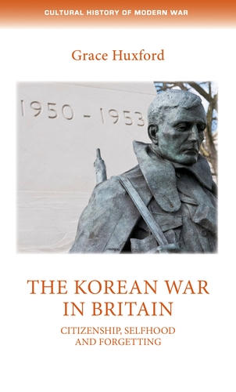
Starter
Grace Huxford is a leading scholar on the Korean War.
This is an area capturing historians’ attention at this very moment.
She is Senior Lecturer in Modern History at the University of Bristol.
Notes:
Left: Grace Huxford/University of Bristol, https://research-information.bris.ac.uk/en/persons/grace-huxford
Right: Manchester University Press, https://manchesteruniversitypress.co.uk/9781526118950/

Slide 4
How do specialist historians approach British responses to the Korean War?
Historian | Whose responses do they focus on? | What types of sources do they use? | How does the emphasis of this work differ from the historians/scholars you have already encountered in this enquiry?
Dockrill (1986)
Hopkins (2001)
Huxford (2018)
Activity 1
Data capture. Use specialist Sources 1–3 to complete the first two columns of this table (Resource sheet 8.3A).

Slide 5
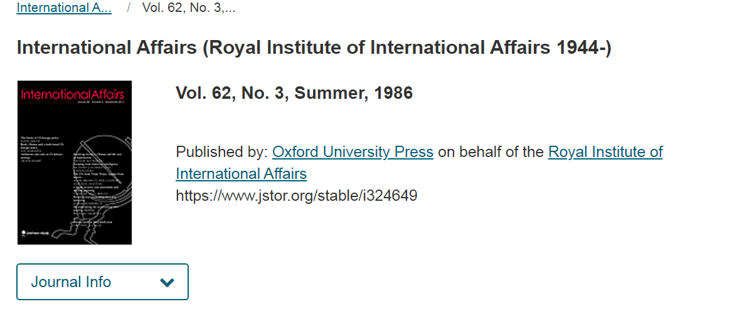
Specialist historian: Michael L. Dockrill
Source 1:
Extract from
M. L. Dockrill (1986) ‘The Foreign Office, Anglo-American relations and the Korean War, June 1950–June 1951’ in International Affairs (Royal Institute of International Affairs 1944–), 62, no. 3, pp. 459–476.
Published by: Oxford University Press on behalf of the Royal Institute of International Affairs
https://www.jstor.org/stable/2617887

Slide 6
Source 1:
Michael L. Dockrill
Despite these misgivings, Strang was pleased by the determined American response in Korea: as he told the French ambassador on 27 June, ‘the Americans, conscious of their strength and remembering the history of pre-war years, had decided that it was better to run the risk of nipping in the bud Communist aggression in the Far East than refrain from action’. The Foreign Office overcame the reluctance of the Chiefs of Staff to send a British troop contingent to South Korea – in the Chiefs’ view, Britain was already over-stretched militarily in the Far East. When General Omar Bradley, the Chairman of the US Joint Chiefs of Staff (JCS), requested a British ground contribution on 30 June, the Deputy Under-Secretary, Sir Pierson Dixon, feared that a refusal to meet this request would have harmful effects on Anglo-American relations. Nor was he unmindful that a British contribution would enable Britain to insist on closer Anglo-American consultation on Far Eastern policy. He feared that ‘the Americans may, if the military situation becomes desperate, contemplate using atomic weapons, and I feel that at the appropriate moment we ought to obtain an assurance from them that these weapons will not be used without prior consultation with us’. Britain had already put its naval forces in Japanese waters at the disposal of the United Nations Command, and on 25 July Prime Minister Clement Attlee persuaded the Cabinet to agree to two battalions of British infantry being transferred to South Korea from Hong Kong. Divergences between the two countries over Far Eastern policy soon emerged, however, and they were to sour relations throughout the Korean war. However delighted the Foreign Office might be at the tough US response to North Korea’s aggression, officials could not forget that South Korea was a marginal issue as far as Britain’s interests were concerned, and feared that the invasion was a Kremlin feint to distract the attention of the West from Western Europe and the Middle East.
Notes:
Source 1: Extract from Source 1: Extract from M. L. Dockrill (1986) ‘The Foreign Office, Anglo-American relations and the Korean War, June 1950–June 1951’ in International Affairs (Royal Institute of International Affairs 1944–), 62, no. 3, pp. 459–476. Published by: Oxford University Press on behalf of the Royal Institute of International Affairs
https://www.jstor.org/stable/2617887

Slide 7
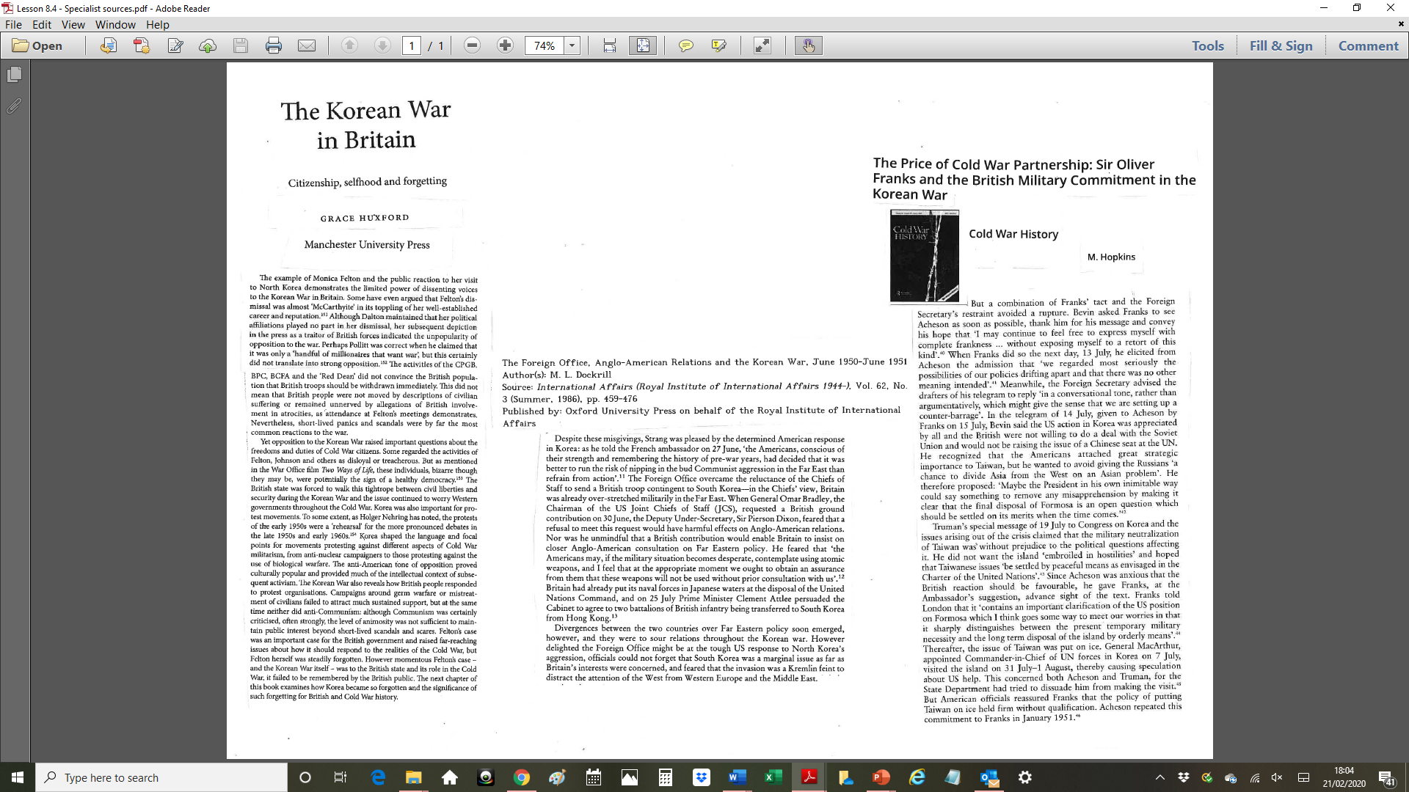
Specialist historian: Michael Hopkins
Source 2:
Extract from
Hopkins, M. (2001) ‘The price of Cold War partnership: Sir Oliver Franks and the British military commitment in the Korean War’ in
Cold War History, 1, no. 2, pp. 28–46.
DOI: 10.1080/713999922

Slide 8
Source 2:
Michael Hopkins
But a combination of Franks’ tact and the Foreign Secretary’s restraint avoided a rupture. Bevin asked Franks to see Acheson as soon as possible, thank him for his message and convey his hope that ‘I may continue to feel free to express myself with complete frankness… without exposing myself to a retort of this kind’. When Franks did so the next day, 13 July, he elicited from Acheson the admission that ‘we regarded most seriously the possibilities of our policies drifting apart and there was no other meaning intended’. Meanwhile the Foreign Secretary advised the drafter of his telegram to reply ‘in a conversational tone rather than argumentatively, which might give the sense we are setting up a counter-barrage’. In the telegram of 14 July, given to Franks on 15 July, Bevin said the US action in Korea was appreciated by all and the British were not willing to do a deal with the Soviet Union and would not be raising the issue of a Chinese seat at the UN. He recognised that the Americans attached great strategic importance to Taiwan, but he wanted to avoid giving the Russians ‘a chance to divide Asia from the West on an Asian problem’. He therefore proposed: ‘maybe the President in his own inimitable way could say something to remove any misapprehension by making it clear that the final disposal of Formosa is an open question which should be settled on its merits when the time comes.
Truman’s special message of 19 July to Congress on Korea and the issues arising out of the crisis claimed that the military neutralisation of Taiwan was without prejudice to the political questions affecting it. He did not want the island ‘embroiled in hostilities’ and hoped that Taiwanese issues ‘be settled by peaceful means as envisaged in the Charter of the United Nations’. Since Acheson was anxious that the British reaction should be favourable, he gave Franks, at the ambassador’s suggestion, advance sight of the text. Franks told London ‘that it contains an important clarification of the US position on Formosa which goes some way to meet our worries in that it distinguishes between the present temporary military necessity and the long term disposal of the island by orderly means’. Thereafter the issue of Taiwan was put on ice. General MacArthur, appointed Commander in Chief of UN forces in Korea on 7 July, visited the island on 31 July–1 August, thereby causing speculation about US help. This concerned both Acheson and Truman, for the State Department had tried to dissuade him from making the visit. But American officials reassured Franks that the policy of putting Taiwan on ice held firm without qualification. Acheson repeated this commitment to Franks in January 1951.
Notes:
Source 2: Extract from Hopkins, M. (2001) ‘The price of Cold War partnership: Sir Oliver Franks and the British military commitment in the Korean War’ in Cold War History, 1, no. 2, pp. 28–46. DOI: 10.1080/713999922

Slide 9
Source 3:
Extract from
Huxford, G. (2018) The Korean War in Britain: citizenship, selfhood and forgetting. Manchester: Manchester University Press.
Specialist historian: Grace Huxford

Slide 10
Source 3:
Grace Huxford
The example of Monica Felton and the public reaction to her visit to North Korea demonstrates the limited power of dissenting voices to the Korean War in Britain. Some have even argued that Felton’s dismissal was almost ‘McCarthyite’ in its toppling of her well-established career and reputation. Although Dalton maintained that her political affiliations played no part in her dismissal, her subsequent depiction in the press as a traitor of British forces indicated the unpopularity of opposition to the war. Perhaps Pollitt was correct when he claimed that it was only a ‘handful of millionaires that want war’, but this certainly did not translate into strong opposition. The activities of the CPGB, BPC, BCFA and the ‘Red Dean’ did not convince the British population that British troops should be withdrawn immediately. This did not mean that British people were not moved by descriptions of civilian suffering or remained unnerved by allegations of British involvement in atrocities, as attendance at Felton’s meetings demonstrates. Nevertheless, short-lived panics and scandals were by far the most common reactions to the war.
Yet opposition to the Korean War raised important questions about the freedoms and duties of Cold War citizens. Some regarded the activities of Felton, Johnson and others as disloyal or treacherous. But as mentioned in the War Office film Two Ways of Life, these individuals, bizarre though they may be, were potentially the sign of a healthy democracy. The British state was forced to walk this tightrope between civil liberties and security during the Korean War and the issue continued to worry Western governments throughout the Cold War. Korea was also important for protest movements. To some extent, as Holger Nehring has noted, the protests of the early 1950s were a ‘rehearsal’ for the more pronounced debates in the late 1950s and early 1960s.
Korea shaped the language and focal points for movements protesting against different aspects of Cold War militarism, from anti-nuclear campaigners to those protesting against the use of biological warfare. The anti-American tone of opposition proved culturally popular and provided much of the intellectual context of subsequent activism. The Korean War also reveals how British people responded to protest organisations. Campaigns around germ warfare or mistreatment of civilians failed to attract much sustained support, but at the same time neither did anti-Communism: although Communism was certainly criticised, often strongly, the level of animosity was not sufficient to maintain public interest beyond short-lived scandals and scares. Felton’s case was an important case for the British government and raised far-reaching issues about how it should respond to the realities of the Cold War, but Felton herself was steadily forgotten. However momentous Felton’s case – and the Korean War itself – was to the British state and its role in the Cold War, it failed to be remembered by the British public. The next chapter of this book examines how Korea became so forgotten and the significance of such
forgetting for British and Cold War history.
Notes:
Source 3: Extract from Huxford, G. (2018) The Korean War in Britain: citizenship, selfhood and forgetting. Manchester: Manchester University Press

Slide 11
How does the work of specialist historians contrast with scholars already encountered?
Now complete the final column of the data capture using
Sources 4–7 (shown on the next slide)
What are the key differences in emphasis between the specialist historians and the other scholars regarding the elites?

Slide 12
Non-specialist sources
Source 4: M. Curtis, Web of Deceit (2003)
The view has long been held that Britain ‘has lost an empire and not yet found a role’, in the famous words of US Secretary of State, Dean Acherson, several decades ago. Yet Britain’s real role is easily discovered if we are concerned to look… Britain’s role remains an essentially imperial one: to act as junior partner to US global power; to help to organise the global economy to benefit Western corporations; and to maximise Britain’s (that is, British elites’) independent political standing in the world and thus remain a world power.
Source 5: P. Joyce, The State of Freedom: a social history of the British state (2013)
… the purpose and identity of the civil servant as a ‘statesman’ – a man of the state who in actual practice was little different in outlook and character from leading politicians: and little different in the degree to which he held power. I also consider the occupational culture and ethical stylisation of the politician. Shared outlook, social background and education united the two. Therefore, in uniting the term ‘governing classes’ it is these people that we should have in mind, for contrary to some understandings, and to the doctrine of the separation of politics and administration, it was in both figures that the real business of government took place.
The high bureaucrat, just as much as the politician, was involved in making state policy.
Source 6: Extract from the Prison Notebooks of A. Gramsci
The conquest of cultural power comes before political power and this is achieved through the concerted action of intellectual ‘organic’ call-outs. Infiltrated into all of the communication, expression, and academic media.
Source 7: E. Herman and N. Chomsky, Manufacturing Consent: the political economy of the mass media (1988)
The national media typically target and serve elite opinion, groups that, on the one hand, provide an optimal ‘profile’ for advertising purposes, and, on the other, play a role in decision-making in the private and public spheres. The national media would be failing to meet their elite audience’s needs if they did not present a tolerably realistic portrayal of the world. But their societal purpose’ also requires that the media’s interpretation of the world reflect the interests and concerns of the sellers,
the buyers, and the governmental and private institutions dominated by these groups.

Slide 13
Why do some scholars critique elite power and others not?
Activity 3
Using the cards on Resource sheet 8.3B (and Slide 14), fill out this table on reasons for the differing approaches of scholars to elite power.
What conclusions can you draw from this activity?
Scholar | Experience/ desire for career progression | Ideology/ political views | Area of specialism | Funding body | publisher | Given their context, how engaged with elite power is this scholar likely to be?
Huxford
Dockrill
Hopkins
Curtis
Joyce
Chomsky
Gramsci

Slide 14
Articles by Hopkins have appeared in the following journals: Cold War History, Intelligence and National Security, and Journal of Transatlantic Studies. All journals are associated with right-wing scholarship. | Curtis has noted that, in spite of being a well-respected historian, he has not been invited to appear on any BBC programmes for many years. | Hopkins has been funded by the Wilson Center, which is arguably a body used to promote US foreign policy interests and is certainly extremely critical of leftist movements, both historically and currently. | Dockrill focused on diplomatic history and was based in the War Studies department of his university. Both are deemed bastions of right-wing scholars. | The Royal Institute of International Affairs is the other name for Chatham House. Chatham House is an NGO that aims to promote debate on international affairs.
Curtis is middle-aged and does not currently have an academic post. | Hopkins and Dockrill have authored texts together. | She focuses on social history, which is often the preserve of leftist historians. | Cold War history, which is Hopkins’ specialist area, is dominated by right-leaning works. | Her 2018 book on the Korean War in Britain was the first she had published.
Curtis’s views place him on the left of the political spectrum. | His most famous works were completed in the 1920s during his imprisonment by the Fascist dictator Mussolini. | Joyce is an extremely long-serving academic who works at the University of Manchester. | Joyce is a social historian, which is often the preserve of leftist historians. | Chomsky is in his 80s, has decades of renown in various fields of academia and has been voted the world’s leading intellectual.
Each year, Chatham House awards a prize to those deemed to have made a significant contribution to improving international relations. In 2013, this was awarded to US Secretary of State Hillary Clinton. | Gramsci was a Marxist. | She completed her PhD from Warwick University in 2015. | Chomsky’s work is never reviewed by the mainstream media in Britain. | Chomsky is an anarchist.

Slide 15
Plenary
How do you think the issues that you’ve engaged with in this lesson relate to school textbooks?
Write a paragraph in answer to the following question: What do elite responses to the Korean War teach us about Britain in the early Cold War years and what do scholarly responses to these developments teach us about the construction of history?
Expand this to an essay for homework if you wish.

