Slide 1
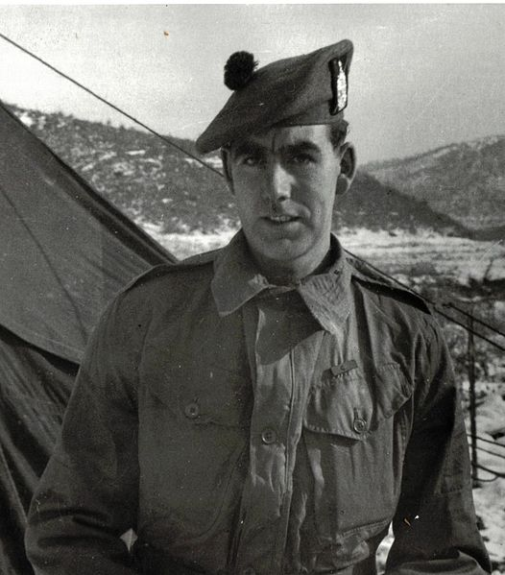
Enquiry 3:
Impact and memory How has the
Korean War been remembered?

Slide 2
Enquiry overview:
How has the Korean War been remembered?
Lesson 3.1
Who was most deeply affected by the Korean War between 1950 and 1953?
Lesson 3.2
Why did some British military veterans forget the Korean War and deliberately remember it again years afterwards?
Lesson 3.3
Who should be remembered on our new memorial and how?

Slide 3
Lesson 3.1 Overview
Lesson 3.1
Who was most deeply affected by the Korean War between 1950 and 1953?
Content covered in this lesson:
The death of Corporal Belsay
The Battle of Jangjin (Chosin) Reservoir
The No Gun Ri Incident
Casualties

Slide 4
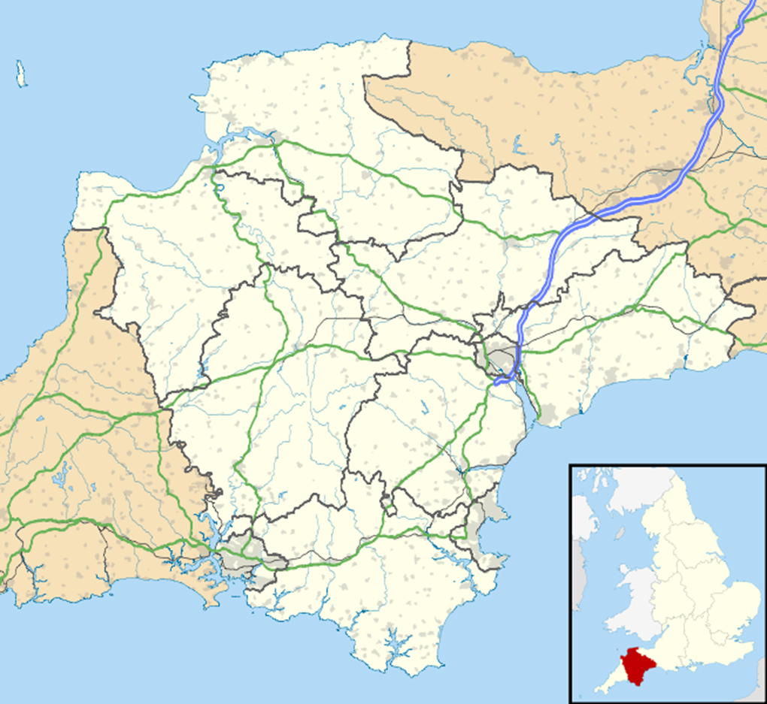
The home village of Corporal Belsay
Starter
Who was affected
by the death of Corporal Belsay?
Bickleigh
in Devon
Notes:
Image: Maps Crown Copyright Ordnance Survey Open Data CC SA 3.0

Slide 5

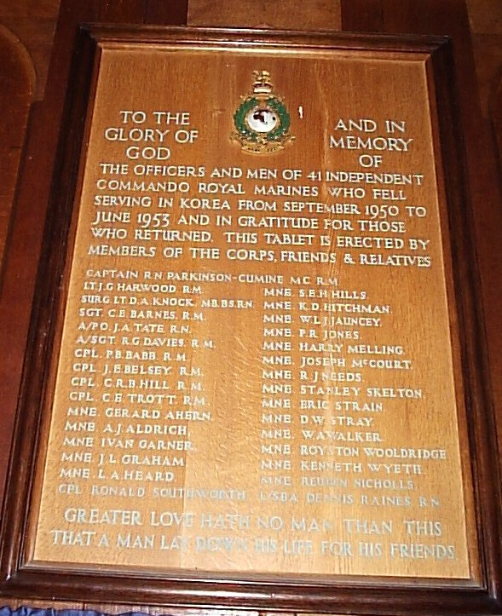
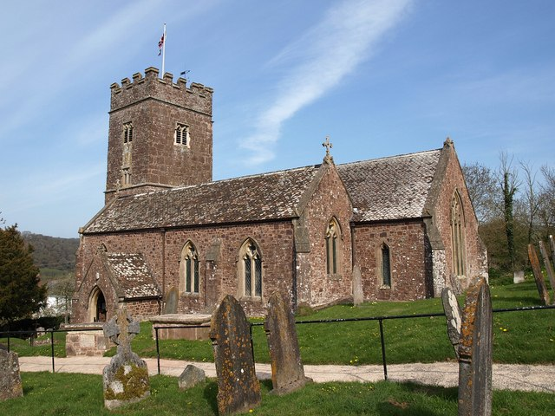
The memorial to Corporal Belsay
Badge of the Royal Marines
Badge of the Royal Marines
Cpl J. E. Belsay R. M.
Notes:
Images:
Bickleigh Church Commando Memorial: www.waymarking.com/waymarks/WM89CF_Korean_Memorial_Bickleigh_Church_near_Plymouth_Devon_UK
Royal Marines Badge: Public domain
St Mary’s Church, Bickleigh: © Derek Harper www.geograph.org.uk/photo/1826043

Slide 6
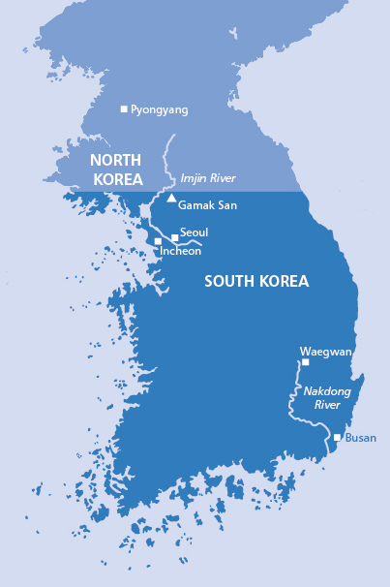
The death of Corporal Belsay
Rank and name | Corporal Jarvis Edward Belsay, Royal Marines
Age at death | 21
Circumstances of his death | 29 November 1950 At the Battle of Jangjin (Chosin) Reservoir, Korea Missing in action, body never recovered
Commemoration | No known grave Name commemorated on a United Nations plaque in Korea
Family details | Lived in Devon Had been recently married in September 1950 to Joyce West in Tavistock, Devon
Notes:
Not sure about map, found on Pinterest taken from this website https://history.army.mil/brochures/kw-chinter/chinter.htm (may need chasing up for permission or substituting)

Slide 7
Who would have been most deeply affected by the death of Corporal Belsay?
Not really affected at all
Directly but not deeply affected
Moved but not directly affected
Quite deeply affected
Most deeply affected
His wife, Joyce
His parents
His fellow soldiers, who may only have known him for a little time
The enemy soldier who may have killed him
His former school friends
The postman who brought news of his death to his wife and parents
The local priest who may have comforted his wife and parents (remember, his name is on the local church memorial)
His brothers or sisters
His grandparents
His aunts, uncles and cousins
His adult friends from Devon
His parents’ friends
Other local people who knew him by sight
A local reporter who reported his death
Here is a list of people who might be affected by the death of Corporal Belsay.
Mark on the impact scale (Resource sheet 3.1B), with a letter or by drawing a line, how affected you think they would be. (You have no evidence for this – only your common sense as a human being.)

Slide 8
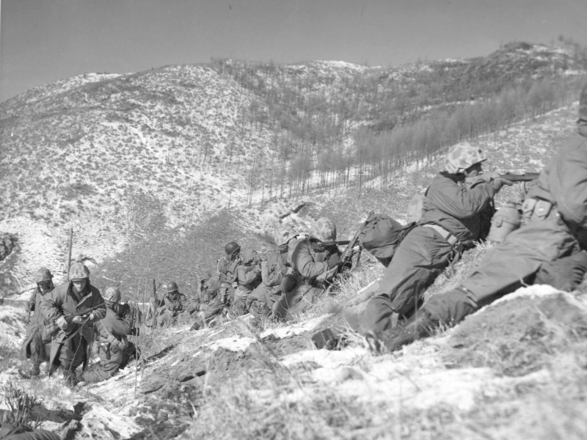
Battle of Jangjin (Chosin) Reservoir
27 November to
13 December 1950
Notes:
Left image: US Marine Corps https://commons.wikimedia.org/wiki/File:Marines_engage_during_the_Korean_War.jpg

Slide 9
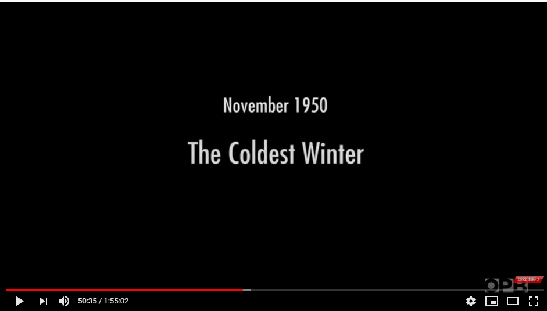
Battle of Jangjin (Chosin) Reservoir
This is the battle where Corporal Belsay died.
British troops were supporting their US and South Korean allies.
United Nations forces had been advancing towards the Yalu River (the border with China) when they were forced back in dreadful winter conditions by Chinese communist forces who had entered the war for the first time.
Watch the video on the right to find out more about this battle.
Extract from a documentary, Korea The Never-Ending War, also shown by the BBC in 2019
(50’33” to 57’22”)
Notes:
Video: www.youtube.com/watch?v=DoSRwmuVYyI

Slide 10
Who would probably have been most deeply affected by fighting conditions at the Battle of Jangjin (Chosin) Reservoir?
Not really affected at all
Directly but not deeply affected
Moved but not directly affected
Quite deeply affected
Most deeply affected
A. US and South Korean soldiers
who saw the frozen bodies of soldiers from their own side whom they did not personally know.
B. Chinese and North Korean soldiers who saw the frozen bodies of soldiers from their own side whom they knew personally.
C. US and South Korean soldiers who had to drag dead bodies of enemy soldiers and burn them to keep warm.
F. The families and friends of US and South Korean soldiers who died (they may not have known how terrible the fighting conditions were).
E. US, Chinese, North and South Korean soldiers who froze to death or died in the fighting.
D. Chinese and North Korean soldiers who saw the frozen bodies of enemy soldiers.
I. Chinese and North Korean soldiers
who saw the frozen bodies of soldiers from their own side whom they did not personally know.
H. US and South Korean soldiers who saw the frozen bodies of soldiers from their own side whom they knew personally.
G. The families
and friends of Chinese and North Korean soldiers who died (they may not have known how terrible the fighting conditions were).
K. US General MacArthur, who had told US soldiers that they would win the war and be home before Christmas.
J. Chinese and North Korean leaders, determined to win
the war.

Slide 11
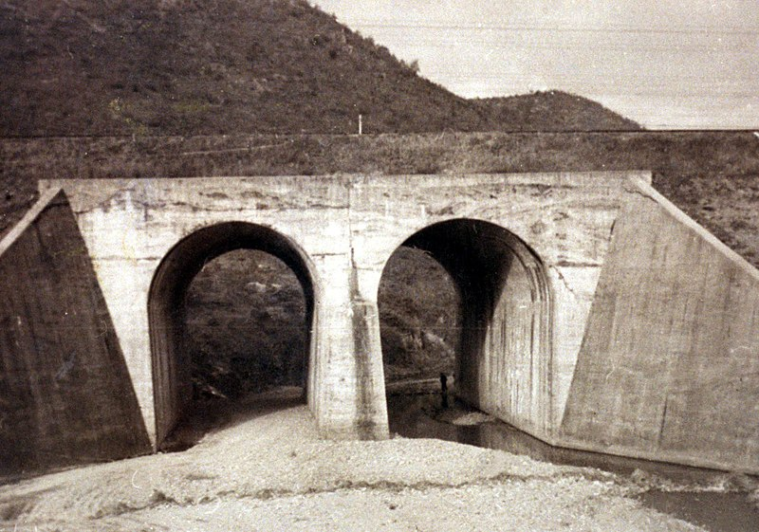
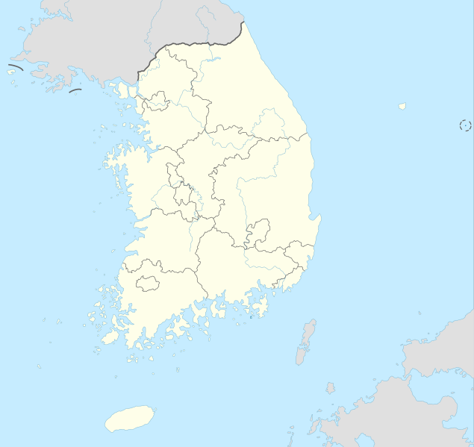
The No Gun Ri Incident 26–29 July 1950
Notes:
Left: No Gun Ri International Peace Foundation, https://commons.wikimedia.org/wiki/File:No_Gun_Ri_bridge-1960.jpg
Right: https://commons.wikimedia.org/wiki/File:South_Korea_adm_location_map.svg

Slide 12
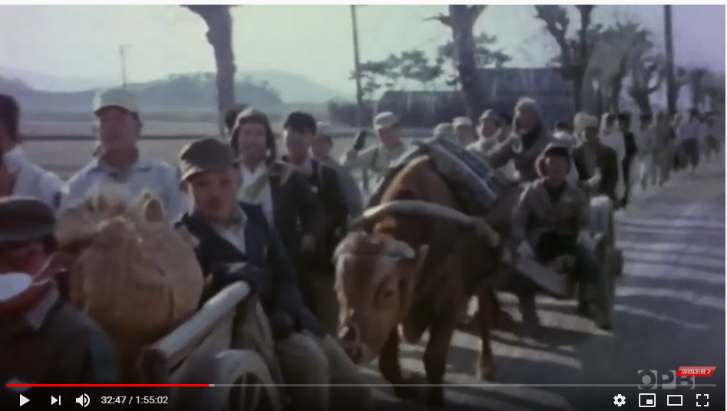
The No Gun Ri Incident
Slide 11 shows a bridge at No Gun Ri.
Between 26 and 29 July 1950, South Korean refugees sheltered there.
Numerous witnesses testified that they were fired on by US forces from the air and by infantry who feared that North Korean soldiers and spies might be concealed in their midst.
Watch the clip to find out more about
this incident. The video includes eyewitness testimony.
Clip from Korea The Never-Ending War
(32’47” to 37’25”)
Notes:
Video: www.youtube.com/watch?v=DoSRwmuVYyI

Slide 13
Who would probably have been most deeply affected by the No Gun Ri Incident at the time it happened in July 1950 and immediately afterwards?
Not really affected at all
Directly but not deeply affected
Moved but not directly affected
Quite deeply affected
Most deeply affected
13-year-old Korean refugee Yang Hye-Suk, who pulled out her own damaged eye.
Any North Korean soldiers or spies actually hiding among the refugees, fearful of discovery.
US pilots who attacked Korean refugees from the air, believing that they might be hiding North Korean soldiers or spies.
The injured mother of child refugee Yang Hye-Suk, whose daughter pulled out her own damaged eye.
US commanders, officials and politicians responsible for the policy of firing on Korean refugees and determined to defeat the enemy.
Korean refugee boy Chung Koo- Doo, whose older brother and sister
were killed in front of him (he was less than two years old at the time).
North Korean commanders
and officials attempting to defeat the US and its allies, whatever the cost.
Korean refugees in the crowds who were not injured but were trapped for three days and nights without food and water, terrified of being attacked and seeing bodies of their fellow refugees and perhaps friends and family lying unburied.
The father of Korean refugee boy Chung Koo- Doo, who saw two of his young children killed in front of his remaining child.
US soldiers on foot who fired into crowds of Korean refugees, afraid that they might hide North Korean soldiers.

Slide 14
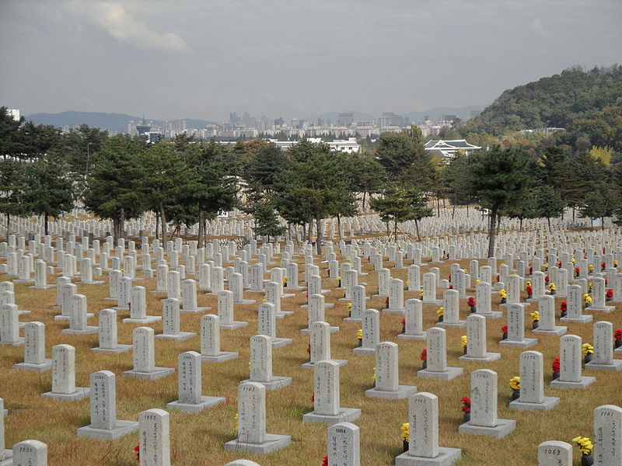
In terms of casualties, which countries were most deeply affected by the Korean War between 1950 and 1953?
Not really affected at all
Directly but not deeply affected
Moved but not directly affected
Quite deeply affected
Most deeply affected
The next two slides detail the casualties of each combatant country (and a few non-combatants still participating).
Organise these into an order, starting with the country most deeply affected
(at the top) and ending with the country least affected at the bottom.
War graves in Seoul National Cemetery 26th Sanctuary, South Korea
Notes:
Image: Public domain https://en.wikipedia.org/wiki/Seoul_National_Cemetery#/media/File:Seoul_National_Cemetery_26th_Sanctuary.JPG

Slide 15











Casualties of the Korean War
South Korea
Total military deaths 137,899
450,742 wounded
24,495 missing
8,343 prisoners
Estimates of civilian deaths range from 990,000 to
2–3 million
Britain
Total military deaths 1,078
2,674 wounded
179 missing
977 prisoners
Canada
Total military deaths 516 1,042 wounded
1 missing
33 prisoners
Chinese
(People’s Republic of China)
Total military deaths 183,108 ]
383,500 wounded
25,621 missing 7,110 prisoners
(Chinese figures)
Over 400,000 military deaths
and 486,000 wounded
(US estimates)
North Korea
Total military deaths
215,000–406,000
303,000 wounded
120,000 missing or prisoners
1,550,000 civilians killed/wounded (estimate)
USA
Total military deaths in combat and other causes 36,574
103,134 wounded
7,926 missing
France
Total military deaths 262
1,008 wounded
7 missing
3 prisoners
Turkey
Total military deaths 741
2,068 wounded
163 missing
977 prisoners
Colombia
Total military deaths 163
448 wounded
28 prisoners
Australia
Total military deaths 339
1,042 wounded
43 missing
26 prisoners
Thailand
Total military deaths 129
1,139 wounded
5 missing

Slide 16













Ethiopia
Total military deaths 121
536 wounded
Philippines
Total military deaths 92
299 wounded
97 missing or prisoners
Belgium
Total military deaths 101 478 wounded
5 missing
1 prisoner
South Africa
Total military deaths 34
9 prisoners
Netherlands
Total military deaths 122
645 wounded
3 missing
Luxembourg
Total military deaths 3
New Zealand
Total military deaths 34
299 wounded
1 missing/prisoner
Soviet Union
282 deaths
India
Total deaths 1 (not a soldier)
Japan
Total deaths (not soldiers) 79
Norway
Total military deaths 3
Denmark
No Danish soldiers were sent
to Korea and no Danes died.
Instead, Denmark sent a hospital ship, where doctors and nurses tended the wounded and sick
Greece
Total military deaths 192
543 wounded
3 prisoners

Slide 17
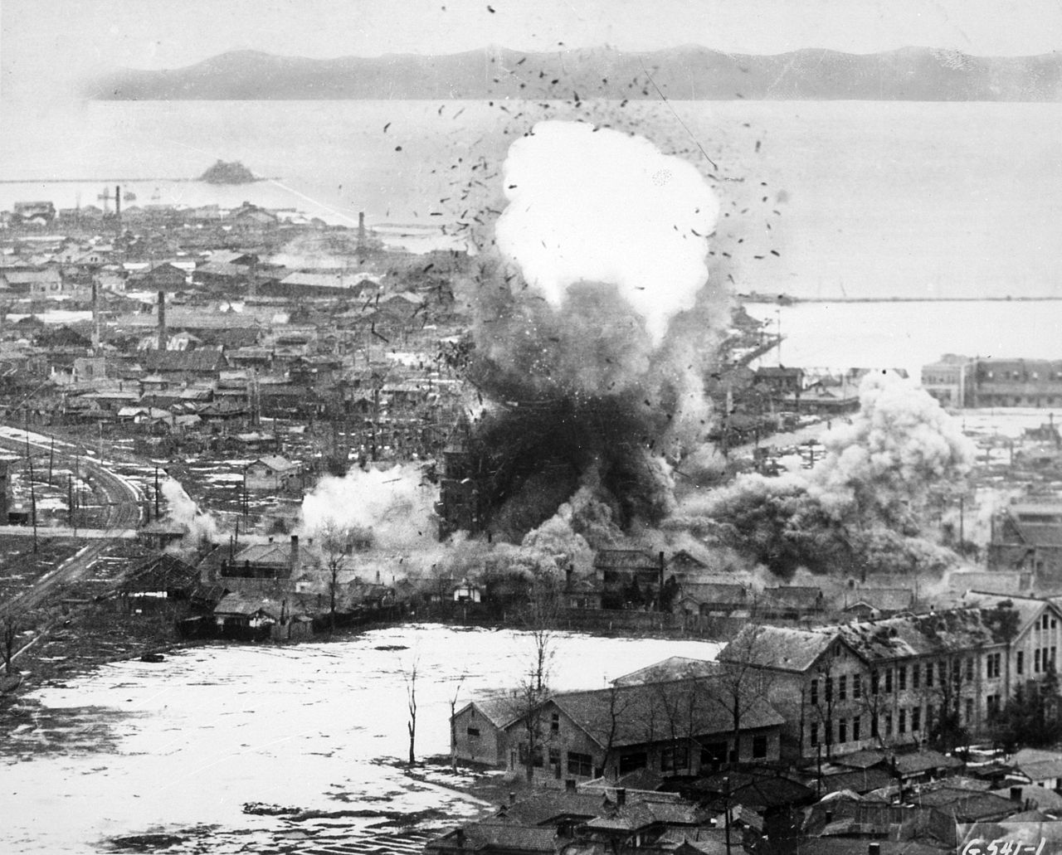
Plenary
Why have we chosen this image to sum up this lesson?
Notes:
Image: US Air Force https://commons.wikimedia.org/wiki/File:Korean_War_bombing_Wonsan.jpg

