Slide 1
Enquiry:
How should the Korean War be remembered?
Lesson 3.1
Who was most deeply affected by the Korean War between 1950 and 1953?
Lesson 3.2
Why did some British military veterans forget the Korean War and deliberately remember it again years afterwards?
Lesson 3.3
Who should be remembered on our new memorial and how?

Slide 2
Lesson 3.2 Overview
Lesson 3.2
Why did some British military veterans forget the Korean War and deliberately remember it again years afterwards?
Content covered in this lesson:
Use video evidence to make a living graph of the Korean War experience of Bill Speakman VC.
Make a living graph to compare the changing attitudes to the war of the British public and of British veterans who served in the war.
Compare Bill Speakman’s story with other veterans’ stories.

Slide 3
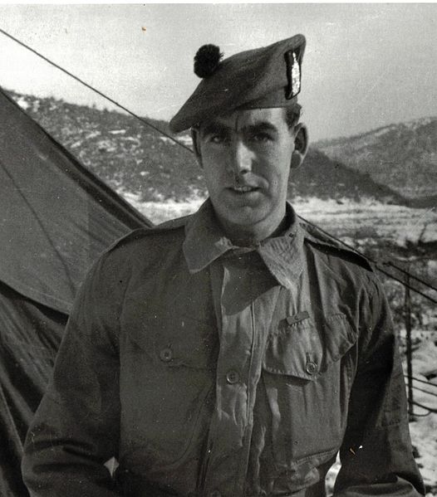
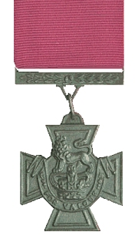
Private Bill Speakman VC
Notes:
Left: Public domain, https://commons.wikimedia.org/wiki/File:Bill_Speakman_VC.JPG
Right: Public domain, https://commons.wikimedia.org/wiki/File:Victoria_Cross.jpg

Slide 4
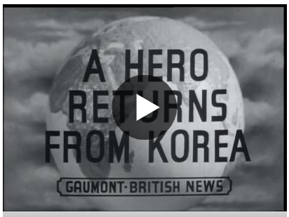
What can Pathé News tell us about
Bill Speakman and attitudes to the
Korean War?
Starter
What impression does the newsreel give of:
Bill Speakman?
Speakman’s family?
Altrincham, Speakman’s home town?
Support for the Korean War among the
British public?
How does it give these impressions through:
Music?
The voiceover (main script)?
Notes:
Video: www.britishpathe.com/video/VLVAAZHBB7SPKNLWPHS9CYWMJBD77-HERO-WILLIAM-SPEAKMAN-RETURNS-FROM-KOREA/query/Speakman

Slide 5
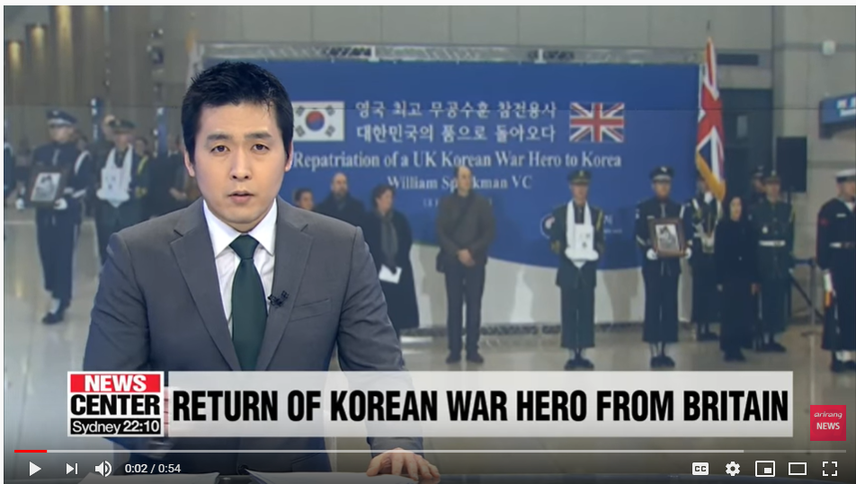
The Bill Speakman story
In 1968, Bill Speakman VC finally left the British Army.
In 2010, Bill Speakman VC visited Korea for the first time since the 1950s, on a trip paid for by the South Korean government. He was very moved by it.
In June 2018, Bill died.
In 2019, his ashes were buried in South Korea at his own request.
This video describes the reception in Korea.
In 1969, he stole £120 from a woman’s purse in Edinburgh. He returned the money and probably only escaped punishment because of his medal. Soon afterwards, he sold his Victoria Cross to pay for a new roof (the medal was later replaced). Bill had trouble controlling his alcoholic drinking.
In 2015, Bill Speakman VC gave his medals (including his replacement Victoria Cross) to the South Korean government and people to show his gratitude for how he had been treated.
Notes:
Video: https://youtu.be/EiJdpMvtRvs

Slide 6
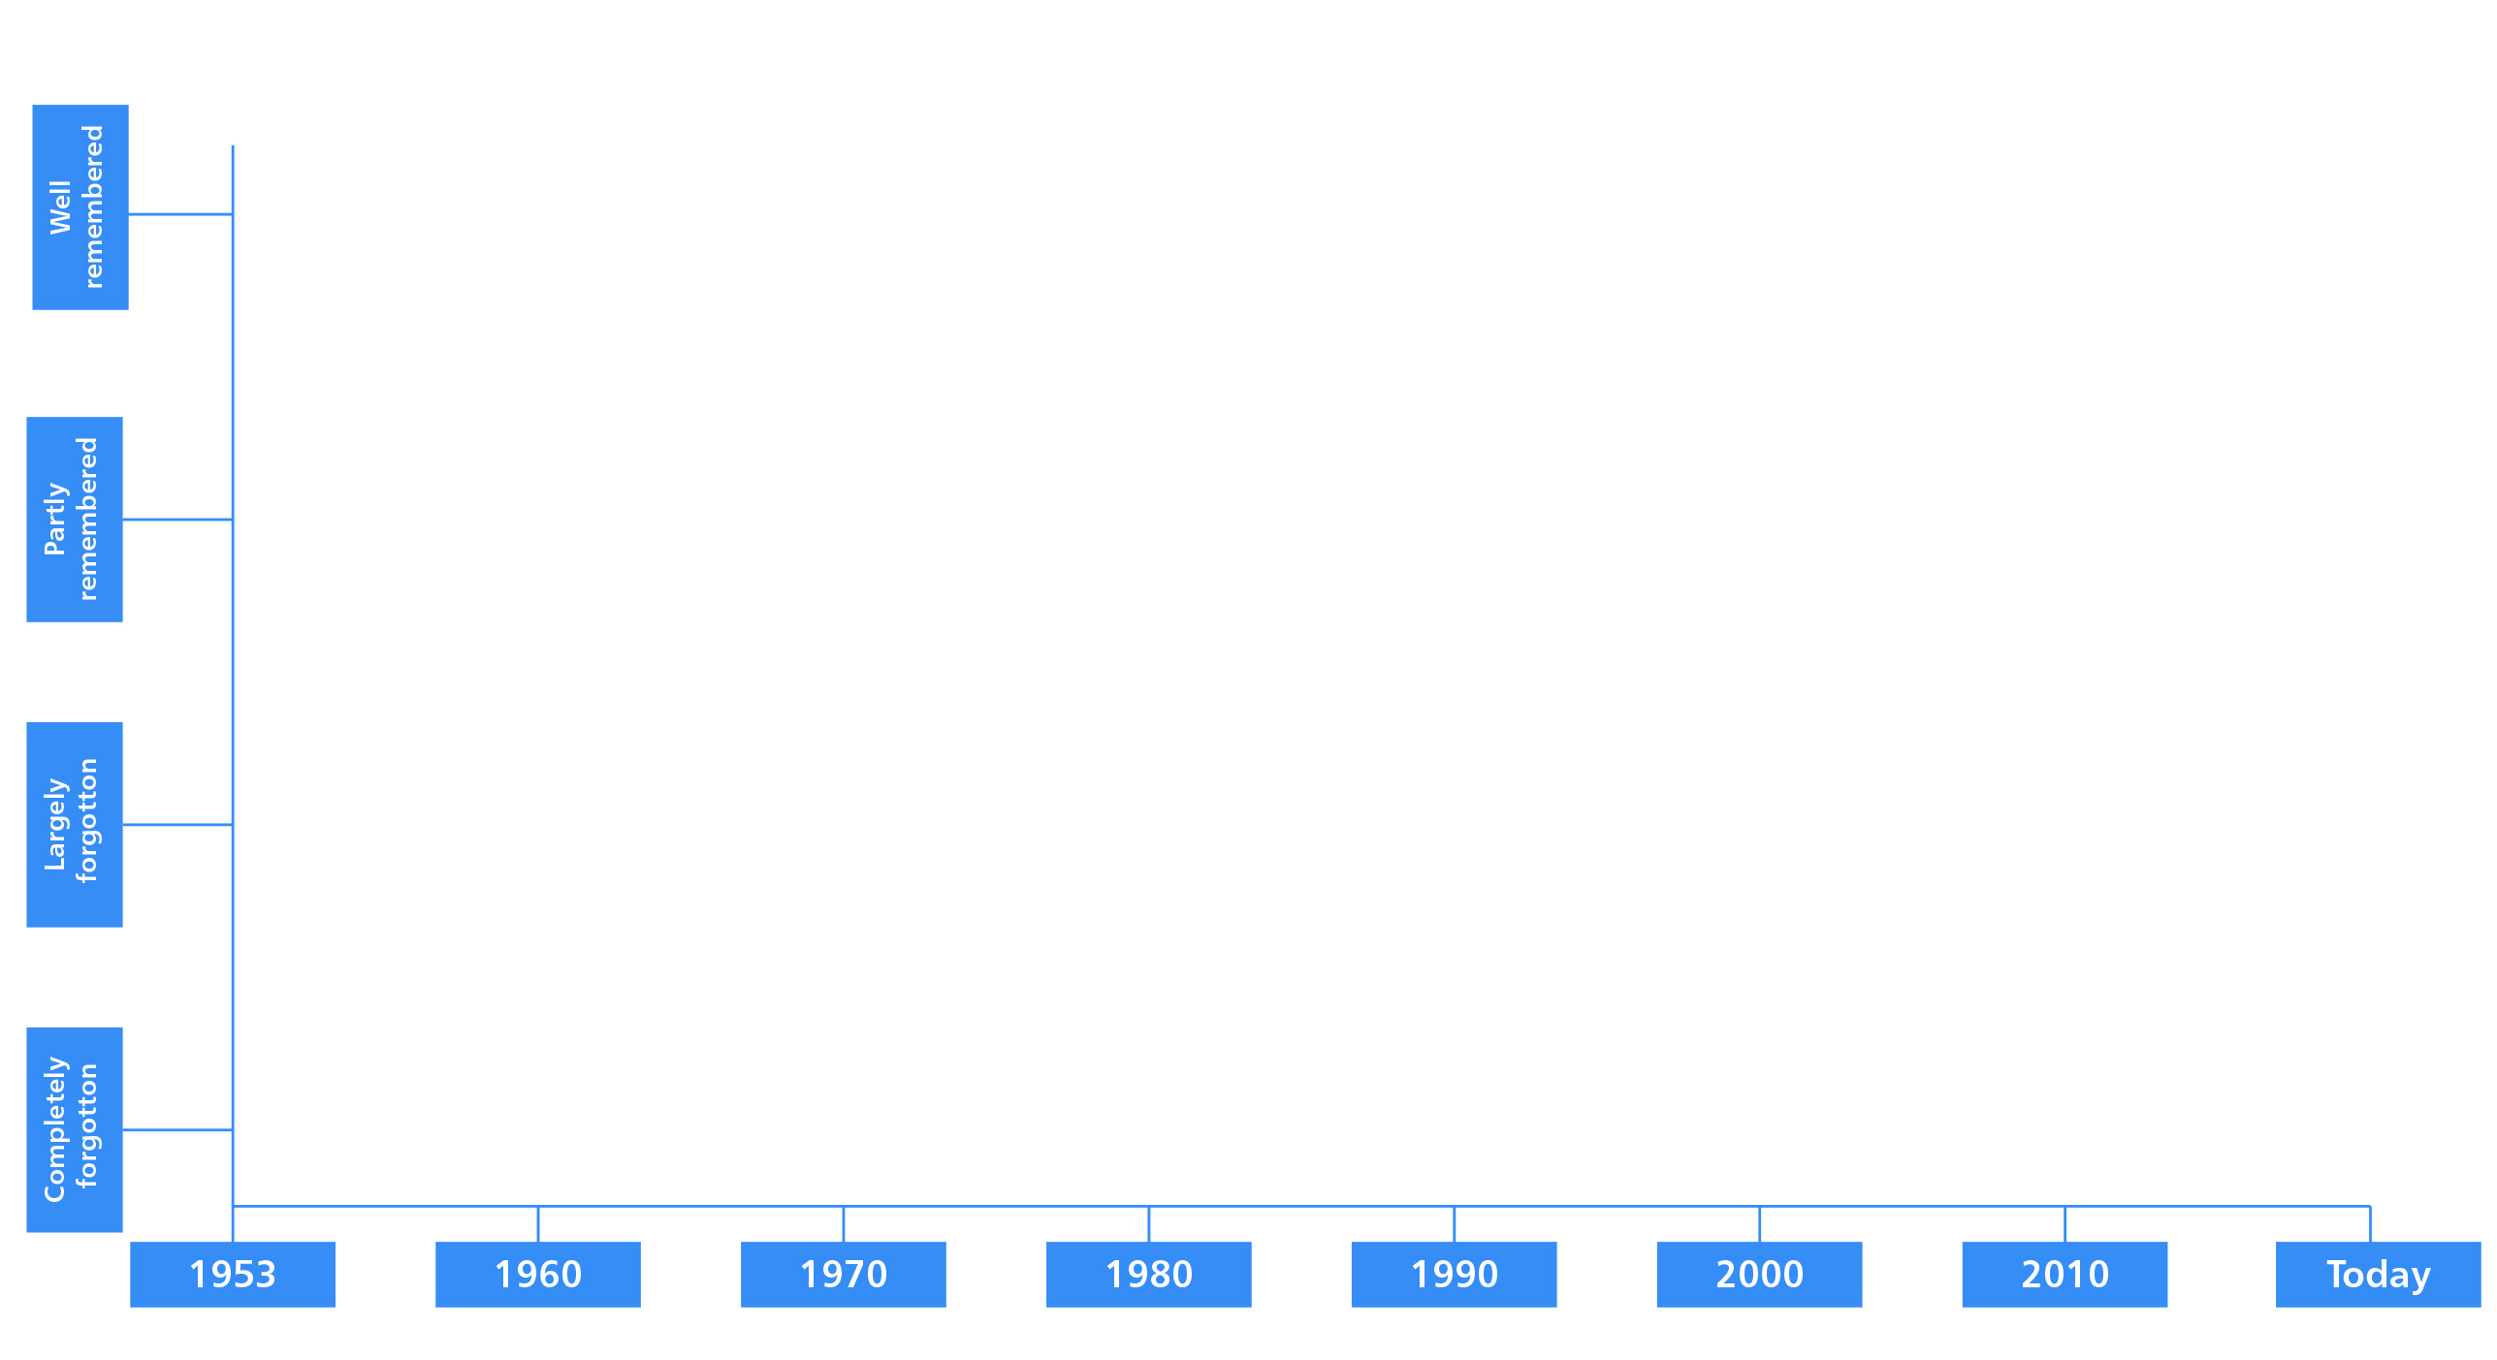
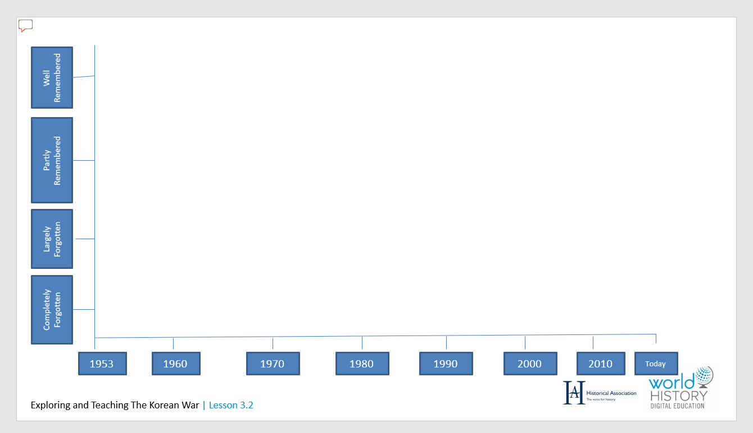
Plotting Bill Speakman’s story
Activity 1
This lesson is about how the Korean War was forgotten and then remembered by veterans and the public. You will be using a graph like this (Resource sheet 3.2A).
To get used to using it, plot the events of Bill’s life that you have just found out about.

Slide 7
Where should we start our graph?
Activity 2A
Your main task for this lesson is to make a living graph like this. You will use two colours to show how memory of the war changed:
  For the British public as a whole
  For British military veterans of the
  Korean War
First you need to think about where to start. Think about where each line might start on the vertical axis if the only available evidence you had about attitudes in 1953 was the Pathé newsreel extract you have just watched about Bill Speakman’s reception in Altrincham.
Now you are going to watch two more video clips to see whether they give the same impression.
How did veterans and the public remember the Korean War?

Slide 8
As you watch this next clip, remember that…
Many British soldiers who served in the Korean War were teenage conscripts fulfilling their National Service requirements.
Some soldiers had been captured and imprisoned by communist China and North Korea during the war, and it was feared that some POWs had been brainwashed by communist propaganda.
Definitions
National Service – the time that young men spent conscripted in to the Armed Forces (extended from 18 months to two years during the Korean War)
POW – prisoner of war
Brainwashing – the process where people are continually exposed to a particular point of view or set of ideas and persuaded to accept them

Slide 9
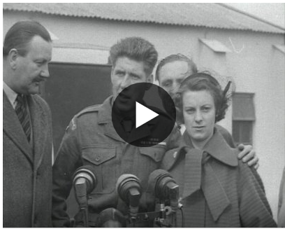
Video evidence 2: Pathé newsreel
Activity 2B
What impression does the newsreel give of:
British prisoners of war returning from Korea
in September 1953 (two months after the armistice that ended it)?
Crowds waiting to greet the men?
Public suspicion about them?
Is the newsreel as positive about the war as the earlier one about Speakman in Altrincham?
Now you have two pieces of evidence, where would you start your line?
Notes:
Video: www.britishpathe.com/video/pows-home-aka-korea-p-o-w-s-return-to-lyneham

Slide 10

Video evidence 3: Feature film, 1954
Activity 2C
What can the 1954 feature film A Hill in Korea tell us about attitudes towards the Korean War?
How is the music intended to make the audience feel?
Who is the film dedicated to?
How are the soldiers introduced? What impression does it give about them?
Now you have three pieces of evidence, where would you start your line?
Notes:
Video: https://archive.org/details/ahik5345435

Slide 11
Why did some British military veterans forget the Korean war between 1953 and the 1970s?
Activity 3
You will be given Evidence cards A–M (Resource sheet 3.2B). These will help you to plot the first two decades of your graph from 1953–1970s.
You have to decide where the evidence cards belong on your graph. To do this, you will have to read your cards carefully.
What date does it refer to? This will tell you where it belongs on the bottom axis.
  Some cards have a particular date that could be marked with a cross on the graph.
  Others refer to a trend over time, which can help you to judge the overall position of the line on the graph.
Who is the evidence about? Veterans’ attitudes – coloured blue? Public attitudes – coloured pink? Or both? This will tell you which line it belongs on.
Is the war forgotten or remembered? This will tell you how high or low to put it.
For example, where would you put this card on your graph?
Once you have plotted your graph, discuss the relationship between the two lines.
Example Evidence card
E.
On 31 July 1953 (when the Armistice ended the Korean War), there was more reporting in the newspapers about the Ashes cricket matches between England and Australia than the end to fighting.

Slide 12

EVIDENCE CARDS
A.
Veteran Jim Preston-Bell (a very young army officer in the Korean War) talked about returning to Britain to become a student at Cambridge University in 1951 while the war was still being fought. He described himself as ‘A nine-day wonder’ (people were interested in his experience for a short time). ‘On the tenth day people [had] forgotten and I had forgot too and began to live the rest of my life… I think people in England were fed up with war by then. They had had the First and Second World War and Korea was an unnecessary war, far away, [in a] place where nobody knew, fighting for people one didn’t know why… We came back forgotten war soldiers.’
B.
‘Everything and everybody connected with... Korea just simply sank out of sight. Years went by during which time I never met anyone who had served in Korea. There were no books in the library and no films about Korea. There was nothing. It was as though it – the Korean War –had never happened. A truly forgotten war.’ Veteran Ron Larby in 1993, talking about the 1950s and afterwards in Britain.
C.
When the Armistice was signed,
a local news reporter in Bury St Edmunds in Suffolk said that local people were puzzled when the United Nations flag (the side on which Britain had fought) was flown from the Town Hall because they didn’t know that the war was even over (or maybe they didn’t even recognise the flag).
Notes:
Image: Public domain

Slide 13
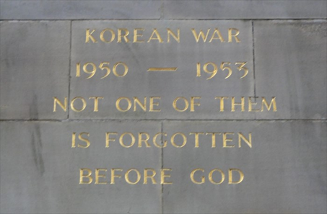
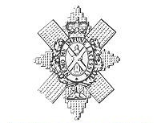
EVIDENCE CARDS
D.
‘I would never speak about the Korean War [when I came back] because it was so soon after the Second World War that if you said anything [they would say] “Och, that was nothing son, [compared to] what we suffered in the Second World War” – so you never spoke about it.’
Veteran Bill Easton of the Scottish Black Watch Regiment, interviewed in 2012.
E.
On 31 July 1953 (when the Armistice ended the Korean War), there was more reporting in the newspapers about the Ashes cricket matches between England and Australia than the end to fighting.
H.
In the 1950s, only a few local war memorials were set up to remember the Korean War. Sometimes they were just plaques or wording added to First and Second World War memorials.
Engraving added to Halifax First World War Memorial
F.
Many British veterans of the Korean War had been very young when they fought in Korea. From the 1950s to the 1980s, most were still busy working full time and bringing up families.
G.
Only 40,000 British soldiers served in the Korean War. Of these, just over 1,000 died. To British people, these seemed very small numbers compared to the First and Second World Wars.
Notes:
Left: Public domain https://commons.wikimedia.org/wiki/File:Black_Watch.jpg
Right: https://www.waymarking.com/waymarks/WMTPVH_Korean_War_Inscription_On_WWI_Memorial_Halifax_UK

Slide 14
EVIDENCE CARDS
I.
No British feature films were made about the Korean War in the 1960s or 1970s.
J.
Reunions of Korean War veterans were very rare
before 1976. There was no veterans association to bring them together.
L.
In 1954, the British feature film A Hill in Korea was made about the Korean War. No other films were made about the Korean War in the 1950s.
K.
In the 1960s and up to 1974, the Vietnam War was widely reported on television, radio
and in the newspapers – much more so than the Korean War had ever been. A large protest movement grew in the United States. The Korean War seemed a distant memory compared to Vietnam.
M.
In the 1950s, war memorials were set up all over the country for the Second World War.
Lots of war films were made in the 1950s and 1960s about how the British won the Second World War.

Slide 15
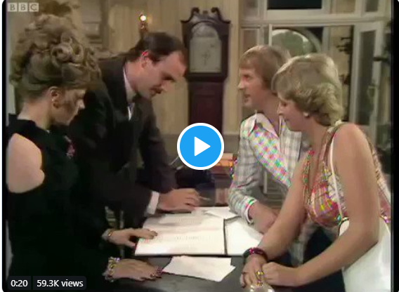
Why did some British military veterans deliberately remember the Korean War from the 1970s onwards?
Activity 4
Does this clip alter your living graph for the early 1970s?
Look at Evidence cards 1–26 (Resource sheet 3.2C), which cover the period from the 1980s to the present.
Use these to plot the rest of your graph from the 1970s onwards.
Try to agree a whole-class version of the living graph.
Notes:
Video: https://twitter.com/fawltytowers_/status/1025063852986257409?lang=en-gb (Fawlty Towers, Season 1 Episode 3 'The Wedding Party’, BBC)

Slide 16
EVIDENCE CARDS
1.
In 2013, the British Korean Veterans Association disbanded because its members were becoming very old and more were dying each year.
2.
In 1976, two British Korean War veterans started a group where men like them could meet together and discuss their memories. They had help from the South Korean Embassy in finding other British veterans.
6.
Many British Korean War veterans retired in the 1980s. It gave them more time to think about their experiences in the war.
7.
In 1981, the British Korean Veterans Association was founded as a national organisation where former British soldiers who had served in the Korean War could meet together in branches around the country.
3.
In 1987, a small monument to the Korean War was unveiled in St Paul’s Cathedral in London.
4.
No British feature films about the Korean war were made in the 1980s.
8.
In 2014, a small Korean War monument was set up in Whitehall, London near the Cenotaph. It was partly paid for by the South Korean government.
9.
No British feature films about the Korean War were made in the 1990s.
5.
In 2004, there were 59 branches of the British Korean Veterans Association around the country.

Slide 17
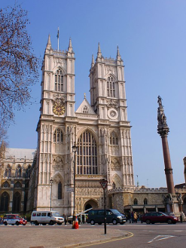
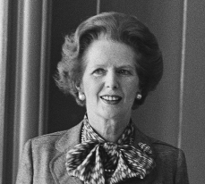

EVIDENCE CARDS
10.
In 1982, Argentina invaded and occupied the British Falkland Islands in the South Atlantic (North Korea also invaded South Korea without warning in 1950). British prime minister Margaret Thatcher fought a war to recapture the islands. She never made comparisons between the Falklands War and Britain’s involvement in the Korean War, resisting aggression by one country against another.
11.
From the late 1980s onwards, the South Korean government (grateful to international veterans for fighting to keep their country free from communist control between 1950 and 1953) paid for some British veterans to visit Korea. Veterans saw the places in which they had fought, paid tribute to dead comrades and noticed how rich and democratic South Korea had become. Many veterans were deeply moved by how grateful South Koreans appeared to be – it made what they had suffered seem more worthwhile.
12.
In 2003, on the fiftieth anniversary of the end of the Korean War, the Queen went to a remembrance service at Westminster Abbey in London, attended by veterans.
13.
No British feature films about the Korean War were made between 2000 and 2010.
Notes:
Left: Public Domain/Nationaal Archief (Dutch National Archives) https://commons.wikimedia.org/wiki/File:Premier_Thatcher_932-7042_(cropped).jpg
Right: CC BY-SA 3.0/Σπάρτακος/Wikimedia https://commons.wikimedia.org/wiki/File:Westminster-Abbey.JPG

Slide 18
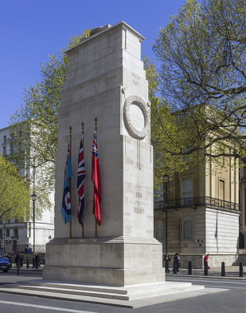
EVIDENCE CARDS
14.
In 2013, veterans of the Korean War were asked to march past the Cenotaph in Whitehall (the national memorial to British soldiers who died during the First World War) on Remembrance Sunday in November for the first time. This was partly because there were few veterans of the Second World War left to do it and hardly any First World War veterans left at all.
15.
From the 1980s onwards, national museums like the Imperial War Museum interviewed Korean War veterans about their experiences before they died. This helped some of them to come to terms with their experiences.
18.
In 1988, BBC and Channel 4 showed documentaries about British involvement in the Korean War for the first time. Not many people watched them compared to documentaries about the First and Second World Wars.
16.
No British feature films about the Korean War were made between 2010 and 2020.
19.
From the late 1980s, a few veterans wrote and published memoirs describing their Korean War experiences. This helped to spread knowledge about British involvement in the war.
17.
In 2000, on the fiftieth anniversary of the outbreak of the Korean War, the British Korean Veterans Association set up a national memorial to those soldiers who served and died in Korea at the National Memorial Arboretum in Staffordshire.
Notes:
Image: CC BY-SA 4.0/Andrew Shiva/Wikipedia https://commons.wikimedia.org/wiki/File:UK-2014-London-The_Cenotaph.jpg

Slide 19
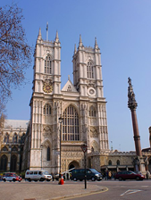

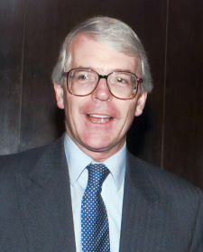
EVIDENCE CARDS
20.
In 1990, Iraq invaded and occupied Kuwait in the Middle East (North Korea also invaded South Korea without warning in 1950). In 1991, British forces helped the United States to drive out the Iraqis in what was called the Gulf War. British prime minister John Major never mentioned any comparisons between the Gulf War and Britain’s involvement in the Korean War in resisting aggression by one country against another.
21.
On the sixtieth anniversary of the end of the Korean War, in July 2013, around 300 British Korean War veterans paraded past the Cenotaph (the British memorial to the dead of the First World War) in London. They attended a national service of remembrance at Westminster Abbey, along with British government ministers and members of the Royal Family. These events and details of the Korean War appeared in British news reports.
Notes:
Left: U.S. Defense Visual Information Center, https://commons.wikimedia.org/wiki/File:Major_PM_full.jpg
Centre: CC BY-SA 3.0/Σπάρτακος/Wikimedia https://commons.wikimedia.org/wiki/File:Westminster-Abbey.JPG
Right: CC BY-SA 4.0/Andrew Shiva/Wikipedia https://commons.wikimedia.org/wiki/File:UK-2014-London-The_Cenotaph.jpg

Slide 20
Plenary
Now that you have studied more evidence about veterans’ attitudes to the war, give your view: is Bill Speakman’s story typical?
Notes:
Left: Public domain, https://commons.wikimedia.org/wiki/File:Bill_Speakman_VC.JPG
Right: Public domain, https://commons.wikimedia.org/wiki/File:Victoria_Cross.jpg

