Slide 1
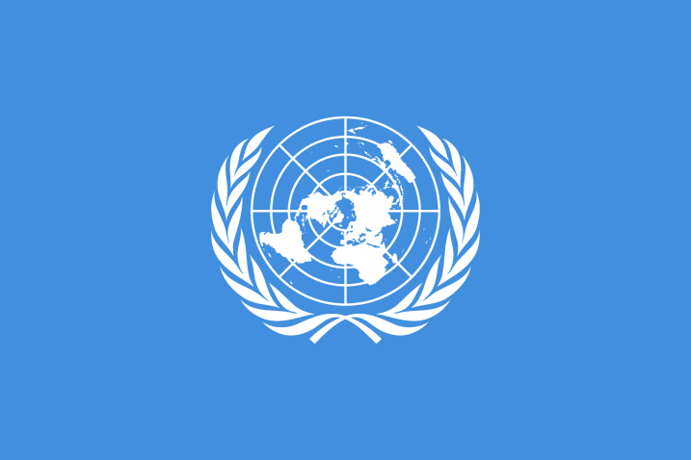
Resource sheet 3.2B
Why did some British military veterans forget the Korean war between 1953 and the 1970s? Evidence cards
A.
Veteran Jim Preston-Bell (a very young army officer in the Korean War) talked about returning to Britain to become a student at Cambridge University in 1951 while the war was still being fought. He described himself as ‘A nine-day wonder’ (people were interested in his experience for a short time). ‘On the tenth day people [had] forgotten and I had forgot too and began to live the rest of my life… I think people in England were fed up with war by then. They had had the First and Second World War and Korea was an unnecessary war, far away, [in a] place where nobody knew, fighting for people one didn’t know why… We came back forgotten war soldiers.’
B.
‘Everything and everybody connected with... Korea just simply sank out of sight. Years went by during which time I never met anyone who had served in Korea. There were no books in the library and no films about Korea. There was nothing. It was as though it – the Korean War –had never happened. A truly forgotten war.’ Veteran Ron Larby in 1993, talking about the 1950s and afterwards in Britain.
C.
When the Armistice was signed, a local news reporter in Bury St Edmunds in Suffolk said that local people were puzzled when the United Nations flag (the side on which Britain had fought) was flown from the Town Hall because they didn’t know that the war was even over (or maybe they didn’t even recognise the flag).
Notes:
Image: Public domain/United Nations https://commons.wikimedia.org/wiki/File:Flag_of_the_United_Nations.svg

Slide 2
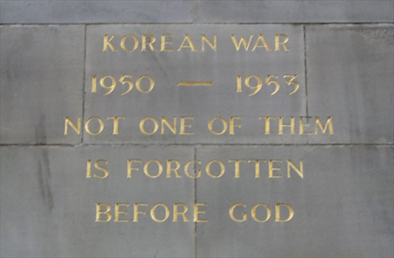
D.
‘I would never speak about the Korean War [when I came back] because it was so soon after the Second World War that if you said anything [they would say] “Och, that was nothing son, [compared to] what we suffered in the Second World War” – so you never spoke about it.’
Veteran Bill Easton of the Scottish Black Watch Regiment, interviewed in 2012.
E.
On 31 July 1953 (when the Armistice ended the Korean War), there was more reporting in the newspapers about the Ashes cricket matches between England and Australia than the end to fighting.
H.
In the 1950s, only a few local war memorials were set up to remember the Korean War. Sometimes they were just plaques or wording added to First and Second World War memorials.
Engraving added to Halifax First World War Memorial
F.
Many British veterans of the Korean War had been very young when they fought in Korea. From the 1950s to the 1980s, most were still busy working full time and bringing up families.
G.
Only 40,000 British soldiers served in the Korean War. Of these, just over 1,000 died. To British people, these seemed very small numbers compared to the First and Second World Wars.
Notes:
Left: Public domain https://commons.wikimedia.org/wiki/File:Black_Watch.jpg
Right: https://www.waymarking.com/waymarks/WMTPVH_Korean_War_Inscription_On_WWI_Memorial_Halifax_UK

Slide 3
I.
No British feature films were made about the Korean War in the 1960s or 1970s.
J.
Reunions of Korean War veterans were very rare
before 1976. There was no veterans association to bring them together.
L.
In 1954, the British feature film A Hill in Korea was made about the Korean War. No other films were made about the Korean War in the 1950s.
K.
In the 1960s and up to 1974, the Vietnam War was widely reported on television, radio
and in the newspapers – much more so than the Korean War had ever been. A large protest movement grew in the United States. The Korean War seemed a distant memory compared to Vietnam.
M.
In the 1950s, war memorials were set up all over the country for the Second World War.
Lots of war films were made in the 1950s and 1960s about how the British won the Second World War.

