Slide 1
Enquiry overview:
Why did Britain go to war (again) in 1950?
Lesson 1.1
Why was there a war in Korea and why did Britain join in?
Lesson 1.2
How significant was opposition to the Korean War in Britain?

Slide 2
Lesson 1.2 Overview
Lesson 1.2
How significant was opposition to the Korean War in Britain?
Content covered in the lesson:
How did the British government ‘sell’ the Korean War to the British people?
How did British people respond to the war?
How do we judge the significance of opposition to the war?
Who opposed the war and why?

Slide 3
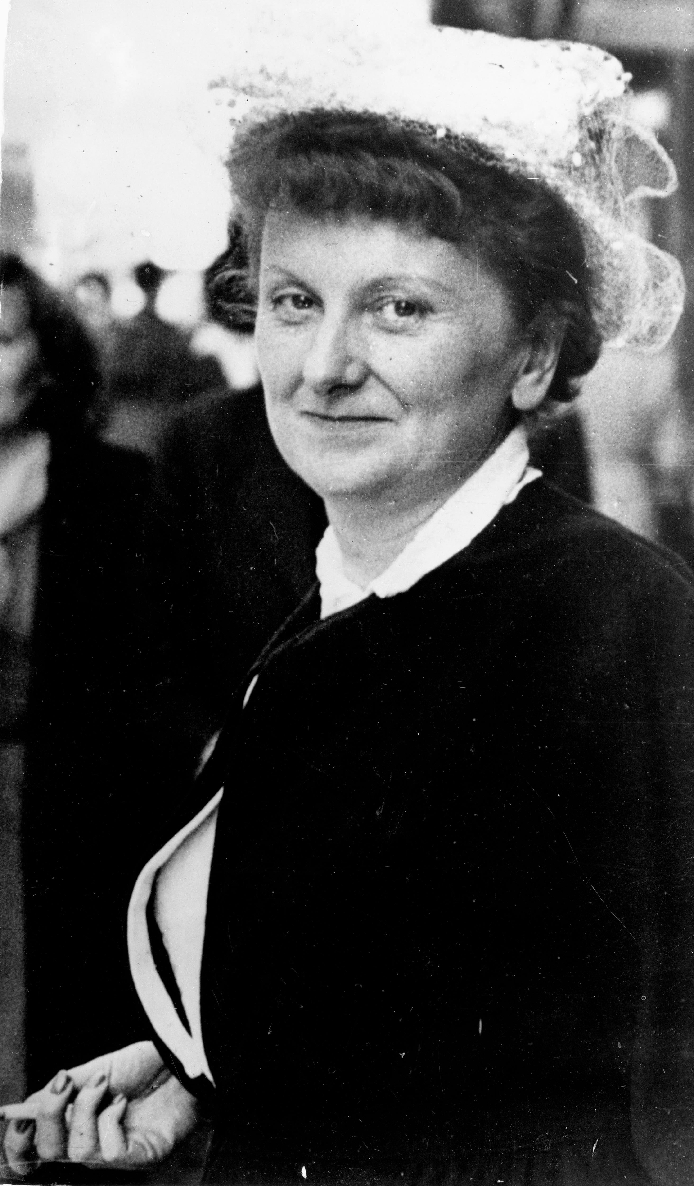
Why was Monica Felton sacked?
Starter
This is Monica Felton. In June 1951, she was sacked from her job.
Read the eight clues you have been given about Monica Felton (Slide 4 and Resource sheet 1.2A).
With your partner, decide on a theory about why she may have been sacked.
Notes:
Image: © Keystone Press / Alamy Stock Photo E0RRNN

Slide 4
CLUES
Monica Felton starter
Monica Felton was a town planner. She was a government employee working on the planning of Stevenage in 1951, one of the new towns built in post-war Britain. | Monica Felton was a member of the Labour Party. She described herself as a socialist and a pacifist.
Felton went on a trip in June 1951. Her trip made national headlines in papers such as the Daily Mail. | Many British newspapers and some MPs were calling for Felton to be put on trial for treason (betraying her country).
Felton’s trip was debated in Parliament. | Felton missed an important meeting in Westminster in June 1951.
Monica Felton was 45 years old in 1951. | Felton published a book called That's Why I Went in 1954.

Slide 5
Why was Monica Felton sacked?
Your clues were missing one vital piece of information: whereabouts did Monica Felton go on her trip in June 1951?
The answer is of course: Korea.
You will find out more about Monica Felton’s story later in the lesson.

Slide 6
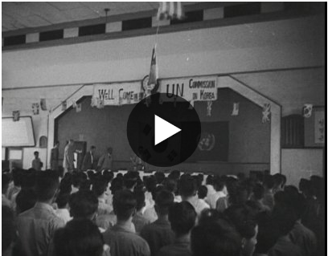
How did the British government ‘sell’ the Korean War to the British people?
You have already studied why war broke out in Korea in 1950, and how 18 countries, including Britain, provided troops or support of some kind to the UN forces fighting North Korea.
Back in Britain, the majority of the population favoured British involvement in Korea, although some people were concerned that government funding might be diverted from health and welfare towards a war in Asia.
So how did the government persuade British people that sending British troops to Korea was necessary?
Activity 1
Watch this newsreel from September 1950 and answer the questions on Resource sheet 1.2B.
Notes:
Video: www.britishpathe.com/video/british-in-korea

Slide 7
How did British people respond to the war?
Most historians agree that the war produced some significant but short-lived anxiety. Some people even re-dug their Anderson shelters from WWII!
There continued to be a high level of interest in the war during the first year (as we saw in the newsreel), but by 1952 there was less interest as the war slowed down.
What we will study today is the people and groups who were opposed to British involvement in the war. We are going to
measure how significant the opposition was.
Activity 2
How could we measure/judge how significant opposition was? E.g. were there more people who supported or opposed the war?
With your partner, come up with two more ways to measure the opposition.

Slide 8
How do we judge the significance of opposition? Significance criteria
Were they a majority?
Did more people support
or oppose the war?
How serious was the opposition? E.g. mild criticism of certain aspects? Outright condemnation?
Were the people who opposed the war important individuals?
Was the opposition organised?
What was the reaction of the media/Parliament/ others to those who opposed the war? Were they alarmed? How did they treat opposers?
Did their words or actions change anything? Did anybody take any notice?

Slide 9
Who opposed the war and why?
Activity 3
In your pairs, you will receive one role card. It will give you details about one person, group or organisation who opposed the war in Korea.
Fill in your grid (on the next slide or Resource sheet 1.2C).
Measure the significance of their opposition by giving it a number from 1 to 5. 1 is insignificant opposition. 5 is highly significant opposition.
You need to be ready to feed back to the rest of the class.
Monica Felton
James Cameron
Joseph Needham
Hewlett Johnson
Harry Pollitt/
CPGB

Slide 10
 | Why did they oppose the war? | What did they do? | How were they received by other people in Britain? | How significant 1 – 5?
Harry Pollitt/British communists
War correspondents
Joseph Needham
Hewlett Johnson
Monica Felton

Slide 11
ROLE CARD
Opposition case study: Communists
The Communist Party of Great Britain (CPGB) was led by Harry Pollitt.
They were strongly anti-American. They argued that the war was being fought purely to make the USA money and to spread their control over the world. Pollitt wrote that ‘British lads were being forced to shoot down other lads in Korea.’
The CPGB held 7,000 campaign meetings in 1952 alone and also used their newspaper,
The Daily Worker, to get their message across. They wrote lots about the impact of the war on Korean civilians. They also (falsely) accused the USA of using smallpox germs in Korea.
Their journalist, Alan Winterton, visited Korea in July 1950 and wrote a leaflet called ‘I Saw the Truth in Korea’, claiming that the US bombing in Korea was worse than the Nazi bombing of Coventry.
RESPONSE
Most British newspapers and many British people were highly anti-communist. This meant that any ideas of British communists were usually heavily criticised, including their view on Korea, even though most British people were ambivalent about the war. Therefore they failed to gain much sympathy or support.
Some employees in London firms were sacked for circulating communist peace petitions. There was even one story that a 17-year-old Scout had been dismissed from the Boy Scouts as his communist tendencies went against his oath to the King!
Nevertheless, the anti-American feeling of the CPGB was shared by others. A mass survey in London in 1951 found that people were talking about the USA trying to ‘control the world’.
Notes:
Image: https://flashbak.com/wp-content/uploads/2015/05/2660350.jpg
Sources:
Quote from Pollitt from Britain Arise (1952), pp. 3–4 and 12. Cited in Huxford, p. 132.
Alan Winterton – ‘I Saw the Truth in Korea’, p. 3. Cited in Huxford, p. 134.
Mass survey in London, 1951: Mass Observation Archive 4965, 22 March 1951. Cited in Huxford, p. 135.
Huxford, G. (2018) The Korean War in Britain: citizenship, selfhood and forgetting, Manchester: Manchester University Press.

Slide 12
ROLE CARD
Opposition case study: War correspondents
James Cameron and Bert Hardy
British journalist James Cameron (right) and photographer Bert Hardy (left) covered the war for Picture Post.
Although Cameron did not disagree with the war on principle, on 16 September 1950, he described the fighting as 'filthy’.
He wrote about the suffering of the local population.
He was sacked for trying to publish shocking pictures of POW (prisoner of war) treatment and atrocities committed by South Korean forces.
After the war, Cameron was a founding member of the Campaign for Nuclear Disarmament (CND).
The Daily Telegraph’s war correspondent documented the impact of war on civilians and drew parallels with Nazi concentration camps.
The BBC’s correspondent, Rene Cutforth, accompanied UN forces in the winter retreat down the Peninsula in 1950–51 and wrote about the plight of Korean refugees on the road. He also criticised the first US use of napalm.
RESPONSE
War correspondents had mixed success in exposing the civilian casualties of the war. Cameron’s coverage was well known. Picture Post was one of the few publications to cover civilian suffering in any great detail. However ,in May 1951, the Labour MP Frank Allaun wrote that there were few people willing to ‘spare a thought for the thousands killed or horribly wounded in a single day’s fighting in Korea last week’.
Notes:
Cameron quote: Picture Post, 16 September 1950, p. 11. Cited in Huxford, p. 137.
Allaun quote: Picture Post, 23 June 1951, p. 10. Cited in Huxford, p. 139.

Slide 13
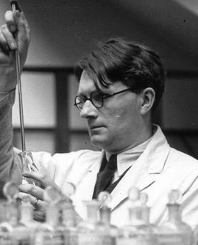
ROLE CARD
Opposition case study: Joseph Needham
The People’s Republic of China claimed that the United States had started a campaign of bacteriological warfare. Supposedly, the USA had dropped diseased rodents and insects over China and North Korea for two months from January 1952.
These allegations turned out to be false propaganda by the PRC. Nevertheless, they were supported by Joseph Needham, a leading scientist.
Needham was a well-known biochemist who visited China and North Korea in the summer of 1952. While there, he spoke to two captured American airmen who claimed to have been involved in dropping bacteriological weapons on North Korea.
When he returned to Britain, Needham went on a lecture tour and wrote to The Times, urging other scientists to study the claims.
RESPONSE
Other scientists were critical of the evidence and Needham had limited impact, although it did bring Britain’s attention back to Korea briefly.
A meeting of the Trades Union Congress in Margate called for banning of chemical and ‘germ’ warfare. The British Peace Committee also organised lectures on the dangers of germ warfare across the country.
Notes:
Image: The Needham Research Institute http://www.nri.cam.ac.uk/joseph1.html

Slide 14
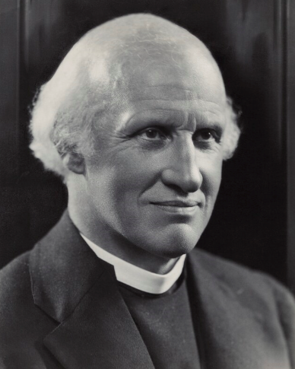
ROLE CARD
Opposition case study: Hewlett Johnson
Hewlett Johnson
Johnson was known as the ‘Red Dean of Canterbury’ because of his support for the USSR.
Johnson had visited the USSR in the 1930s. He saw socialism and Christianity as allies.
Johnson visited China in 1952 and became utterly convinced by Chinese claims that the USA was using germ warfare against their troops. (These allegations turned out to be false propaganda by China.)
He brought back a 35ft-long petition from Chinese pastors and churches against germ warfare.
RESPONSE
The British press criticised Johnson for his trip and said that it was undermining British troops in Korea.
In response, Johnson wrote a pamphlet called ‘I Appeal’, where he attempted to defend himself and again criticised the alleged use of germ warfare.
Johnson sent his pamphlet to all his fellow peers in the House of Lords but received little support from them. One accused him of being a communist and another asked whether legal action against Johnson was possible!
However, Johnson did receive some support. For example, the socialist historian EP Thompson wrote to him in support, speaking out against the way the press had attacked him.
Notes:
Image: © National Portrait Gallery www.npg.org.uk/collections/search/portrait/mw52095/Hewlett-Johnson

Slide 15
ROLE CARD
Opposition case study: Monica Felton
Monica Felton
Felton was a town planner helping to design and build Stevenage, one of the ‘new’ towns built in post-war Britain. She was a government employee and also a member of the Labour Party.
She went to Korea in summer 1951 on a 'fact-finding' mission arranged by an international women’s organisation.
She returned to Britain claiming that she had seen refugees and orphans, the destruction of temples and museums, mass graves and evidence of widespread brutality by British and allied soldiers.
The organisation’s report urged people to call for immediate withdrawal of British troops from Korea.
RESPONSE
There was a public outcry. Felton was attacked in the press. She was sacked from her job, given that she was a government employee and had missed an important meeting.
Sections of the country called for her to be placed on trial for treason. (She wasn’t!)
Felton held a series of meetings in London in June 1951, which attracted hundreds of people. The Press Association reported that women openly wept at her descriptions of violence against Koreans.
Some individuals did protest over her sacking, and 80 Labour MPs went to hear her speak in 1951.

Slide 16
How significant was opposition to the war?
Plenary
On your sheet, circle which of these words you think best describe British opposition to the Korean War.
Write down one to three pieces of evidence to support your view.
Now write your name on your sticky note and place it on the continuum on the right to sum up your overall view of the significance of opposition.
half-hearted | intense | isolated
hostile | mild | concentrated
committed | ignored | alarming
unorganised | organised | unimportant
limited | loud | influential
successful | widespread | ineffective
Insignificant
Highly significant

