Slide 1
Enquiry overview
Lesson 4.1
Why did the UNO join the USA in the Korean War?
Lesson 4.2
Case studies:
How significant a role did members of the UN play in the Korean War?

Slide 2
Lesson 4.2 Overview
Lesson 4.2
Case studies:
How significant a role did members of the UN play in the Korean War?
Content covered in the lesson:
Case studies of how:
Denmark
The Netherlands
Turkey and
Canada
contributed to the UN force 1950–53.

Slide 3




How significant a role did members of the UN play in the Korean War?
Led by the United States, 21 members of the United Nations took part in the Korean War.
In this lesson, you will investigate how the following four member countries participated in the conflict: Denmark, The Netherlands, Turkey and Canada.

Slide 4
Case study 1
Denmark
Each case study has a source pack. On the front of the source pack, you will find the name of the country and a summary of its contribution to the UN coalition that fought in the Korean War.
Total man-days contributed | Number of people sent to Korea | Supporting units sent
630 | 100 | 1 hospital ship, the Jutlandia

Slide 5
On page 2 of the source pack, you will find guiding questions to help you understand the sources.
Guiding questions:
Read Source 2. From the first paragraph, what can you infer from the source about Danish people’s reaction to the Korean War?
According to Sources 2 and 5, in what ways did the Jutlandia serve soldiers fighting in the Korean War?
Why do you think that the author of Source 2 describes the Jutlandia as
‘a memorable chapter in history that Danes are proud of’? Hint: Look at the provenance of the source to help you answer this question.
How significant was the Danish contribution to the Korean War? Use all of the sources and your own knowledge to help you to answer this question.

Slide 6
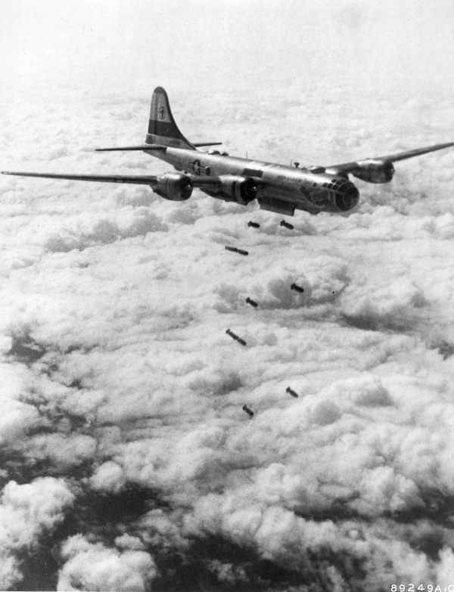
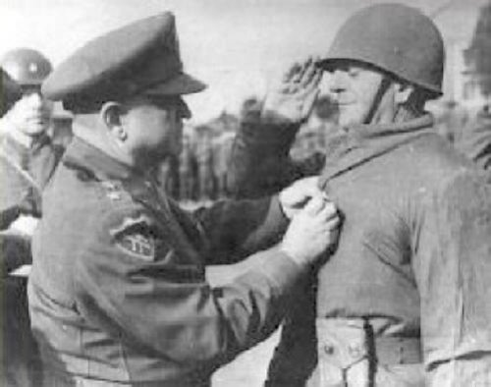
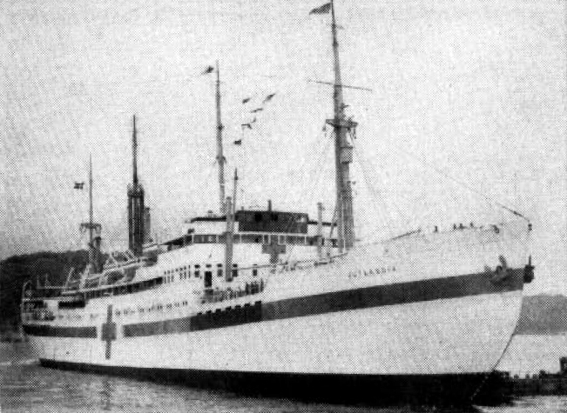
How significant a role did members of the UN play in the Korean War?
Activity
In small groups, work through the guiding questions for your chosen case study.
Notes:
Left: Jutlandia https://en.wikipedia.org/wiki/File:Danish_hospital_ship_Jutlandia_in_Korea_1951.jpg
Middle: B39 Superfortress https://en.wikipedia.org/wiki/Korean_War#/media/File:WarKorea_B-29-korea.jpg
Right: Turkish soldiers https://upload.wikimedia.org/wikipedia/commons/9/99/WaltonWalker%26TahsinYazici.jpg

Slide 7
How significant a role did members of the UN play in the Korean War?
Plenary
Based on your case study, prepare a verbal answer to this question to share with the class.
In your answer you must:
Refer to evidence in your case study.
Make use of at least one of the words on the right to explain the significance of the country that you investigated.
Vital
Highly
Very
Decisive
Fundamental
Limited
Less

