Slide 1
Enquiry 7 overview:
An unfinished war
Why was there no peace in Korea?
Lesson 7.1
Why did the Korean War drag on until 1953?
Lesson 7.2
How did the war leave an enduring impact on the Korean
people?
Lesson 7.3
Could a ‘hot war’ have erupted again in Korea during the Cold War?
Lesson 7.4
Why has there not been peace in Korea even after the end
of the Cold War?

Slide 2
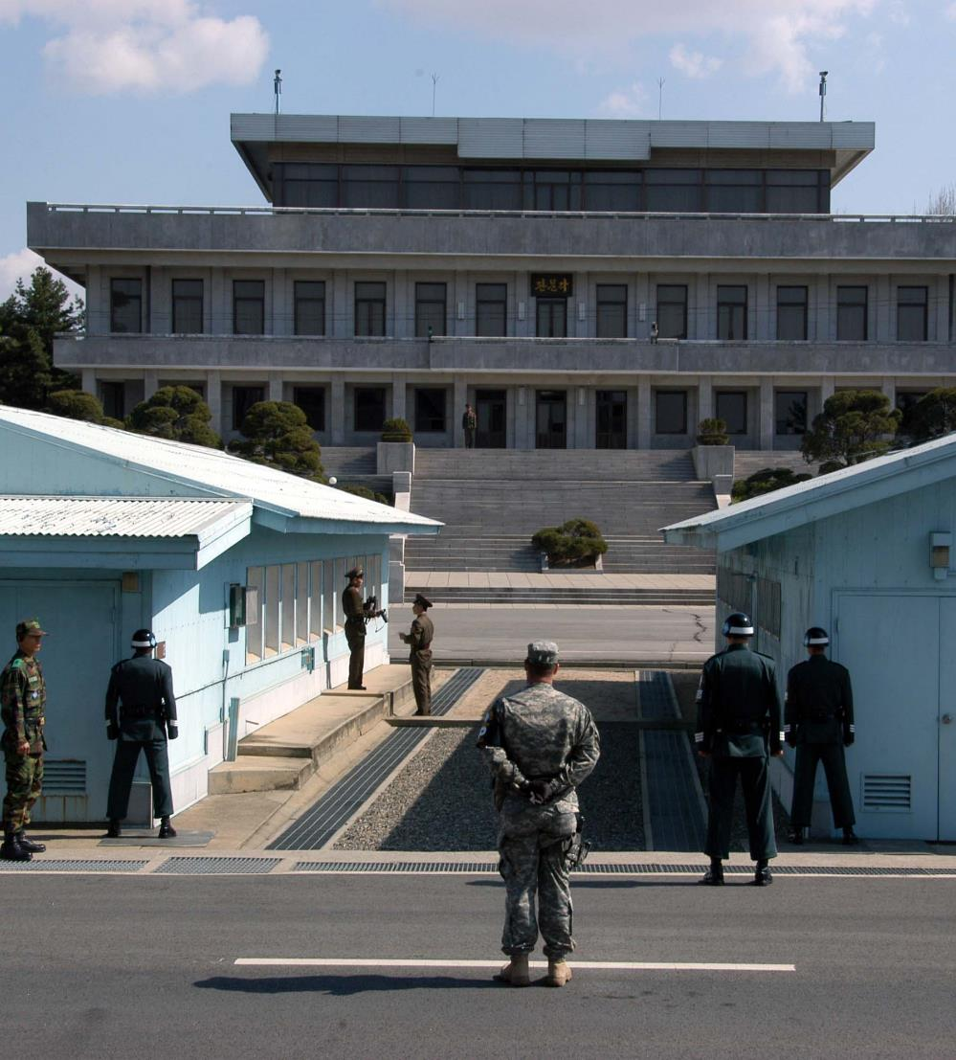
Lesson 7.3: Could a ‘hot war’ have erupted again in Korea during the Cold War?
Starter
What does the photo show?
Where do you think it was taken?
Where are the soldiers from?
What are the soldiers looking at?
What does this photo suggest about the relationship between South and North Korea?
Notes:
Image: CC BY-SA 3.0/Driedprawns/Wikipedia https://commons.wikimedia.org/wiki/File:070401_Panmunjeom3.jpg

Slide 3
Lesson 7.3 Overview and aims
Lesson 7.3
Could a ‘hot war’ have erupted again in Korea during the Cold War?
In this lesson you will:
Identify and sort the main events and factors that shaped inter-Korean relations from 1953 to the end of the Cold War.
Analyse and evaluate primary sources related to the key events and factors that shaped diplomatic tensions on the Korean Peninsula.
Reach a judgement on whether there was a potential for a reoccurrence of war in Korea during the Cold War.

Slide 4
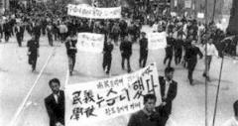
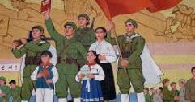
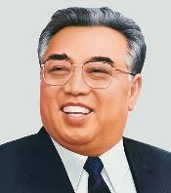
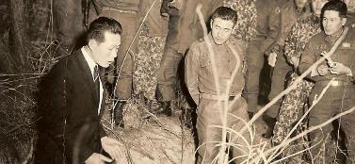
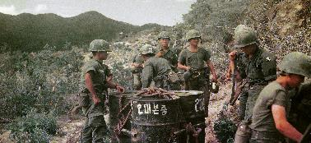
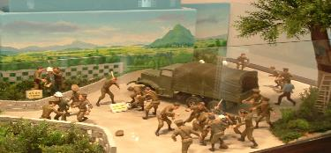
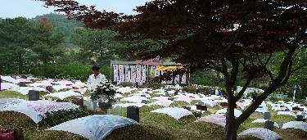
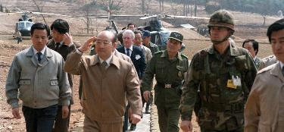
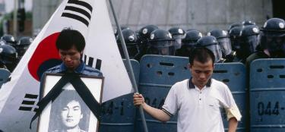
How did Cold War tensions continue to shape events in Korea?
Activity 1
Match these images (shown larger on Slide 6) with the descriptions on
Slide 5).
Arrange the cards in chronological order.
Note: Cards that cover the whole period can be placed at the beginning.
© Kim Newton All Rights Reserved
Notes:
Image credits, from top left:
April Revolution: Kyunghyang Shinmun, http://news.khan.co.kr/kh_news/khan_art_view.html?artid=200808181834035&code=210000
North Korean propaganda image: CC BY 2.0/Mark Fahey from Sydney, Australia/Wikimedia, https://commons.wikimedia.org/wiki/File:North_Korean_propaganda_(1).jpg
Kim Il Sung image: CC BY-SA 3.0/Gilad Rom/Wikimedia, https://commons.wikimedia.org/wiki/File:Kim_Il_Sung_Portrait-2.jpg
General Han Moo-hyup with Kim Shin-jo: CC BY-SA 3.0/Relamian/Wikimedia, https://commons.wikimedia.org/w/index.php?curid=25643922
South Korean soldiers in Vietnam: CC BY 2.0/Phillip Kemp/Wikimedia, https://commons.wikimedia.org/wiki/File:Photo_taken_by_Phillip_Kemp_from_cockpit_after_sling-loading_water_drums_to_outpost..jpg
© Author/Guy Birks, taken at the Joint Security Area, Panmunjeom, South Korea, 2012
Mangwol-dong cemetery: CC BY-SA 3.0/Rhythm/Wikimedia, https://commons.wikimedia.org/w/index.php?curid=4089746
Chun Doo-hwan and Claude M. Kicklighter, US Department of Defense, https://commons.wikimedia.org/w/index.php?curid=16569008
© Kim Newton All Rights Reserved; https://global.arizona.edu/sites/default/files/Newton_Seoul_1987_0.jpg; see article https://global.arizona.edu/news/ua-journalist-delivers-historic-photo-south-korean-leader

Slide 5
A. After a short period of détente in the early 1970s, tensions reignited with the ‘Axe Murder Incident’ in 1976, which raised the prospect of a renewal in armed conflict. North Korean soldiers attacked an American work party trying to chop down a tree inside the demilitarised zone between North and South Korea. Two US army officers were killed. Readiness levels for American forces in Korea were raised to DEFCON 3 and rocket attacks were considered. However, the South Korean president did not push for military action.
B. Kim Il Sung maintained power from 1953 to 1994, when he passed away as a result of a stroke. He used a mix of propaganda, terror and ideology to maintain control over North Korea throughout the period.
C. An attempt to kill South Korean President Chun Doo Hwan took place when North Korea planted a bomb in a mausoleum in Yangon, Myanmar during a visit by Chun. He survived but 21 people, including some government ministers, were killed. On 29 November 1987, a bomb planted on a Korean Air flight exploded over the Andaman Sea, killing all 115 people on board. Seoul accused Pyongyang, which denied involvement.
D. Syngman Rhee was forced from power in South Korea. After rigged elections were held, student protestors successfully pushed for the resignation of Rhee. For a year, a fragile democratic government admistered the country. A military coup led by General Park Chung Hee was carried out in 1961, with the resultant termination of the infant democracy.
E. President Park was assassinated by his intelligence chief after an argument in 1979. A military coup directed by Chun Doo-Hwan was opposed by protestors in the city of Gwangju in May 1980. Student demonstrators, labelled as ‘communist sympathisers’, were brutally put down, with around 160 killed. The uprising failed but served to inspire pro-democracy movements in the latter part of the decade.
F. Pro-democracy movements in South Korea swept the country. Free elections were held in 1987. The USSR collapsed. Kim Il Sung was deprived of resources and support, to the extent that it contributed towards the development of the famine in the mid- to late-1990s. However, Kim continued to maintain firm control over North Korea and started to accelerate moves towards a nuclear weapons capability.
G. South Korea became involved in the Vietnam War. President Park sent troops in 1964 to support the US intervention. 300,000 South Korean soldiers served in the war until their withdrawal in 1973. South Korea’s decision to join resulted from various underlying causes, including the development of US–ROK relations, political benefits and the promise of economic aid from the United States. North Korea also sought to give aid and assistance to North Vietnam.
H. Both countries carried out a continuous propaganda campaign throughout the period. Propaganda in the North was (and still is) used to promote the cult of the leader, anti-Americanism and ‘anti imperialism’, as well as emphasise ‘Juche’ – self-reliance. A ban on films and music, as well as media censorship, was in place on both sides of the Peninsula.
I. North Korea attempted an assassination on South Korean President Park. On 21 January 1968, a team of 31 North Korean commandos was sent to Seoul to assassinate President Park Chung Hee but was intercepted by South Korean security forces. All but two were killed. The North also captured a US patrol boat, the US Pueblo. South Korea planned an attempted incursion and assassination mission against Kim Il Sung. It was cancelled after diplomatic relations improved.

Slide 6


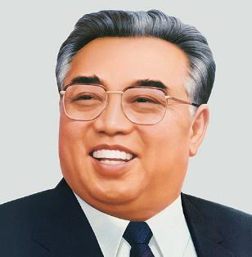
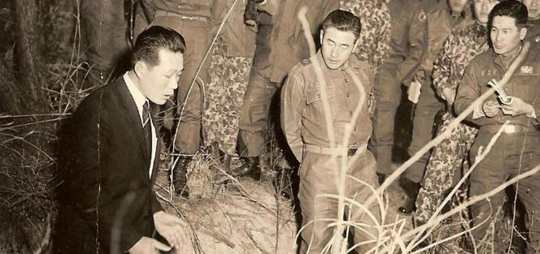
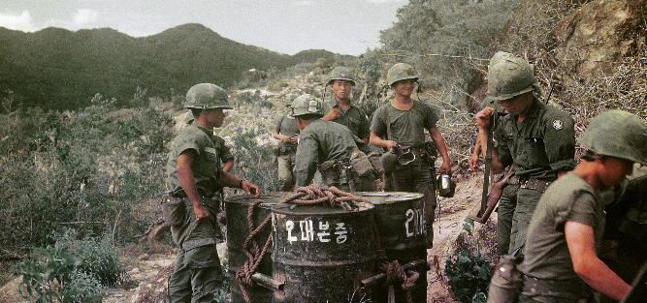
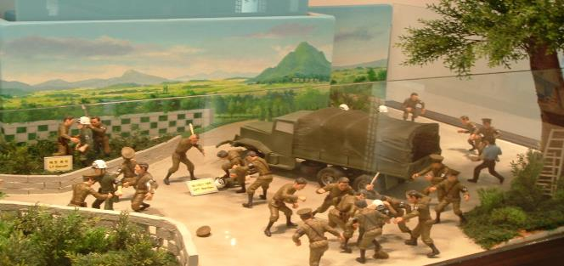
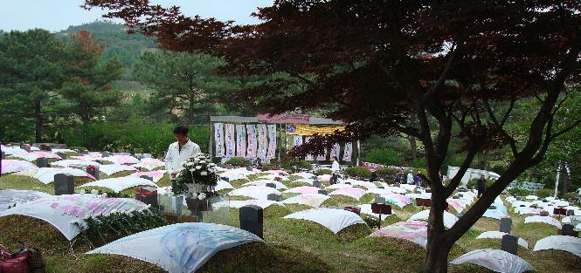

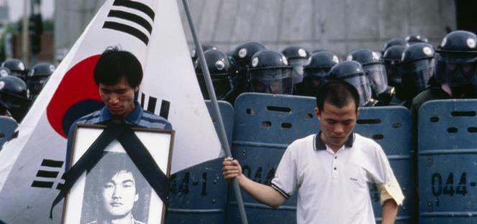
© Kim Newton All Rights Reserved
Notes:
Image credits, from top left:
April Revolution: Kyunghyang Shinmun, http://news.khan.co.kr/kh_news/khan_art_view.html?artid=200808181834035&code=210000
North Korean propaganda image: CC BY 2.0/Mark Fahey from Sydney, Australia/Wikimedia, https://commons.wikimedia.org/wiki/File:North_Korean_propaganda_(1).jpg
Kim Il Sung image: CC BY-SA 3.0/Gilad Rom/Wikimedia, https://commons.wikimedia.org/wiki/File:Kim_Il_Sung_Portrait-2.jpg
General Han Moo-hyup with Kim Shin-jo: CC BY-SA 3.0/Relamian/Wikimedia, https://commons.wikimedia.org/w/index.php?curid=25643922
South Korean soldiers in Vietnam: CC BY 2.0/Phillip Kemp/Wikimedia, https://commons.wikimedia.org/wiki/File:Photo_taken_by_Phillip_Kemp_from_cockpit_after_sling-loading_water_drums_to_outpost..jpg
© Author/Guy Birks, taken at the Joint Security Area, Panmunjeom, South Korea, 2012
Mangwol-dong cemetery: CC BY-SA 3.0/Rhythm/Wikimedia, https://commons.wikimedia.org/w/index.php?curid=4089746
Chun Doo-hwan and Claude M. Kicklighter, US Department of Defense, https://commons.wikimedia.org/w/index.php?curid=16569008
© Kim Newton All Rights Reserved; https://global.arizona.edu/sites/default/files/Newton_Seoul_1987_0.jpg; see article https://global.arizona.edu/news/ua-journalist-delivers-historic-photo-south-korean-leader

Slide 7
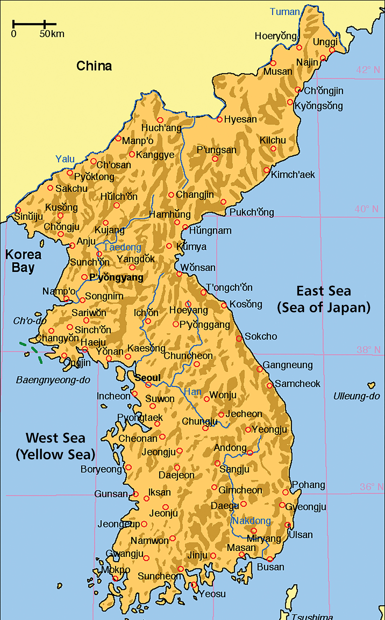
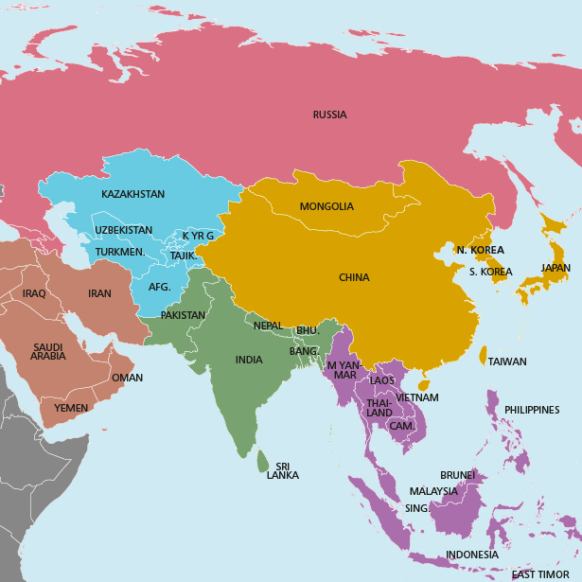
How did Cold War tensions continue to shape events in Korea?
Activity 2
1. On these two maps, mark where each event or factor on Slides 5 and 6 took place or occurred. Use the larger maps on Slide 8 or Resource sheet 7.3B.
Additional questions
2. What does the geographic spread of the events reveal about the nature of the conflict?
3. Why did some of the events occur outside of Korea?
4. What might this reveal about connections between the Koreas and Cold War allies?
Notes:
Korean map accessed at: https://commons.wikimedia.org/wiki/File:Map_of_korea_en.png
Map of Asia accessed at: https://commons.wikimedia.org/wiki/File:Map_of_Asia_(it).svg

Slide 8
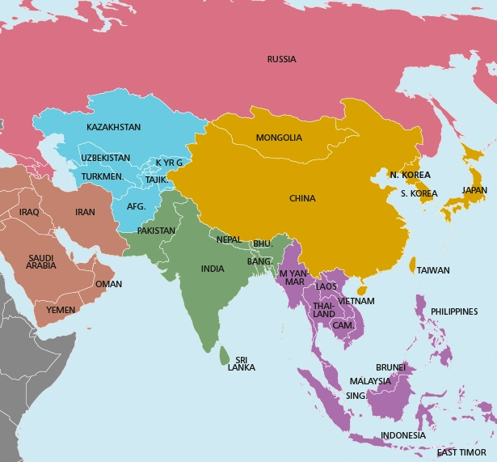
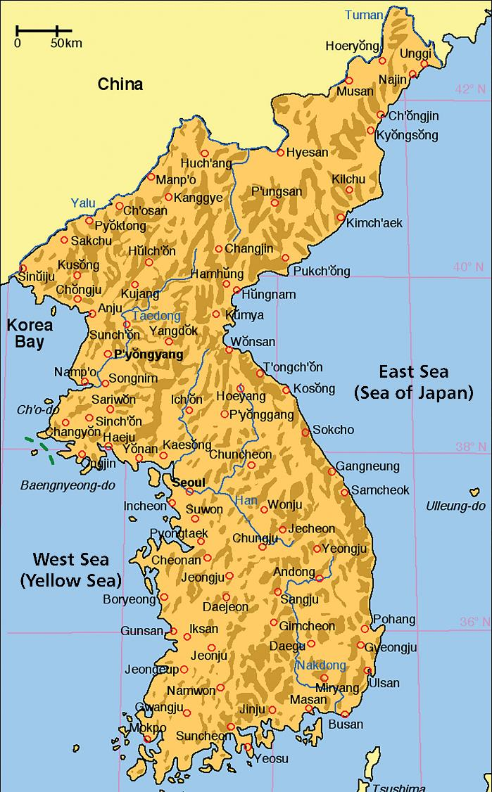
Notes:
Korean map accessed at: https://commons.wikimedia.org/wiki/File:Map_of_korea_en.png
Map of Asia accessed at: https://commons.wikimedia.org/wiki/File:Map_of_Asia_(it).svg

Slide 9
Could war have broken out again?
War
Activity 3
Work in a group of three. You will be given three of these events/factors to examine in detail.
Together, answer the questions that relate to each of your events/factors. The questions are in your source packs.
After answering the questions, discuss as a group where on the war/peace arrow you would put each event/factor, based on the evidence you have been given.
Peace

Slide 10
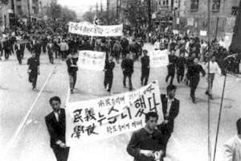
EVENT/FACTOR CARD 1
Syngman Rhee removed from power
Syngman Rhee was forced from power in South Korea. After rigged elections were held, student protestors successfully pushed for the resignation of Rhee. For a year, a fragile democratic government admistered the country. A military coup led by General Park Chung Hee in 1961 ended the infant democracy.
Activity 3A
Use your Sources 1–2 to find out:
What do the sources suggest about why Rhee was removed?
Do the sources agree at all? How do they differ?
Are the sources useful?
Using the sources, what impact did the event have on inter-Korean relations?
Notes:
Image: Kyunghyang Shinmun, http://news.khan.co.kr/kh_news/khan_art_view.html?artid=200808181834035&code=210000

Slide 11
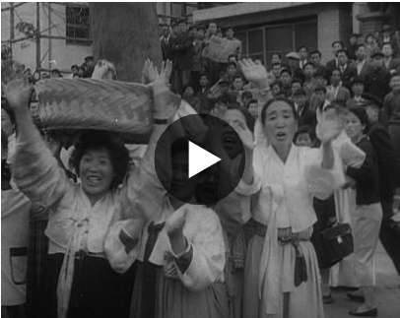
Source 1:
‘Record of a conversation with Comrade Kim Il Sung, 2 May 1960’, Journal of Soviet Ambassador in the DPRK A. M. Puzanov for the period 29 April through to 30 May 1960, Pyongyang
EVENT/FACTOR CARD 1
Source 2:
British Pathé report on Rhee’s removal
Kim Il Sung gave a general assessment of the events occurring in South Korea.
He noted that broad strata of the South Korean population, especially students, are taking part in them. Syngman Rhee and his government have been overthrown as a result of the popular uprising. As everyone knows, the government is formed of American stooges. Therefore, in spite of all kinds of restrictive measures being undertaken by the provisional government of South Korea right now, the population will continue the struggle for the realization of their fundamental demands, first of all for the elimination of the division of Korea and for the withdrawal of American troops.
The Korean Workers Party thinks that the more progressive-minded parties there are in South Korea the easier it will be for the KWP to pursue work among the broad strata of the South Korean population… Kim Il Sung said, we think that after some time we will nevertheless be able to establish contacts between the North and South of Korea (postal traffic, reciprocal visits of representatives of political parties and organizations, and with time, partial movements of populations). He said that it is necessary to diligently and carefully prepare for this, including preparing political cadres.
Notes:
Source 1: https://digitalarchive.wilsoncenter.org/document/116112
Source 2:www.britishpathe.com/video/the-end-for-rhee

Slide 12
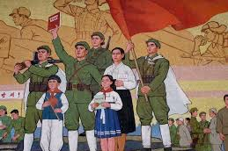
EVENT/FACTOR CARD 2
Propaganda campaigns
Both North and South Korea continued propaganda campaigns throughout the period.
Propaganda in the North was (and still is) used to promote the cult of the leader, anti-Americanism and ‘anti imperialism’, as well as to emphasise ‘Juche’ – self-reliance.
Film, music and media were censored on both sides of
the Peninsula.
Activity 3B
Use your Sources 3–7 to find out:
What do the sources reveal about the various methods of propaganda that have been used by North and South Korea throughout the conflict?
How did propaganda serve to maintain tensions on the Korean Peninsula?
What was the effect of the propaganda
on ordinary people?
How useful are the sources for an understanding of how propaganda was
used to maintain Cold War tensions on
the Peninsula?
Notes:
Image: CC BY 2.0/Mark Fahey from Sydney, Australia/Wikimedia, https://commons.wikimedia.org/wiki/File:North_Korean_propaganda_(1).jpg

Slide 13
EVENT/FACTOR CARD 2
Source 3:
A comic strip published by the South Korean government in 1968. The speech bubbles give information on how to identify and report spies, telling you to be suspicious if…
‘a person, who is said to have died during the Korean War, suddenly showed up’
‘a person uses the North Korean vernacular’
‘a person is unaware of the prices of goods’
‘a person asks for the location of a police station or checkpoint,
or the geographical features (mountains) of a neighborhood’
Concerning how to report suspicious people, the leaflet says that…
‘one should directly report to the nearest police station, military base or town office’.
Notes:
Source 3: Image courtesy of the National Museum of Korean Contemporary History

Slide 14
EVENT/FACTOR CARD 2
Source 4:
A letter carried by activist group North Korea’s Peace Balloons, sent from South Korea into North Korea in 2015
‘Our dear siblings in North Korea! Hello North Korean siblings! Around the world, people are always with you. Your difficulties are well-known internationally. We hope North and South Korean people will reunite in the near future. Please live a long and healthy life! Stay strong. We love you. We miss you so much. Warning! It is possible that some bad people may have sprayed these socks with poison that could harm you. If you find the socks, do not touch them with your bare hands. Pick them up with tools and store them in plastic bags. If possible, rinse these socks under running water for at least 10 hours before wearing.’

Slide 15
EVENT/FACTOR CARD 2
Source 5:
An extract from a news article published in South Korea in 2018. The title of the article was ‘Why do some South Koreans believe a myth that North Koreans have horns?’
‘I once met a senior in South Korea who asked me if North Koreans have horns on their heads,’ said North Korean defector Lee Gwang-sung, who arrived in Seoul in late 2015.
I said: ‘Are we cows? How can we have horns on our heads?’’
Shin Eun-mi, an elderly Korean-American who grew up near Seoul, mentioned something similar in a separate interview.
‘When I was in elementary school in South Korea, teachers taught me that North Koreans had horns on their heads like monsters,’ Shin said.
She eventually realized it wasn’t true.
‘I knew that biologically, it is impossible for human beings to have horns,’ she said, ‘but the demonized images of North Koreans had lingered into my life.’
Source 6:
An image from a 1987 South Korean elementary school textbook showing a North Korean. Above, the text reads: ‘Take the leader back to the North’
www.npr.org/sections/parallels/2017/04/04/521742040/why-do-some-south-koreans-believe-a-myth-that-north-koreans-have-horns?t=
Notes:
Source 5: www.psywarrior.com/NKoreaH.html
Source 6: Jihye Lee/For NPR, www.npr.org/sections/parallels/2017/04/04/521742040/why-do-some-south-koreans-believe-a-myth-that-north-koreans-have-horns?t=

Slide 16
EVENT/FACTOR CARD 2
Source 7:
A leaflet published by the North Korean government. On the left is US President Jimmy Carter. Next left is South Korean President Park Chung Hee. The next figure represents the US military and the small figures represent typical South Korean troops.
The text says: ‘There will never be peace as long as Americans are in South Korea and when the war starts South Korean soldiers will be the first to die’
Notes:
Source 7: North Korean government leaflet

Slide 17
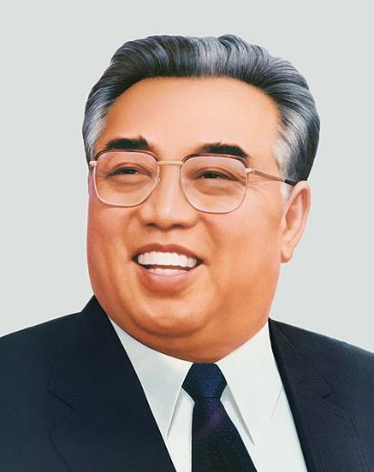
EVENT/FACTOR CARD 3
Kim Il Sung
Kim Il Sung maintained power from 1953–1994, when he died from a stroke. He used a mix of propaganda, terror and ideology to maintain control over North Korea throughout the period.
Activity 3C
Use your Sources 8–10 to
find out:
How did the continued reign of Kim provoke a continuation of tensions on the Peninsula?
Notes:
Image: CC BY-SA 3.0/Gilad Rom/Wikimedia, https://commons.wikimedia.org/wiki/File:Kim_Il_Sung_Portrait-2.jpg

Slide 18
Source 8:
Account of Lee Min-bok, a defector from North Korea living in the South
EVENT/FACTOR CARD 3
(Lee Min-bok, 60, was a researcher at North Korea’s Academy of Agricultural Science. He first tried to defect, unsuccessfully, in 1990. He eventually left North Korea in June 1991 and came to South Korea in 1995. His family sent him these diaries.)
“I’ have a bit of an academic side. According to Kim Il Sung’s teachings, people are supposed to keep diaries. Everyone in North Korea should strictly follow Kim Il Sung’s teachings, so I did as I was supposed to and kept a diary.
Even though Kim Il Sung is a villain here, in North Korea he’s above everything. We learned that he studied well and gave our lives purpose. I lived according to those teachings. I wrote these out of loyalty to the Leader. That was our ideology, and I lived my life in strict adherence to it.
No one could think differently.
I got hold of these diaries 10 years after I arrived in South Korea. I had been sending money to my family in the North and they sent them to me. I didn’t write any complaints in diaries. I would’ve been in big trouble if I did.
My diaries are a record of my history in North Korea. I am thinking about turning these diaries into a book. I’d like to publish a book about how to change North Koreans’ thinking when unification happens. These diaries show how North Koreans think and how their minds are constructed. People need to make these into a textbook, because they need proof.
Talking is not as effective.’
Notes:
Source 8: www.reuters.com/investigates/special-report/northkorea-china-border-defectors

Slide 19
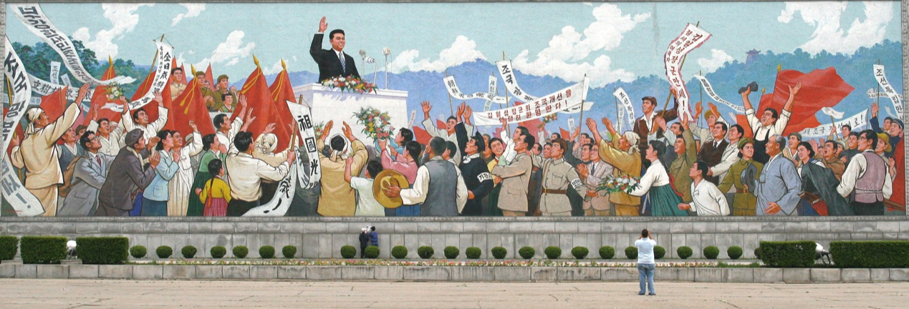
EVENT/FACTOR CARD 3
Source 9:
A mural depicting Kim Il Sung addressing the Korean people in Kaeson Revolutionary Site, Pyongyang
Source 10:
Historian B.R. Myers in The Cleanest Race: how North Koreans see themselves and why it matters ‘The masses are reminded with increasing frequency that because the nation cannot survive without the leader who constitutes both its heart and its head, they must be ready to die to defend him. As if the logic were not in itself reminiscent of fascist Japan, the regime makes increasingly bold use of the very same terms – such as “resolve to die” (kyolsa) and “human bombs” (yukt’an) – that were so common in imperial Japanese and colonial Korean propaganda during the Pacific war.’
Notes:
Source 9: CC BY-SA 3.0/Gilad Rom/Wikimedia, https://commons.wikimedia.org/w/index.php?curid=3610920

Slide 20
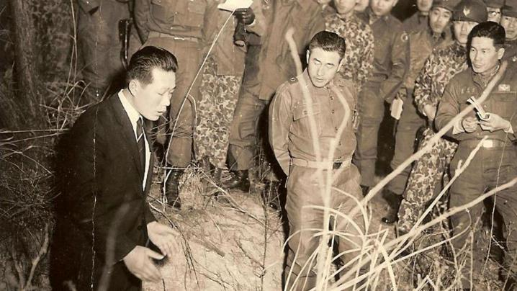
EVENT/FACTOR CARD 4
Raids
In January 1968, a team of 31 North Korean commandos was sent to Seoul to assassinate President Park Chung Hee. They were intercepted by South Korean security forces. All but two were killed.
The North also captured a US patrol boat, the US Pueblo. South Korea planned an attempted incursion and assassination mission against Kim Il Sung. It was cancelled after diplomatic relations improved.
Activity 3D
Use your Sources 11–15 to find out:
What does the Soviet reaction to the attempted assassination on Park suggest about North Korean-USSR relations?
How and why does the Chinese view of North Korea’s actions differ to that of the USSR? (Source 11 and 13)
Can movies serve as useful tools of information/interpretations of an event? What are their strengths/limitations? (Source 15)
Why did the attempted assassinations not result in war?
Notes:
Image: CC BY-SA 3.0/Relamian/Wikimedia, https://commons.wikimedia.org/w/index.php?curid=25643922

Slide 21
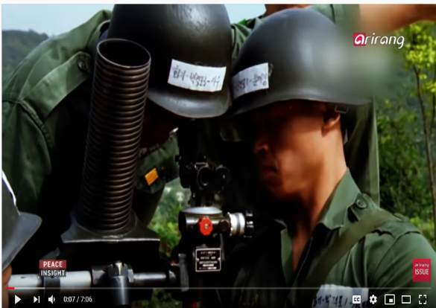
EVENT/FACTOR CARD 4
Source 11:
25 January 1968, Telegram from Pyongyang to Bucharest, top secret, no. 76.017, flash: The Embassy of Romania in the DPRK reports on the Soviet Union’s response to the Blue House Raid and the seizure of the USS Pueblo
S. Golosov said: ‘the North Koreans know the unfavorable position of the USSR towards the intentions and the tendencies to hasten reunification through the use of force and therefore we are afraid that we will not be consulted; and this situation is caused by the fact that we do not know the dynamics of Sino–Korean relations and the attitude of the People’s Republic of China towards the Korean issue, particularly in its recent form shaped by the DPRK [since the January 21 attack].’
Lastly, the Soviet diplomat added that the North Korean Ministry of Foreign Affairs has been trying, at all levels, to find out the answer to one pressing question: ‘Whether the USSR will help the DPRK and in what form in the case of the resumption of an all-out war on the Korean Peninsula.’ ‘When we try to moderate this warmongering state of mind,’ Golosov added, ‘on many occasions, our position is not taken into account.’
Source 12 Overview of the ‘Blue House Raid’ by Arirang News, 2018
Notes:
Source 11: https://digitalarchive.wilsoncenter.org/document/113944
Source 12: www.youtube.com/watch?v=TDAEPC32zZc

Slide 22
Source 13:
The Embassy of Romania in the DPRK reports on China’s relations with North Korea following the Blue House Raid and the seizure of the USS Pueblo, 17 March 1968
EVENT/FACTOR CARD 4
The Chinese diplomat has repeatedly underlined that the war preparations of the DPRK are welcome, since it is certain that the United States wants to expand the battlefield in Asia, not only in Vietnam, Thailand, and Cambodia, but definitely in Korea as well. He added that the outbreak of war in Korea is inevitable, a logical consequence given that the country cannot remain separated indefinitely and that for the DPRK, this would be a just liberation war.
Wang Peng answered that this idea had the potential to demobilize the Korean people and it did not mirror reality, because it was still possible that the Americans would start a war in less than a week or two. We, the Chinese diplomat added, share the conviction of the Korean comrades that war is drawing near and the People’s Republic of China has repeatedly declared that it would grant its full support to the DPRK.
Notes:
Source 13: https://digitalarchive.wilsoncenter.org/document/113968

Slide 23
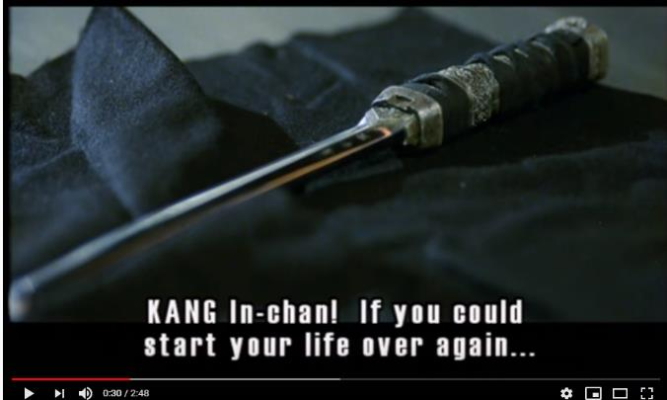
EVENT/FACTOR CARD 4
Source 14:
The ROK Minister of Defence expresses his displeasure at the lack of a US response towards the Blue House Raid as compared to the Pueblo incident, 23 January 1968
Source 15:
Trailer for the movie Silmido about the team of commandos trained by South Korea to assassinate Kim Il Sung. After the mission was cancelled, the men were betrayed, with all of them killed.
1) The Minister of Defence was emotionally irate and indicated the US had done little after the North Korean raid aimed at the assassination of President Park except call a meeting at Panmunjom and take normal operational steps, but because of Pueblo incident brought F-105’s into Osan without prior ROK knowledge, was moving Enterprise, and seemed to be ready to risk war.
2. (S) He said would refrain from retaliatory raids against North Korea for time being, but if North Koreans made other significant raids, he would promise nothing further.
3. (S) He commented it would be wrong to cancel Armistice Commission meeting set for 1100 hours tomorrow because it had been announced publicly with purpose to protest vicious attack on Presidents mansion, Seoul.
Notes:
Source 14: https://digitalarchive.wilsoncenter.org/document/113368
Source 15: www.youtube.com/watch?v=3PWIFA-ulP0

Slide 24
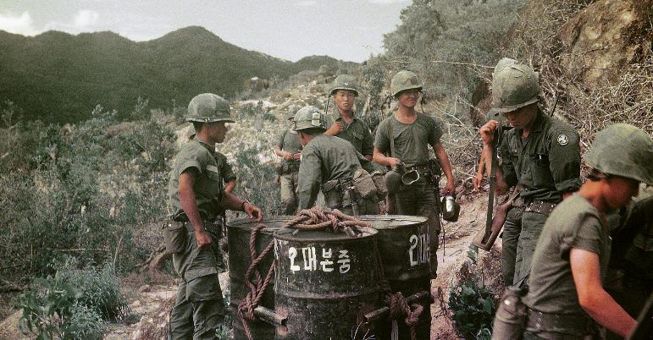
EVENT/FACTOR CARD 5
The Vietnam War
South Korea became involved in the Vietnam War. President Park sent troops in 1964 to support the US intervention. 300,000 South Korean soldiers served in the war until their withdrawal in 1973. South Korea’s decision to join resulted from various underlying causes, including the development of US–ROK relations, political benefits and the promise of economic aid from the United States. North Korea also sought to give aid and assistance to North Vietnam.
Activity 3E
Use your Sources 16–18 to find out:
What did the two Koreas achieve/hope to achieve from the Vietnam War?
What does Y. Kim in Source 17 indicate about why South Korea was worsening the situation in Vietnam?
Did participation in the war have a deep impact on inter-Korean relations?
Notes:
Image: CC BY 2.0/Phillip Kemp/Wikimedia, https://commons.wikimedia.org/wiki/File:Photo_taken_by_Phillip_Kemp_from_cockpit_after_sling-loading_water_drums_to_outpost..jpg

Slide 25
EVENT/FACTOR CARD 5
Source 16:
A report written by the Soviet intelligence services about co-operation between North Korea, Romania and Vietnam in May 1967
DPRK leaders have advocated coordinating the aid of the socialist countries to Vietnam and in confidential conversations has criticized the Chinese for their rejection of cooperation.
It should be taken into account that the Korean comrades view the Vietnamese events primarily from the point of view of their possible consequences for Korea. In their opinion, the security of the DPRK, an expansion of the aggression of the American imperialists in Asia, and the prospects for the revolutionary movement in South Korea depend to a large degree on the outcome of developments of the war in Vietnam. The DPRK leadership supports only a military solution of the Vietnamese issue and has a negative attitude toward the possibility of combining armed struggle and a political settlement in Vietnam.
Notes:
https://digitalarchive.wilsoncenter.org/document/116701

Slide 26
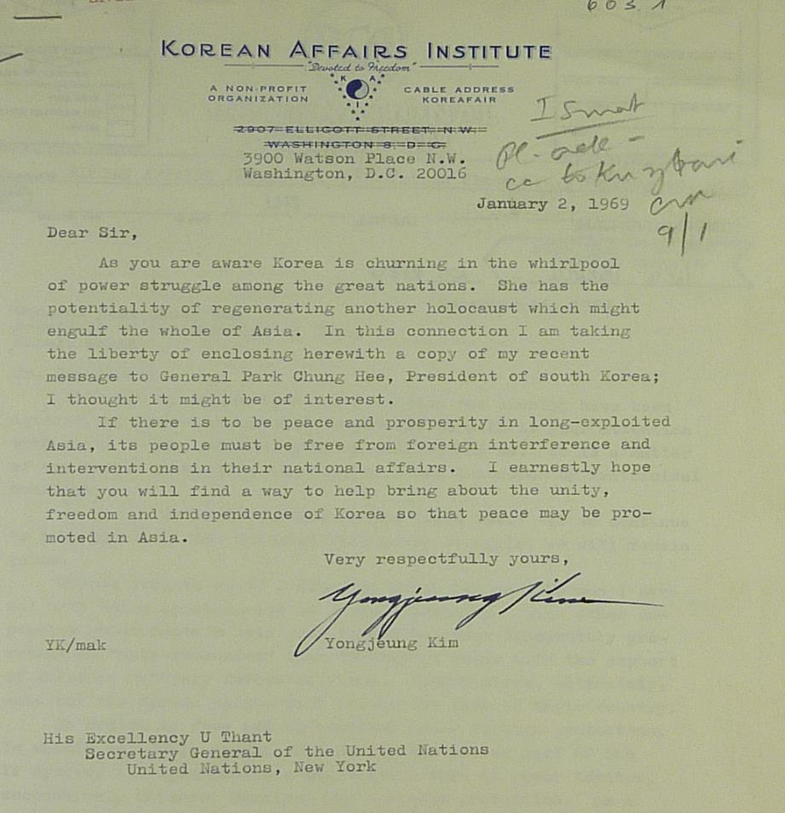
EVENT/FACTOR CARD 5
Source 17
Letter from the president of the Korean Affairs Institute to the UN Secretary General, concerning the Republic of Korea’s involvement in the Vietnam War, 2 January 1969
Notes:
Source 17: https://digitalarchive.wilsoncenter.org/document/117251

Slide 27
EVENT/FACTOR CARD 5
Source 18:
Historian Glenn Baek on South Korean participation in the Vietnam War
ROK participation in Vietnam was made possible because the United States was willing to underwrite the entire Korean military and civilian operations in the country. And for Korea’s contribution to the war, the ROK government was well compensated. Korea is believed to have earned US$5 billion during eight years of deployment from various sources, including increased American military assistance to modernize ROK armed forces, special allowances paid to ROK soldiers in Vietnam, multi-million-dollar civilian contracts, and expanded trade with Vietnam. After the first two years of deployment, revenues from the war made up 40 percent of Korea’s foreign exchange earnings, and from 1965 to 1972, the country earned an estimated US$1 billion in hard currency.
Some scholars estimate that financial gains from the war accounted for 7–8 percent of Korea’s GDP
in 1966–1969. Korea’s impressive growth coincided with Park’s export-oriented industrialization program (1967–1972) in which the government sought to expand exports by supporting particular
firms with subsidized loans, price controls, and tax reductions while protecting the domestic market with import quotas.
Notes:
http://en.asaninst.org/contents/issue-brief-no-53-a-perspective-on-koreas-participation-in-the-vietnam-war

Slide 28
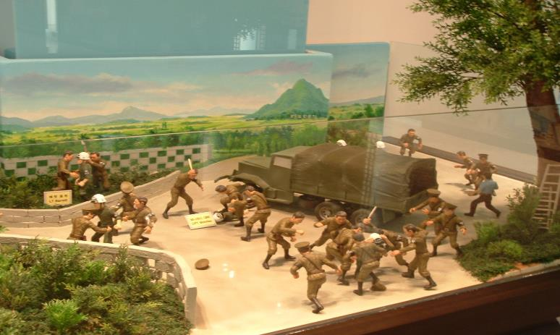
EVENT/FACTOR CARD 6
The Axe Murder Incident, 1976
After a short period of détente in the early 1970s, tensions reignited with the ‘Axe Murder Incident’ in 1976, which raised the prospect of a renewal in armed conflict. North Korean soldiers attacked an American work party trying to chop down a tree inside the demilitarised zone between North and South Korea. Two US army officers were killed in what became known as the ‘Axe Murder Incident’. Readiness levels for American forces in Korea were raised to DEFCON 3 and rocket attacks were considered. However, the South Korean president did not push for military action.
Activity 3F
Use your sources 19–22 to find out:
Were the US preparations for cutting down the tree on the second attempt an indication that war was a strong likelihood?
What do the Soviet and Chinese accounts (Sources 21 and 22) suggest about their perspective on the Axe Murder Incident?
Which source has the most value for gaining an understanding of why the incident did not escalate into war?
Notes:
Image: © Author/Guy Birks, taken at the Joint Security Area, Panmunjeom, South Korea, 2012

Slide 29
EVENT/FACTOR CARD 6
Source 19:
Overview of the Axe Murder Incident from online magazine Frontline World
On August 18, 1976, the two sides came closer to war than any time since the Korean War armistice.
On that day, a party of nine South Koreans, accompanied by two U.S. officers and four American military police, ventured into the DMZ to prune a poplar tree. They’d decided that the tree hindered a clear view between two U.N. checkpoints. The party from the South was met near the tree by a North Korean lieutenant and seven other men. At first, the North Koreans didn’t seem bothered by the intentions of the tree-cutting crew. Then the North Korean lieutenant demanded the party halt its work. When he was refused, a truckload of North Korean reinforcements showed up. The incident quickly turned into a bloody conflict, resulting in two American soldiers being beaten then axed to death.
A U.N. commando captured the killings on film.
Who took the first swing is still debated on both sides. North Korea accused the United States of a ‘premeditated act’ aimed at provoking war. Regardless of which country the world believed to be the aggressor, the fact that a dispute over a tree threatened the onset of a hot war was indicative of the extreme and ongoing tensions in the zone.
Notes:
Adapted from: www.pbs.org/frontlineworld/stories/northkorea/1976.html

Slide 30
EVENT/FACTOR CARD 6
Source 20:
CIA Report, 18 August 1976, ‘DMZ Incident’
On the morning of 18 August North Korean guards attacked and overpowered a small UN Command work party in the Joint Security Area at Panmunjom. Two US Army officers were killed and several other military personnel -- both US and South Korean -- sustained injuries. The two US officers were beaten to death while they lay helplessly on the ground.
We are virtually certain that this incident was a deliberate provocation. We believe it was intended to support North Korea’s diplomatic offensive against the US and South Korea -- Pyongyang is asserting that it proves that the US is the major source of tension in Korea -- and also to arouse US public opinion about the American troop presence in Korea during the presidential election campaign. The North Koreans are unlikely to undertake any high-risk military adventures; whether they will engage in further controlled acts of violence will depend heavily on their interpretation of the US response.
Source 21:
The Embassy of Romania in Beijing assess the Chinese response to the Panmunjeom or ‘Axe Murder Incident’ of August 1976
The diplomatic corps in Beijing broadly comments on the incident. Most diplomats we talked to (from socialist and non-aligned countries as well as from capitalist countries) think this was a mistake on behalf of the North Koreans, which would not bring them any political or diplomatic gains. The reserved tone of the Chinese propaganda apparatus is to be noticed, as it does not want to get engaged in an international campaign which may derail the course adopted by the People’s Republic of China in its relations with the United States and with surrounding countries. The same sources believe that the USSR cannot get engaged in a military conflict on the Korean Peninsula either, for its own reasons.
Notes:
Source 20 accessed at: www.fordlibrarymuseum.gov/library/document/0324/1553751.pdf
Source 21 accessed at: https://digitalarchive.wilsoncenter.org/document/114117

Slide 31
EVENT/FACTOR CARD 6
Source 22:
The Embassy of Romania in Moscow assesses the Panmunjeom or ‘Axe Murder Incident’ of August 1976.
Sept 01, 1976
The Democratic People’s Republic of Korea embassy made pressures on the Soviet side to support the Korean position through press activity, by publishing some governmental declarations which would condemn the United States. North Korean diplomats said that the ‘commentaries and the support from the Soviet Union, are of little importance.’
[To the Russians mind], the incident provoked by the North Koreans had a local character, not having originated, so it seems,
from the center.
The coverage given by the Democratic People’s Republic of Korea propaganda apparatus, the large-scale internal measures, including mobilizations, military maneuvers, measures adopted in relation to other countries (not to send nor to receive official delegations) do not have, according to Soviet beliefs, a ready ground on which these measures could be justified.
This can be explained, in turn, through the internal difficulties, mostly in terms of economic matters, such as a bad harvest, drought, the failure to fulfill certain main indicators in industry, as well as an attempt to use this incident to promote even further the national vigilance spirit and the effective military preparedness of the entire people. We would like to mention that Pak Su-gwon pointed out that this year’s harvest is very good, superior to that from last year. At the same time, he confirmed the existence of difficulties in other industrial sectors, such as energy, for example.

Slide 32
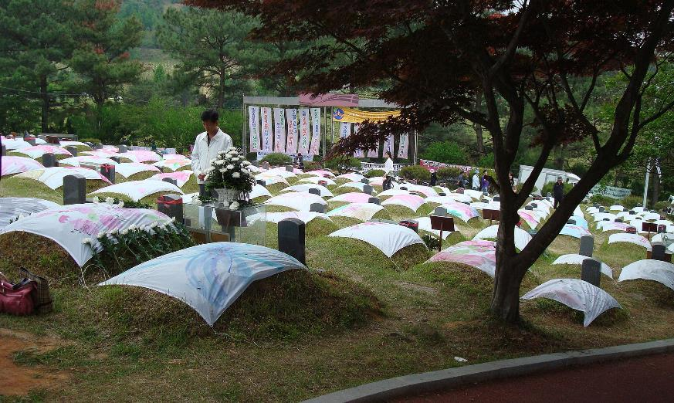
EVENT/FACTOR CARD 7
Assassination, coup and popular uprising
President Park was assassinated by his intelligence chief after an argument in 1979. A military coup directed by Chun Doo-Hwan was opposed by protestors in the city of Gwangju in May 1980. Student demonstrators, labelled as ‘communist sympathisers’, were brutally put down, with around 160 killed. The uprising failed, but served to inspire pro-democracy movements in the latter part of the decade.
Activity 3G
Use your sources 23–27 to find out:
Was the North involved in instigating the riots in the city of Gwangju?
What do the sources suggest about America’s view of the Chun dictatorship and its actions in Gwangju?
What does the incident reveal about the relationship between the USA and its Cold War ally at the beginning of the ‘Second Cold War’?
Notes:
Image: CC BY-SA 3.0/Rhythm/Wikimedia, https://commons.wikimedia.org/w/index.php?curid=4089746

Slide 33
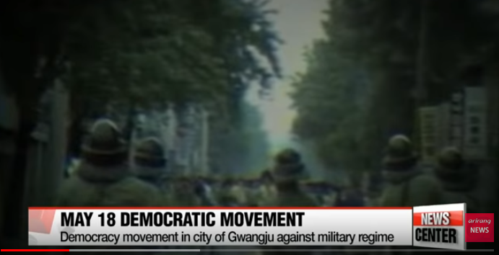
EVENT/FACTOR CARD 7
Source 23:
March 1980: Correspondence of the US Ambassador to South Korea in the lead-up to the events in Gwangju
Within the control structure a particularly worrisome phenomenon is the great power of Chun Doo Hwan, who has spread his intelligence security net throughout the military structure, and, despite flat assurances against involving himself in politics (as he defines politics) gives the impression of a man biding his time to take over control of the government either directly or behind some facade. Should he try to extend his formal power to include the KCIA or manipulate the next elections, he could precipitate dangerous public and rest and reactivate stresses within the ROK army – even his December 12 collaborators might turn on him.
Source 24:
A documentary by a South Korean news network about the Gwangju Uprising in 1980
Source 25:
CIA alert memo, 9 May 1980
While what we have observed of North Korean reactions to developments in the South since the Park assassination does not yet suggest an intention to exploit the situation militarily, I continue to be concerned about the adequacy of warning on Korea. In this light the current South Korean unrest, which brings with it the possibility of a military takeover, is yet another in a series of recent events that could undermine stability in the South and tempt Pyongyang to attack.
Notes:
Source 23: http://timshorrock.com/wp-content/uploads/korea-foia-_5-gleysteen-march-1980.pdf
Source 24: www.youtube.com/watch?v=8Ye-NcQozMI

Slide 34
EVENT/FACTOR CARD 7
Source 26:
Officials from the US Department of State, the White House, the CIA, NSC, OSD and JCS determine US policy towards South Korea in light of the events in Gwangju,
22 May 1980
After a full discussion of the current situation 'n Korea there was general agreement that the first priority is the restoration of order in Kwangju by the Korean authorities with the minimum use of force necessary without laying the seeds for wide disorders later. Once order is restored, it was agreed that we must press the Korean Government, and the military in particular, to allow a greater degree of political freedom to evolve.
It was agreed that we do not need to do more than we have done up to now. We have counselled moderation, but have not ruled out the use of force, should the Koreans need to employ it to restore order.
Source 27:
June 1980: Correspondence of the US Ambassador to South Korea after the events
in Gwangju
Notes:
Source 26: https://digitalarchive.wilsoncenter.org/document/122095
Source 27: http://timshorrock.com/wp-content/uploads/korea-foia-_5

Slide 35
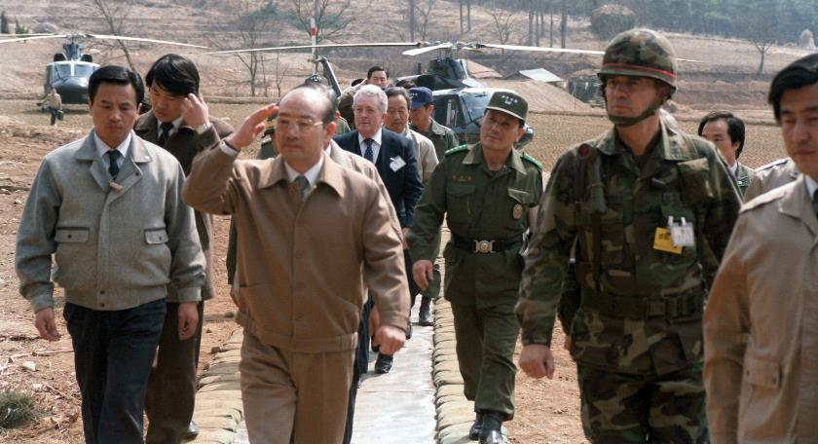
EVENT/FACTOR CARD 8
Attacks
North Korea attempted to kill South Korean President Chun Doo Hwan by planting a bomb in a mausoleum in Yangon, Myanmar during a visit by Chun. He survived but 21 people, including some government ministers, were killed.
On 29 November 1987, a bomb planted on a Korean Air flight exploded over the Andaman Sea, killing all 115 people on board. Seoul accused Pyongyang, which denied involvement.
Activity 3H
Use your Sources 28–30 to find out:
What do the attacks indicate about the North’s actions/approach in the 1980s? What was the nature of the attacks?
Was North Korea responsible for both attacks?
Do the concerns outlined by Kim Il Sung show that the North was less inclined to seek a confrontation? (Source 30)
Notes:
Image: US Department of Defense, https://commons.wikimedia.org/w/index.php?curid=16569008

Slide 36
EVENT/FACTOR CARD 8
Sources 28A and 28B:
Facsimiles of CIA reports on the Rangoon Bombing Incident, 13 October 1983
Notes:
Sources 28A and 28B: www.cia.gov/library/readingroom/docs/DOC_0000408056.pdf

Slide 37
EVENT/FACTOR CARD 8
Source 29:
A report on a discussion between Kim Il Sung and Demichev, a Soviet diplomat, following the KAL incident, 14 September 1983
Following the Soviet information provided on the incident of the South Korean airplane, Kim Il Sung said the following: He accepts the Soviet standpoint that the [USSR] was compelled to shoot down the civilian airliner because of a hostile provocation. He knows that in the wake of the incident, the international situation has become more tense in Europe, too. But:
The DPRK keeps silent, because it is in a peculiar situation, and faces a lot of difficulties. If Chun Doo Hwan, the puppet president of South Korea, had been on the plane, ‘they would have clapped their hands’ over the event, and they would have also published it by now. Unfortunately, this was not the case, for the victims included persons who were merely their South Korean compatriots and some of whom might even have had relatives living in the North. The Chinese [CP] and some other Communist parties also condemned the shoot-down of the plane.
Notes:
https://digitalarchive.wilsoncenter.org/search-results/1/%7b%22search-in%22%3a%22all%22%2c%22term%22%3a%22chun+doo+hwan%22%7d?recordtype=record

Slide 38
EVENT/FACTOR CARD 8
Source 30:
A report of the first meeting between Kim Il Sung and Erich Honecker upon the former’s 1984 official visit to the GDR
The situation with South Korea is very complicated and also very dangerous. Every year the American armies conduct a major military exercise. They conducted these exercises even prior to the Reagan era, but since Reagan took office this has grown. Last year 100,000 South Korean soldiers took part in this military exercise in addition to the American soldiers: These exercises were ‘Team Spirit ’83’ and ‘Team Spirit ’84’.
We have to take countermeasures every time the enemies conduct such military exercises, and this is a great hindrance for our production. Since the number of soldiers in our army is smaller than that of the South Korean army, we have to mobilize many workers in these cases. But when the workers are mobilized, one work shift is dropped for up to one and a half months per year. That is a great loss.
We proposed conducting tri-partite talks between us, the US, and South Korea this year in order to reduce tensions.
The goal of these talks should be to replace the armistice with a peace treaty with the US. We proposed a nonaggression pact to South Korea. We hope that this will help to improve the tense situation, as well. And then the armies for both sides would be reduced and the Americans would withdraw from South Korea. Our opponent is using the pretext that we would attack South Korea, and says that this is why the Americans have to remain in South Korea. There is constant talk in the US House of Representatives that our military forces are stronger than those of South Korea – the purpose of this talk is to deceive the people of the world. In truth, it is not even possible for us to have more armed forces than our opponents. We have a population of 17 million, while South Korea has a population of 30 million. Just looking at these figures it is clear that it is impossible for us to be stronger militarily.

Slide 39
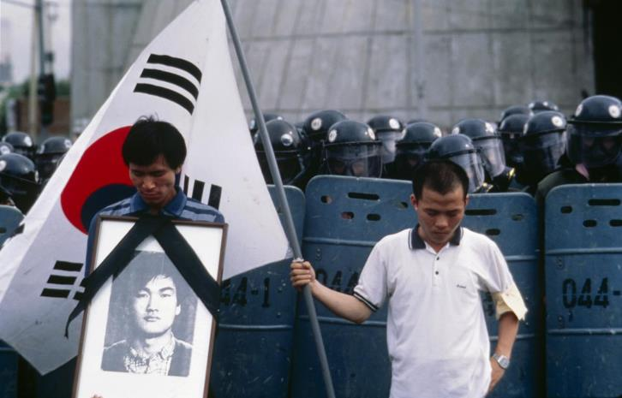
EVENT/FACTOR CARD 9
Democracy
Pro-democracy movements swept South Korea. Free elections were held
in 1987.
After the collapse of Communism in the USSR in 1989, Kim Il Sung was deprived of resources and support. This contributed to the North Korean famine in the mid- to late-1990s.
However, Kim continued to maintain firm control over North Korea and accelerated the development of a nuclear weapons capability.
Activity 3H
Use your Source 31 to find out:
What does the source suggest about how the USSR’s recognition of South Korea impacted on North Korea’s policy?
Is the source valuable in developing an understanding of why the end of the Cold War did not lead to peace on the Korean Peninsula?
© Kim Newton All Rights Reserved
Notes:
Image: © Kim Newton All Rights Reserved

Slide 40
EVENT/FACTOR CARD 9
Source 31:
Aleksandr Kapto, former Soviet Ambassador to North Korea, reflects on the Soviet Union’s relationship with North and South Korea
Gorbachev, in spite of promises, which he had personally given to Kim Il Sung, not to establish relations with South Korea, sharply changed his position and, during a meeting with Roh Tae-woo in San Francisco, gave him green light to expedite this process. This is what the South Korean President wanted.
Reaction of Pyongyang was definitely negative, and, moreover, emotional to the highest degree. There was an additional circumstance that added fuel to the raging fire, which I am still surprised about. [Eduard] Shevardnadze flew to Pyongyang to ‘consult’ with Kim Il Sung after the Soviet leadership had already made a positive resolution on the South Korean problem. North Korea felt that the USSR was in contravention of previous agreements.
As the North Korean minister stated, the establishment of diplomatic relations between the USSR and South Korea by itself leads to the cancellation of the Korean–Soviet treaty of alliance, which was signed in July 1961. It was directly stated that the Soviet side systematically violated the Korean–Soviet treaty of alliance.
In case of the cancellation of the Korean–Soviet treaty of alliance – it was then stated – we will have to look for ways to resolve many questions on our own. And as South Korea hosts US nuclear weapons, it is necessary to follow the road of development of weapons to counteract the aforesaid weapons. In this case, the DPRK will have to depart from the Treaty of Nuclear Non-Proliferation.
The responsibility for this would of course rest on the USSR as well. With this, there was a reminder that the USSR is responsible, alongside the USA, for having partitioned Korea along the 38th parallel.
Notes:
https://digitalarchive.wilsoncenter.org/search-results/
1/%7B%22publisher%22:%228%22%7D/date_desc?recordType=Record

Slide 41
Was a reoccurrence of war likely during the Cold War?
Activity 4
1. Where on this line would you place the events/factors you have studied?
Peace
War
2. Overall, was there the potential for a reoccurrence of war?

Slide 42
Plenary
Lesson 7.3
Could a ‘hot war’ have erupted again in Korea during the Cold War?
Discuss:
Answer the lesson question: Could a ‘hot war’ have erupted again in Korea during the Cold War?
Why did the conflict not finish with the end of the Cold War? Use the evidence you have gathered in your factor analysis to support your answer.

