Slide 1
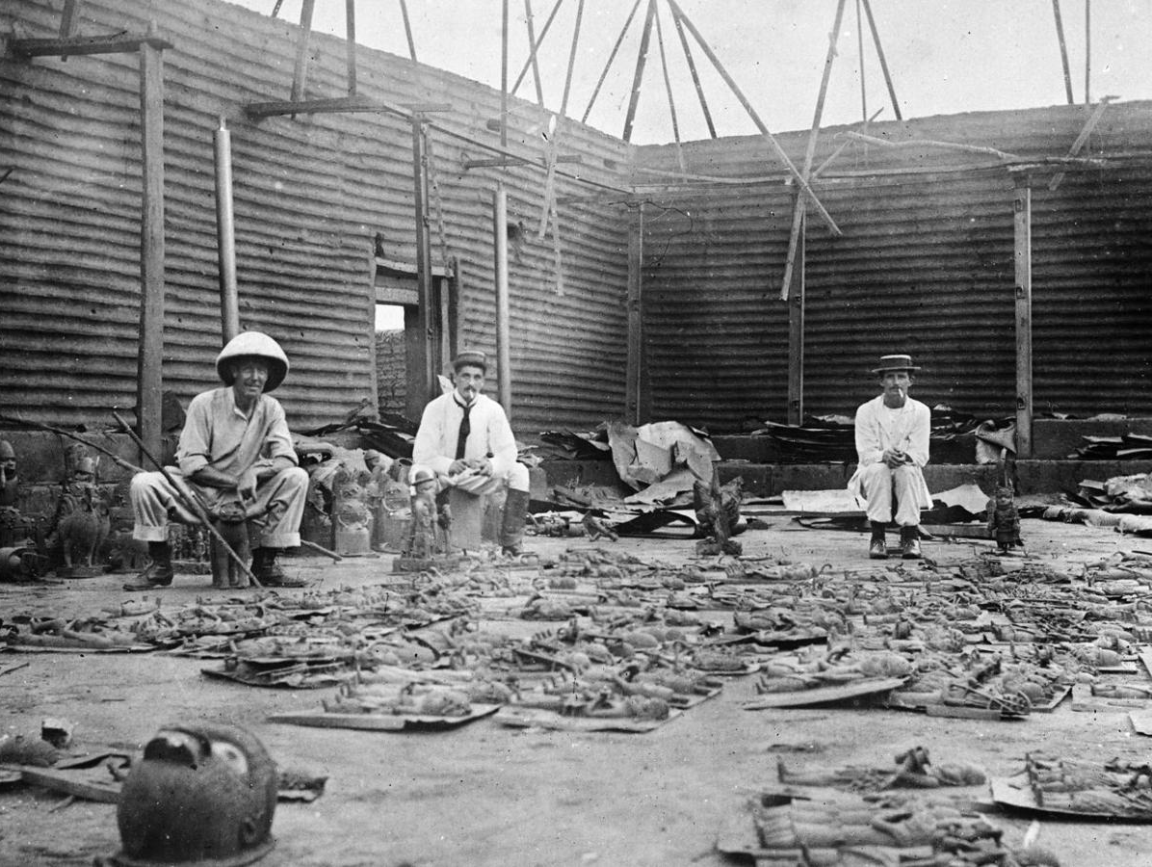
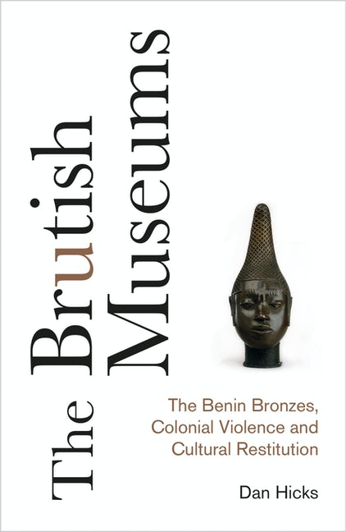

How did the British colonise Great Benin?
Story
Paragraph title | The story of how Benin was colonised | Summarise in one or two bullet points.
 | Benin’s first contact with the British was in approximately 1553, when the British sent two ships to the Benin River. Subsequently, Benin traded pepper, palm oil and eventually slaves. The Benin Kingdom started to decline in the 1700s as other African states turned to slavery to make money. Benin had refused to trade slaves and so started to lose power compared with other West African countries that did sell slaves. In 1888, the rubber tyre was invented by Scottish inventor John Dunlop. The British knew that Benin had many rubber trees and in 1892 signed an agreement with the Oba for access. In 1896, the Oba said that the British had broken the agreement so stopped all trade on the Niger River. As a result, in December 1896, James Phillips, a British official, led an expedition to demand an end to the collection of taxes from British traders. Unknown to Phillips, the chiefs had warned Oba Ovonramwen of his plan. On 4 January 1897, the Benin army caught Phillips and his men unprepared in a forest near Ughoton. They persuaded him not to continue because of a religious festival. Phillips, ignoring these warnings, was killed, alongside his troops, with only two British officials surviving. Upon hearing the news, Britain mounted an expedition to capture Benin. On 17 February 1897, Admiral Harry Rawson led 1,200 troops to invade the city. The Bini army (army of Benin) launched ambushes and resisted bravely. There is some evidence that they performed sacrifice of animals (possibly humans) to ask the gods to save them from the British. Eventually the British took Benin City and arrested the Oba Ovonramwen. British troops looted the city and took ivory, precious metals and the famous Benin Bronzes, which showed the history of the kingdom. On 19 February 1897, the city was burnt to the ground. The Oba was deported to the port of Calabar and 700 years of the kingdom’s history came to an end. The British controlled Nigeria until its independence in 1960.
Sources
A
B
‘The King of Benin has continued to do everything in his power to stop the people from trading and prevent the government from opening up the country. I am certain there is only one remedy, that is to depose the King of Benin… I wish to take 250 troops, two seven-pounder guns, 1 maxim gun and 1 rocket. I believe sufficient ivory may be found in the king’s house to pay the expenses incurred.’
A letter from James Phillips , Acting Consul of the Niger Coast Protectorate to British Prime Minister Salisbury, November 1896
Interior of the Royal Palace during looting, February 1897
Scholarship
Keyword: Restitution – the restoration of something lost or stolen to its proper owner
The two largest collections of Benin Bronzes are located in Berlin and in the British Museum in London. Since gaining independence in 1960, Nigeria has sought the return of these artefacts on several occasions. The British Museum sold more than 30 Benin Bronzes to the Nigerian government between 1950 and 1972. In 2015, a Benin Bronze head was sold to a private collector for a record fee of £10m.
There is now a growing movement saying that the Benin Bronzes should be restored to Nigeria without payment. Dan Hicks is professor of archaeology at Cambridge University. His book The Brutish Museums puts forward an argument for returning the Bronzes.
‘Restitution is not subtraction; it is refusing any longer to defend the indefensible; it is supporting African institutions, colleagues and communities; addressing western museums’ roles as sites of conscience and remembrance, tackling the ongoing effects of racial violence, paying a debt, rebuilding a relationship. No museum can stop the world from changing around it. Dialogue is giving way to action. We don’t know how this ends for the ten thousand objects looted from Benin. Ten thousand unfinished events.”’
Archaeologist Dan Hicks in The Brutish Museums, p. 234
Task 1 Read through the story of the colonisation of Great Benin. For each paragraph, you need to create a title on one side and a short summary (two bullet points maximum) on the other. | Task 2 Look at Sources A and B. What can you infer about the intentions of the British expedition to Benin City in 1897? | Task 3 Read through the interpretation by Dan Hicks. Highlight which you think are the three most important sentences. What do you think he means by the Bronzes being ‘Ten thousand unfinished events’?
Notes:
Images (top, bottom right): www.theartnewspaper.com/interview/and-a-or-dan-hicks-on-the-british-pillaging-of-the-benin-bronzes-and-what-museum-curators-can-do-today
Image (bottom left): http://www.plutobooks.com/9780745341767/the-brutish-museums/

