Slide 1
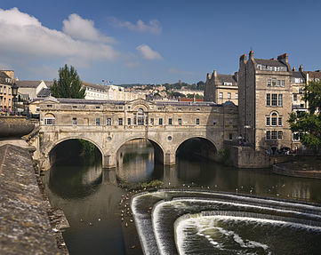
Pulteney Bridge and Great Pulteney Street
The street and bridge were commissioned and built between 1769 and 1774 using the wealth of Sir William Pulteney, who owned sugar plantations on the Caribbean islands of Grenada, Tobago and Dominica. At his death in 1805, Pulteney’s wealth was estimated at £600,000 – around £637 million in today’s money.
Notes:
Image from Wikimedia Commons (user: Jürgen Matern)

Slide 2
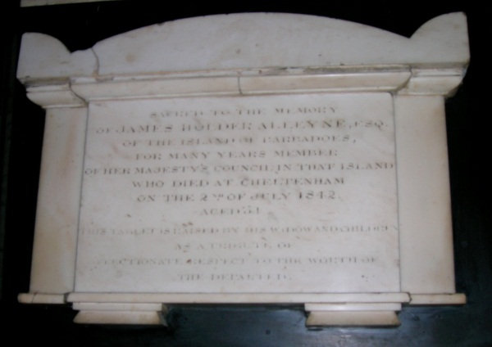
Bath Abbey
The Abbey contains more memorials to West Indian plantation owners, slave traders and sugar merchants than any other place in the United Kingdom. Many chose to retire to Bath in their old age due to its fashionable status and the baths’ reputation for health-giving properties. In the north part of the Abbey is the marble memorial to James Holder Alleyne, one of the richest plantation owners on Barbados, who died in 1842. When slavery was abolished on British plantations in 1834, Alleyne received £13,000 in compensation from the British government – around £17 million in today’s money.
Notes:
Image: Tom Allen

Slide 3
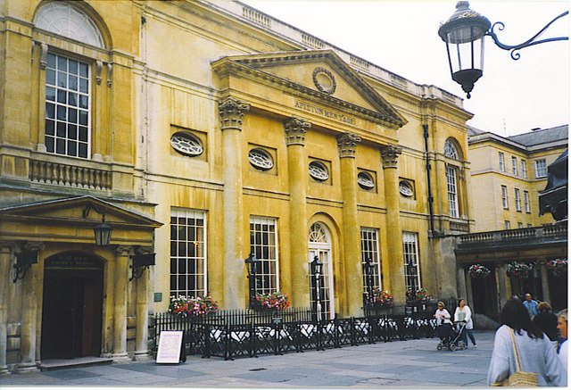
The Pump Room
In 1705, Beau Nash arrived in Bath and quickly worked to turn the town into a centre for gambling and parties. He encouraged the slave traders from nearby Bristol to come to Bath and spend their money on entertainment and gambling. He gave an overlay of respectability to the pursuit of pleasure, and soon huge amounts of money were being spent in the city, transforming it from a small and poor settlement into a hugely wealthy and fashionable city. Nash’s headquarters were at the Pump Room, and a statue of him still stands inside the building.
Notes:
Image from Wikimedia Commons (user: Colin Smith)

Slide 4
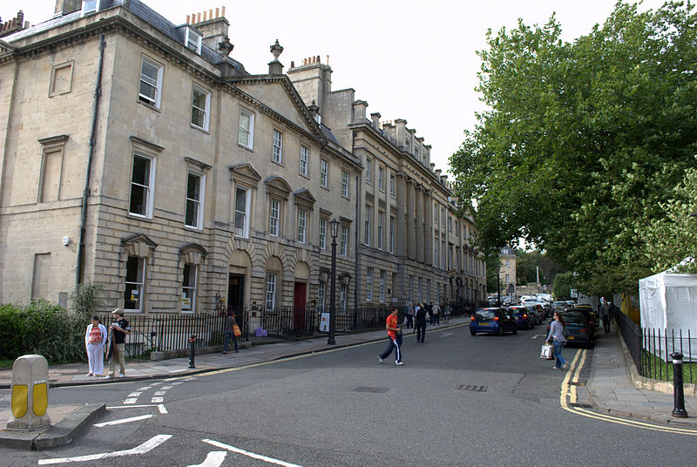
Queen Square
Bath was completely redesigned and rebuilt during the Georgian period (1714–1830). Two of the most important architects were John Wood and his son John Wood Junior, who designed some of the most well-known buildings in the city. One of their first grand designs was Queen Square, which was started in around 1725. To pay for their buildings, they required investment by wealthy patrons. The Duke of Chandos was their first major investor. He was the director of the Royal Africa Company in the 1720s and much of his wealth came from the transatlantic slave trade.
Notes:
Image from Wikimedia Commons (user: NotFromUtrecht)

Slide 5
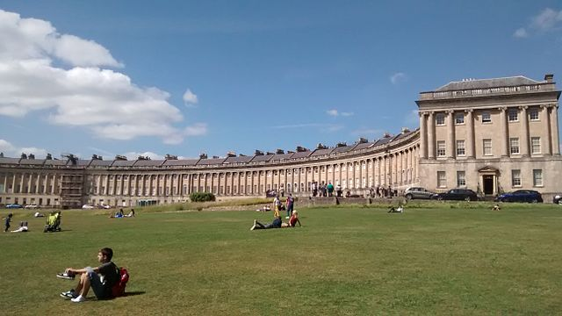
The Royal Crescent
As well as investment from people involved in the slave trade when it was originally constructed, the most famous address in Bath also appears several times in the records of slave-owners who were compensated by the British government when slavery was abolished in the West Indies in 1834. Jonathan Morgan lived at 20 Royal Crescent, and was given £12,381 (around £16 million in today’s money) in compensation for his ‘lost property’ when the enslaved people were freed on his plantations on the Caribbean island of St Vincent.
Notes:
Image from Wikimedia Commons (user: Asierog)

