Slide 1
Activities that are less essential to the flow and development of the enquiry are identified by this green background

Slide 2
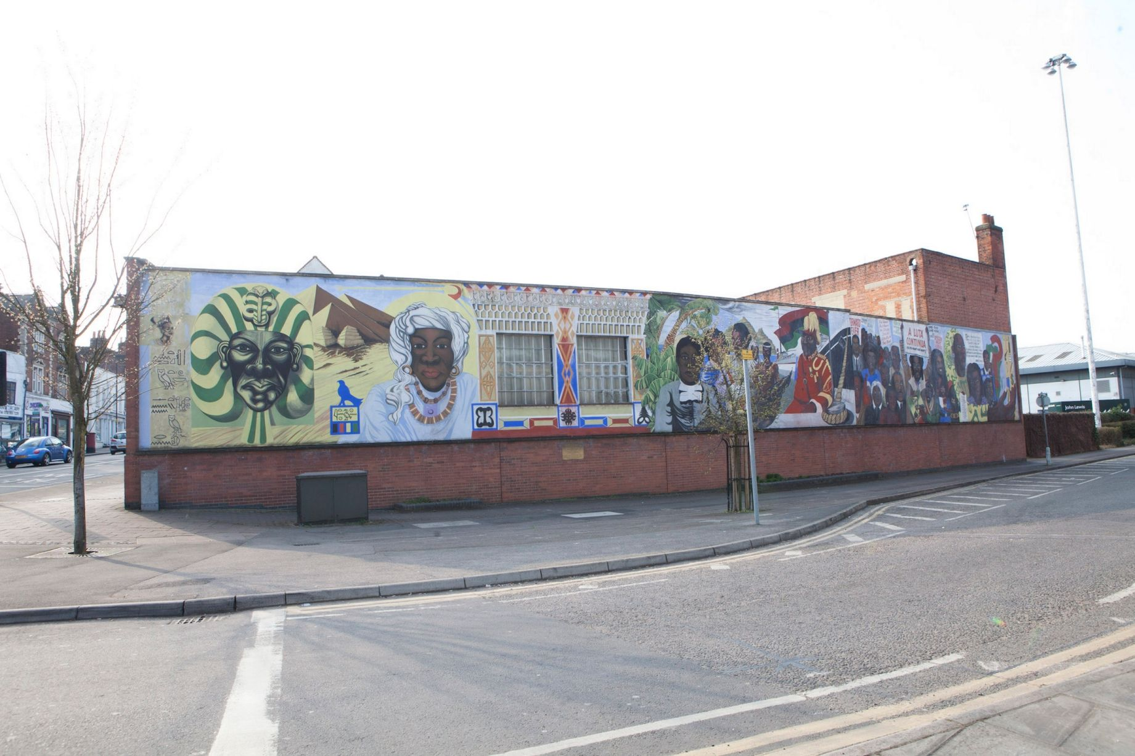
Our enquiry:
How should Reading recognise its connections to the history of people of African descent?
Notes:
Image source: www.getreading.co.uk/news/local-news/gallery/angles-reading-central-club-mural-8854439

Slide 3
‘It's a bright spark of life in Reading’s townscape’
Think back to the last lesson: why do people care about this mural being preserved? Remember that it’s cost the council £1 million.
Notes:
The lesson starts with a quick recap of the previous lesson to help keep the enquiry question in mind.
Image source: www.getreading.co.uk/news/local-news/gallery/angles-reading-central-club-mural-8854439

Slide 4
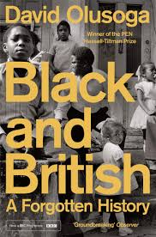
How should we remember people of African descent in eighteenth-century Reading?
Lesson aim
To identify what evidence tells us about the status and role of people of African descent in Georgian Britain, and to judge how we should remember and acknowledge this history today
Scholarship reading
Start reading through the extract from Black and British
Notes:
Image source: www.amazon.co.uk/Black-British-Forgotten-David-Olusoga/dp/1447299760

Slide 5
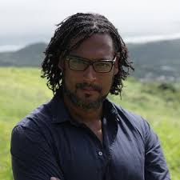
Black Britons in the Georgian period
The picture is mixed and much of it is concealed. What we can say is that most black Georgians lived lives of constrained unfreedom as slaves or low-ranking servants. Some were brutally treated by men and women who regarded them as their property and as the law was unclear on the issue they were able to make their claim real through physical force and violence. Black Britons who rejected that predicament fell into another one, and struggled destitute on the streets, where many lived off charity or crime, their names turning up in the records of the courts. The lives of the most fortunate were characterized by some degree of social mobility, with opportunities for learning and engaging in a religious life. Those who had the time and the security to look beyond their own needs were politically active and culturally productive.
Constrained: restricted
Predicament: problem
Destitute: with nothing
Notes:
Use the David Olusoga extract to establish the position of black people in Georgian Britain. Students should be able to identify that life for Black Britons in the period was extremely hard, but some did manage to become ‘politically active’ and ‘culturally productive’. If students have studied the Justice 2 History enquiries, then they could be reminded of the abolition campaign, and of those sharing their experiences on slave ships and as slaves.
Images: www.amazon.co.uk/Black-British-Forgotten-David-Olusoga/dp/1447299760; https://twitter.com/davidolusoga

Slide 6
Black Britons in the Georgian period
What can we learn from Olusoga about the status of people of African descent in Britain in the Georgian period?
What difficulties did they face?
What happened to most of those who weren’t slaves?
What did some manage to achieve?
The picture is mixed and much of it is concealed. What we can say is that most black Georgians lived lives of constrained unfreedom as slaves or low-ranking servants. Some were brutally treated by men and women who regarded them as their property and as the law was unclear on the issue they were able to make their claim real through physical force and violence. Black Britons who rejected that predicament fell into another one, and struggled destitute on the streets, where many lived off charity or crime, their names turning up in the records of the courts. The lives of the most fortunate were characterized by some degree of social mobility, with opportunities for learning and engaging in a religious life. Those who had the time and the security to look beyond their own needs were politically active and culturally productive.
Constrained: restricted
Predicament: problem
Destitute: with nothing

Slide 7
How should we remember people of African descent in eighteenth- century Reading?
David Olusoga says that for the Georgian period:
‘The picture is mixed and much of it is concealed. What we can say is that most black Georgians lived lives of constrained unfreedom as slaves or low-ranking servants.’
What do you think this means?
Lesson aim
To identify what evidence tells us about the status and role of people of African descent in Georgian Britain, and to judge how we should remember and acknowledge this history today
Notes:
Image source: www.amazon.co.uk/Black-British-Forgotten-David-Olusoga/dp/1447299760

Slide 8
It’s difficult to know about the lives of Black Georgians
David Olusoga says that for the Georgian period:
‘The picture is mixed and much of it is concealed. What we can say is that most black Georgians lived lives of constrained unfreedom as slaves or low-ranking servants.’
What do you think this means?
They’re not all technically slaves, but they’re not free to do what they want
Constrained: restricted
Notes:
Image source: www.amazon.co.uk/Black-British-Forgotten-David-Olusoga/dp/1447299760

Slide 9
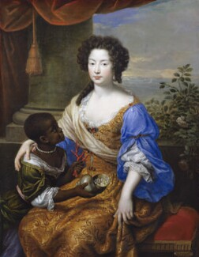
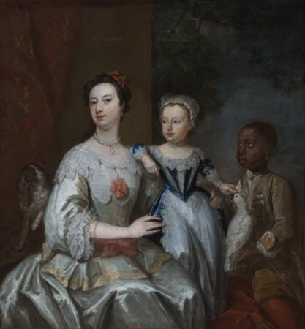
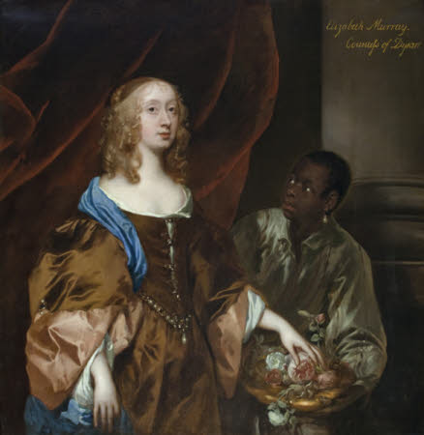
Louise de Keroualle, Duchess of Portsmouth, with a Black servant
Lady Grace Carteret, Countess of Dysart, with a child, possibly Lady Frances Tollemache, and a Black servant
Elizabeth Murray, Lady Tollemache, with a Black servant
Study the images carefully
What are the key features of the portraits?
What message about the women are they are trying to convey?
How would these portraits be viewed at the time they were painted?
www.bbc.co.uk/teach/class-clips-video/history-ks3--gcse-black-people-in-britain-during-the-atlantic-slave-trade-era/zm8nqp3
Notes:
Introduce the three paintings and consider the way in which the black servants are portrayed. Students might pick out that they are all looking at their mistress, but none of the women are looking at them. They’re always behind the mistress, and appear as not much more than an accessory. Students should consider what these portraits tell us about attitudes towards Black servants, and how people at the time would see the Black servants as a status symbol.
Louise de Keroualle, Duchess of Portsmouth: National Portrait Gallery, www.npg.org.uk/collections/search/use-this-image.php?mkey=mw05102
Lady Grace Carteret: National Trust Images, https://artuk.org/discover/artworks/lady-grace-carteret-17131755-countess-of-dysart-with-a-child-lady-frances-tollemache-17381807-and-a-black-servant-cockatoo-and-spaniel-217090
Elizabeth Murray: National Trust Images, https://artuk.org/discover/artworks/elizabeth-murray-16261698-lady-tollemache-later-countess-of-dysart-and-duchess-of-lauderdale-with-a-black-servant-217126

Slide 10
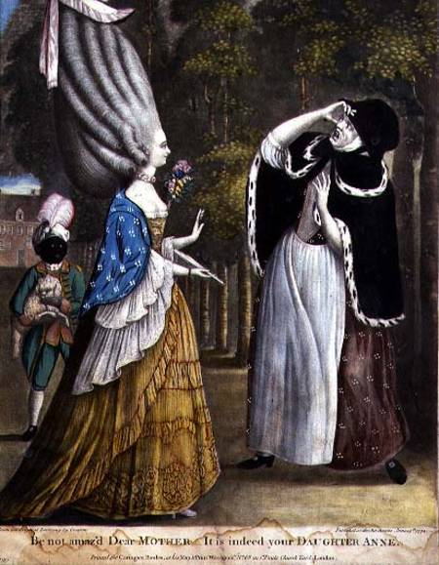
‘Be not amaz’d Dear Mother, It is indeed your daughter Anne’
This is a satirical (comedy) image created in 1774. It is making fun of a ‘Town Miss’, one of the women who lived independently in Georgian London. The Black page boy in livery and a turban was an accessory that many women saw as essential.
What does this tell us about the status of Black people in Britain in the Georgian period?
Notes:
This might be used as a real stretch for groups where appropriate; it is a challenging source and the presence of the Black boy is not the main point of the cartoon. This is part of the point of using it in this lesson – the fact that he’s so casually used as evidence of the woman’s obsession with her appearance and not there as a real person tells us about the attitudes towards using Black pageboys at the time.
Image: © The Trustees of the British Museum, www.britishmuseum.org/collection/object/P_1935-0522-1-39%E2%80%8B

Slide 11
Black people in Reading in the Georgian period
How might we find out whether there were Black people in Reading in the Georgian period?
Possible sources of evidence about Black people in Reading in the eighteenth century
Olusoga said when talking about the history of Black people in Georgian Britain that ‘much of it is concealed’. Why do you think he said this?
Notes:
So far the lesson has focused on Georgian Britain, rather than Reading – at this point ask students what kind of evidence we might find of the presence of Black people in Reading in the period. Remind them that Olusoga called this history ‘concealed’ – discuss why, because Black people in Georgian Britain were mostly in positions of slavery, unfree servitude or poverty, they show up in very few records.

Slide 12
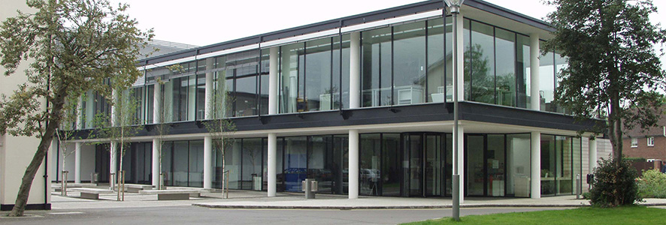
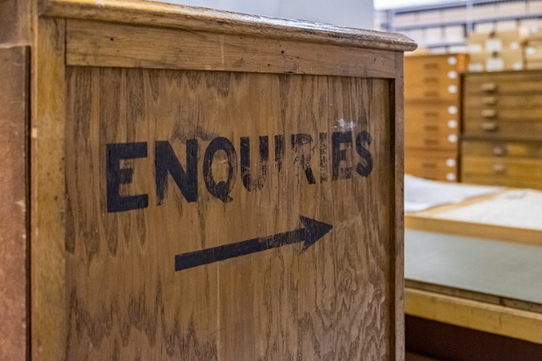
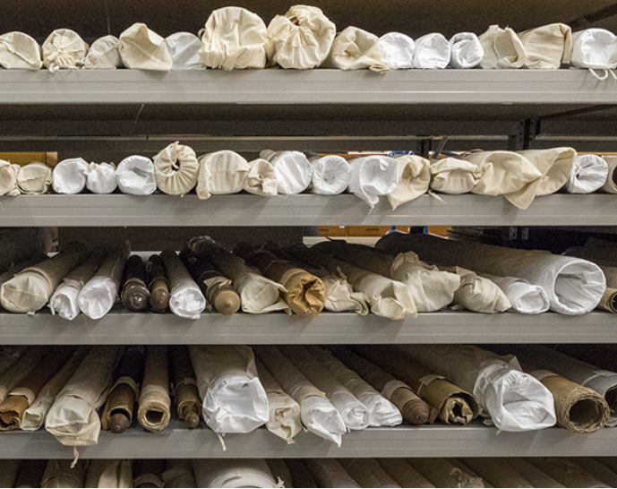
Berkshire Records Office
The Berkshire Records Office holds the records of births, baptisms, marriages and burials for the different parishes of Berkshire for the last nearly 900 years.
Notes:
The list from RISC specifies when individuals are of African descent, although we can’t know whether there are more whose origins or ethnicity are not mentioned. What has been researched in detail is where they turn up in parish records. Many believed that if they were Christian, they would be safe from slavery – we can see this in the baptism records. Show students the original records and how much work has gone into researching this history.
Images: http://berkshirerecordoffice.org.uk
List of records: Reading’s Slave Links by RISC

Slide 13
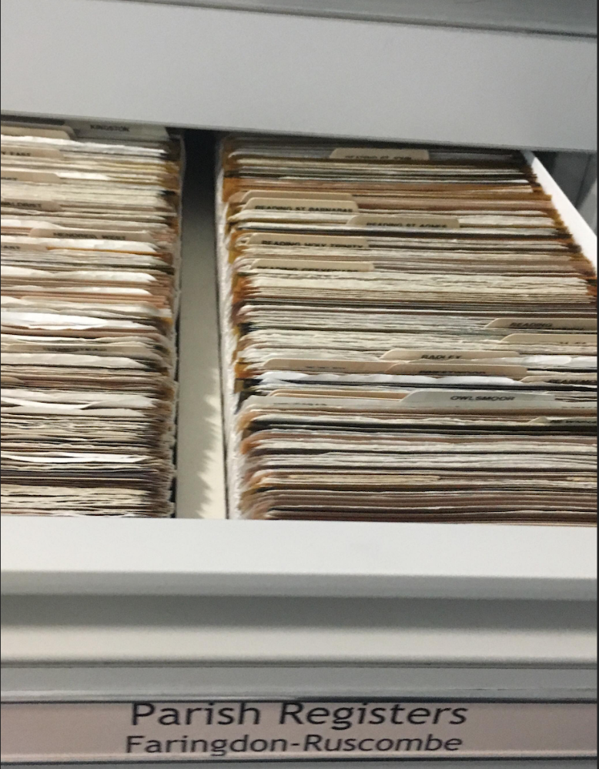
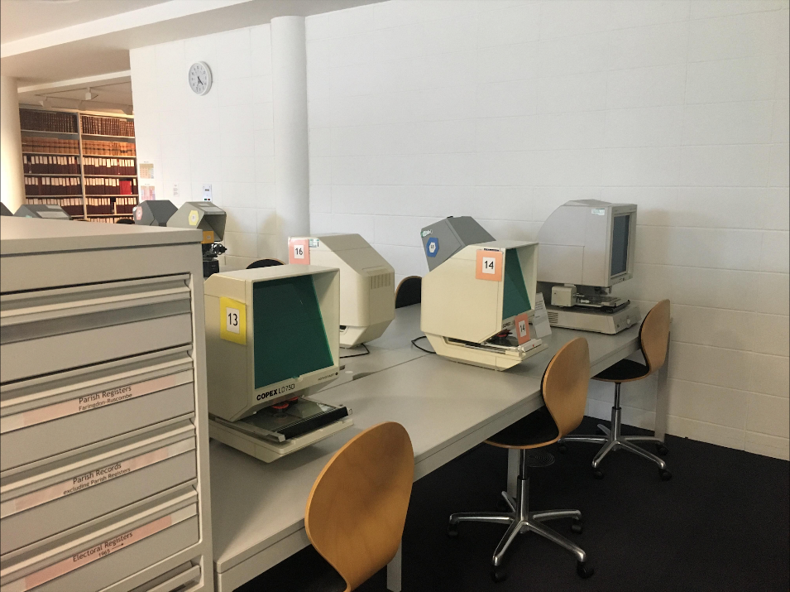
Berkshire Records Office
Notes:
Images: http://berkshirerecordoffice.org.uk

Slide 14
Berkshire Records Office
Study the page of the record in your pairs. What do you notice?
How could we use this as evidence about people of African descent?
Notes:
There has been a significant amount of research by the Black and Asians in Britain Association (www.basauk.com *now a dead link) into the parish records, which specifically state that the people registered are of African descent. There are likely to be far more people of African descent than actually recorded, as the nature of their status and economic position means that they’re not likely to turn up in records. What has been researched in detail is where they turn up in these parish records. Many believed that if they were Christian, they would be safe from slavery –we can see this in the baptism records. Show students the original records and how much work has gone into researching this history.
Images: http://berkshirerecordoffice.org.uk

Slide 15
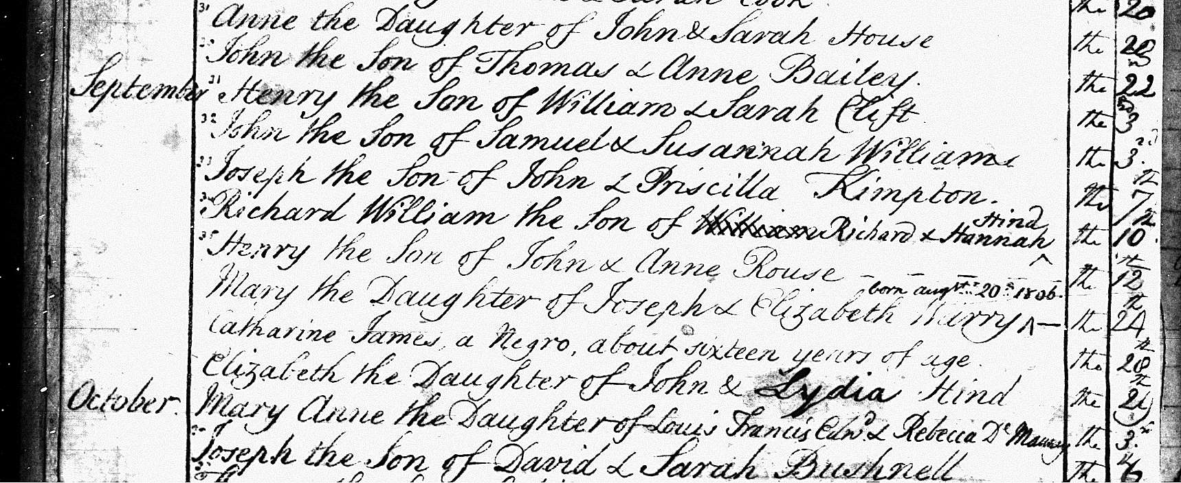
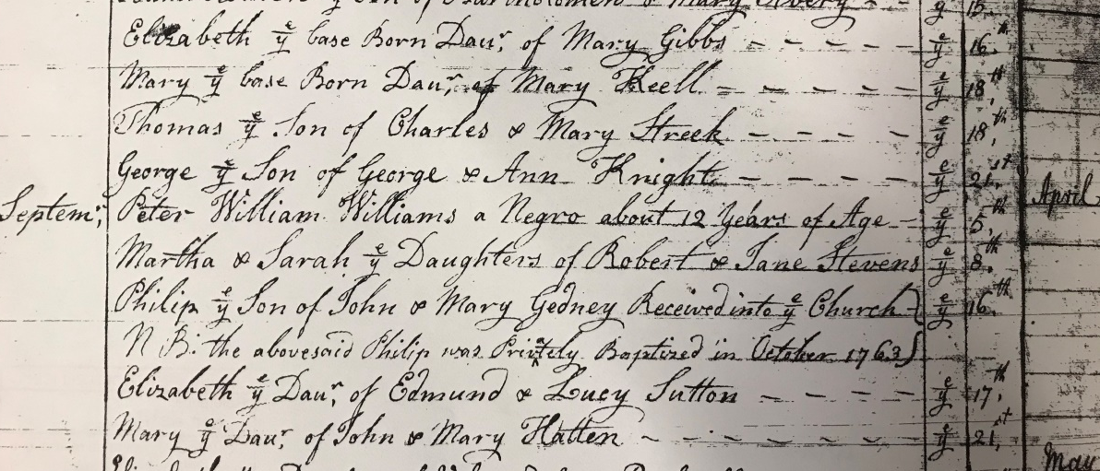
Examples of records
St Mary, Reading, baptism, 1806:
‘Catharine James, a negro, about sixteen years of age’
St Mary, Reading, baptism , 5 September 1773:
‘Peter William Williams a negro about 12 years of age’
What can we learn from these records?
What questions could we ask?
Notes:
Be clear with students about the use of the term ‘negro’ in these documents, which you are using in a historical context. If not covered in previous lessons/enquiries, you could consider as a class why this term is so offensive today, and how it wasn’t just referring to people of African descent, but also carried with it ideas about status and inferiority, and the implication that they were unfree. Here, we could link these two to the young servants that we’ve seen in the portraits. They’re both listed as ‘negroes’ so it’s possible that they were unfree servants. Both of them were baptised in the centre of Reading. We could ask about why they were baptised, and whether they were children of Black servants in the area or were brought to Britain from Africa or the Caribbean.

Slide 16
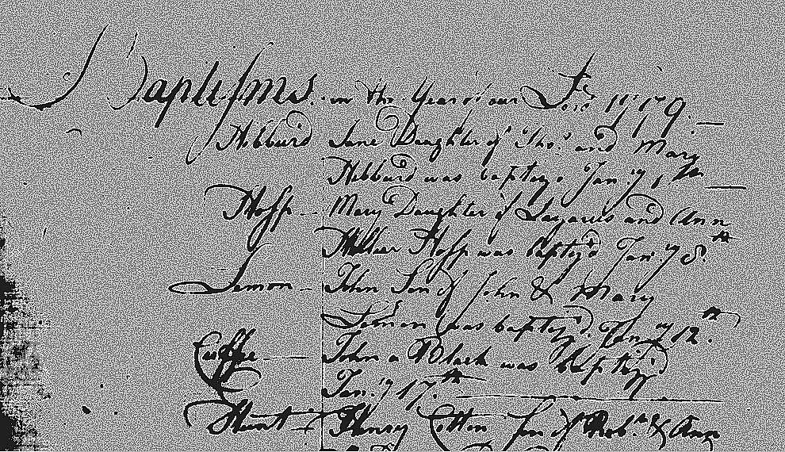
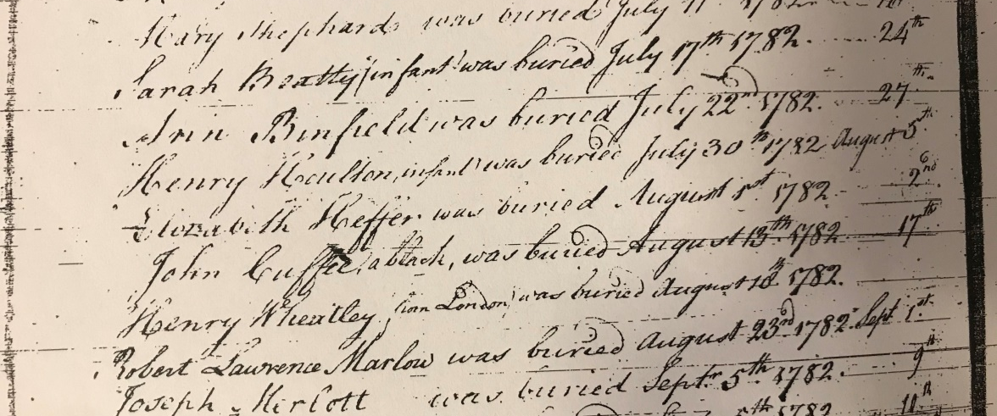
Examples of records
1779 baptisms:
‘Cuffee, John a Black was baptised’
Deaths:
‘John Cuffee, a black, was buried August 13th 1782’
What can we learn from these records?
What questions could we ask?
Notes:
Students might notice that John Cuffee was baptised only three years before his death. He shows up in the exact same parish records so has stayed in the same place since his baptism. That might be because he had to because he was a servant (free or unfree) or because he was free and settled in the area. We could ask about why he stayed, whom he was with, whether he had family, what he died of so soon after his baptism, and who buried him. The facts that he is listed as a ‘Black’ rather than a ‘negro’ and that there is no mention of a master or owner suggest that he might have been a free man, but record-keeping was not that consistent.

Slide 17
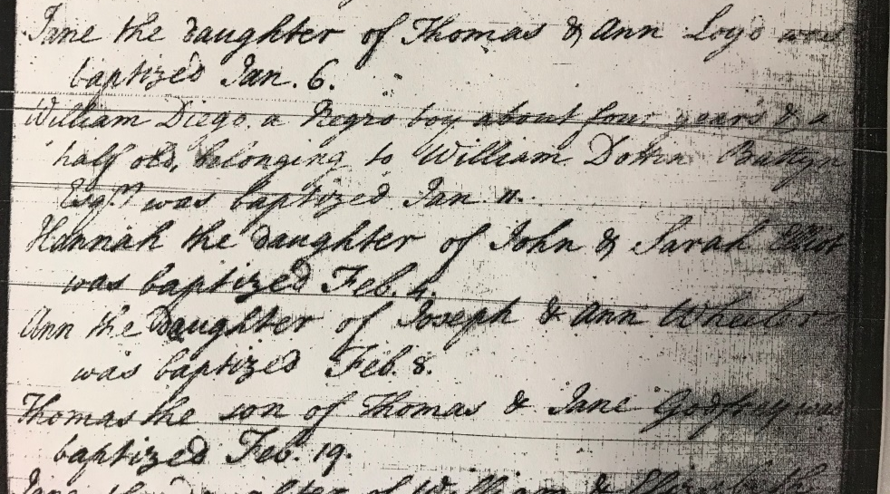
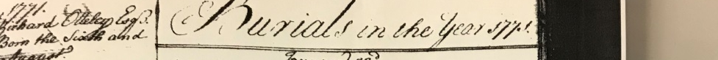

Examples of records
Sunninghill, baptism, May 1755:
‘William Diego, a negro boy about four years and a half old, belonging to William Dottin Battyn Esq. was baptised’
Thatcham, burial, 14 October 1771:
‘Thomas a negro servant to Richard Ottley Esq.’
What can we learn from these records?
What questions could we ask?
Notes:
It’s interesting that these two records are clear about the status of William and Thomas. For William, being only four and a half and ‘belonging to’ make it clear that he was a slave. The Legacies of British Slave-ownership site doesn’t have a listing specifically for William Dottin Battyn, but the family name is connected to plantations in Barbados, and there may be a (perhaps tenuous) link: www.ucl.ac.uk/lbs/estate/view/655. There is one listing for a Richard Ottley; although there are no clear links to Berkshire, the dates would work: https://www.ucl.ac.uk/lbs/person/view/2146632290. These two records show that people in Berkshire definitely ‘owned’ enslaved Africans, one of whom was only a very young child.

Slide 18
Berkshire Records Office
St Mary, Reading, baptism, 1806: ‘Catharine James, a negro, about sixteen years of age’
St Mary, Reading, baptism , 5 September 1773: ‘Peter William Williams a negro about 12 years of age’
1779 baptisms: ‘Cuffee, John a Black was baptised’
Deaths: ‘John Cuffee, a black, was buried August 13th 1782’
Sunninghill, baptism, May 1755: ‘William Diego, a negro boy about four years and a half old, belonging to William Dottin Battyn Esq. was baptised’
Thatcham, burial, 14 October 1771: ‘Thomas a negro servant to Richard Ottley Esq.’
Read through the list of records from the Berkshire Records Office that we have looked at.
There were many who argued that if you were Christian you could not be a slave.
What do these records tell us about Black people in Reading in the eighteenth century?
Notes:
This is not an exhaustive list; the Black and Asian People in Berkshire project, via www.basauk.com, have produced a summary of dozens of records of people from Berkshire who were of African descent. Some are contested but for most it’s clearly identified that they were Black or ‘negro’, and in some cases their origins in Africa are listed. The full list can be accessed in a folder in the Berkshire Records Office, and images of the documents are in the folder. It is entirely possible that there were many more people of African descent in Reading at this time – we only have records of those who were baptised here, which would not have been all of them, and of those who died and whose deaths were registered in a Berkshire parish. Because people of African descent were normally in an ‘unfree’ state or were servants – or, if free, faced poverty and hardship – they’re far less likely to show up in the records from the time.
List of documents from RISC’s Reading’s Slave Links http://antislavery.ac.uk/items/show/34

Slide 19
Berkshire Records Office
St Mary, Reading, baptism, 1806: ‘Catharine James, a negro, about sixteen years of age’
St Mary, Reading, baptism , 5 September 1773: ‘Peter William Williams a negro about 12 years of age’
1779 baptisms: ‘Cuffee, John a Black was baptised’
Deaths: ‘John Cuffee, a black, was buried August 13th 1782’
Sunninghill, baptism, May 1755: ‘William Diego, a negro boy about four years and a half old, belonging to William Dottin Battyn Esq. was baptised’
Thatcham, burial, 14 October 1771: ‘Thomas a negro servant to Richard Ottley Esq.’
Read through the list of records from the Berkshire Records Office.
There were many who argued that if you were Christian you could not be a slave.
What do these records tell us about Black people in Reading in the eighteenth century?
There were people of African descent in Reading in the eighteenth century
Presence of people of African descent
Seen as a novelty, would have been relatively few people of African descent in Reading in the eighteenth century
Starting to be accepted – they were being baptised
Many worked as or were children of servants
Several were unfree

Slide 20
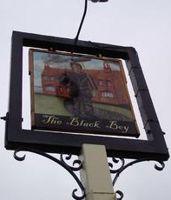
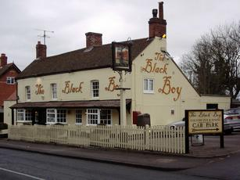
The Black Boy pub
Notes:
Having established that there were people of African descent in Reading in this period, introduce the Black Boy pub. Show students what’s on the pub’s website about its history (slide 24) – there’s no acknowledgement that the name might refer to a Black servant, although students have seen evidence that there were Black servants in Reading in the Georgian period and Reading Museum does state that there were Black servants at Caversham Park.
Images: www.beerintheevening.com/pubs/s/13/13505/Black_Boy/Shinfield

Slide 21
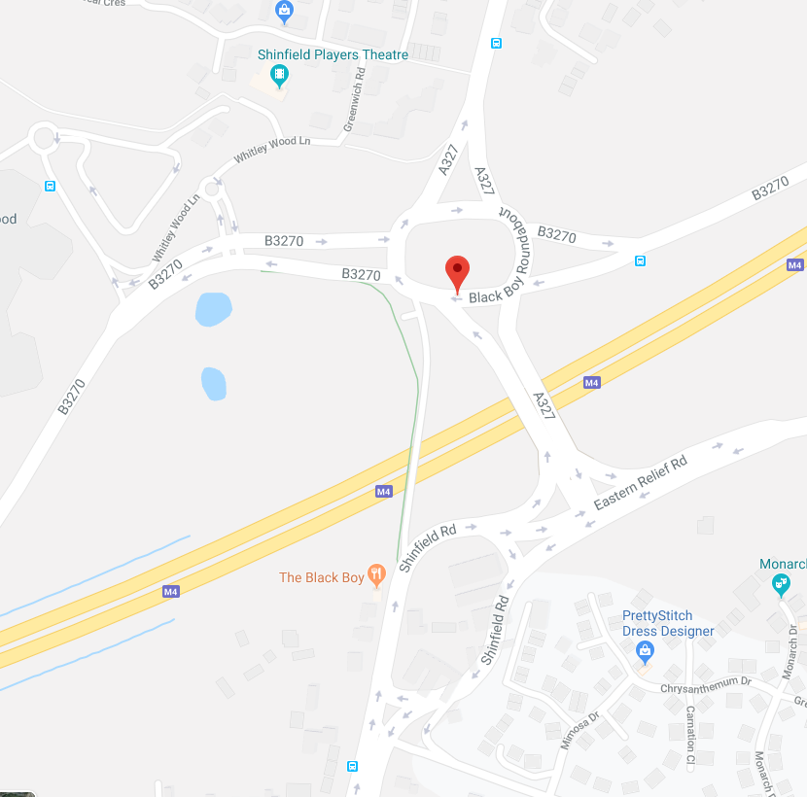
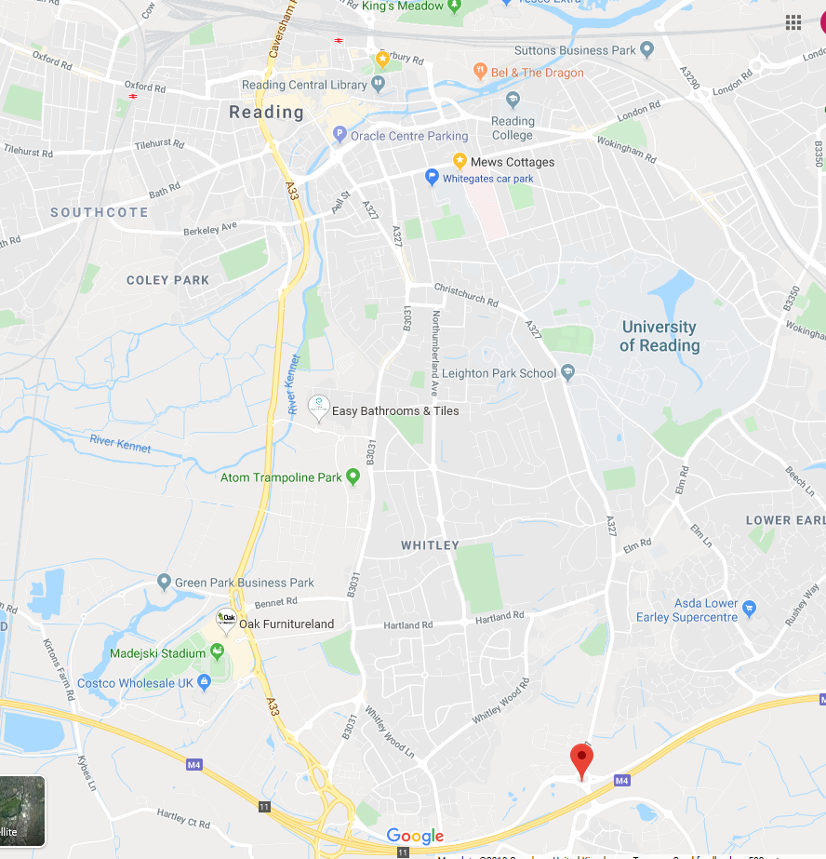
Notes:
Maps: Google

Slide 22
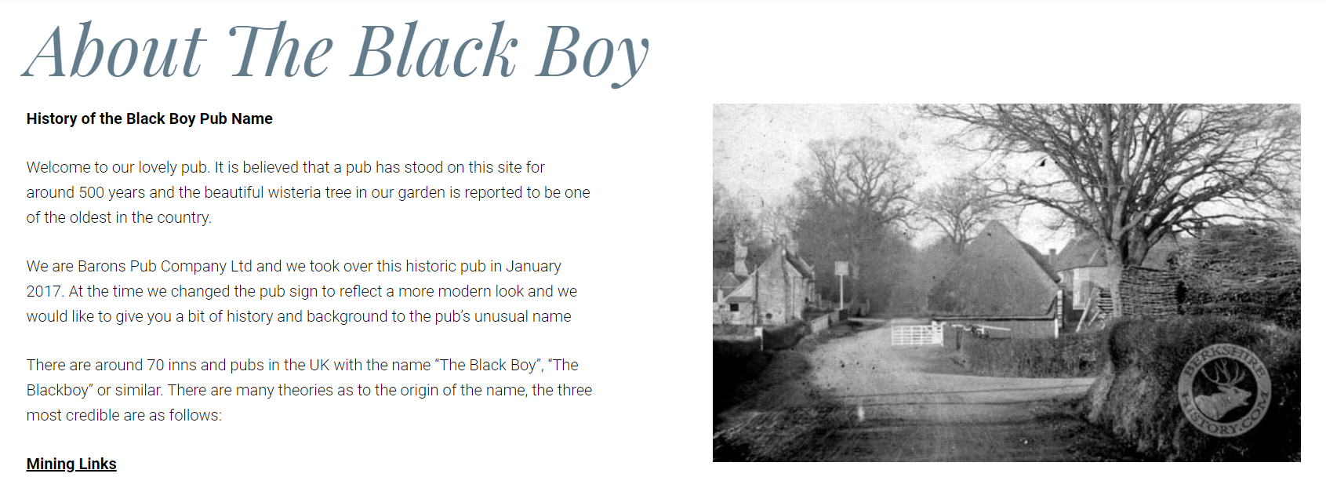
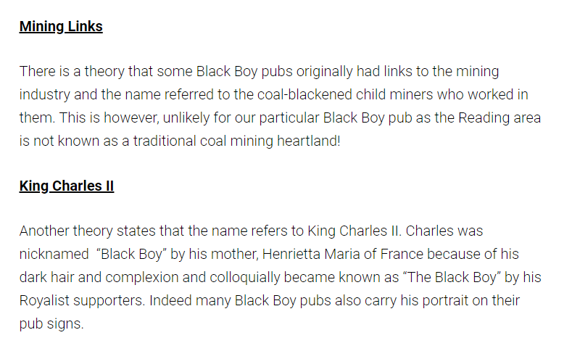
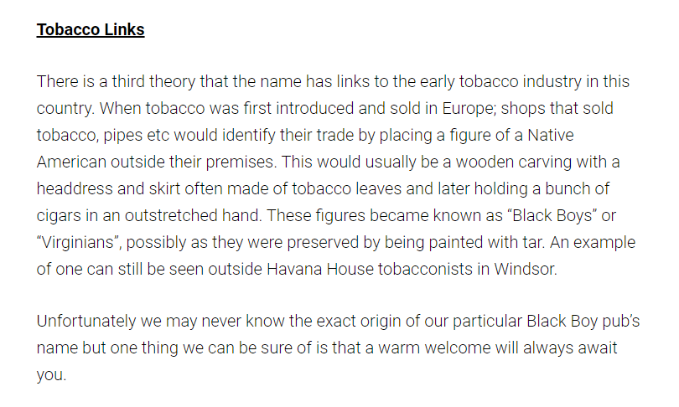
www.baronspubs.com/blackboy/about
Notes:
https://www.baronspubs.com/blackboy/about
This webpage has been updated since October 2019. In 2017, there was talk about renaming the pub, which was then dropped (www.telegraph.co.uk/news/2017/01/21/pub-firm-drops-plans-re-name-black-boy-pub-protest-locals). In January 2019, it was announced that they were changing the name, but Reading Chronicle reported that this was unpopular (www.readingchronicle.co.uk/news/19025504.shinfield-pub-black-boy-change-name-due-racist-connotations-said), after carrying out a poll (slide 26). This is definitely an interesting debate to get into with students, but the fact that the pub doesn’t even acknowledge that a Black unfree servant might be the origin of the name seems disingenuous, when the idea of changing the name has been there for years. Slide 24 shows the Dictionary of Pub Names explanation. There’s clearly a debate to be had; changing the name arguably hides part of the history – when taught about this, students have tended to argue that it should be acknowledged that it is a possibility openly by the pub, but not necessarily that the name be changed.

Slide 23
Should the Black Boy pub’s website acknowledge the possibility that their name came from a Black pageboy in Reading?
Notes:
www.baronspubs.com/blackboy/about
Image: www.beerintheevening.com/pubs/s/13/13505/Black_Boy/Shinfield

Slide 24
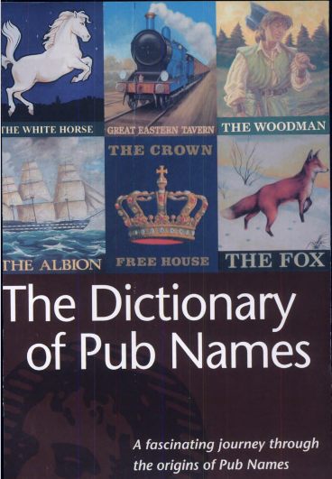
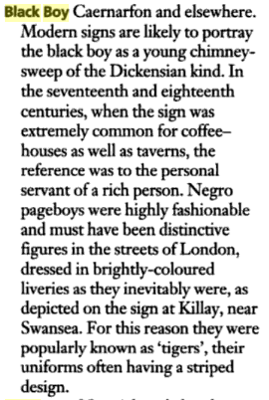
Notes:
Show students that the Dictionary of Pub Names is very clear that the name ‘Black Boy’ for a pub was often a reference to Black servants, as well as how the name has more recently been linked to chimney sweeps (the pub’s picture outside is of a chimney sweep, but there’s no reference to that on the website).
Source: https://books.google.co.uk/books?redir_esc=y&id=k-4SrdUPNFoC&q=black+boy#v=snippet&q=black%20boy&f=false

Slide 25
Write the text for an email to the owners of the pub, explaining whether you think that they should add the possible origin of the pub name to their website.
Dear Sir/Madam
We have been researching the impact of the transatlantic slave trade on Reading, and believe that there’s a chance that the history about your pub name may not be accurate.
The name ‘Black Boy’ is likely to refer to…
For example, we know that…
Therefore, I feel that you should amend the information about your pub to say…
Thank you for considering my email. Kind regards…
Notes:
Students respond by writing to the pub owners to inform them of the possibility that the name comes from a Black servant (opportunity for feedback to students on their use of evidence, clarity of argument, etc.).
www.baronspubs.com/blackboy/about

Slide 26
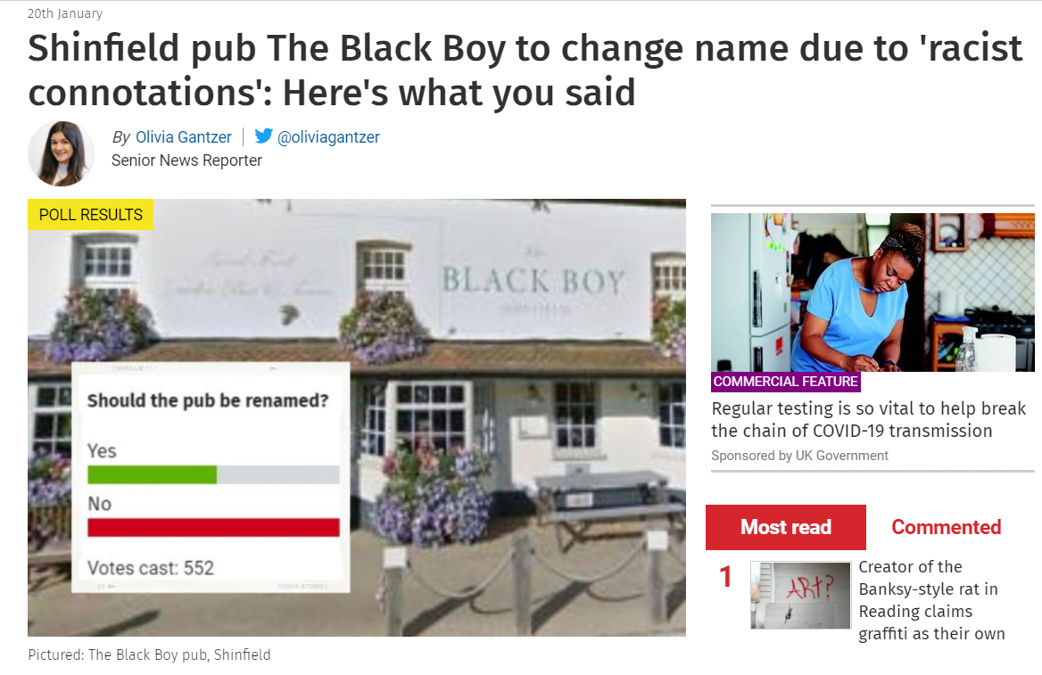
Do we think that the Black Boy pub should change its name?
What are the arguments for and against?
www.readingchronicle.co.uk/news/19025504.shinfield-pub-black-boy-change-name-due-racist-connotations-said
Notes:
www.readingchronicle.co.uk/news/19025504.shinfield-pub-black-boy-change-name-due-racist-connotations-said

Slide 27
How should we remember eighteenth-century people of African descent in Reading?
Lesson aim
To identify what evidence tells us about the status and role of people of African descent in Georgian Britain, and to judge how we should remember and acknowledge this history today
Should places connected with people of African descent in Reading acknowledge the links to this ‘forgotten’ history?
Notes:
Discuss the broader question of whether places should acknowledge this history. Students might also have ideas about how to acknowledge this history – these could like to the mural as a form of community public commemoration.

Slide 28
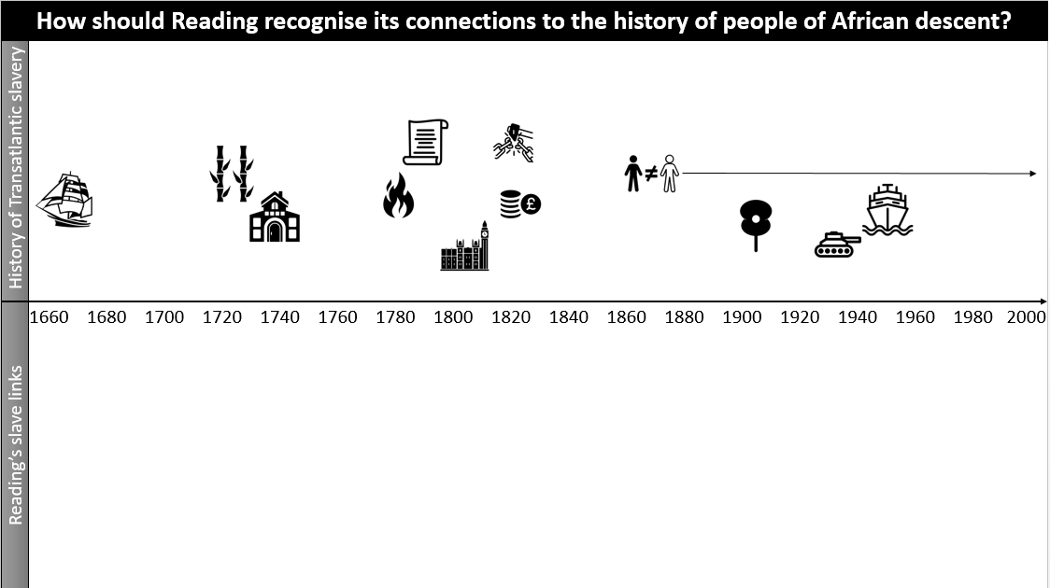
Homework
This is to help you start to draw together your ideas so that you’ve got them ready for our outcome at the end of the topic.
On the top half, you’re using the images to help you to identify the key events and stages in the development of the transatlantic slave trade and its legacy in Britain; some of the later ones we haven’t done yet and we will add later. You can go up to the 1860s.
On the bottom half, you are going to add what we learn about the connections of this history to Reading.
Notes:
This could be done in lesson time, used as a knowledge organiser across several lessons or set as an ongoing homework task for students to complete after lessons. It’s a useful tool at the end of the unit so that students have something to get their ideas from for their museum display. Depending on preference and the class, there is a blank version of the timeline, or written labels could be added to make it a shorter task for students.

Slide 29
Our enquiry
How should Reading recognise its connections to the history of people of African descent?
Notes:
Image source: www.getreading.co.uk/news/local-news/gallery/angles-reading-central-club-mural-8854439

