Slide 1
What questions can we ask about this building? Aim for seven – list them in your book in full sentences.
Your questions might start with:
Who…
Where…
What…
Why…
When…
Notes:
Students could write a list as a ‘do now activity’ as they come in. Some students might recognise the buildings behind the Central Club.
Image source: www.getreading.co.uk/news/property/gallery/take-look-reading-central-club-13350405

Slide 2
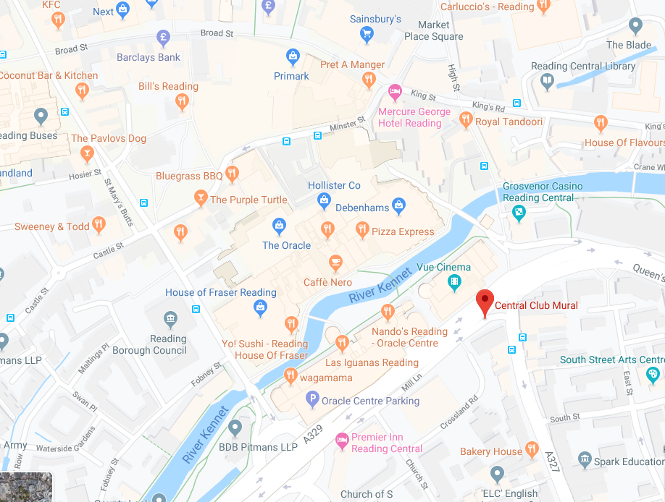
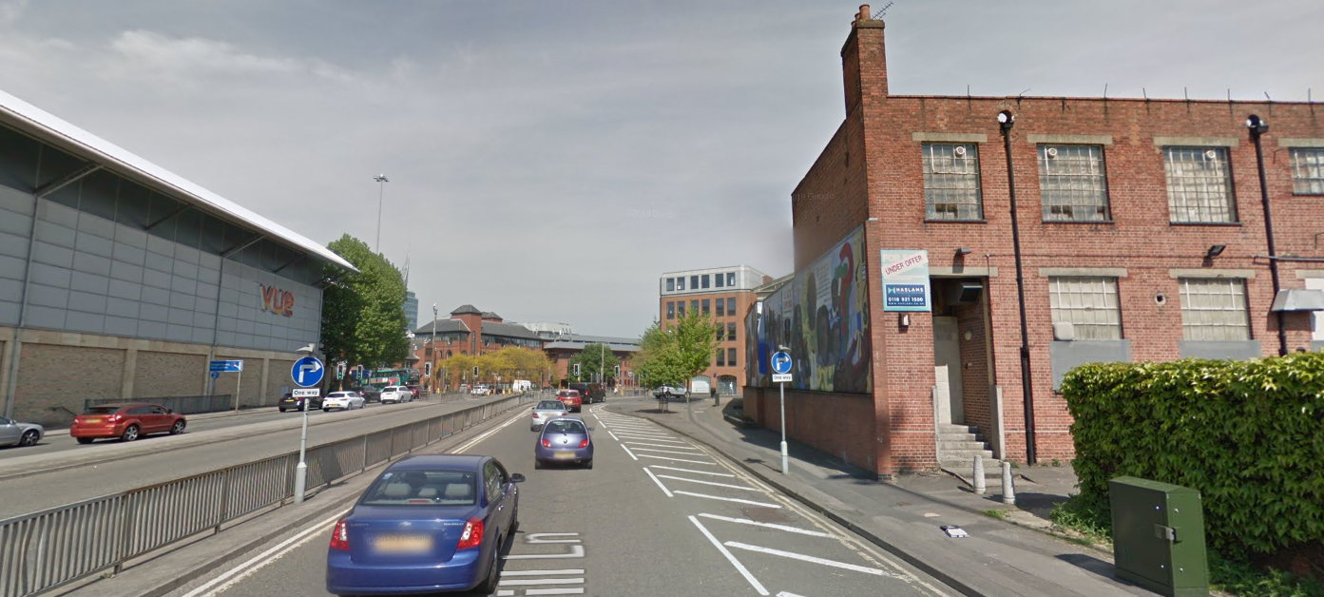
Notes:
The building is in a central location – valuable land – and its become increasingly derelict.
Image source: Google Street View

Slide 3
‘It's a bright spark of life in Reading's townscape’
The Central Club Mural is in a prominent location in central Reading. It depicts black history through thousands of years, including the people in Reading involved in designing and painting the mural.
Notes:
Introduce students to the mural on the side of the building – some should recognise it, though many will have seen it but not know who it depicts or why.
Image source: www.getreading.co.uk/news/local-news/gallery/angles-reading-central-club-mural-8854439

Slide 4
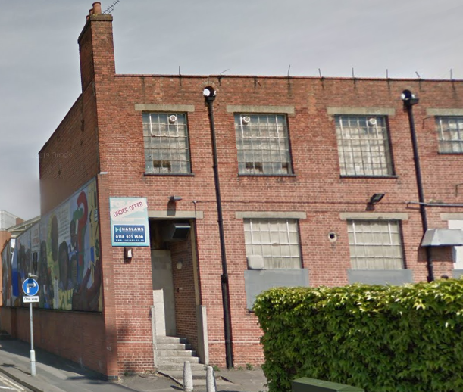
Notes:
The fact that the building is for sale has sparked a great deal of concern and protest in the local community previously served by the Central Club – largely British-Caribbean.
Image: Google Street View

Slide 5
‘It's a bright spark of life in Reading's townscape’
Watch the clip of the protest.
What can we work out about the mural and its meaning to the local community?
www.getreading.co.uk/news/reading-berkshire-news/protesters-march-reading-council-bid-13672312
Notes:
Watch the clip on the protest and discuss why people in the local community feel so passionately about saving the mural.
Image source: www.getreading.co.uk/news/local-news/gallery/angles-reading-central-club-mural-8854439
For information on the mural and the sale of the building: www.bbc.co.uk/news/uk-england-berkshire-42257426

Slide 6
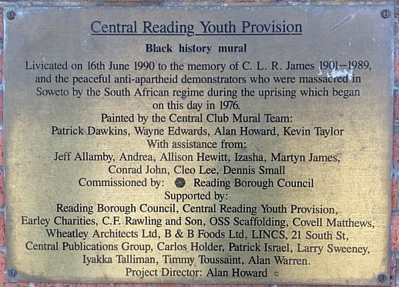
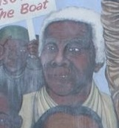
C.L.R. James 1901–1989
James was born in Trinidad in 1901, where he initially became a teacher. He was an historian, novelist and Marxist (Communist) thinker. He argued for political independence for Africa and the Caribbean, which for much of his lifetime were still part of the British Empire. One of his most famous books was about the Haitian Rebellion. He was also a cricketer.
Notes:
Image sources: www.whitleypump.net/2018/07/19/sale-of-the-central-club; www.getreading.co.uk/news/local-news/gallery/angles-reading-central-club-mural-8854439

Slide 7
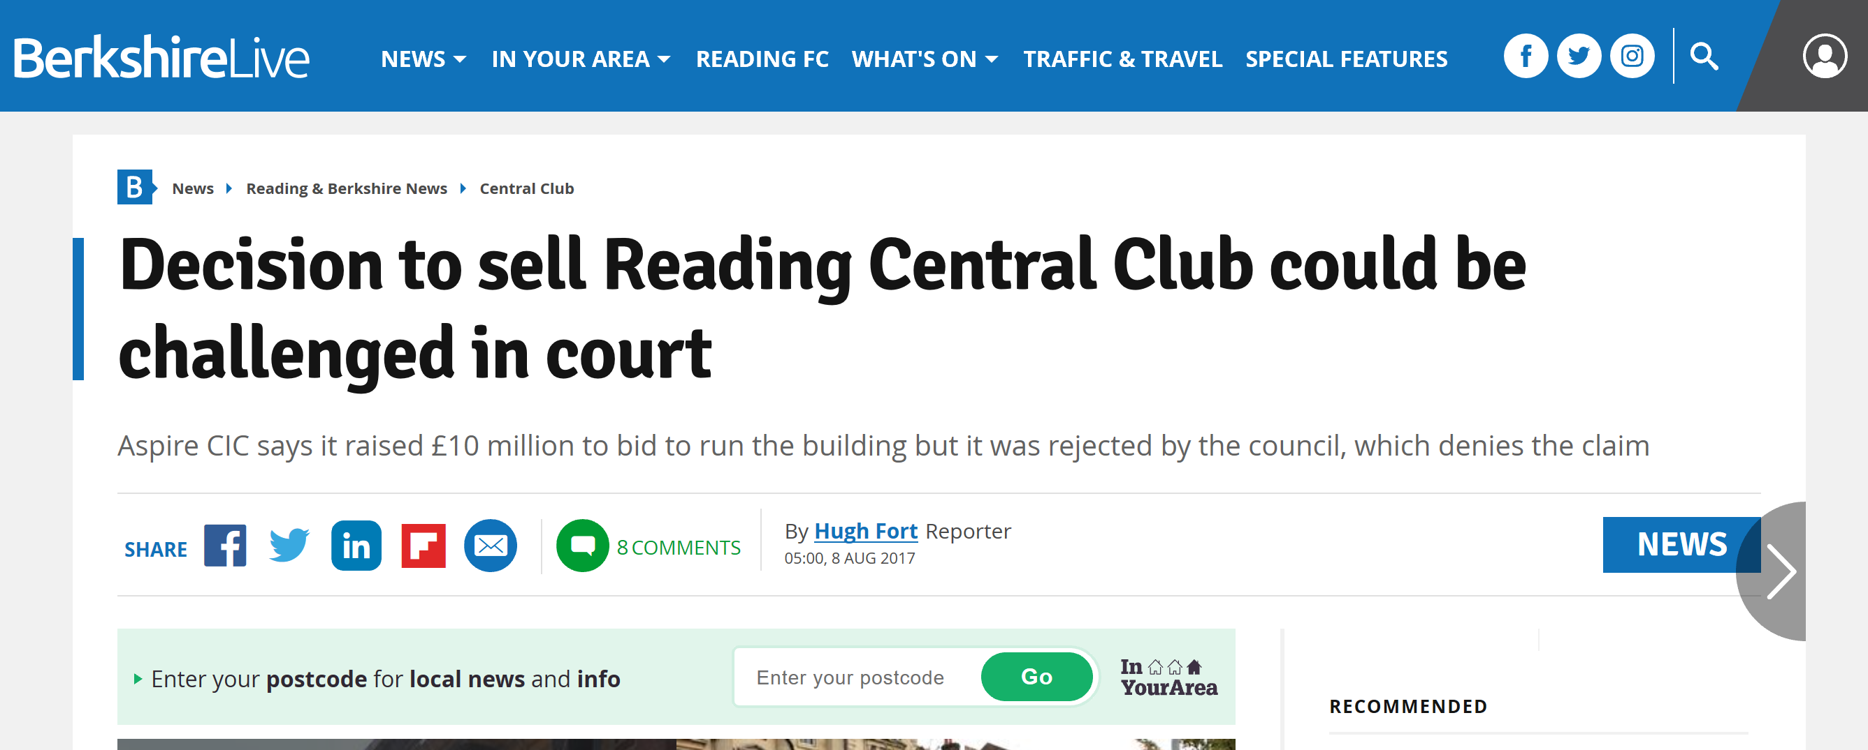
Notes:
Screenshots from: www.getreading.co.uk/news/reading-berkshire-news/decision-sell-reading-central-club-13441221; www.getreading.co.uk/news/reading-berkshire-news/protesters-march-reading-council-bid-13672312

Slide 8
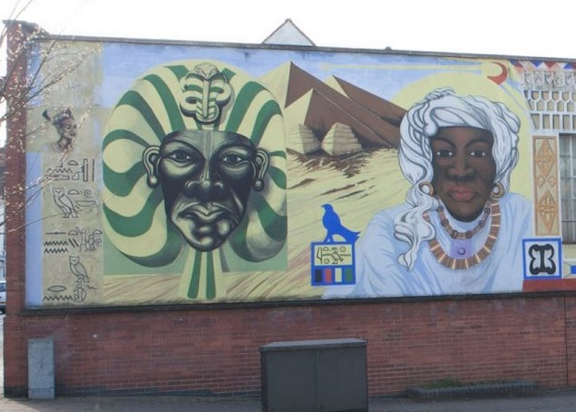
Why is the Central Club Mural so important to the local community?
Aim 1: To identify the key individuals in the Central Club Mural
Aim 2: To assess the reasons why the individuals are seen as significant
Aim 3: To consider its importance to the local community and Reading more widely
From what we’ve seen already, start a list about why the Central Club Mural is important to the local community.
Notes:
Read the information about the mural and establish the background to the mural and its creation in the 1990s. Link to why the local community care about the mural – how it represents recognition of a history that is otherwise not seen as much.
Image sources: Google Street View, www.getreading.co.uk/news/local-news/gallery/angles-reading-central-club-mural-8854439

Slide 9
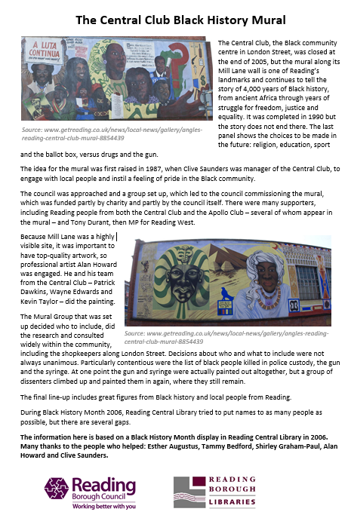
Read about the creation of the mural. Can we add to our reasons why the mural is so important to the local community?
Notes:
Read the information about the mural and establish the background to the mural and its creation in the 1990s. Link to why the local community care about the mural – how it represents recognition of a history that is otherwise not seen as much.

Slide 10
Who is depicted on the mural?
Study your section of the mural and find out about the individuals depicted. Label the key information about each individual on the image of the mural. Consider key dates, their experiences and actions, and the impact that they had.
Why do you think these individuals were chosen for the mural?
How does this help us to understand why the mural is important to the local community today?
Notes:
Students should investigate the individuals on the mural and consider why they were chosen to be included on the mural. Teachers could co-ordinate students to then feed back and see the full mural in groups of four, or get students to look at a section and feed back to the whole class.

Slide 11
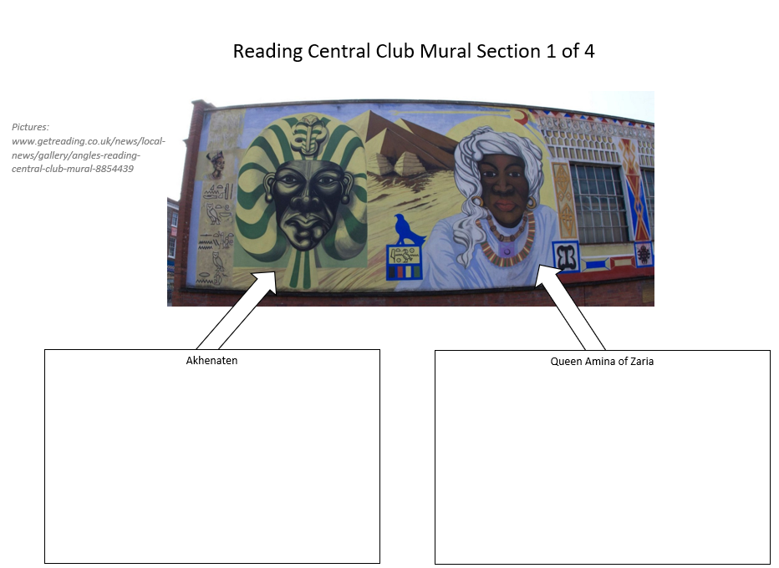

Slide 13
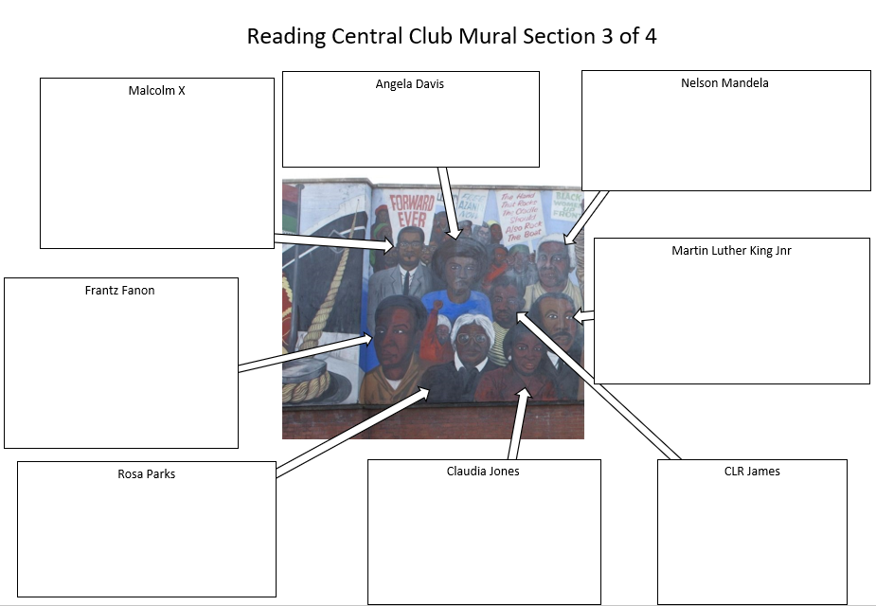

Slide 14
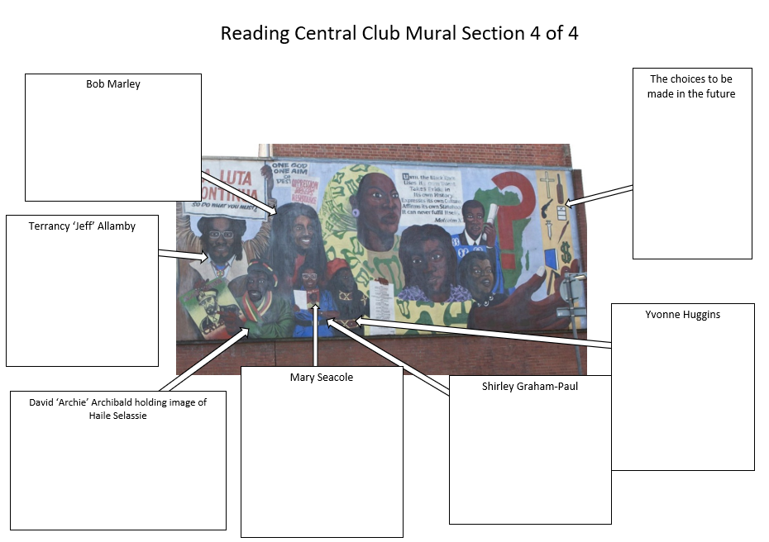

Slide 15
How did the designers and artists choose who to include?
Why were the people on the mural chosen?
Notes:
When feeding back, students might consider how the individuals are inspiring to people today; how they have made a significant contribution to improving the lives of people of African descent; how they have made a significant contribution to changing events and situations; how they play a role in changing the world today; and how their story teaches us about important issues. Keep linking this back to why people in Reading care about this mural today.
Image source: www.getreading.co.uk/news/local-news/gallery/angles-reading-central-club-mural-8854439

Slide 16
Why is it important to recognise the contribution of people of African descent to Reading? Why should Reading care about this mural, and not just the Caribbean community around it?
International Decade for People of African Descent (2015 - 2024) - YouTube
Notes:
Show students the clip from the UN International Decade for People of African Descent. Consider why the history of people of African descent is something that everyone in Reading (and obviously beyond) should recognise is important, and not just the British-Caribbean community.
Video: www.youtube.com/watch?v=9edo0Qaq-ZI

Slide 17
‘It's a bright spark of life in Reading's townscape’
Reading Borough Council have given the mural protected status. This has cost them £1 million in the sale price of the building. Why do you think they did this?
Notes:
The ‘In Your Area’ article below says that it cost the council £1 million to ensure that the mural is protected.
www.inyourarea.co.uk/news/reading-council-sells-central-club-for-flats-but-loses-1m-to-save-mural
Image source: www.getreading.co.uk/news/local-news/gallery/angles-reading-central-club-mural-8854439

Slide 18
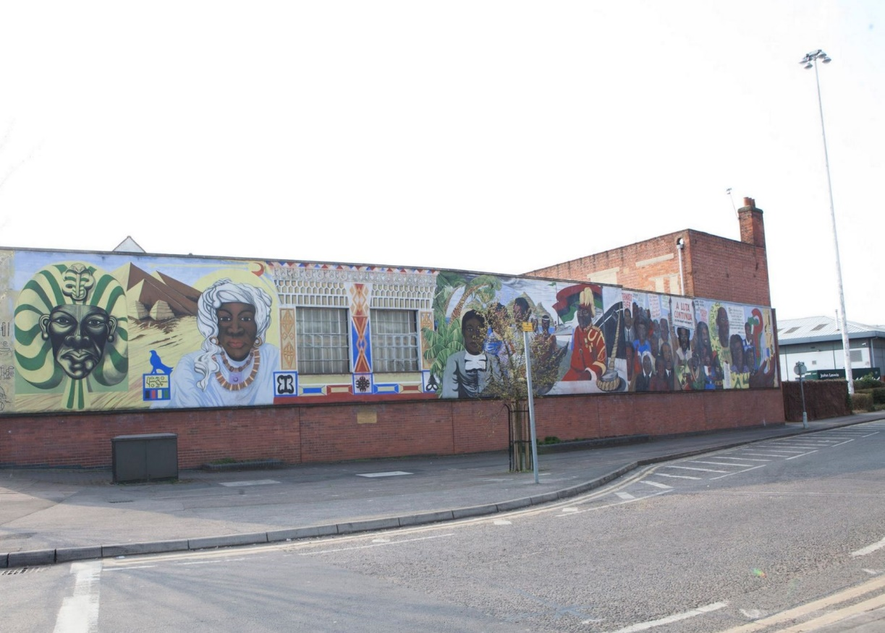
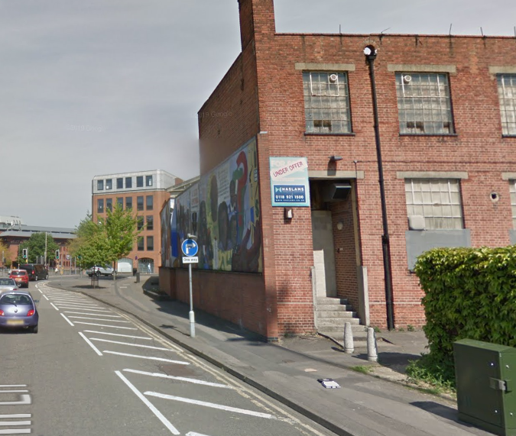
How should Reading recognise its connections to the history of people of African descent?
Our enquiry:
Notes:
Image sources: Google, Street View, www.getreading.co.uk/news/local-news/gallery/angles-reading-central-club-mural-8854439

