Slide 1
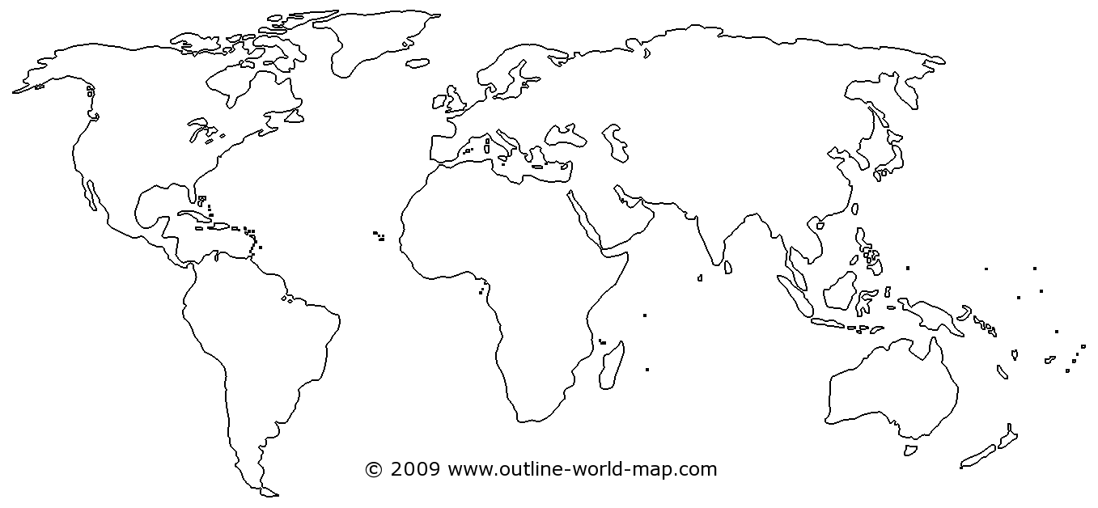
Notes:
Image: www.outline-world-map.com

