Slide 1
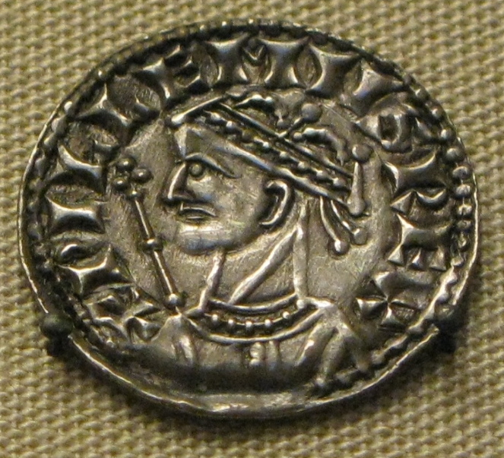
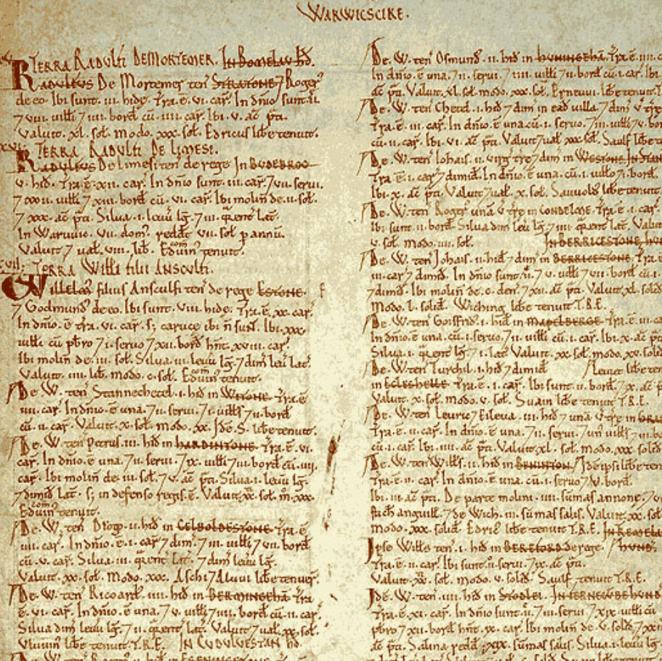
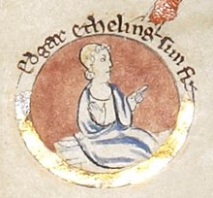
Enquiry lesson 6: When did the Normans complete their conquest?
KEY QUESTIONS:
What does it mean to judge the Conquest as ‘complete’?
How could we tell when the Norman Conquest was complete?
How and why did the experience of conquest vary so much in different places and at different times?
Images: William I coin, Edgar the Aetheling and Domesday extract, all Wikimedia Commons
Notes:
Teacher notes: A reminder of the enquiry question.
Images: https://commons.wikimedia.org/wiki/File:William_the_Conqueror_silver_coin.jpg; https://commons.wikimedia.org/wiki/File:Edgar_the_%C3%86theling.jpg; https://commons.wikimedia.org/wiki/File:Domesday_Book_-_Warwickshire.png

Slide 2
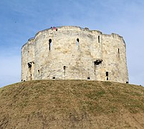
Castles, cathedrals and the Domesday Book
Image: York Castle, Wikimedia Commons
Background image: York Castle, Wikimedia Commons
Notes:
Image: https://commons.wikimedia.org/wiki/File:Tour_Clifford_York_41.jpg

Slide 3
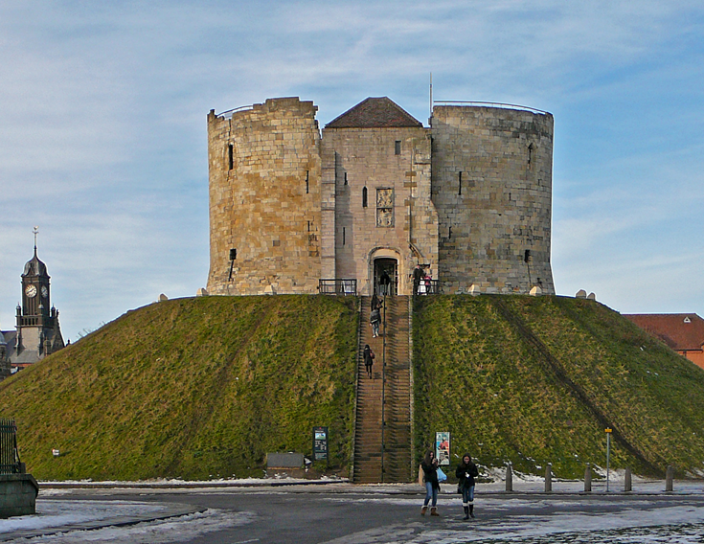
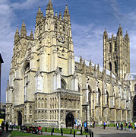
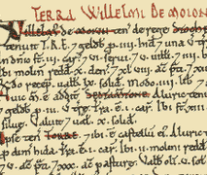
Castles, cathedrals and land: When did ordinary people feel ‘conquered’?
Over 90% of England’s population in 1066 could be classed as peasantry.
What do you think the impact of the Norman Conquest was like for them?
Was it significant?
Did they feel it at all?
Images: Canterbury Cathedral, York Castle, Domesday Book – all Wikimedia Commons
Notes:
Teacher notes: Discussion task in pairs or groups. Note the change of emphasis to ordinary people/the landscape/land ownership/overlordship, etc.
Images: https://commons.wikimedia.org/wiki/File:Canterbury_Cathedral_-_Portal_Nave_Cross-spire.jpeg; https://commons.wikimedia.org/wiki/File:Clifford%27s_Tower_(5259021070).jpg; https://commons.wikimedia.org/wiki/File:Dunster_Somerset_DomesdayBook.png

Slide 4
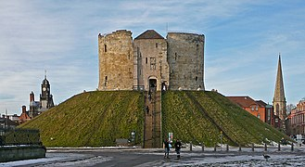
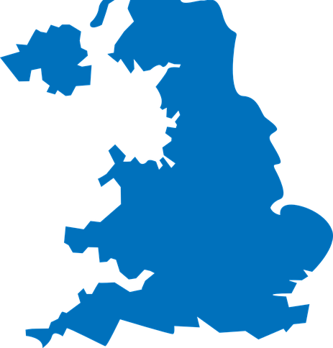
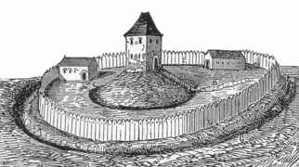
When did the Normans complete their conquest?
Castles, cathedrals and Domesday: 1066–1086
Stages of Norman castle building 1067–1086
Map credit: Holly Hiscox
Images: York Castle, wooden motte and bailey, both Wikimedia Commons
Notes:
Teacher notes: Image analysis 1 can be undertaken in a number of ways – whole class, individually or paired discussion. I would suggest that each student has their own completed copy of this for the final task on the big overview sheet (Slide 1, Lesson 1). If schools don’t have access to colour printing, you can leave spaces between the separate sections for analysis, or show a coloured version on the board and get students to colour-code their own.
Images: Holly Hiscox; https://commons.wikimedia.org/wiki/File:Clifford%27s_Tower_(5259021070).jpg; https://commons.wikimedia.org/wiki/File:Motte_Strichzeichnung.png

Slide 5
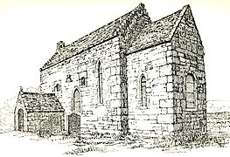
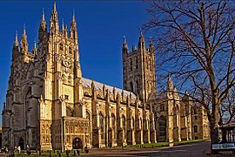
When did the Normans complete their conquest?
Castles, cathedrals and Domesday: 1066–1086
Image: Escomb church, County Durham, Wikimedia Commons
This building dates from the early Anglo-Saxon period. It would originally have been built in wood, and later rebuilt in stone.
Image: Canterbury Cathedral, Wikimedia Commons
The complete Norman rebuilding of an original Anglo-Saxon structure began in 1070.
Notes:
Teacher notes: Image analysis 2 can be undertaken in a number of ways – whole class, individually or paired discussion. I would suggest that each student has their own completed copy of this for the final task on the big overview sheet (Lesson 1, Slide 1). Students might need guiding through this task. Why do the Normans bother to rebuild Canterbury Cathedral in this way? What are they saying about themselves and about religion?
Images: https://commons.wikimedia.org/wiki/File:Escomb_Church,_County_Durham.jpg; https://commons.wikimedia.org/wiki/File:Canterbury-cathedral-wyrdlight.jpg

Slide 6
When did the Normans complete their conquest?
Castles, cathedrals and Domesday: 1066–1086
The Anglo-Saxon Chronicle (E)
After this the king had great thought and very deep conversations with his council about this land, how it was occupied, or with which men. Then he sent his men all over England into every shire and had them ascertain how many hundreds of hides there were in the shire, or what land and livestock the king himself had in the land, what dues he ought to have in 12 months from the shire. Also he had it recorded how much land his archbishops had, and his diocesan bishops, and his abbots and his earls, and – though I tell it at too great length – what or how much each man had who was occupying land here in England, in land or in livestock, and how much money it was worth. He had it investigated so very narrowly that there was not one single hide, not one yard of land, not even (it is shameful to tell – but it seemed no shame to him to do it) one ox, not one cow, not one pig was left out, that was not set down in his record. And all the records were brought to him afterwards.
Extract from the Domesday Book (www.nationalarchives.gov.uk/education/focuson/domesday/take-a-closer-look/)
IIII. The Land of St. Peter of Westminster: In ‘Ossulstone’ Hundred In the vill in which St. Peter’s Church is situated [Westminster] the abbot of the same place holds 13½ hides. There is land for 11 ploughs. To the demesne belongs 9 hides and 1 virgate, and there are 4 ploughs. The villeins have 6 ploughs, and there could be 1 plough more. There are 9 villeins each on 1 virgate and 1 villein on 1 hide, and 9 villeins on each half a virgate and 1 cottar on 5 acres, and 41 cottars who pay 40 shillings a year for their gardens. [There is] Meadow for 11 ploughs, pasture for the livestock of the vill, woodland for 100 pigs, and 25 houses of the abbot’s knights and other men who pay 8 shillings a year. In all it is worth £10; when received, the same; TRE £12. This manor belonged and belongs to the demesne of St. Peter’s Church, Westminster.
Notes:
Teacher notes: Domesday can be undertaken in a number of ways – whole class, individually or paired discussion. I would suggest that each student has their own completed copy of this for the final task on the big overview sheet (Lesson 1, Slide 1). No colour-coding here – I would just get the students to summarise the key points of the two sources in their own words in the corresponding boxes. Perhaps there is some interesting discussion to be had – the attitude of the Anglo-Saxon Chronicle towards Domesday displayed in this extract and how much the details of the extract from Domesday support this.

Slide 7
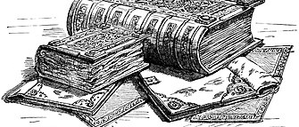
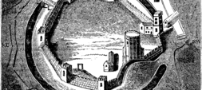
Castles, cathedrals and the Domesday Book The final focus for our enquiry is how William and the Normans secured control of the whole country – in contrast to responding to specific rebellions, for example. Think: how do each of these mechanisms help William and the Normans to consolidate their control over England?
Images: Domesday Book, ancient plan of Oxford Castle, both Wikimedia Commons
Notes:
Images: https://commons.wikimedia.org/wiki/File:Domesday-book-1804x972.jpg; https://commons.wikimedia.org/wiki/File:Ancient_plan_of_Oxford_Castle.png

Slide 8
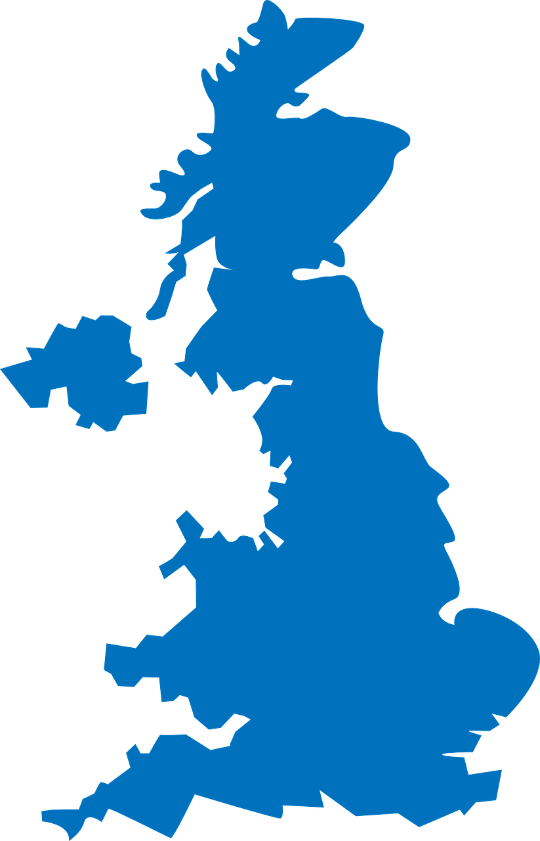
Finding evidence for our enquiry: When did the Normans complete their conquest?
The Norman Conquest: Castles, cathedrals and Domesday
Use the final box on your sheet to write a summary of the importance of castles, cathedrals and Domesday. There is no need to link to any particular part of the map, since these changes affected the whole nation.
Try to explain what you have found out from the sources that helps you to answer the enquiry question (your evidence). Think about the following:
- What had William I and William II achieved?
- Did any problems still remain?
- How far does this evidence help us to answer the enquiry question?
.
.
.
Notes:
Teacher notes: Students move to overarching enquiry sheet, following the prompts above. They should be used to doing this by now!
Image: https://pixabay.com/vectors/united-kingdom-map-great-britain-36481

