Slide 1
Do now: What’s the question? Come up with THREE questions that match with a correct ‘answer’ below.
Malcolm III Edgar the Aetheling Abernethy
Margaret of Wessex Duncan
1071 1079 1087
Alnwick William Rufus (II) 1093

Slide 2
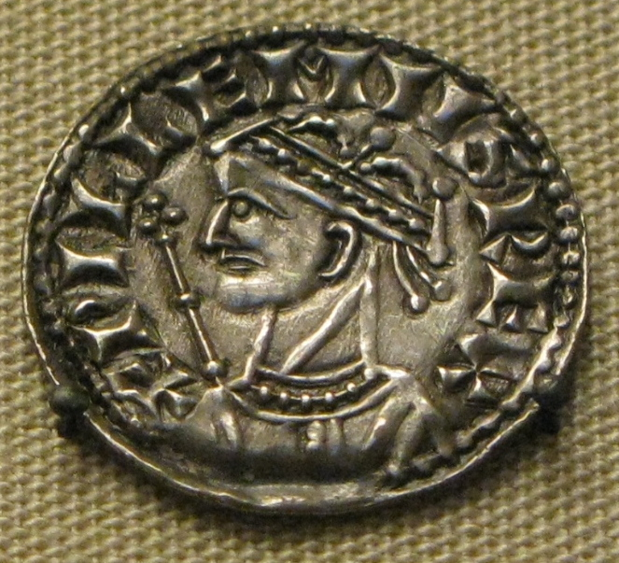
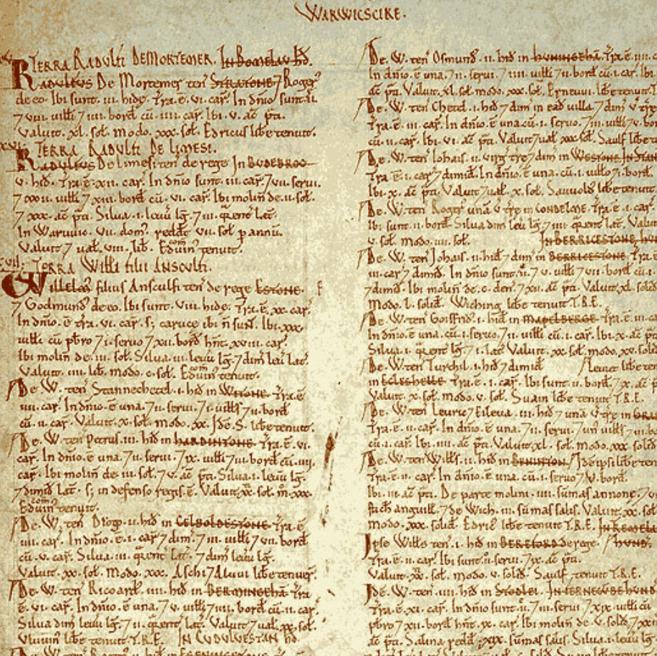
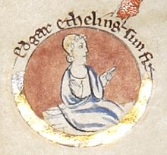
Enquiry lesson 5: When did the Normans complete their conquest?
KEY QUESTIONS:
What does it mean to judge the Conquest as ‘complete’?
How could we tell when the Norman Conquest was complete?
How and why did the experience of conquest vary so much in different places and at different times?
Images: William I coin, Edgar the Aetheling and Domesday extract, all Wikimedia Commons
Notes:
Teacher notes: Give a reminder of the enquiry question, the focus of the next three lessons.
Images: https://commons.wikimedia.org/wiki/File:William_the_Conqueror_silver_coin.jpg; https://commons.wikimedia.org/wiki/File:Edgar_the_%C3%86theling.jpg; https://commons.wikimedia.org/wiki/File:Domesday_Book_-_Warwickshire.png

Slide 3
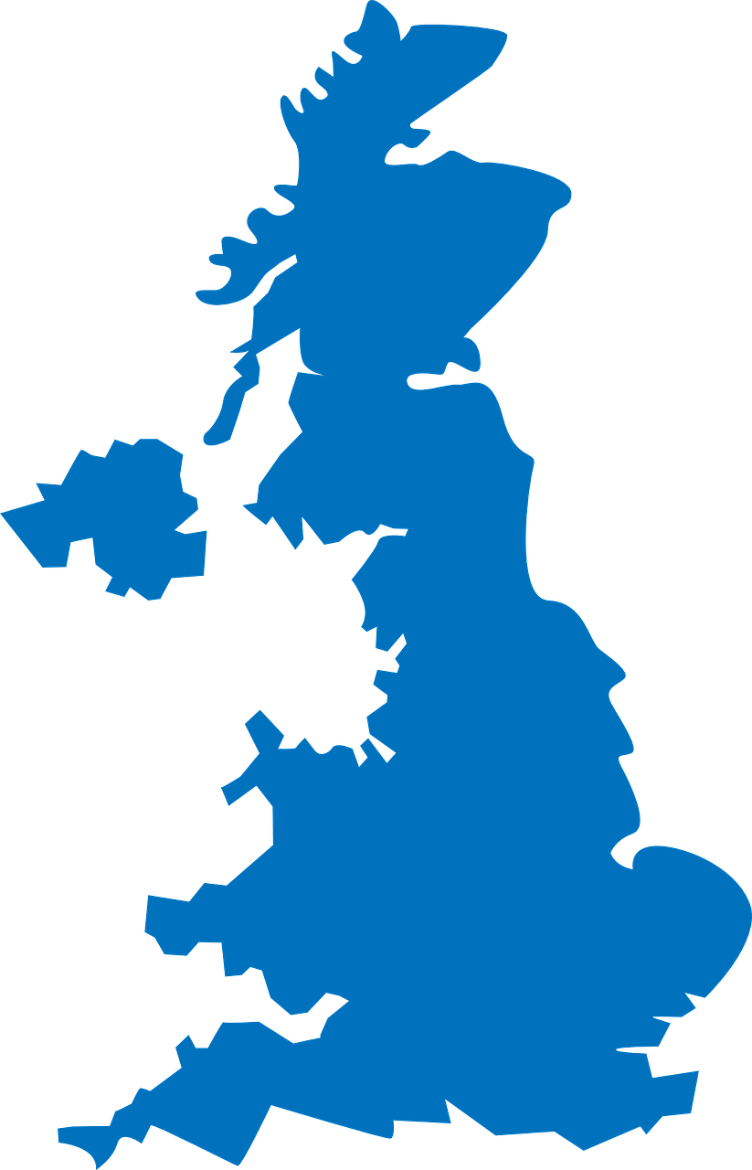
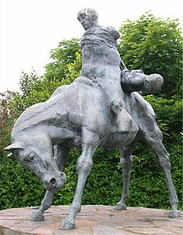
The Norman Conquest: Beyond England
WALES
How did the Welsh and their rulers respond to the Norman Conquest of England?
What was the experience of conquest like in Wales?
Can a better appreciation of events here help us to reach a judgement about when the Conquest was complete?
?
?
Images: map – pixabay; Harlech statue: The Two Kings – Wikimedia Commons
Notes:
Images: https://pixabay.com/vectors/united-kingdom-map-great-britain-36481; https://commons.wikimedia.org/wiki/File:Harlech_Statue_The_Two_Kings.jpg

Slide 4
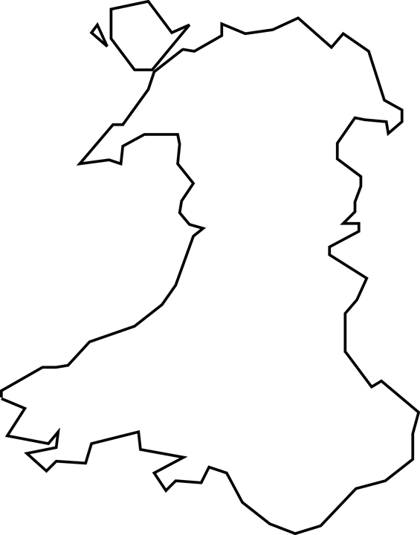
Wales in 1066: Some context…
Welsh identity as true ‘Britons’
The kingdoms of Wales in the Middle Ages
Wales and Harold Godwinson – 1063
Map credit: Holly Hiscox
Notes:
Teacher notes: It is important for students to understand the background – I talk to them about this, making reference to the map. Wales was separate to England in the eleventh century, and for most of the time was split into different kingdoms, each with their own ruler. Although Wales was divided politically, it was united in other ways, e.g. through law (the laws of Hywel Dda in the late tenth century codified and built on existing Welsh common law), culture/identity (the Welsh saw themselves as the true descendants of the ancient Britons; in terms of culture, there was a strong bardic tradition; the Mabinogion, which was compiled in the twelfth and thirteenth centuries, was derived from earlier oral traditions, for example) and language (Welsh). The kingdoms of Wales had been briefly unified by Gruffydd ap Llewelyn in 1057 until his death in 1063. Harold Godwinson launched attacks against Llywelyn throughout the 1060s, and it was one of these attacks that ultimately resulted in Llywelyn’s death. As a consequence, the Godwinsons were unpopular figures in Wales. The information on Slide 5 is useful to illustrate some of this.
Image: Holly Hiscox

Slide 5
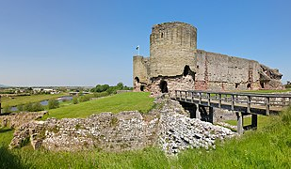
Gruffydd ap Llywelyn
King of Wales, 1055 to 1063: He united the whole of Wales in 1055, having previously been king of Gwynedd and Powys – ‘the first and last King of Wales’.​
An ally of Aelfgar, heir to the earldom of Mercia (and father of Edwin and Morcar). ​
Aelfgar was an enemy of Harold Godwinson, who had deprived him of his earldom for a time. Gruffydd helped Aelfgar to launch attacks along the Welsh/Mercian border. Aelfgar was ultimately restored to his earldom.​
Gruffydd ap Llywelyn married Aelfgar’s daughter Eadgyth (Edith – sister of Edwin and Morcar). ​
Edward the Confessor recognised Gruffydd as the rightful king of Wales, but after Aelfgar’s death in 1062, his position was more vulnerable.​
In late 1062, Harold Godwinson (with the approval of King Edward), launched a surprise attack on Gruffydd’s royal court at Rhuddlan. Gruffydd escaped, but in 1063 he was killed by a combined force led by Harold and Tostig Godwinson, who were also working with his Welsh enemies.​
After his death, Gruffydd’s head and the figurehead of his ship were sent to Harold Godwinson.​
Harold Godwinson later married Edith (Gruffydd’s widow, and Edwin and Morcars sister) in an attempt to unite the families.​
Image: Rhuddlan Castle, Wikimedia Commons
Notes:
Teacher notes: I suggest printing small versions for students to stick into their books. There is lots to discuss here – students are often particularly surprised at Edith (sister of Edwin and Morcar, and wife of Gruffydd) having to marry Harold Godwinson after Gruffydd’s death in January 1066.
Image: https://commons.wikimedia.org/wiki/File:Rhuddlan_Castle_14.jpg

Slide 6
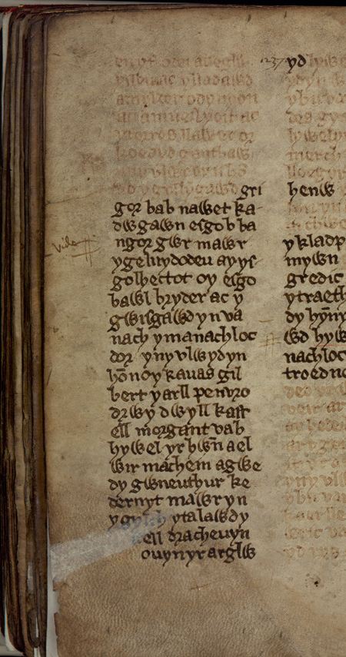
Finding evidence for our enquiry: When did the Normans complete their conquest?
The source:
Brut y Tywysogion
Read the extract and respond to the prompts to complete the first stage of your worksheet.
Images: St David’s Cathedral, Brut y Tywysogion, both Wikimedia Commons
Notes:
Teacher notes: See source booklet/next slide for printing.
Images: https://commons.wikimedia.org/w/index.php?search=st+davids+cathedral&title=Special:MediaSearch&go=Go&type=image; https://commons.wikimedia.org/wiki/File:Chronical_of_the_Princes_(f.260).jpg

Slide 7
Brut y Tywysogion (Part 1)
The death of Gruffudd ap Llywelyn, king of Wales, after a campaign against him by Harold Godwinson:
1063 One thousand and sixty-one [sic] was the year of Christ when Gruffudd ap Llywelyn was slain, after innumerable victories and taking of spoils and treasures of gold and silver and precious purple raiment, through the treachery of his own men, after his fame and glory had increased and after he had aforetimes been unconquered, but was now left in the waste valleys, and after he had been head and shield and defender to the Britons. And then died Joseph, bishop of Menevia.
The Norman Conquest of England:
1066 A year after that, Harold, king of Denmark, thought to subdue the Saxons. And against him in a sudden battle there rose up the other Harold, king of the Saxons, son of earl Godwin: and he had first been an earl, but thereupon, after the death of Edward, king of the Saxons, he raised himself through oppression to the very height of kingship. And through innate [native] treachery he invited the other unarmed from the ships to the land, and there he slew him. And as he was enjoying the glory of victory, a certain man called William the Bastard, leader of the Normans, and with him a mighty host, came against him; and after a mighty battle and a slaughter of the Saxons, he despoiled him of his kingdom and of his life, and he defended for himself the kingdom of the Saxons with victorious hand and a mighty noble host.
Brut y Tywysogion (Part 1)
The death of Gruffudd ap Llywelyn, king of Wales, after a campaign against him by Harold Godwinson:
1063 One thousand and sixty-one [sic] was the year of Christ when Gruffudd ap Llywelyn was slain, after innumerable victories and taking of spoils and treasures of gold and silver and precious purple raiment, through the treachery of his own men, after his fame and glory had increased and after he had aforetimes been unconquered, but was now left in the waste valleys, and after he had been head and shield and defender to the Britons. And then died Joseph, bishop of Menevia.
The Norman Conquest of England:
1066 A year after that, Harold, king of Denmark, thought to subdue the Saxons. And against him in a sudden battle there rose up the other Harold, king of the Saxons, son of earl Godwin: and he had first been an earl, but thereupon, after the death of Edward, king of the Saxons, he raised himself through oppression to the very height of kingship. And through innate [native] treachery he invited the other unarmed from the ships to the land, and there he slew him. And as he was enjoying the glory of victory, a certain man called William the Bastard, leader of the Normans, and with him a mighty host, came against him; and after a mighty battle and a slaughter of the Saxons, he despoiled him of his kingdom and of his life, and he defended for himself the kingdom of the Saxons with victorious hand and a mighty noble host.
How does the source present Gruffudd ap Llywelyn, and the circumstances of his death?
How does the source present Gruffudd ap Llywelyn, and the circumstances of his death?
How does the source present Harold Godwinson? What words does it use to describe him/his actions?
How does this part of the source describe the actions of William at Hastings?
How does the source present Harold Godwinson? What words does it use to describe him/his actions?
How does this part of the source describe the actions of William at Hastings?
Notes:
Teacher notes: Double-copy slide for printing – finding evidence for our enquiry from this source.

Slide 8
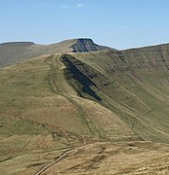
How can learning about eleventh-century Wales help us to answer our enquiry question?
Rhys ap Tewdwr had ruled Deheubarth (South Wales) since 1081, with the agreement of King William. However, in 1093, the Normans killed Rhys ap Tewdwr, ‘with whom fell the kingdom of the Britons’ according to the Brut y Tywysogion. The source states that within months of Rhys ap Tewdwr’s death, Normans had taken over significant areas of Wales and had built castles to subdue the local populations, ‘and then the French seized all the lands of the Britons’. A year later, the sources mention that the Welsh attempted to rebel against the Normans with some success, destroying a castle at Gwynedd. The following source from Henry of Huntington gives more information about what happened in the years after.​
Henry of Huntingdon, The History of the English People 1000–1154​
In the tenth year of his reign (1097), William the Younger, returned to England on the eve of Easter and landed at Arundel. After he had joyously worn his crown at Windsor at Whitsun (24 May), he marched into Wales with a large army and defeated numerous bands of Welshmen, but also lost many of his own men in the narrow defiles of those regions. So, seeing that they could not be conquered, more because of the nature of the terrain than from their valour and arms, he had castles built on the borders of Wales and returned to England.
Image: Brecon Beacons, Wikimedia Commons
Notes:
Image: https://commons.wikimedia.org/wiki/File:Brecon_Beacons_-_geograph.org.uk_-_2632126.jpg

Slide 9
QUESTION: What does this information tell us about our enquiry question: When did the Normans complete their conquest?
Offa’s Dyke was built in the eighth century and was named after the Anglo-Saxon king of Mercia, Offa, who is thought to have ordered its construction.​
The Normans built several castles in the areas shown under their control on the map. The area along the border between Wales and England became known as the Welsh Marches and had the densest concentration of motte and bailey castles of anywhere in the kingdom.​
The Lords who ruled the Marcher earldoms had special powers granted to them, with more independence to rule over their land than other earls.​
Image: www.castlesfortsbattles.co.uk/south_wales/assets/norman_penetration_wales_1150.png
Notes:
Image: www.castlesfortsbattles.co.uk/south_wales/assets/norman_penetration_wales_1150.png

Slide 10
Finding evidence for our enquiry: When did the Normans complete their conquest?
The Norman Conquest and WALES, 1066–1097
Continue the annotation of your own version of the map to show the border region of England and Wales.
Link the area near Wales on your map to the nearest notes box on the sheet with an arrow.
Write a summary explaining what you have found out from the sources that helps you to answer the enquiry question (your evidence). Think about the following:
- What had William I and William II achieved?
- But what problems still remained?
- How far does this evidence help us to answer the enquiry question?
.
.
.
Notes:
Teacher notes: Students move to overarching enquiry sheet, following the prompts above. They should be used to doing this by now!

