Slide 1
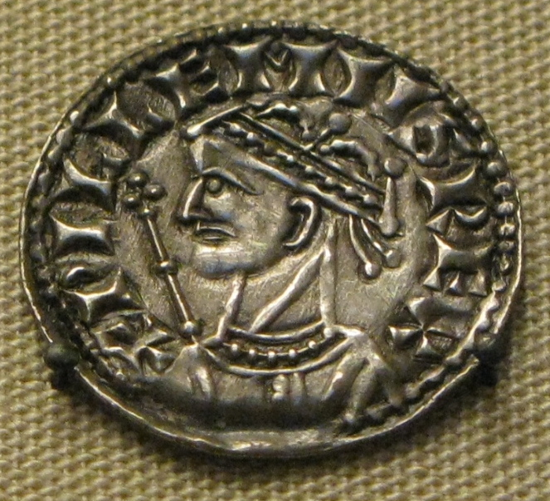
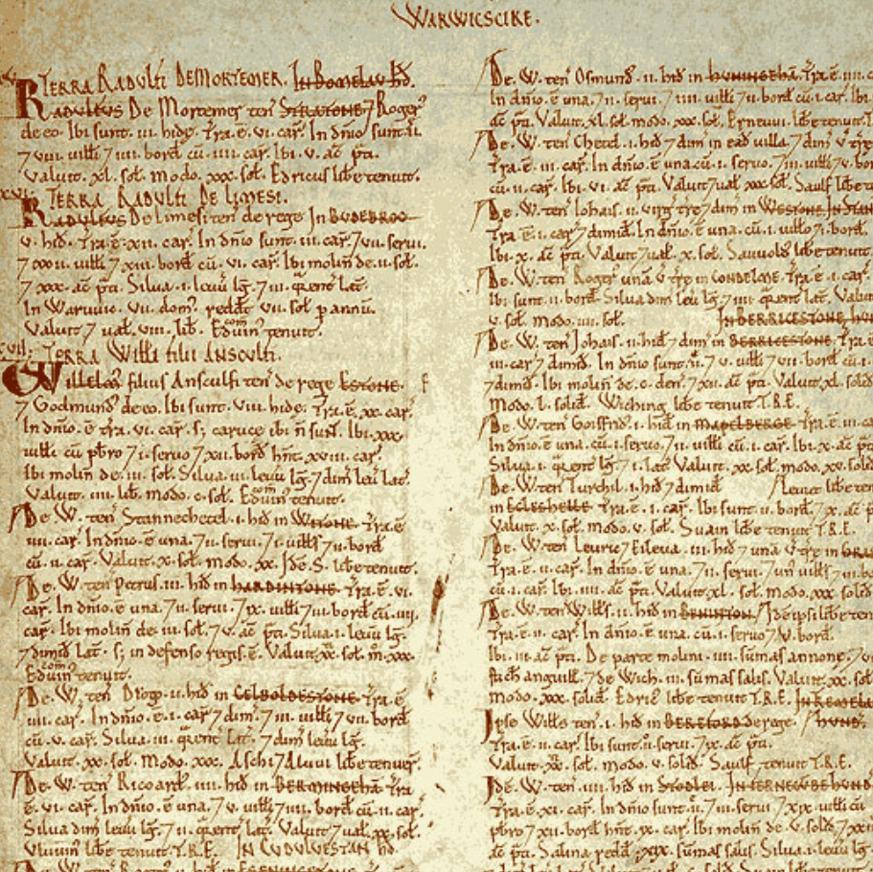
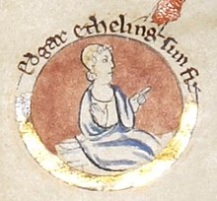
Enquiry lesson 4: When did the Normans complete their conquest?
KEY QUESTIONS:
What does it mean to judge the Conquest as ‘complete’?
How could we tell when the Norman Conquest was complete?
How and why did the experience of conquest vary so much in different places and at different times?
Images: William I coin, Edgar the Aetheling and Domesday extract, all Wikimedia Commons
Notes:
Teacher notes: Reminder of the enquiry question – the focus of the next four lessons.
Images: https://commons.wikimedia.org/wiki/File:William_the_Conqueror_silver_coin.jpg; https://commons.wikimedia.org/wiki/File:Edgar_the_%C3%86theling.jpg; https://commons.wikimedia.org/wiki/File:Domesday_Book_-_Warwickshire.png

Slide 2
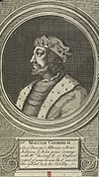
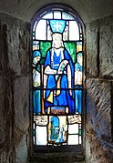
The Norman Conquest: Beyond England
SCOTLAND
How did Scotland respond to the Norman Conquest of England?
What is the significance of Saint Margaret of Scotland?
Can a better appreciation of events here help us to reach a judgement about when the Conquest was complete?
?
?
Images: map – Pixabay; Malcolm III and Margaret – both Wikimedia Commons
Notes:
Teacher notes: Introduction.
Images: https://pixabay.com/vectors/united-kingdom-map-great-britain-36481; https://commons.wikimedia.org/wiki/File:Malcolm_III_Engraving.jpg; https://commons.wikimedia.org/wiki/File:St_Margaret%27s_Chapel_-_St_Margaret_of_Scotland_-_geograph.org.uk_-_3118378.jpg

Slide 3
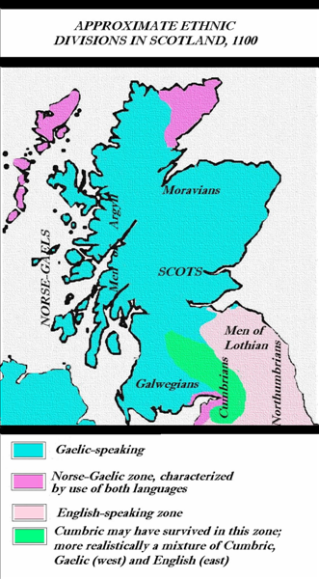
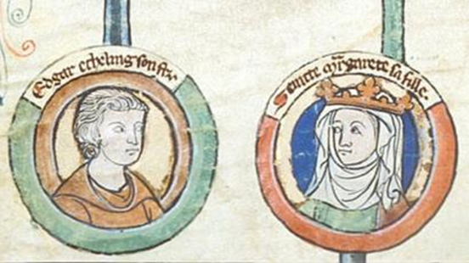
Scotland in 1066: Some context…
‘Scottish’ identities
The kingdoms of Scotland in the Middle Ages
The relationship of Scotland with England
Notes:
Teacher notes: Explanation is required here – the difference between Scotland and England is important. Scotland was an entirely separate kingdom to England, with a different court and royal family. The indigenous Picts had been joined over time by Vikings and Scots, a Celtic people who were originally from Ireland. In the eleventh century, the Orkneys and north-east of Scotland were still under Scandinavian control, separate from the rest of the Scottish kingdom. The Gaelic culture and language of the Scots began to dominate the region by the eleventh century, but disparity in terms of language use and customs continued. The border with England was not clearly defined, and raids/skirmishes often occurred. Discuss the court of Malcolm III and links to English exiles (see information sheet).
Images: https://commons.wikimedia.org/wiki/Atlas_of_Scotland#/media/File:SCOTLANG1100.PNG; www.bbc.co.uk/news/uk-36701131 – credit British Library.

Slide 4
House of Wessex Family Tree
For image please visit: https://britroyals.com/wessextree.asp
Notes:
Teacher notes: The family tree is useful in showing the significance of Margaret’s lineage: descending from Alfred the Great and the Anglo-Saxon Wessex kings, sister to Edgar Aetheling, etc. Her marriage to Malcolm is significant because of this, and draw out the importance of the next generation – the marriage of Malcolm and Margaret’s daughter Matilda to Henry I, which links the Norman kings to the old Anglo-Saxon royal house. Discuss the importance of this – students can annotate/highlight in books.
Image: https://britroyals.com/wessextree.asp

Slide 5
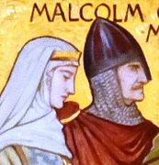
When did the Normans complete their conquest? SCOTLAND
TASK
Read the information sheet.
Show the ‘connections’ between each of the key individuals by filling in the connections sheet.
HOW DO WE KNOW THIS?
3. Colour-code sections of the information sheet to match up with the same information from the Anglo-Saxon Chronicle.
Image: Wikimedia Commons
Notes:
Teacher notes: See corresponding ‘information’, ‘source’ and ‘connections’ resources. The source sheet is designed to help students to see how our understanding is derived from the sources. Useful website: ‘Kings and queens of Scotland’ – www.historic-uk.com/HistoryUK/HistoryofScotland/Kings-Queens-of-Scotland
Image: https://commons.wikimedia.org/wiki/File:Margaret_and_Malcolm_Canmore_(Wm_Hole).JPG

Slide 6
Finding evidence for our enquiry: When did the Normans complete their conquest?
The Norman Conquest and SCOTLAND, 1066–93
Continue the annotation of your own version of the map to show the border region of England and Scotland.
Link the area near Scotland on your map to the nearest notes box on the sheet with an arrow.
Write a summary explaining what you have found out from the sources that helps you to answer the enquiry question (your evidence). Think about the following:
- What had William I and William II achieved?
- But what problems still remained?
- How far does this evidence help us to answer the enquiry question?
.
.
.
Notes:
Teacher notes: Students move to overarching enquiry sheet. Hopefully the source work and previous discussion have provided students with plenty of ideas with which to complete 3), but you will obviously need to circulate/provide support, etc.
Image: https://pixabay.com/vectors/united-kingdom-map-great-britain-36481

