Slide 1
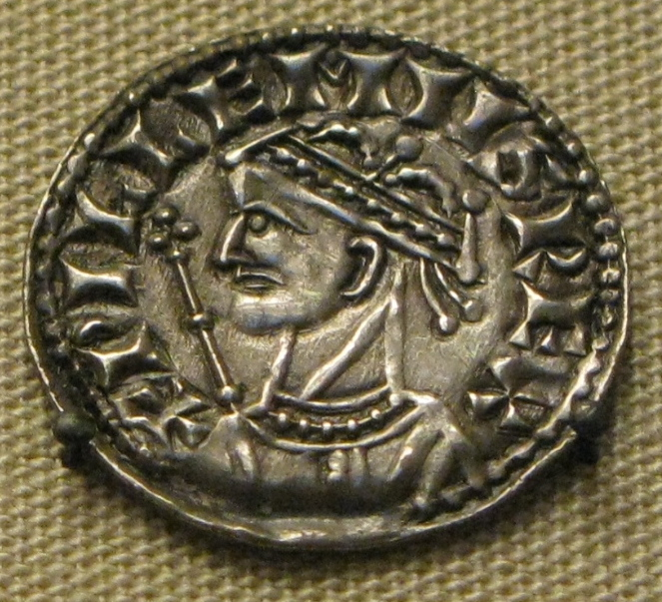
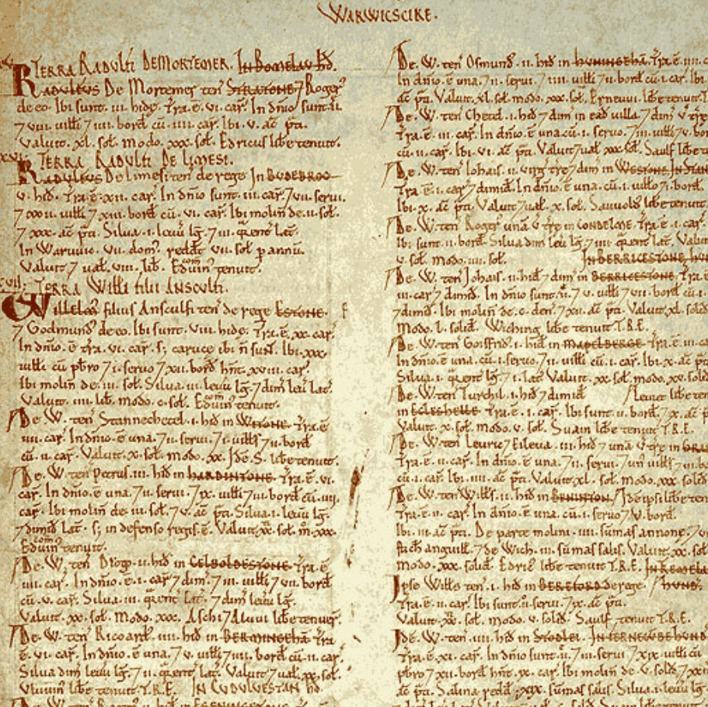
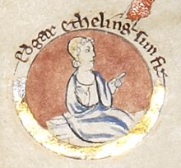
Enquiry lesson 3: When did the Normans complete their conquest?
KEY QUESTIONS:
What does it mean to judge the Conquest as ‘complete’?
How could we tell when the Norman Conquest was complete?
How and why did the experience of conquest vary so much in different places and at different times?
Images: William I coin, Edgar the Aetheling and Domesday extract, all Wikimedia Commons
Notes:
Teacher notes: Reminder of the enquiry question – the focus of the next five lessons.
Images: https://commons.wikimedia.org/wiki/File:William_the_Conqueror_silver_coin.jpg; https://commons.wikimedia.org/wiki/File:Edgar_the_%C3%86theling.jpg; https://commons.wikimedia.org/wiki/File:Domesday_Book_-_Warwickshire.png

Slide 2
Do now: THE NORTH keyword bingo CHOOSE FOUR
Edwin and Morcar Harrying York Minster
Robert Cumin Edgar the Aetheling
Eadric Bristol Gold and silver
The Humber 100,000 famine
1069 1067 1068
Notes:
Teacher notes: Students cross off their chosen words when they hear the definition.

Slide 3
Have a look at this poster. It was published in 1959 by the Railway Executive Eastern Region, and was designed as an advertisement to use the train to visit places of interest in Britain.
Who/where does it mention? Have you heard of either this individual or this place before (perhaps you have even been there)?
How would you describe the atmosphere in this poster? What is the significance of the fact that it is being used to try to attract tourists to this area?
Image: ‘Where Hereward the Wake made his last stand, Ely Cathedral, rises in majesty’, National Railway Museum
Notes:
Teacher notes: Introduction to Ely Rebellion. Some students may have heard of Hereward, but most probably will not. Consider the significance of the poster – it must be a well-known figure/from a well-known event that those seeing it would recognise and relate to – heroic imagery, ‘last stand’, etc. Introduce the theme for today’s lesson. Recap the problems still faced by William from the last lesson, particularly the persistence of the Danish fleet, the continued existence of Edgar and others with power bases, and questionable loyalty.
Image:
https://artuk.org/discover/artworks/ely-cathedral-where-hereward-the-wake-made-his-last-stand-9668

Slide 4
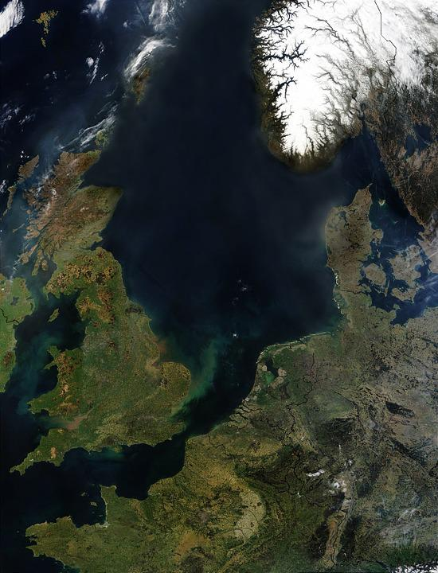
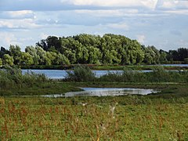
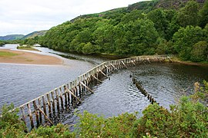
The Ely Rebellion: Some context
Images: Drayton fenland, Wikimedia Commons; map of Britain, Pixabay; wooden causeway, Wikimedia Commons
Notes:
Teacher notes: This provides the context for the main activity to come. Discuss where Ely is in relation to the Danish fleet, the terrain as it would have been in 1066 – inaccessible fenland, etc. – and a quick introduction to Hereward the Wake, as this is the first encounter for some. You could also use the map of Cambridge/Ely here, showing the fenland surrounding Ely: ‘Belsar’s Hill’ – www.castlesfortsbattles.co.uk/east/belsars_hill_fort.html
Images: https://commons.wikimedia.org/wiki/File:Fen_drayton_2013-08_(12621948365).jpg; https://pixabay.com/photos/england-ireland-northern-europe-11105; https://commons.wikimedia.org/wiki/File:Wooden_Causeway_-_geograph.org.uk_-_2064820.jpg

Slide 5
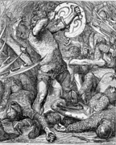
Finding evidence for our enquiry: When did the Normans complete their conquest?
The sources…
The Anglo-Saxon Chronicle, Worcester manuscript (D)
Geffrei Gaimar’s History of the English Peoples (part 1 and part 2)
Read the sources and respond to the prompts to complete the first stage of your worksheet.
Image: Hereward fights the Normans, Wikimedia Commons
Notes:
Teacher notes: See the slides that follow and/or the source booklet.
Image: https://commons.wikimedia.org/wiki/File:097-Hereward_fighting_Normans.png

Slide 6
When did the Normans complete their conquest?
ELY: 1071
The Anglo-Saxon Chronicle, Worcester manuscript (D)
1071: Here Earl Edwin and Earl Morcar ran off and travelled variously in woods and in open country, until Edwin was killed by his own men, and Morcar turned by ship to Ely, and there came Bishop Aethelwine and Siward Bearn and many hundreds of men with them. But then when the king William learnt about this, he ordered out a ship-army and land-army, and surrounded that land, and made a bridge – and [the] ship-army [was] to the seaward. And then they all came into the king’s hand: that was Bishop Aethelwine and Earl Morcar and all those who were with them, except Hereward alone, and all who could flee away with him; and he courageously led them out. And the king took their ships and weapons and many monies and seized all the men and did with them what he wanted; and he sent Bishop Aethelwine to Abingdon and he passed away there.
Notes:
Teacher notes: Ely source analysis 1 can be undertaken in a number of ways – whole class, individually or paired discussion. I would suggest that each student has their own completed copy of this for the final task on the big overview sheet (Slide 1, Lesson 1). If schools don’t have access to colour printing, you can leave spaces between the separate sections for analysis, or show a coloured version on the board and get students to colour-code their own.

Slide 7
When did the Normans complete their Conquest?
ELY: 1071
Geffrei Gaimar’s History of the English Peoples
From there [the outlaws, including Hereward and Morcar,] finding no reason to fear their enemies, they proceeded to Ely. Their intention was to make their quarters there and let winter pass. When William learnt of this, however, he made arrangements to ensure that this would not happen. He summoned his army and sent for his fighting men, both French and English, and his knights. He stationed his naval forces along the coast: enlisted sailors, men-at-arms, mercenaries, and additional troops. These were so numerous that none of those they had encircled was able to move, and moreover all the ways through the wooded areas had been secured and all the surrounding fens were closely and strenuously guarded. The king then ordered a causeway to be constructed over the fens, and declared that he would kill each and every one of the insurgents, and not one of them would escape. When the people in Ely learnt this, they placed themselves in the king’s mercy. All went out to beg mercy except the valiant Hereward, who escaped with a handful of his followers, together with Geri, one of his kinsmen; there were five others with them.
-
Hereward’s companion earl Morcar and bishop [Æthelwine] were rash enough to surrender and both died during their long imprisonment. The others who had surrendered with them underwent so much suffering in prison that it would have been better for them all to have been killed on the day when they were arrested and thrown into prison, and when Hereward made his escape.
Notes:
Teacher notes: Ely source analysis 2 can be undertaken in a number of ways – whole class, individually or paired discussion. I would suggest that each student has their own completed copy of this for the final task on the big overview sheet (Slide 1, Lesson 1). If schools don’t have access to colour printing, you can leave spaces between the separate sections for analysis, or show a coloured version on the board and get students to colour-code their own.

Slide 8
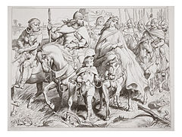
Hereward escapes with a small band of followers, but the Ely Rebellion is crushed.
The Danes have been paid to leave. Aethelwine and Morcar are imprisoned for life.
Is the Conquest now complete?
Image: Hereward the Wake, Wikimedia Commons
Notes:
Teacher notes: Hereward flees. You can give the rest of the story if there is interest/time, maybe even using Gaimar. The Danish threat, as well as that of figures like Morcar, is neutralised. Students will probably suggest that the Conquest is more or less complete by now. Encourage them to consider who/where is left that could continue to cause problems for the Normans. Useful website: ‘Hereward the Wake’ – https://historica.fandom.com/wiki/Hereward_the_Wake
Image: https://commons.wikimedia.org/wiki/File:Alftruda.jpg

Slide 9
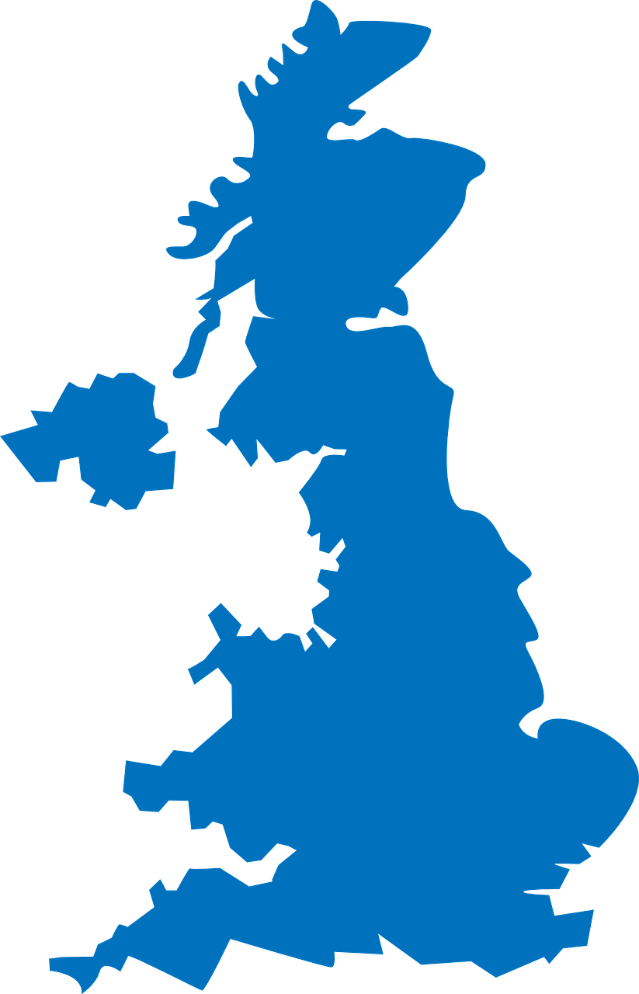
Finding evidence for our enquiry: When did the Normans complete their conquest?
The Norman Conquest and the Ely Rebellion, 1071
Continue the annotation of your own version of the map to show Ely (see opposite).
Link the area near Ely on your map to the nearest notes box on the sheet with an arrow.
Write a summary explaining what you have found out from the sources that helps you to answer the enquiry question (your evidence). Think about the following:
- What had William achieved?
- But what problems still remained?
- How far does this evidence help us to answer the enquiry question?
.
.
Notes:
Teacher notes: Students move to overarching enquiry sheet. Hopefully the source work and previous discussion have provided students with plenty of ideas with which to complete 3), but you will obviously need to circulate/provide support, etc.
Image: https://pixabay.com/vectors/united-kingdom-map-great-britain-36481

