Slide 1
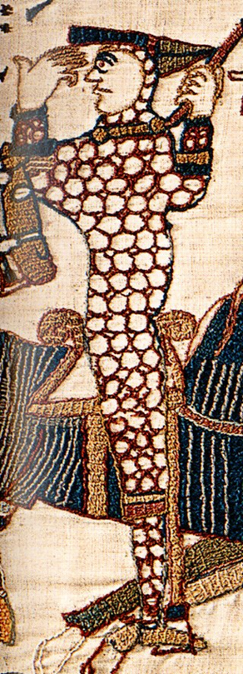
Do now – LONDON Match the correct answer to the question
QUESTIONS
Who did the Witan select to be the next king of England after the death of Harold Godwinson?
Why did William wait in the area around Hastings after the battle?
Where does the Anglo-Saxon Chronicle suggest that the submission to William took place?
Who were some of the important people who submitted to William after he approached London?
When and where was William crowned king of England?
Who did William leave behind in England to help secure his rule after he returned to Normandy?
ANSWERS
Berkhamstead
Christmas Day 1066, Westminster
Edgar the Aetheling
In the hope that the Witan would come and accept him as the new king
Earls Edwin and Morcar, Edgar the Aetheling, Archbishop Aldred
Bishop Odo and Earl William
Image: Bayeux tapestry, Wikimedia Commons
Notes:
Image: https://commons.wikimedia.org/wiki/File:Bayeux_Tapestry_scene55_William_on_his_horse.jpg

Slide 2
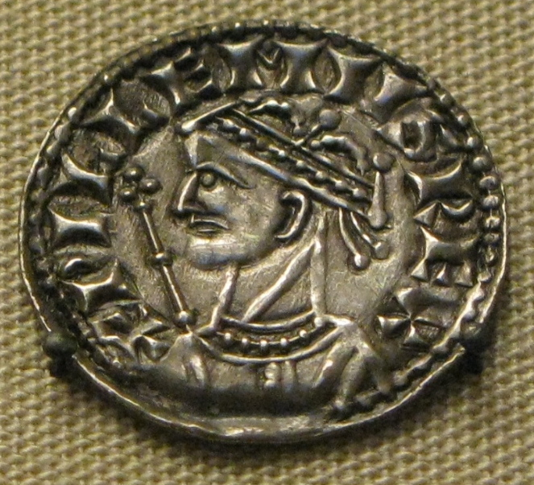
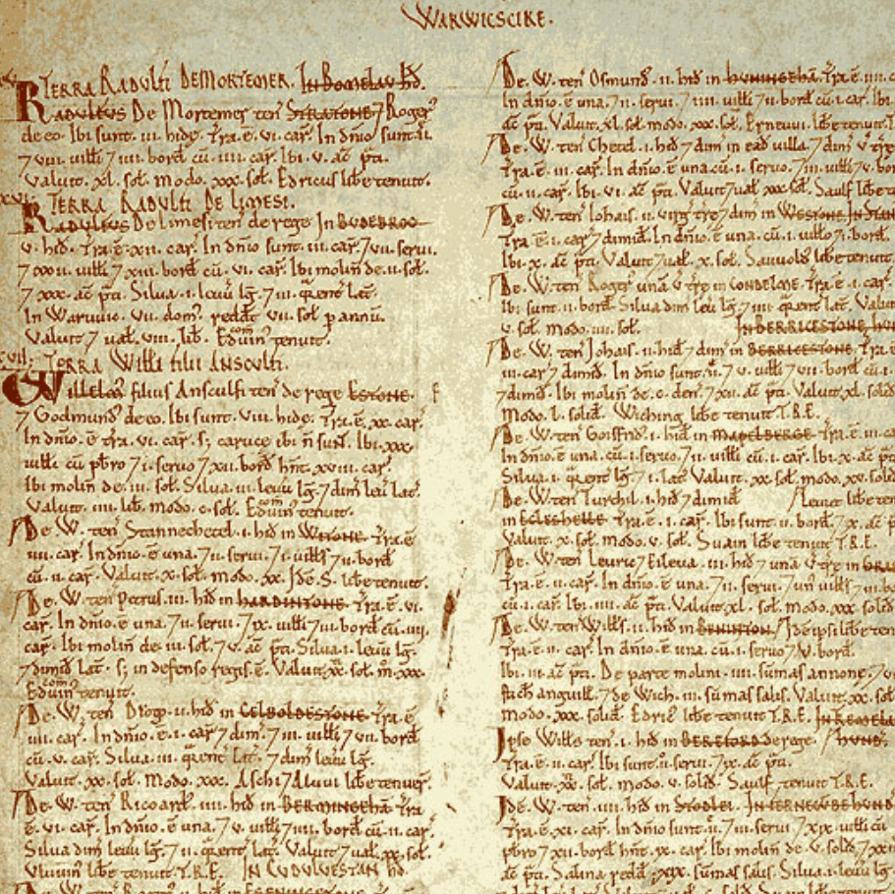
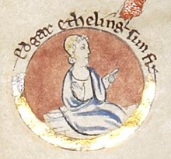
Enquiry lesson 2: When did the Normans complete their conquest?
KEY QUESTIONS:
What does it mean to judge the Conquest as ‘complete’?
How could we tell when the Norman Conquest was complete?
How and why did the experience of conquest vary so much in different places and at different times?
Images: William I coin, Edgar the Aetheling and Domesday extract, all Wikimedia Commons
Notes:
Teacher notes: Reminder of the enquiry question – the focus of the next six lessons.
Images: https://commons.wikimedia.org/wiki/File:William_the_Conqueror_silver_coin.jpg; https://commons.wikimedia.org/wiki/File:Edgar_the_%C3%86theling.jpg; https://commons.wikimedia.org/wiki/File:Domesday_Book_-_Warwickshire.png

Slide 3
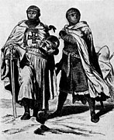
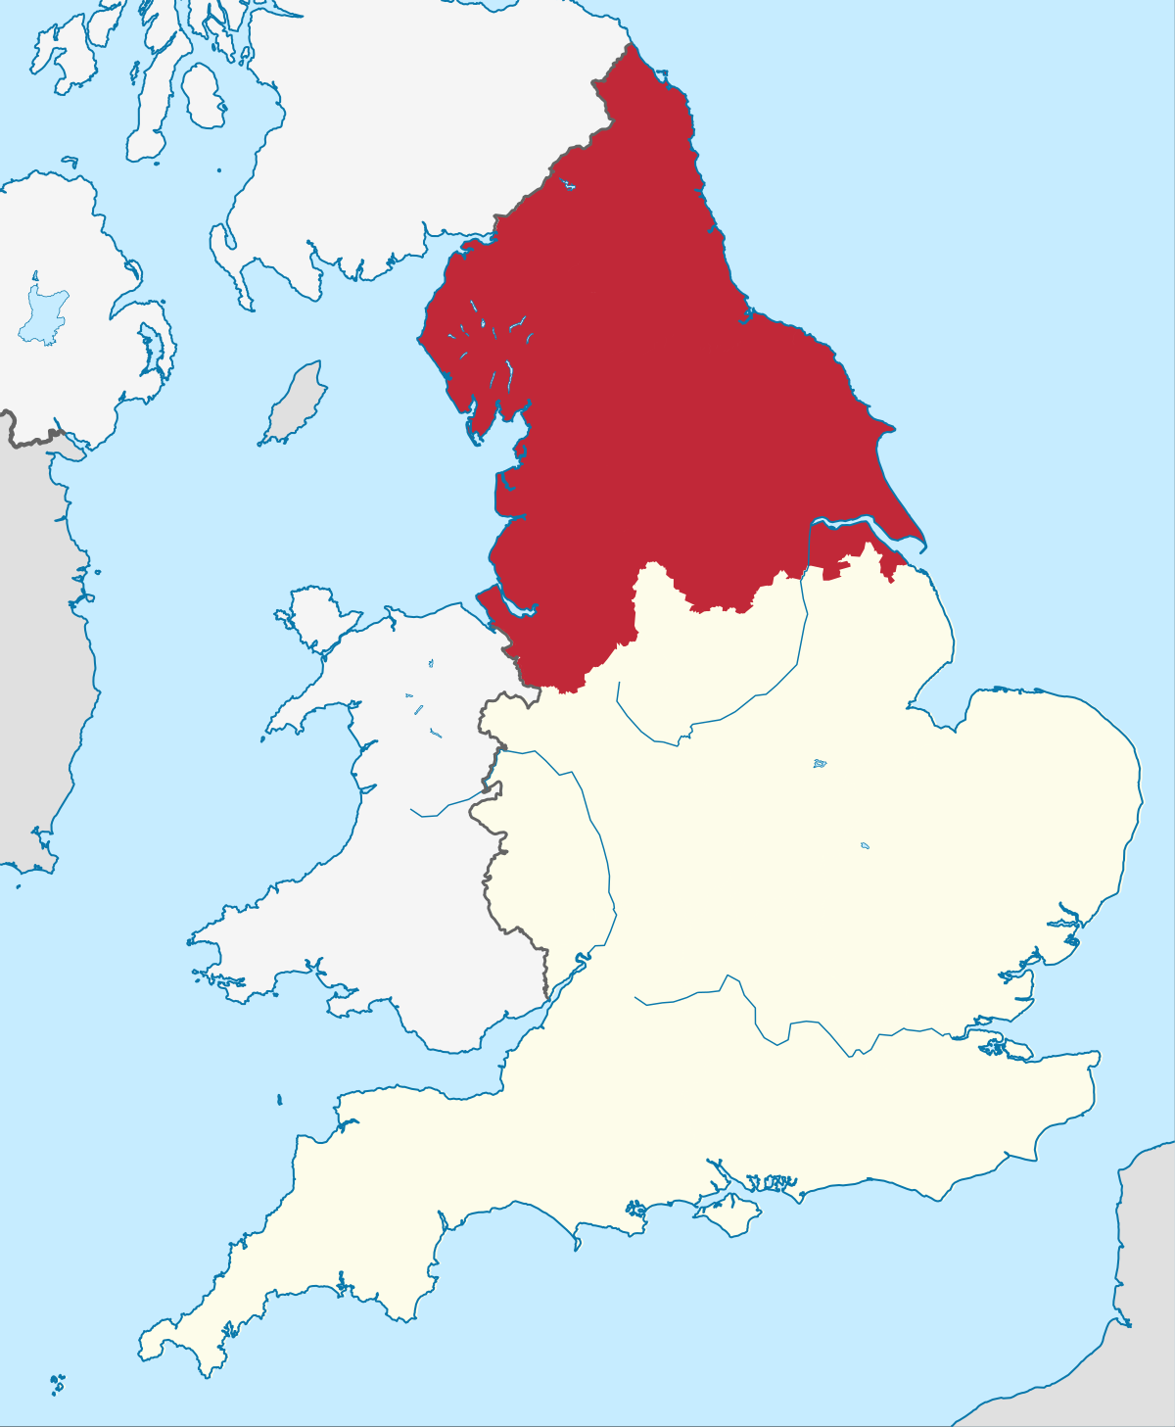
Cast your minds back: What do we already know about the following?
Earls Edwin and Morcar
The North of England
Edgar the Aetheling
Images: Livonia knights, map – north of England and Edgar the Aetheling, all Wikimedia Commons
Notes:
Teacher notes: Recap prior knowledge: who Edwin and Morcar were, their fortunes in 1066, earldoms, etc. The north of England (but also Mercia) – link to Edwin and Morcar but also stress cultural/historic Scandinavian ties. Edgar Aetheling – fortunes in 1066, claim to throne, etc. Links to Scotland too for Edgar and/or the north? Helpful clips from BBC Teach: ‘1066 – claimants to the throne’ – www.bbc.co.uk/teach/class-clips-video/history-ks3-ks4-1066-claimants-to-the-throne/zky76v4; ‘1066 – revolt and resistance’ – www.bbc.co.uk/teach/class-clips-video/history-ks3-ks4-1066/zd32t39
Images: https://commons.wikimedia.org/wiki/File:LivoniaKnight_(bw).jpg; https://commons.wikimedia.org/wiki/File:Northern_England.svg; https://commons.wikimedia.org/wiki/File:Edgar_the_%C3%86theling.jpg

Slide 4
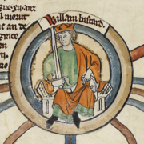
Finding evidence for our enquiry: When did the Normans complete their conquest?
Trouble in the North (and elsewhere…)
TASK:
Read the information and answer the questions in full sentences.
Use at least one quotation from the accompanying source material to support your answers.
Image: William I, Wikimedia Commons
Notes:
Teaching notes: Task using lesson resource – History Today article on the Harrying of the North. Useful clip from BBC Teach: ‘1066 – King William and the Domesday Book’ – www.bbc.co.uk/teach/class-clips-video/history-ks3-ks4-1066/zhwygwx.
Image: https://commons.wikimedia.org/wiki/File:William_the_Conquerer_Illumination.png

Slide 5
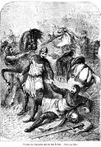
The North has been laid waste. Stricken victims seek survival elsewhere.
Orderic Vitalis
‘In his anger, he commanded that all crops and herds, chattels and food of every kind should be brought together and burned to ashes with consuming fire, so that the whole region north of the Humber might be stripped of all means of sustenance. As a consequence, so serious a scarcity was felt in England, and so terrible a famine fell upon the humble and defenceless people, that more than 100,000 Christian folk of both sexes, young and old alike, perished of hunger.’
Image: Norman armies, Wikimedia Commons
Notes:
Teacher notes: Again, discussion of student findings from the sources – opportunities for wider consideration of the impact of William’s approach to putting down the rebellions in the north. You could bring in other sources here too, in a wider consideration of identity – such as the northern world being linked to the Danes, e.g. Aelnoth later lamenting the failure of the Danes to invade. Useful website: ‘Harrying of the North’ –https://historica.fandom.com/wiki/Harrying_of_the_North. Helpful clip from BBC Teach: 1066 – revolt and resistance’ – www.bbc.co.uk/teach/class-clips-video/history-ks3-ks4-1066/zd32t39
Image: https://commons.wikimedia.org/wiki/File:103-William_the_Conqueror_and_his_son_Robert_(See_p.104.).jpg

Slide 6
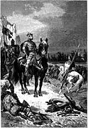
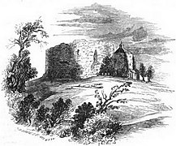
William wears his crown in the charred remains of York minster at Christmas. 1069
Images: Clifford’s Tower, York, built by William I, and William I, both Wikimedia Commons
But is the Conquest complete?
Notes:
Teacher notes: The symbolism here should strike the students. Why does he do it? What does it mean? Broaden the discussion to consider the enquiry question before students turn to the next part of their planning/overarching enquiry sheet. Helpful clip from BBC Teach: ‘How William the Conqueror secured power after 1066’ –www.youtube.com/watch?v=KGDu-_vi8sg
Images: https://commons.wikimedia.org/wiki/File:P99-Cliffords_Tower-York-built_by_William_the_Conqueror.jpg; https://commons.wikimedia.org/wiki/File:William_the_Conqueror_after_Hastings.png

Slide 7
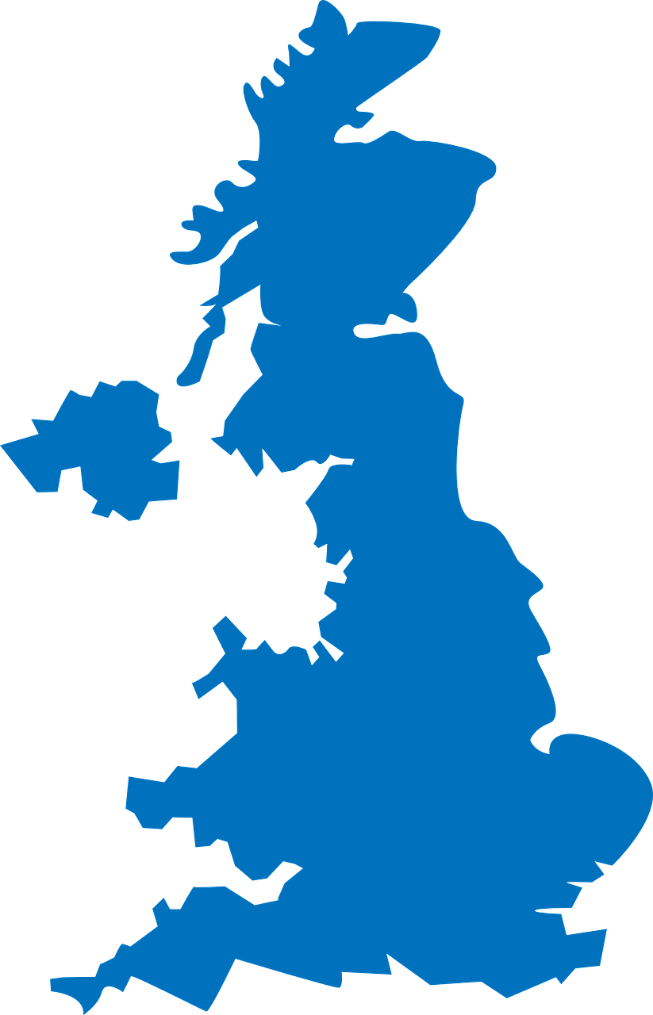
Finding evidence for our enquiry: When did the Normans complete their Conquest?
The Norman Conquest and the NORTH, 1068–69
Continue the annotation of your own version of the map to show Exeter, Warwick, Nottingham and York (see opposite). You could also draw arrows to show William’s route.
Link the area near York on your map to the nearest notes box on the sheet with an arrow.
Write a summary explaining what you have found out from the sources that helps you to answer the enquiry question (your evidence). Think about the following:
- What had William achieved?
- But what problems still remained?
- How far does this evidence help us to answer the enquiry question?
.
.
Notes:
Teacher notes: Students move to overarching enquiry sheet. The first task may need modelling on the board (perhaps this has already been done in previous discussion), and students will definitely need help with correctly labelling the different places and working out the route taken by the Normans in the north (dating is definitely necessary, and additional labelling is welcome). Hopefully the source work and previous discussion have provided students with plenty of ideas with which to complete 3), but you will obviously need to circulate/provide support, etc.
Image: https://pixabay.com/vectors/united-kingdom-map-great-britain-36481

Slide 8
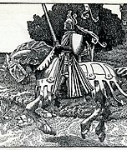
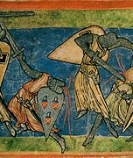
‘With the defeat of the conspiracy and the flight of the Godwine factions, William no doubt felt more secure. He also had more rewards to distribute, for the property of Gytha and her followers, like the lands of those who had fought at Hastings was now deemed forfeit.’ Marc Morris, The Norman Conquest
‘Contemporary kings did sometimes issue an explicit threat to depopulate a land if unable to subdue it, but William’s campaign achieved his clearly defined objectives: the Danish army was outmanoeuvred and neutralized, and the Yorkshire and Northumbrian nobility were brought into meek submission. Probably soon afterwards William gave new Norman lords shares of the conquered land.’
C. P. Lewis
Images: Medieval knight and medieval battle, both Wikimedia Commons
Notes:
Teacher notes: Lesson 2 concludes with some scholarship. Both of these quotations are fairly positive in terms of the extent to which William and the Normans have progressed in their conquest. This is a useful starting point from which to either potentially question some assertions (e.g. Were the Danes ‘neutralised’? For how long?) or to consider other problems that may persist and that are not mentioned here.
Images: https://commons.wikimedia.org/wiki/File:Arthur-Pyle_Mounted_Knight.JPG; https://commons.wikimedia.org/wiki/File:Medieval_battle.jpg
Sources: Morris, M. (2013) The Norman Conquest, Windmill Books.

