Slide 1
When did the Normans complete their conquest?
Map credit: Pixabay
1) The Battle of Hastings, 14 October 1066
Notes:
Worksheet for enquiry – print to minimum A3. Alternatively, you could print out a blank image of Britain and stick it into books, and then students create their own boxes/notes, etc. At each stage of the enquiry, students will annotate the map and complete the relevant box for notes, focusing on what they can learn from the sources and how far they regard the Conquest as being rendered complete. At the end of the enquiry, this sheet will form a plan and contain key information that students can use when coming to their overall judgement.
Image: https://pixabay.com/vectors/united-kingdom-map-great-britain-36481

Slide 2
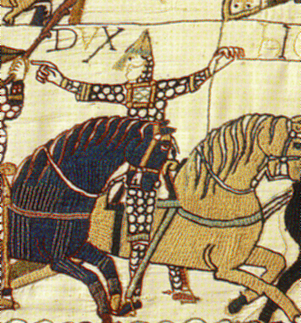
Do now: 1066 – which battle?
In which battle did Edwin and Morcar lead the English army?
In which battle is William of Normandy supposed to have lifted his helmet to inspire his soldiers?
In which battle did the English army line up on Senlac Hill?
In which army was Tostig Godwinson slain?
In which battle did the Viking force defeat the English?
In which battle was Harold Godwinson slain?
Which battle took place on 25 September 1066?
Image: Bayeux Tapestry, Wikimedia Commons
Notes:
‘Do now’ quiz – based on work from previous lessons on the events of January to October 1066.
Image: https://commons.wikimedia.org/w/index.php?search=bayeux+tapestry&title=Special:MediaSearch&go=Go&type=image

Slide 3
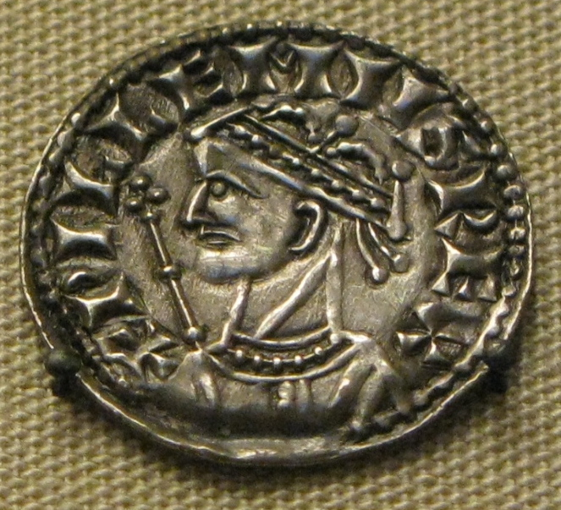
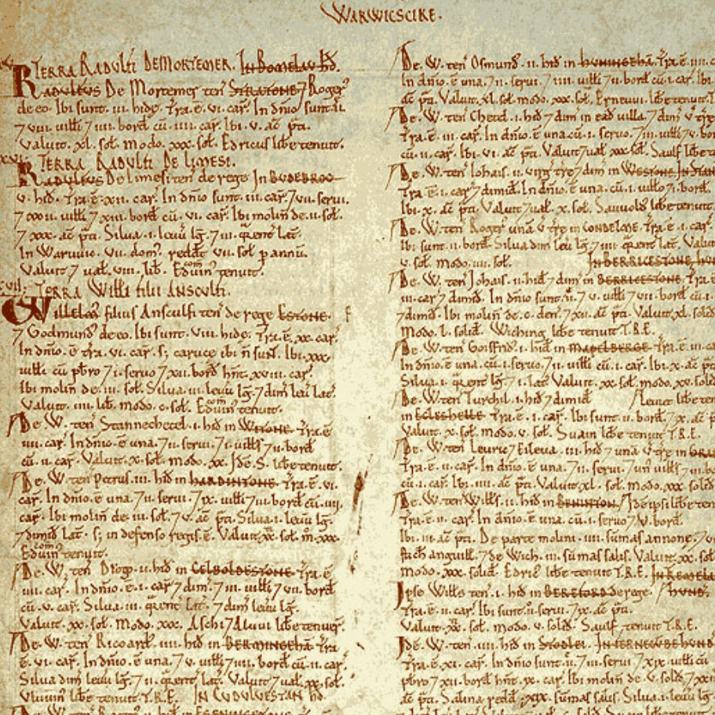
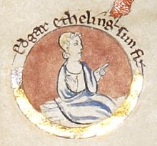
Enquiry lesson 1: When did the Normans complete their conquest?
KEY QUESTIONS:
What does it mean to judge the Conquest as ‘complete’?
How could we tell when the Norman Conquest was complete?
How and why did the experience of conquest vary so much in different places and at different times?
Images: William I coin, Edgar the Aetheling and Domesday extract, all Wikimedia Commons
Notes:
Introduce enquiry with the enquiry question – the focus of the next six lessons.
Images: https://commons.wikimedia.org/wiki/File:William_the_Conqueror_silver_coin.jpg; https://commons.wikimedia.org/wiki/File:Edgar_the_%C3%86theling.jpg; https://commons.wikimedia.org/wiki/File:Domesday_Book_-_Warwickshire.png

Slide 4
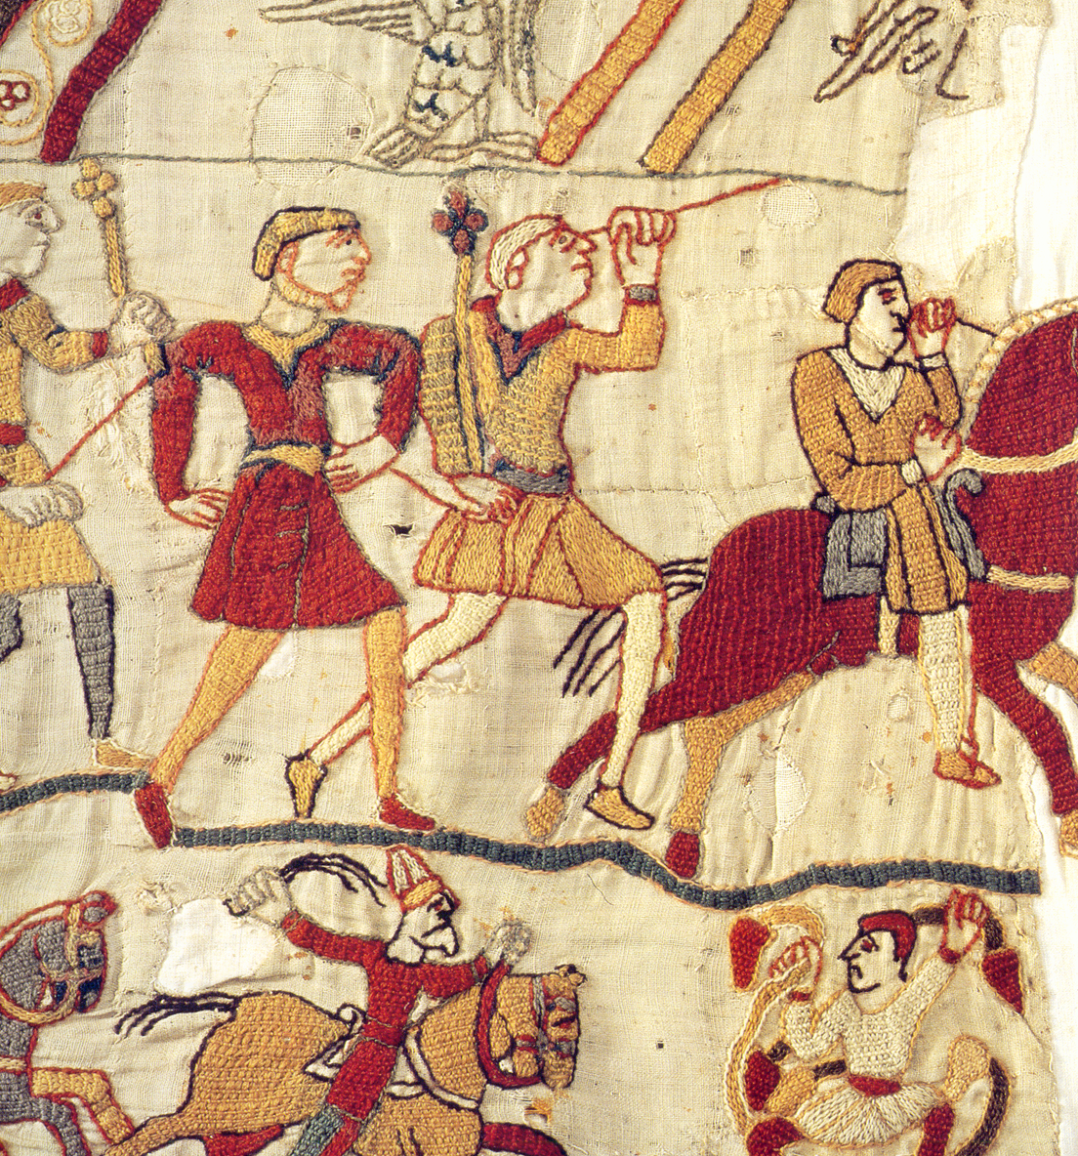
Hastings, October 1066 But isn’t the Conquest already complete?
‘The truth was that, apart from Pevensey and Hastings, every town and city in England remained to be taken.’
Marc Morris, The Norman Conquest (2013), p. 191
Image: Last scene in Bayeux tapestry: Norman victory, remaining English flee the battlefield, Wikimedia Commons
Notes:
Teaching notes: Opportunity for a quick recap of recently studied events of September/October 1066. If Harold Godwinson is dead, why does William not automatically become the king? Discuss and record the key points: English king ‘elected’ to position – needs support of key magnates/Witan. William only controls a very small area on the south coast – there is an entire and diverse kingdom to be subdued. Another problem for William was the existence of someone with a better claim in terms of lineage, e.g. Edgar Aetheling (recap Harold’s seizure of power in January 1066). Who might be likely to oppose and why?
Image: https://commons.wikimedia.org/wiki/File:Fleeing_bayeux_tapestry.png
Source: Morris, M. (2013) The Norman Conquest, Windmill Books.

Slide 5
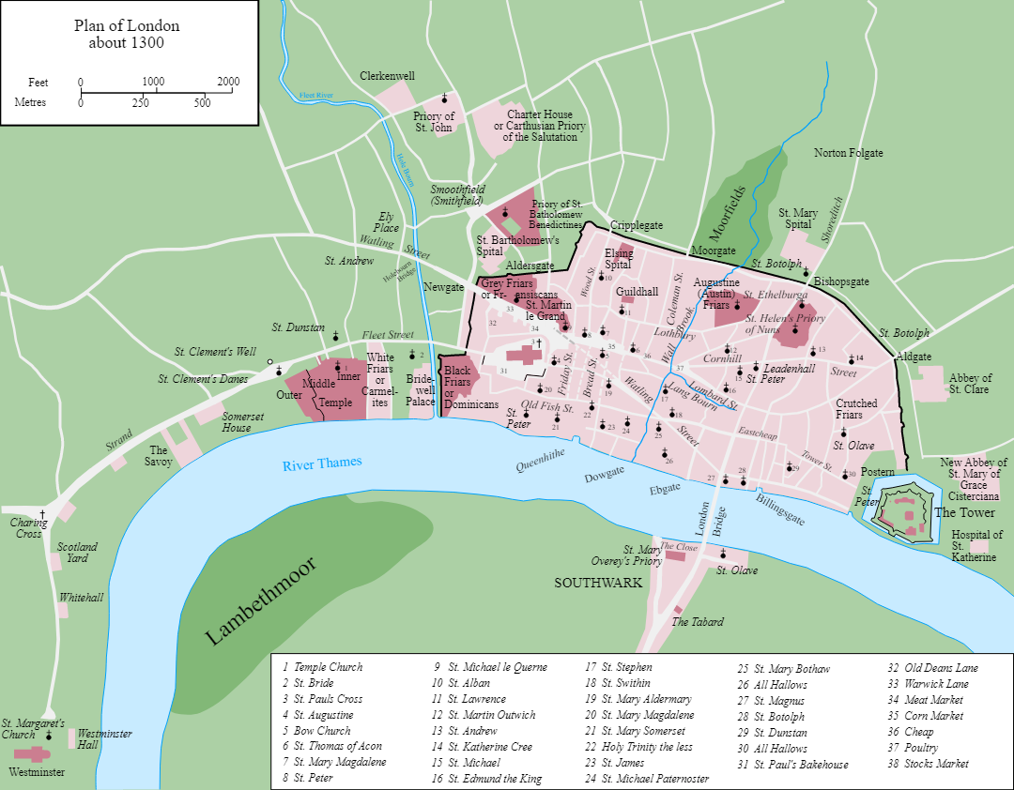
Where next? Why?
LONDON
Hastings
Images: Left – Britain map, Pixabay; Right – London, c.1300, Wikimedia Commons
Notes:
Teacher notes: In addition to the plain map here, it’s also worth using one that shows the earldoms on the eve of the Battle of Hastings in 1066. After the Battle, Harold, Leofwine and Gyrth are all dead – the power of the Godwin family has really been shattered. Discuss: What should William do? What does he need to happen? Discuss his waiting in hope that leading men will come to him to submit, but no such party comes. What should he do? Where should he go? Students are likely to come up with London as the capital – why is this important? You can discuss the 1300 map (obviously later than the period being studied, but it’s good to illustrate London as a city mainly on the north bank of the Thames, etc., so very different from the London with which we are familiar today). It is important to come to an overview of the reasons as a lead-in to sources to begin to establish evidence to help to answer our enquiry: How does William take London? Is the Conquest complete once London is under his control? Why? Why not?
Images: https://pixabay.com/vectors/united-kingdom-map-great-britain-36481; https://commons.wikimedia.org/wiki/File:Map_of_London,_1300.svg

Slide 6
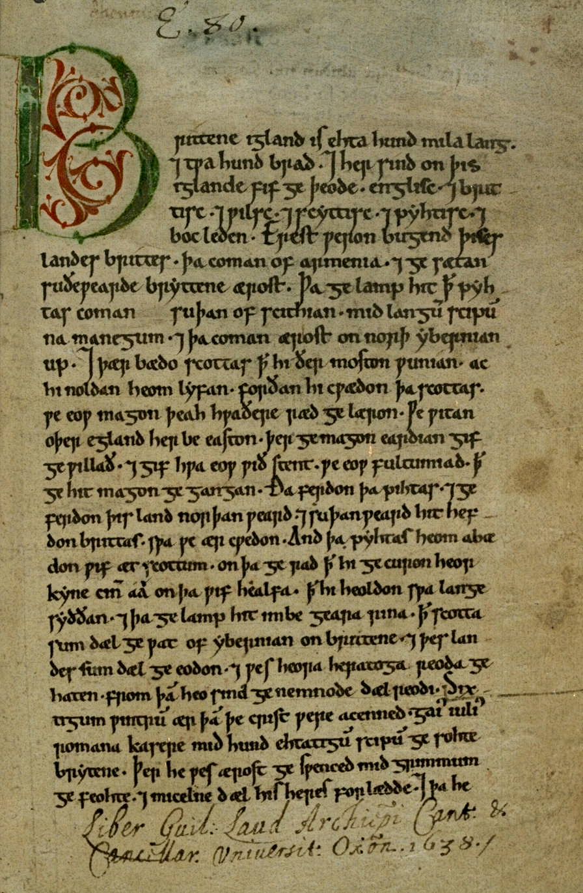
Finding evidence for our enquiry: When did the Normans complete their conquest?
The sources…
The Anglo Saxon Chronicle, Worcester manuscript (D)
Guy of Amiens, The Carmen de Hastingae Proelio (parts 1 & 2)
Read the sources and respond to the prompts to complete the first stage of your worksheet.
Image: Anglo-Saxon Chronicle, Wikimedia Commons
Notes:
Teacher notes: At this stage, it’s crucial that students begin to distinguish between sources and evidence. We can only get evidence to help us to answer our enquiry question by asking particular questions of the sources – they weren’t created with it in mind! The individual source analysis leads to a ‘zoom out’ to consider how the information can help us to see the bigger ‘Conquest’ picture. The three slides that follow can be used as worksheets if printed out. You may not want to do all three – it’s best to choose the one or two that you consider most useful.
Image: https://commons.wikimedia.org/wiki/File:Peterborough.Chronicle.firstpage.jpg

Slide 7
When did the Normans complete their conquest?
LONDON, winter 1066
The Anglo-Saxon Chronicle: source information
The Anglo-Saxon Chronicle – Worcester manuscript (D)
Archbishop Aldred and the garrison in London wanted to have Prince Edgar for king, just as was his natural right; and Edwin and Morcar promised him that they would fight for him, but always when it should have been furthered, so from day to day the later the worse it got, just as it all did in the end. And Earl William went back again to Hastings, and waited there to see whether he would be submitted to; but when he realized that no-one was willing to come to him and [what] came to him afterwards from across the sea, and raided all that region he travelled across until he came to Berkhamsted. And there came to meet him Archbishop Aldred, and Prince Edgar, and Earl Edwin, and Earl Morcar, and all the best men from London; and they submitted from necessity when the most harm was done – and it was great folly that it was not done thus earlier, when God would not remedy matters because of our sins – and gave hostages and swore him oaths, and he promised them that he would be a loyal lord to them. And yet in the middle of this they raided all that they went across. Then on Midwinter’s Day Archbishop Aldred consecrated him king in Westminster; and he gave his hand on it and on Christ’s book, and also swore, before he [Aldred] would set the crown on his head, that he would hold this nation as well as the best of any kings before him did, if they would be loyal to him. Nevertheless he charged men a very stiff tax, and then in the spring went across the sea to Normandy, and took with him Archbishop Stigand, and Aethelnoth, abbot in Glastonbury, and Prince Edgar, and Earl Edwin, and Earl Morcar, and Earl Waltheof, and many other good men from England. And Bishop Odo and Earl William were left behind here, and they built castles widely throughout this nation, and oppressed the wretched people; and afterwards it always grew very much worse. When God wills, may the end be good.
Notes:
Teacher notes: London, guided source analysis 1 can be undertaken in a number of ways – whole class, individually or paired discussion. The box at the top left is a space to write in key information about the source (e.g. the sorts of things that are included in the source booklet about each choice). The other five boxes correspond to the sections of coloured text. This breaks the source down for the students so that they can summarise each in turn. Depending on age/key stage, they will likely need a fair bit of teacher support the first time that they attempt this source of analysis. The aim here is to think about what we can learn from the source – we are imposing our own enquiry question on to it – and it is vital that students do not get caught up with issues of provenance (the dreaded ‘bias’!), etc. These can be discussed, but the key focus here is how this source can become evidence to help us with our enquiry. I would suggest that each student has their own completed copy of this for the final task on the big overview sheet (Slide 1). If schools don’t have access to colour printing, it might be good to leave spaces between the separate sections for analysis, or show a coloured version on the board and get students to colour-code their own.

Slide 8
When did the Normans complete their conquest?
LONDON, winter 1066
The Carmen de Hastingae Proelio of Guy, Bishop of Amiens: source information
The Carmen de Hastingae Proelio of Guy, Bishop of Amiens, part 1
He [William] directed his march to where populous London gleamed. (It is a great city, overflowing with forward inhabitants and richer in treasure than the rest of the kingdom. Protected on the left side by walls, on the right side by the river, it neither fears enemies nor dreads being taken by storm.) The obdurate people conquered in battle sought this place, believing that in it they could dwell for a long time masterless. But because far too great terror surrounded them – everywhere there was lamentation and ungovernable grief – at length the rulers and the magnates made provision for themselves by a plan of this kind; namely, that they consecrate as king a boy of the old royal line, in order that they might not be kingless; for the foolish populace believed it could protect itself merely by the royal name devoid of power. The boy was elected by them to be the shadow of a king, a defence fraught with ruin. The flying rumour that London had a king spread abroad, and what remained of the English nation rejoiced.
Notes:
Teacher notes: London, guided source analysis 2 can be undertaken in a number of ways – whole class, individually or paired discussion. I would suggest that each student has their own completed copy of this for the final task on the big overview sheet (Slide 1). If schools don’t have access to colour printing, it’s possible to leave spaces between the separate sections for analysis, or show a coloured version on the board and get students to colour-code their own.

Slide 9
When did the Normans complete their conquest?
LONDON, winter 1066
The Carmen de Hastingae Proelio of Guy, Bishop of Amiens, part 2
After the election of Edgar, the Carmen says William prepared for a military assault on London: he built siege engines and made battering-rams with horns of iron as well as machines for mining. Then he thundered forth menaces and threatened punishment and war. He vowed that, given the chance, he would raze the walls, level the bastions and reduce the proud tower to rubble.
A local leader called Ansgar gathered the city elders and suggested sending a messenger to William as they feared his military preparations. The next extract begins with the message sent back from William to the Londoners:
‘He [William] shows and maintains that king Edward granted him the gift of the kingdom, and reports that you approved it. This one course remains, therefore, if you wish to survive; to render him homage, with the rights due to him.’ The people approved this, the Witan allowed that it was just, and both assemblies denied that the boy was king. With downcast bearing they proceeded in an orderly concourse to the king’s hall, together with the child. They planned to surrender the city by means of the keys, and to appease wrath by a gift offered with homage.
When he knew of their coming, the king made himself gracious towards those remaining with the boy. He gave them grateful kisses, cheerfully forgave crimes and accepted presents, and showed honour to those thus taken into his favour. Appearing to be one in whom they could trust, he enhanced his own repute and bound their treacherous hearts fast with oaths.
Notes:
Teacher notes: London, guided source analysis 3 can be undertaken in a number of ways – whole class, individually or paired discussion. I would suggest that each student has their own completed copy of this for the final task on the big overview sheet (Slide 1). If schools don’t have access to colour printing, it’s possible to leave spaces between the separate sections for analysis, or show a coloured version on the board and get students to colour-code their own.

Slide 10
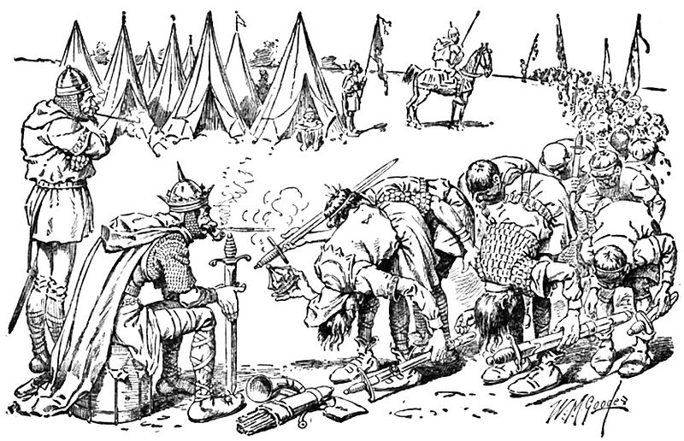
Edwin and Morcar lead the submission to the Normans at Berkhamstead.
William is crowned at Westminster on Christmas Day 1066.
But is the Conquest complete?
Image: Bill Nye’s Comic History of England, Wikimedia Commons
Notes:
Teacher notes: Discussion of sources – what can we learn about what happened between victory at Hastings and William I’s coronation 25 December 1066? Although hopefully students will have a good senses of period from previous lessons leading up to and including Hastings, some ‘world building’ will probably be useful here to fill in some of the gaps from the sources. Keep students focused on the enquiry question, and consider what William has already achieved in terms of the Conquest, but also what still needs to be done. There is the potential to consider other players (e.g. Edgar Aetheling, Edwin, Morcar and so on) and their situation compared to what it has been, and to speculate on future actions.
Image: https://commons.wikimedia.org/wiki/File:083-EDGAR_ATHELING_AND_THE_NOBILITY_OFFER_SUBMISSION_TO_WILLIAM_THE_CONQUEROR.jpg

Slide 11
Finding evidence for our enquiry: When did the Normans complete their conquest?
The Norman Conquest and LONDON, winter 1066
Annotate your own version of the map to show Canterbury, Wallingford, Berkhamstead and London (see opposite). You could also draw arrows, starting from Hastings, to show William’s route.
Link London on your map to the nearest notes box on the sheet with an arrow.
In that box, write a summary explaining what you have found out from the sources that helps you to answer the enquiry question (your evidence). Think about the following:
- What had William achieved?
- But what problems still remained?
- How far does this evidence help us to answer the enquiry question?
Map credit: Pixabay
Notes:
Teacher notes: Students move to the overarching enquiry sheet. The first task may need modelling on the board (perhaps this has already been done in previous discussions), and students will definitely need help with correctly labelling the different places and working out the route taken by the Normans to London. Hopefully the source work and previous discussion have provided students with plenty of ideas to complete 3), but you will obviously need to circulate/provide support, etc.
Image: https://pixabay.com/vectors/united-kingdom-map-great-britain-36481

Slide 12
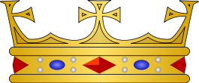
Edward Impey, ‘William the Conqueror and the capture of London in 1066’
‘It can be concluded that there was indeed a period after Hastings when London “had a king”, that effective resistance could have been possible, and that the outcome or at least the pace of William’s adventure could have been very different.’
Marc Morris, The Norman Conquest
‘Did this mean that William was England’s new king? To English minds, the answer must have been yes. As we’ve seen, English kingship was elective: a ruler’s reign began the moment he was accepted by the magnates. This means, of course, that the aetheling must have been regarded as king as well. Although the Anglo-Saxon Chronicle is understandably very coy about saying so, Edgar’s rule had clearly been proclaimed in the days immediately after Hastings.’
Images: Edgar the Aetheling and French heraldic crown, both Wikimedia Commons
Notes:
Teacher notes: Lesson 1 conclusion – discussion of some scholarship and links to the enquiry question. Also discuss William’s coronation and the difference between English/Norman thinking, e.g. English kingship is ‘elective’, and the coronation ceremony is there to confer God’s blessing, whereas for the Normans a person became a king at the time of their coronation and not before. You can tell the story of the coronation at Westminster on Christmas day 1066 – the example of Norman guards on edge outside and at the end of the ceremony is instructive. How far has William got in terms of conquest, but how far does he (and Norman kings after him) have to go?
Images: https://commons.wikimedia.org/wiki/File:Edgar_the_%C3%86theling.jpg; https://commons.wikimedia.org/wiki/File:French_heraldic_crowns_-_Vidame.svg
Sources: Impey, E. (2018) ‘William the Conqueror and the capture of London in 1066’ in D. Bates (ed) 1066 in Perspective, Royal Armouries Conference Proceedings, pp. 35–47; Morris, M. (2013) The Norman Conquest, Windmill Books.

