Slide 1

Diversity Steering Group
Equality, Diversity and Inclusion at GCSE:
A meeting of representatives of the history community
29 June 2022

Slide 2


Slide 3
Purpose of the day
To bring together different voices from the history community, comprising of the Historical Association, Royal Historical Society and other key stakeholder bodies, academic historians, teachers and examination boards to gain a common understanding of:
where we are now,
where we would like to be,
what needs to be done to bring about those changes.

Slide 4

Programme | 10.30 – 16.30
10.30 Introduction to the day (Katharine Burn)
10.40 Session 1: Voices – those who teach the specifications
11.50 Break
12.00 Session 2: Voices – those who offer the specifications
13.15 Lunch
14.00 Introduction to the afternoon: some context on the criteria
14.10 Session 3: The criteria for history at GCSE – current requirements
15.00 Break
15.10 Session 4: The criteria for history at GCSE – future requirements
16.00 Closing Remarks and Next Steps (Peter Mandler)
16.30 Meeting ends

Slide 5
Introduction and Opening Remarks
Katharine Burn

Slide 6
Session 1|10.40-11.50
The voices of those who teach the specifications
5-minute presentations by six teachers who teach the specifications across all the awarding bodies here today
Presentations to focus upon:
  the positives and negatives of their chosen specification in terms of equality, diversity and inclusion relating to content, pedagogy and assessment,
  what they might like to see in terms of further developments.
Followed by table discussion and feedback

Slide 7
Session 2|12.00-13.15
The voices of those who offer the specifications
15-minute presentations by the representatives of the three principal awarding bodies
Presentations to focus upon:
  how they feel their own specifications are developing in terms of equality, diversity and inclusion,
  the work they are currently doing to develop this further,
  what they would like to see in the future,
  what they feel are the barriers to further change.
Followed by table discussion and feedback
Mark Battye Edexcel
Mike Goddard OCR
Eoin Macgabhann AQA
No representative was available today from the Welsh Board.

Slide 8
Lunch

Slide 9

The criteria for history at GCSE
Current and future requirements
Context

Slide 10

Curriculum reform at all key stages
Started with subject criteria at KS5

Slide 11


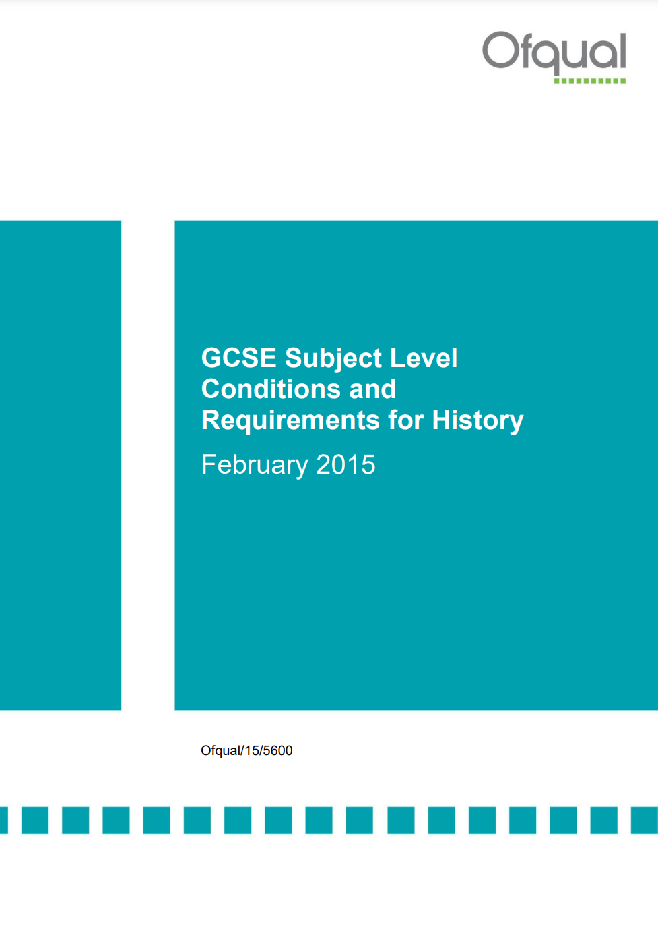

Slide 12
Changes to GCSE: History subject content April 2014
GCSE specifications should include history:
from three eras: Medieval (500-1500), Early Modern (1450-1750) and Modern (1700-present day)
on three time scales: short (depth study), medium (period study) and long (thematic study)
on three geographical contexts: a locality (the historic environment), British and European and / or wider world settings
British history must form a minimum of 40% of the assessed content over the full course
British history is defined as: British history and/ or the history of England, Scotland, Wales and Ireland as appropriate to the historical context and focus of the study.

Slide 13
Changes to GCSE: History subject content April 2014
GCSE specifications in history should require students to study:
Element 1: at least one British depth study chosen from the historical eras defined above
Element 2: at least one European or wider world depth study chosen from the historical eras defined above. This should focus on the history of a nation or group of peoples or on international relations between several nations. It must not merely study British overseas involvements
Important condition: British and wider world depth studies may not be taken from the same era of history or from the same overlapping fifty-year period

Slide 14
Changes to GCSE: History subject content April 2014
Element 3: a period study into British, European or wider world history from any one of the historical eras defined above. One depth study may be from the same era as the period study
Element 4: the historic environment through the study of a particular site in its historical context
Element 5: one thematic study involving the study of people, events and developments drawn from all three eras defined above. Where appropriate, it may also draw on earlier times
NOTE: No coursework, controlled assessment or independent investigation

Slide 15
Changes to GCSE: History subject content April 2014
History assessment objectives
AO1 Demonstrate knowledge and understanding of the key features and characteristics of the periods studied. 35%
AO2 Explain and analyse historical events and periods studied using second-order historical concepts. 35%
AO3 Analyse, evaluate and use sources (contemporary to the period) to make substantiated judgements, in the context of historical events studied. 15%
AO4 Analyse, evaluate and make substantiated judgements about interpretations (including how and why interpretations may differ) in the context of historical events studied. 15%
5 per cent of the marks must be used to credit the accuracy of candidates’ spelling, punctuation and grammar and their use of specialist terminology

Slide 16
Session 3|14.10-15.00
Table Discussion: The Existing GCSE Subject Criteria
In this session we would like you to:
discuss the current GCSE criteria in the light of equality, diversity and inclusion,
identify framing language that might help to develop a common consensus across the history community and, in time with Ofqual, of, for example, the requirement to ensure that 40% of the specification is British history.
This discussion will be followed by a short feedback session.

Slide 17
Session 4 | 15.10-16.00
Table discussion: The Future of the GCSE Subject Criteria
In this session we would like you to discuss:
what we understand the purpose of history education to be,
how the GCSE criteria and the assessment objectives and weightings might need to change in the future in order to achieve this.
This discussion will be followed by a short feedback session.

Slide 18
Closing Remarks and Next Steps
Peter Mandler

Slide 19
Diversity Steering Group
Equality, Diversity and Inclusion at GCSE
Thank you for your participation

