Slide 1


Teaching the AQA History GCSE
Historical Association
Diversity Steering Group
Equality, Diversity and Inclusion at GCSE: A meeting of representatives of the history community
29 June 2022

Slide 2
Specification choices
Paper 1: Understanding the modern world
Section A: Period studies
Choose one of the following options:
AA America, 1840–1895: Expansion and consolidation
AB Germany, 1890–1945: Democracy and dictatorship
AC Russia, 1894–1945: Tsardom and communism
AD America, 1920–1973: Opportunity and inequality
Section B: Wider world depth studies
Choose one of the following options:
BA Conflict and tension: The First World War, 1894–1918
BB Conflict and tension: The inter-war years, 1918–1939
BC Conflict and tension between East and West, 1945–1972
BD Conflict and tension in Asia, 1950–1975
BE Conflict and tension in the Gulf and Afghanistan, 1990–2009
Paper 2: Shaping the nation
Section A: Thematic studies
Choose one of the following options:
AA Britain: Health and the people: c1000 to the present day
AB Britain: Power and the people: c1170 to the present day
AC Britain: Migration, empires and the people: c790 to the present day
Section B: British depth studies including the historic environment
Choose one of the following options:
BA Norman England, c1066–c1100
BB Medieval England: The reign of Edward I, 1272–1307
BC Elizabethan England, c1568–1603
BD Restoration England, 1660–1685

Slide 3
Specification choices
Paper 1: Understanding the modern world
Section A: Period studies
Choose one of the following options:
AA America, 1840–1895: Expansion and consolidation
AB Germany, 1890–1945: Democracy and dictatorship
AC Russia, 1894–1945: Tsardom and communism
AD America, 1920–1973: Opportunity and inequality
Section B: Wider world depth studies
Choose one of the following options:
BA Conflict and tension: The First World War, 1894–1918
BB Conflict and tension: The inter-war years, 1918–1939
BC Conflict and tension between East and West, 1945–1972
BD Conflict and tension in Asia, 1950–1975
BE Conflict and tension in the Gulf and Afghanistan, 1990–2009
Paper 2: Shaping the nation
Section A: Thematic studies
Choose one of the following options:
AA Britain: Health and the people: c1000 to the present day
AB Britain: Power and the people: c1170 to the present day
AC Britain: Migration, empires and the people: c790 to the present day
Section B: British depth studies including the historic environment
Choose one of the following options:
BA Norman England, c1066–c1100
BB Medieval England: The reign of Edward I, 1272–1307
BC Elizabethan England, c1568–1603
BD Restoration England, 1660–1685

Slide 4
Specification choices
AB Germany, 1890–1945: Democracy and dictatorship
BB Conflict and tension: The inter-war years, 1918–1939
AB Britain: Power and the people: c1170 to the present day
BD Restoration England, 1660–1685

Slide 5
Equality, Diversity and Inclusion
Positives
Challenges
Broad sweep of British history
  P&P does help with EDI theme
Flexibility in choices
  Can tailor to intake
Comes up to the present day
  Connects students to their past
Assessment questions are about people
  Germany: Democracy and dictatorship
Every decision narrows the focus
Groups left silent
Feeds misconceptions about EDI in the past
At best is a cautionary tale
Harms the message we are trying to send at Key Stage 3

Slide 6
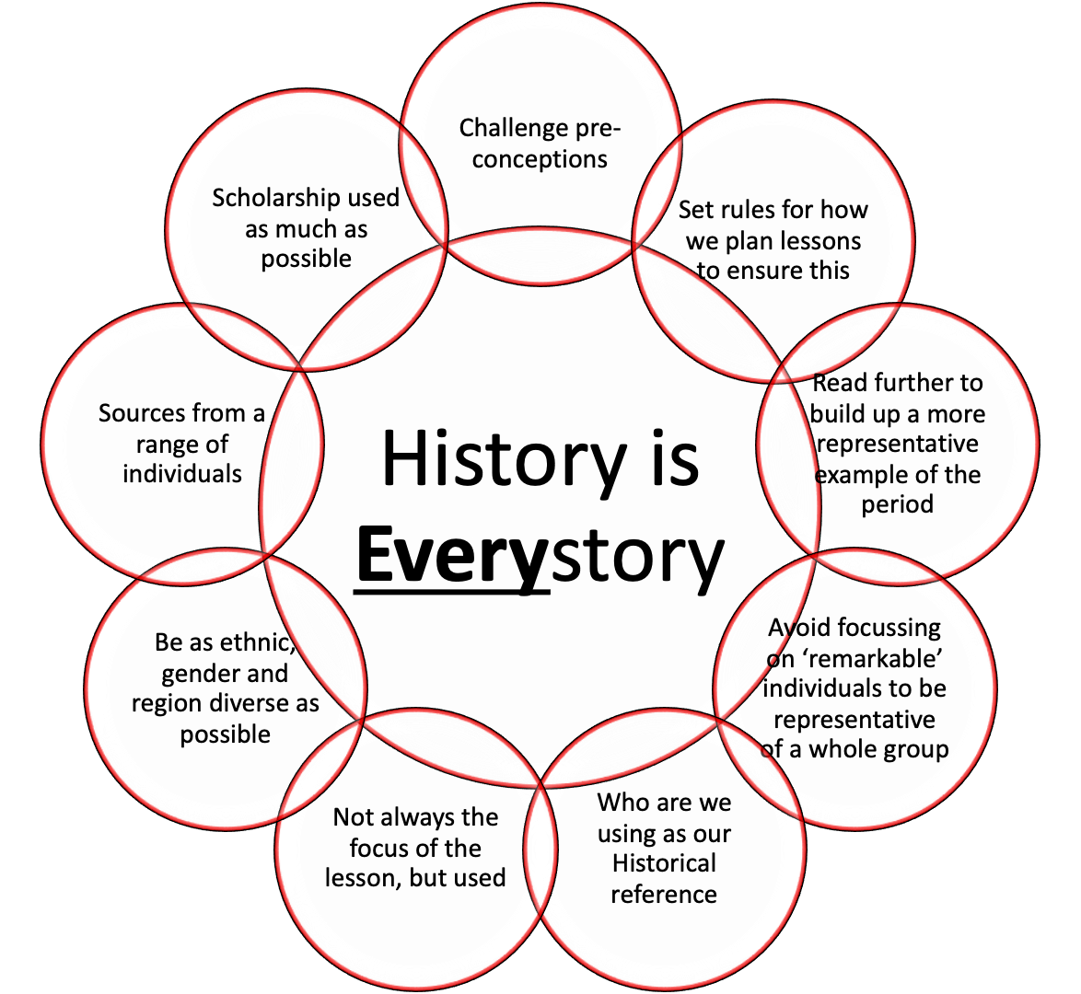
Harms the message we are trying to send at Key Stage 3
The past is a diverse place
Britain exists in a global context
The past explains the present
Understanding what historians do

Slide 7
New Curriculum
Year 7
Year 8
What was it like to be in Year 7 60 years ago?
What do artefacts tell us about Anglo-Saxon England?
To what extent did the Norman Conquest change England?
How powerful were medieval monarchs?
What can portraits tell us about the changing roles of women, 1100–1600?
What did you find on the Silk Road?
Why did the Reformation survive the 1500s?
How did Miranda Kaufmann uncover the hidden lives of Black Tudors?
To what extent was the world turned upside-down in the seventeenth century?
Should England have industrialised?
How has human history changed the environment?
How has the story of the African empires been told?
Who was responsible for the abolition of the slave trade?
How much did the British public know about the front?
How did women protest for equality in the twentieth century?
How typical was the experience of Clifford Spencer? (WWII)
How does Britain’s imperial legacy affect us today?
How has the Holocaust been remembered?
How much did Mao Zedong improve the lives of people in China?
What is the future of history?

Slide 8
New Curriculum
Year 7
Year 8
What was it like to be in Year 7 60 years ago?
What do artefacts tell us about Anglo-Saxon England?
To what extent did the Norman Conquest change England?
How powerful were medieval monarchs?
What can portraits tell us about the changing roles of women, 1100–1600?
What did you find on the Silk Road?
Why did the Reformation survive the 1500s?
How did Miranda Kaufmann uncover the hidden lives of Black Tudors?
To what extent was the world turned upside-down in the seventeenth century?
Should England have industrialised?
Why does the story of nutmeg matter so much?
How has the story of the African empires been told?
Who was responsible for the abolition of the slave trade?
How much did the British public know about the front?
How did women protest for equality in the twentieth century?
How typical was the experience of Clifford Spencer? (WWII)
How does Britain’s imperial legacy affect us today?
How has the Holocaust been remembered?
How much did Mao Zedong improve the lives of people in China?
What is the future of history?

Slide 9
Key Stage 3
Key Stage 4
Key Stage 5
BB Conflict and tension: The inter-war years, 1918–1939
1C: The Tudors
History every story
The past is a diverse place
AB Germany, 1890–1945: Democracy and dictatorship
Britain exists in a global context
2Q: USA American
Dream
The past explains the present
Understanding what historians do
AB Britain: Power and the people, c1170 to the present day
Free choice NEA
BD Restoration England, 1660–1685

Slide 10
Power and the people
Power & Men
Power & Women
Power & Christian Britons
Power & Black Britons
Power & Asian Britons
Power & Disabled Britons
Power & LGBTQ+ Britons
Power & European Britons
This thematic study will enable students to gain an understanding of the development of the relationship between the citizen and the state in Britain over a long period of time. It considers the causes, scale, nature and consequences of protest for that relationship. By charting the journey from feudalism and serfdom to democracy and equality, it reveals how, in different periods, the state responds to challenges to its authority and their impact. It allows students to construct an understanding of the rights and responsibilities of the citizen.

Slide 11

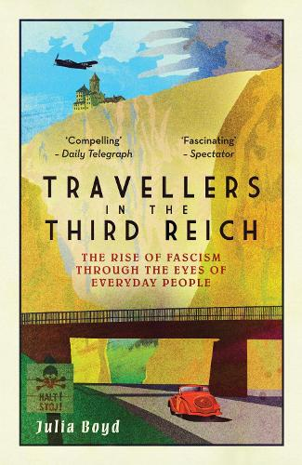
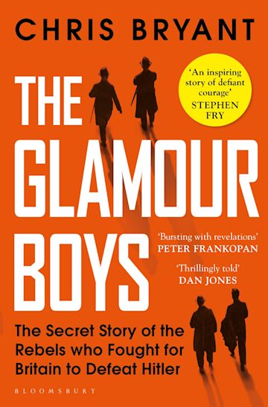
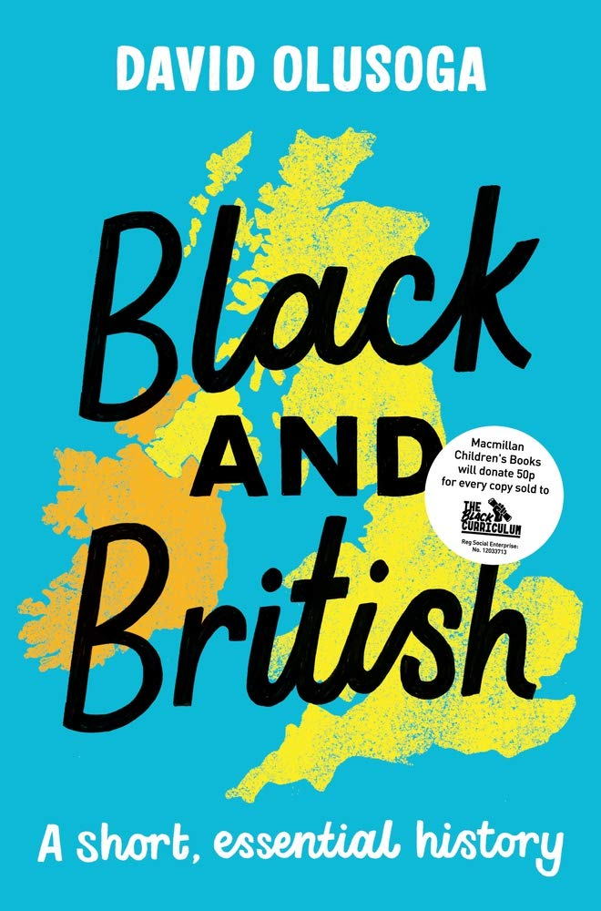
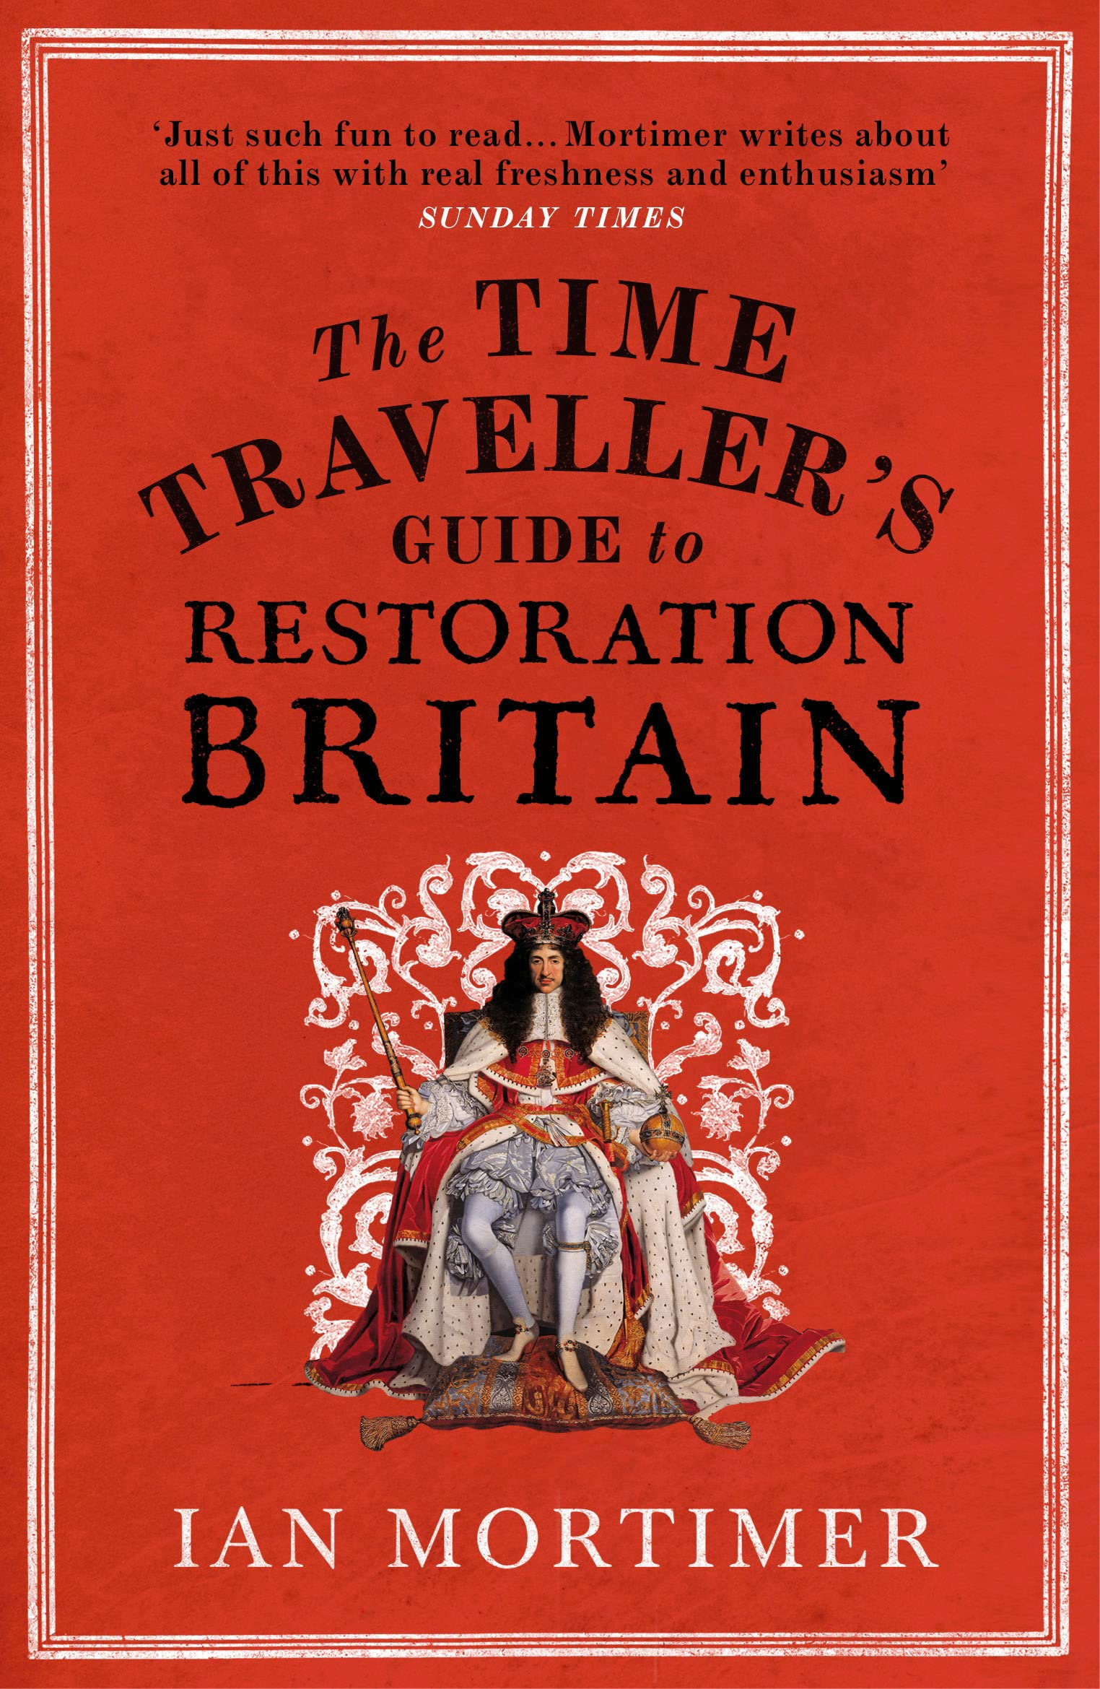
Adding Equality,
Diversity and Inclusion to Our Specification
AB Germany, 1890–1945: Democracy and dictatorship
BB Conflict and tension: The inter-war years, 1918–1939
AB Britain: Power and the people, c1170 to the present day
BD Restoration England, 1660–1685
Notes:
Images: www.amazon.co.uk/Travellers-Third-Reich-Fascism-Everyday/dp/1783963468; www.amazon.co.uk/Glamour-Boys-Secret-Rebels-Britain/dp/1526601737/ref=tmm_pap_swatch_0?_encoding=UTF8&qid=1666437626&sr=1-1; www.amazon.co.uk/Black-British-short-essential-history/dp/1529063396/ref=d_pd_sbs_sccl_2_2/257-0828999-3735122?pd_rd_w=HDDtJ&content-id=amzn1.sym.a0b3831c-e4a4-4b9c-9a28-e04b8e3b1f51&pf_rd_p=a0b3831c-e4a4-4b9c-9a28-e04b8e3b1f51&pf_rd_r=420BDZJRW3BMKKQFXPVH&pd_rd_wg=q9hkE&pd_rd_r=b4067e6c-c6b3-41c5-9e4d-554508640baf&pd_rd_i=1529063396&psc=1; www.amazon.co.uk/Time-Travellers-Guide-Restoration-Britain/dp/0099593394/ref=tmm_pap_swatch_0?_encoding=UTF8&qid=1666437758&sr=1-1

Slide 12
Diverse voices
Part one: Challenging authority and feudalism
Constraints on kingship: the barons’ dissatisfaction with King John’s rule and its resolution; Magna Carta, its terms and its short- and long-term impact.
The origins of Parliament: issues between King Henry III and his barons; the role of Simon de Montfort; the Provisions of Oxford and the Parliament of 1265 and their short- and long-term impact.
Medieval revolt and royal authority: the social, economic and political causes of the Peasants Revolt; actions by rebels and government; impact of the Peasants’ Revolt.
Part two: Challenging royal authority
Popular uprisings against the Crown: the social, economic, religious and political causes of the Pilgrimage of Grace; the implications for royal authority; Henry VIII and his government’s reaction and the impact of the uprising.
Divine Right and parliamentary authority: the causes of the English Revolution; the New Model Army and the development of political radicalism during the Civil War era; the short- and long-term impact of the English Revolution, including the significance of the trial and execution of Charles I, and Oliver Cromwell and the Commonwealth.
Royal authority and the right to representation: the causes of the American Revolution, including the relationship between the government and people; impact and significance of the American Revolution.
Part three: Reform and reformers
The extension of the franchise: radical protest; the Great Reform Act, causes and impact, including further reform; Chartism, causes, actions and impact.
Protest and change: campaigning groups and their methods and impact, including the anti-slavery movement; the Anti-Corn Law League; factory reformers; social reformers.
Workers movements: the development of trade unionism and its impact, including Grand National Consolidation Trades Union (GNCTU), Tolpuddle Martyrs, New Model Unions and new unionism, including the match girls’ and dockers’ strikes.
Part four: Equality and rights
Women’s rights: the campaign for women’s suffrage, reasons, methods and responses; role of individuals, including the Pankhursts; the reasons for the extension of the franchise and its impact; progress towards equality in the second half of the twentieth century.
Workers’ rights: the General Strike (1926), actions, reactions and impact; trade union reform in the late twentieth century.
Minority rights: the development of multi-racial society since the Second World War; discrimination, protest and reform; the Brixton Riots and their impact, including the Scarman Report.
Women and Magna Carta
Eleanor De Montfort
Johanna Ferrour
Africans in the ECW
Jane Whorwood
John Dyott
Nanye-hi aka Nancy Ward
William Cuffy
Annie Knight
Women of Tolpuddle
Kitty Marion
Sophie Duleep Singh
Rosa May Billinghurst
Lesbian and gays support the miners
Diane Abbott

Slide 13
Year | Source (8) | Significance (8) | Similarity (8) | 16-marker
Sample 1 | Cromwell | Explain the significance of the signing of the Magna Carta in the development of the rights of the British people | Explain two ways in which the Peasants’ Revolt and the campaign for the People’s Charter were similar | Has religion been the main factor in causing protest in Britain since medieval times?
Sample 2 | Votes for women | Explain the significance of the trial and execution of Charles I for royal authority | Explain two ways in which the campaigns for workers’ rights in the nineteenth century and protests for the rights of ethnic minorities in the twentieth century were similar | Has war and violence been the main way in which royal authority and governments have been challenged?
2018 | Chartism | Explain the significance of the American Revolution | Compare the Tolpuddle Martyrs with the people involved in the General Strike of 1926 | Has the role of the individual been the main factor in promoting people’s rights in Britain?
2019 | Pilgrimage of Grace | Explain the significance of the General Strike | Compare the Peasants’ Revolt with trade unionism in the nineteenth century | Has war and violence been the main factor in the development of Parliament?
2020 | Votes for women | Explain the significance of the Great Reform Act | Explain two ways in which Simon de Montfort and Oliver Cromwell were similar | Have economic factors been the main cause of protest in Britain?
2021 | Charles I | Explain the significance of the Provisions of Oxford and the Parliament of 1265 | Explain two ways in which the Peasants’ Revolt and the American Revolution were similar | Has the government been the main factor in improving people’s rights in Britain?
2022 | Tolpuddle Martyrs | Explain the significance of the Brixton Riots | Explain TWO WAYS in which the Magna Carta and the Great Reform Act were similar | Have ideas, such as equality and democracy, been the main reason for protest in Britain?

Slide 14
Year | Source (8) | Significance (8) | Similarity (8) | 16-marker
Sample 1 | Cromwell | Explain the significance of the signing of the Magna Carta in the development of the rights of the British people | Explain two ways in which the Peasants’ Revolt and the campaign for the People’s Charter were similar | Has religion been the main factor in causing protest in Britain since Medieval times?
Sample 2 | Votes for women | Explain the significance of the trial and execution of Charles I for royal authority | Explain two ways in which the campaigns for workers’ rights in the nineteenth century and protests for the rights of ethnic minorities in the twentieth century were similar | Has war and violence been the main way in which royal authority and governments have been challenged?
2018 | Chartism | Explain the significance of the American Revolution | Compare the Tolpuddle Martyrs with the people involved in the General Strike of 1926 | Has the role of the individual been the main factor in promoting people’s rights in Britain?
2019 | Pilgrimage of Grace | Explain the significance of the General Strike | Compare the Peasants’ Revolt with trade unionism in the nineteenth century | Has war and violence been the main factor in the development of Parliament?
2020 | Votes for women | Explain the significance of the Great Reform Act | Explain two ways in which Simon de Montfort and Oliver Cromwell were similar | Have economic factors been the main cause of protest in Britain?
2021 | Charles I | Explain the significance of the Provisions of Oxford and the Parliament of 1265 | Explain two ways in which the Peasants’ Revolt and the American Revolution were similar | Has the government been the main factor in improving people’s rights in Britain?
2022 | Tolpuddle Martyrs | Explain the significance of the Brixton Riots | Explain TWO WAYS in which the Magna Carta and the Great Reform Act were similar | Have ideas, such as equality and democracy, been the main reason for protest in Britain?

Slide 15
Year | Source (8) | Significance (8) | Similarity (8) | 16-marker
Sample 1 | Cromwell | Explain the significance of the signing of the Magna Carta in the development of the rights of the British people | Explain two ways in which the Peasants’ Revolt and the campaign for the People’s Charter were similar | Has religion been the main factor in causing protest in Britain since Medieval times?
Sample 2 | Votes for women | Explain the significance of the trial and execution of Charles I for royal authority | Explain two ways in which the campaigns for workers’ rights in the nineteenth century and protests for the rights of ethnic minorities in the twentieth century were similar | Has war and violence been the main way in which royal authority and governments have been challenged?
2018 | Chartism | Explain the significance of the American Revolution | Compare the Tolpuddle Martyrs with the people involved in the General Strike of 1926 | Has the role of the individual been the main factor in promoting people’s rights in Britain?
2019 | Pilgrimage of Grace | Explain the significance of the General Strike | Compare the Peasants’ Revolt with trade unionism in the nineteenth century | Has war and violence been the main factor in the development of Parliament?
2020 | Votes for women | Explain the significance of the Great Reform Act | Explain two ways in which Simon de Montfort and Oliver Cromwell were similar | Have economic factors been the main cause of protest in Britain?
2021 | Charles I | Explain the significance of the Provisions of Oxford and the Parliament of 1265 | Explain two ways in which the Peasants’ Revolt and the American Revolution were similar | Has the government been the main factor in improving people’s rights in Britain?
2022 | Tolpuddle Martyrs | Explain the significance of the Brixton Riots | Explain TWO WAYS in which the Magna Carta and the Great Reform Act were similar | Have ideas, such as equality and democracy, been the main reason for protest in Britain?

Slide 16
conclusion
Diversity is in the specification.
We leave silences based on our choices.
You can put diverse voices back in.
The utility of these diverse voices for the exam is questionable.

