Slide 1
Britain: Power and the people 1170–current day
Building greater diversity into our AQA thematic paper

Slide 2
Overview of content
Part 1: Challenging authority and feudalism
Part 2: Challenging royal authority
Part 3: Reform and reformers
Part 4: Equality and rights

Slide 3
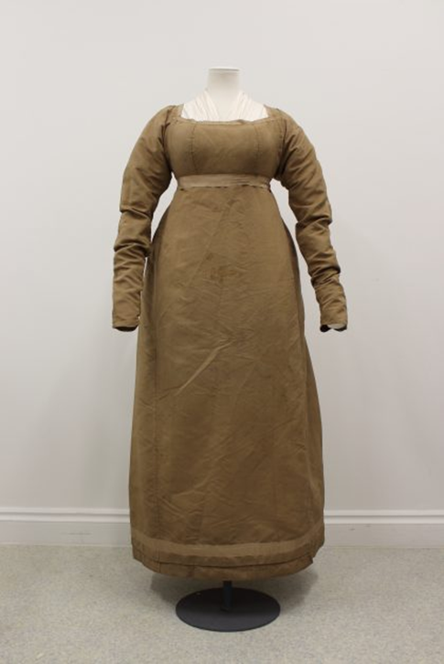
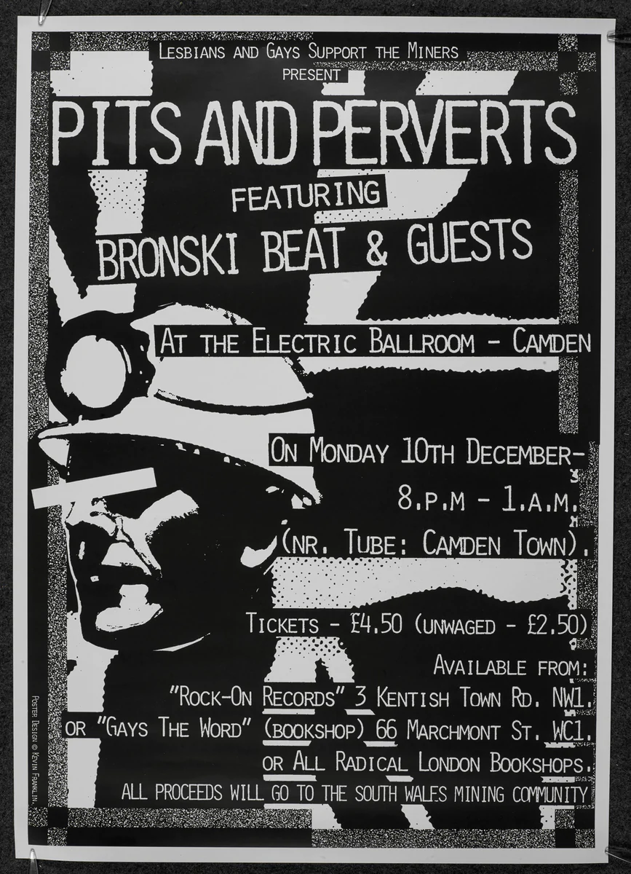
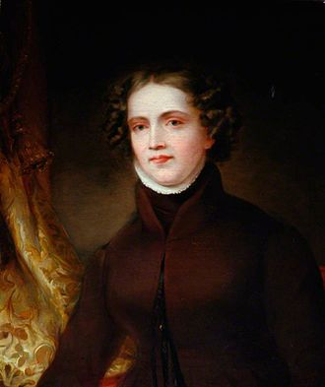
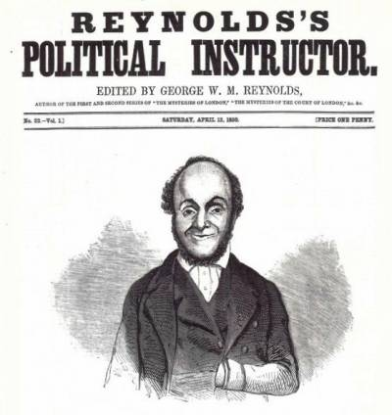
Power of individual stories
Johanna Ferrour: ‘chief perpetrator and leader of rebellious evildoers from Kent’.
Margaret Cheney: ‘There can be no doubt that many women were ardent supporters of the Pilgrimage.... Lady Bulmer’s execution... was an object-lesson to husbands... to teach them to distrust their wives.’
John Blanke (‘Meanwhile, Elsewhere… Mughals’) – routine representation
Lady Ann Cunningham: ‘She goeth in armour and with a pistoll by her side readie charged, and wishes him there, saying shee would burie the bullets in his bowels’.
Women at Peterloo – Helen Antrobus (PHM): https://phm.org.uk/blogposts/the-women-of-peterloo
William Cuffay – Chartism
Anne Lister – Victorian entrepreneur
Sarah Chapman and the 1888 Match Girls’ Strike (PHM): https://phm.org.uk/blogposts/the-match-girls-strike
Windrush: www.bl.uk/windrush (Floella Benjamin – Coming to England)
Made in Dagenham – Shirley Williams
LSGM and the Miners’ Strike (Pride)
David Lammy on Grenfell and the Hostile Environment Policy
Notes:
Images (clockwise from top left): https://phm.org.uk/blogposts/the-women-of-Peterloo; © Kevin Franklin, www.bl.uk/collection-items/pits-and-perverts; www.wcml.org.uk/our-collections/activists/william-cuffay; https://en.wikipedia.org/wiki/Anne_Lister

Slide 4
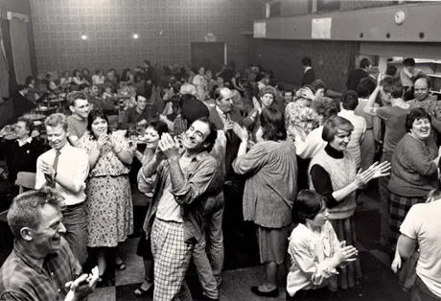
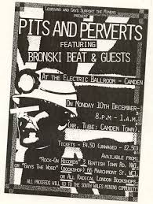
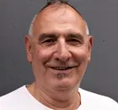
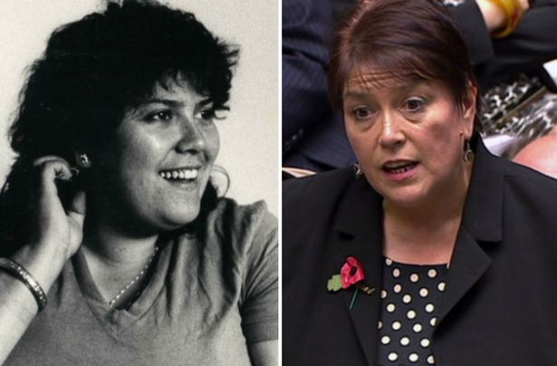
Meanwhile, elsewhere… in the LGBTQ+ community (1984–5)
In the midst of pit closures and the economic uncertainty of the early to mid 1980s, an unlikely alliance formed between a mining community in South Wales and a gay and lesbian group from London. The group became known as LGSM (Lesbians and Gays Support Miners) and raised over £11,000 for the people of Dulais Valley. Although, on the surface, they appeared to have little in common, in an era of homophobia and anti-union sentiment, they were drawn together through hatred of Margaret Thatcher, the police and the tabloids.
In 1984, the LSGM drove a few old minibuses and a clapped-out VW campervan to South Wales to present their donations to the miners. They were unsure of the kind of reception they would receive. Fortunately for all involved, a sense of solidarity prevailed. Mark Ashton, who died of AIDS in 1987, was one of the founders of LGSM and argued: ‘One community should give solidarity to another. It is really illogical to say, “I'm gay and I'm into defending the gay community but I don't care about anything else…”.’
A key negotiator between LSGM and the miners of Dulais was Dai Donovan, an open-minded and warm representative of miners in South Wales. He spoke out at 1984 benefit concert ‘Pits and Perverts’ (a phrase used by the Sun newspaper, which LGSM reclaimed!). This concert raised nearly £6,000 to support those on strike. Up to this day, Donovan continues to speak out against homophobia, reminding people that it is wrong to persecute others simply because of who they love. In 2019 he said, ‘To effect real change, you have to go out of your comfort zone, join with others, to argue and to defend what you believe in. Together you are stronger.’
This bit of history was kept relatively hidden until it became the subject of a film in 2014, Pride. The writer, Stephen Beresford, describes the narrative as ‘a legend in the gay community. But it was like Chinese whispers – I wasn't sure whether to believe it.’ Much of the archive material was kept in the People’s History Museum in Manchester.
To show their support to the LGSM, the Welsh miners attended the Pride March in London in 1985. This was revolutionary at the time, but testament to the fact that, regardless of sexuality or background, we are all people and should stand together for things that we believe are worthwhile causes.
Key people
Jonathan Blake was a key activist in LGSM. He was one of the first people to be diagnosed with HIV in the UK and recently celebrated his 70th birthday. ‘With the South Wales miners at the 1985 Labour party conference, we put gay rights on the agenda. The [resulting equality resolution] became the trajectory that would lead to civil partnerships and marriages. The NUM didn’t want anything to do with poofs. But Dai [Donovan] put pressure on them – he was as good as his word.’
Sian James worked closely with the LGSM in the 1980s. She had been married at 16 and had two children by the age of 20. She helped to feed families during the strike and felt afterwards that people believed she had a voice worth listening to. She went to college and got her qualifications, and went on to become a Labour MP for Swansea East. She says, ‘It doesn't matter what colour, sexuality or creed you are, there will always be a common thread.’
Notes:
Images (clockwise from top left): Theodor Adorno, via www.versobooks.com/blogs?post_author=88111; People’s History Museum, via www.theguardian.com/film/2014/aug/31/pride-film-gay-activists-miners-strike-interview; www.walesonline.co.uk/news/politics/welsh-labour-mp-former-office-11009704; © Kevin Franklin, www.bl.uk/collection-items/pits-and-perverts; Andy Hall for the Observer, via www.theguardian.com/film/2014/aug/31/pride-film-gay-activists-miners-strike-interview

Slide 5
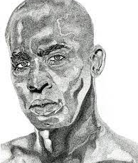
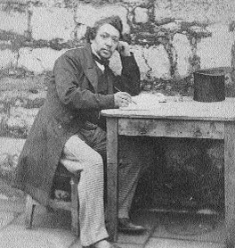
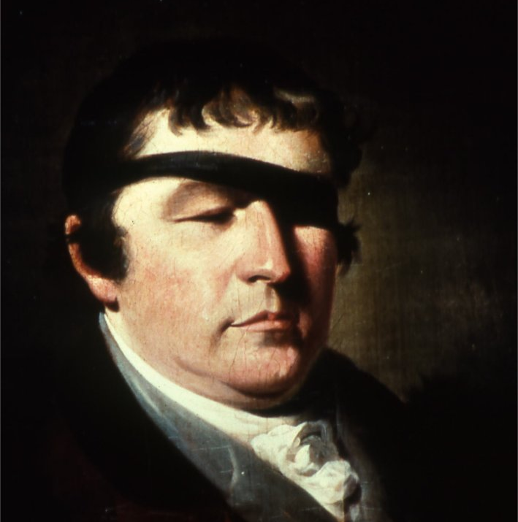
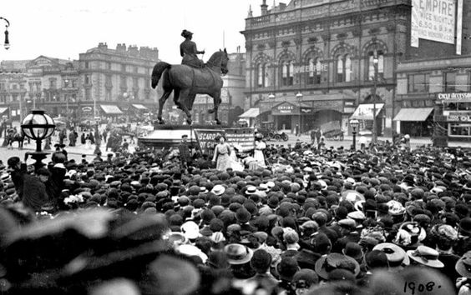
Local dimensions
Widows from Liverpool petitioning the government during the ECW
Jack Gladstone, leader of the Demerara Rising 1823
James Brown (not the singer!) – founder of democracy in the Isle of Man
Edward Rushton – blind abolitionists
Kate Sheppard and Florence Barry: www.mappingwomenssuffrage.org.uk
Currently working on an oral history project with drama department about events in Toxteth in 1981
Anthony Walker
Photographs showing familiar places in different times
Notes:
Images (clockwise from top left): Errol Ross Brewster, via www.stabroeknews.com/2022/01/17/features/in-the-diaspora/white-debt-time-for-britain-to-pay-up-for-its-legacy-of-slavery; www.tynwald.org.im/education/history/1867/Pages/brown.aspx; www.alamy.com/stock-photo-four-suffragettes-speaking-opposite-the-empire-theatre-liverpool-1908-28224629.html; https://en.wikipedia.org/wiki/Edward_Rushton

Slide 6
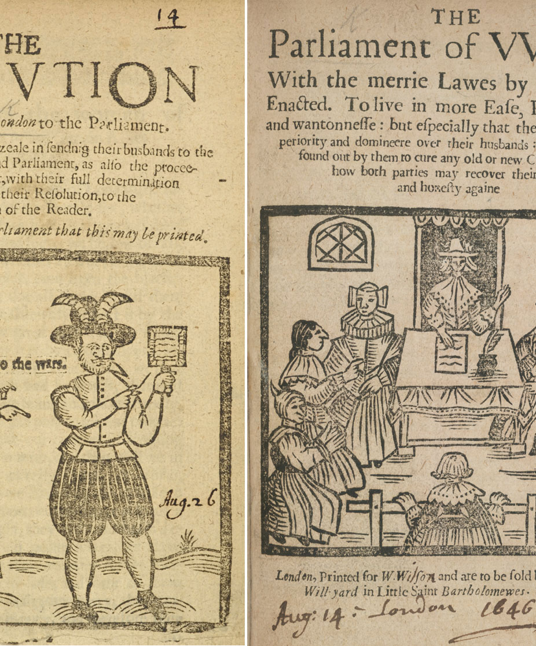
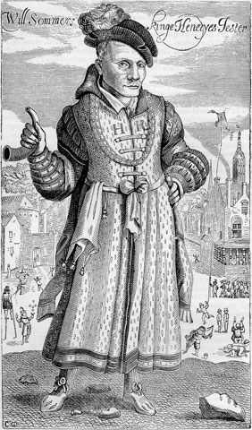
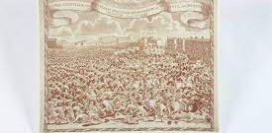
Use of primary evidence
Material culture and objects to uncover narratives from the past – discussions about historical silences and how to populate them (subversive cross stitch!)
Visibility of women
Visibility of working class
Visibility of people of colour
Visibility of queer history
Visibility of disability
Notes:
Images (clockwise from top left): ©British Library, via www.nationalarchives.gov.uk/education/resources/women-english-civil-wars/women-english-civil-wars-source-7; https://en.wikipedia.org/wiki/Will_Sommers; ©People’s History Museum, via http://teachinghistory100.org/objects/about_the_object/peterloo_handkerchief

Slide 7
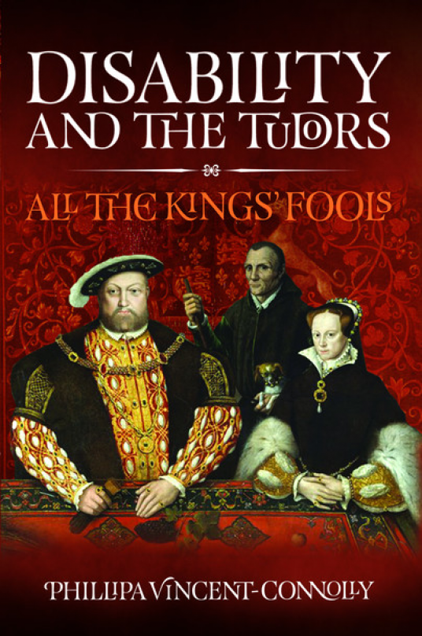
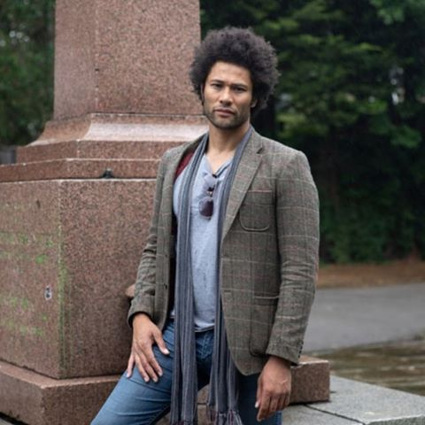
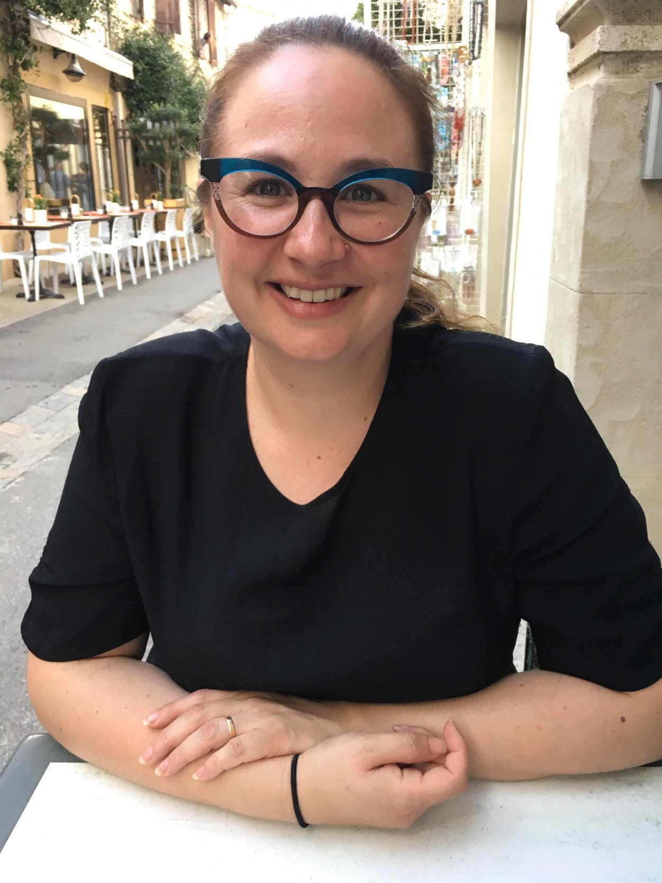
Selecting interpretations
Notes:
Images (clockwise from top left): www.waterstones.com/book/england-arise/juliet-barker//9780349123820; www.amazon.co.uk/Disability-Tudors-All-Kings-Fools-ebook/dp/B09KQ3JBXY; https://twitter.com/nml_muse/status/1291355079572848645; www.amazon.co.uk/Black-British-short-essential-history/dp/1529063396; www.amazon.pl/Queer-City-London-Romans-Present/dp/0099592940; https://blog.royalhistsoc.org/2021/07/23/rhs-publication-research-and-teaching-awards-2021; www.amazon.co.uk/gp/product/B0791JCDSB/ref=dbs_a_def_rwt_hsch_vapi_tkin_p1_i1

Slide 8
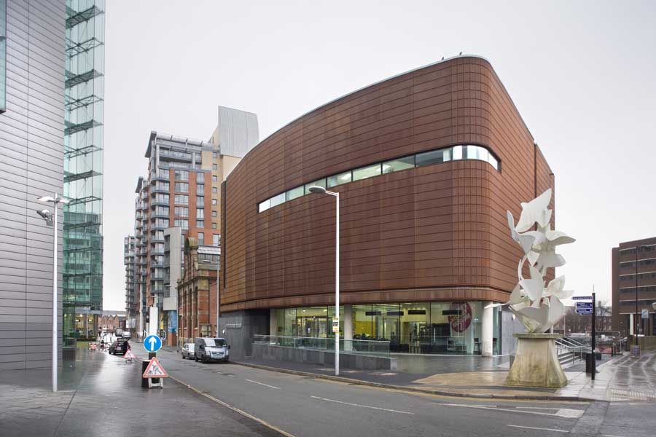
Useful resources to build in more diverse voices
Meanwhile, Elsewhere…
RETEACH
People’s History Museum Manchester (blogs, objects and drama sessions)
Citizens Project
Historic England – oral histories pack
Walking tours with local historians
Podcasts
Notes:
Images (clockwise from top left): https://historicengland.org.uk; www.royalholloway.ac.uk/research-and-teaching/departments-and-schools/history/what-will-i-study/citizens-project; www.austinsmithlord.com/projects/peoples-history-museum; https://reteach.org.uk/subject/history

Slide 9
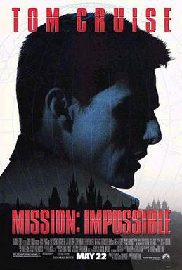
Barriers
Specifications are Anglo-centric and dominated by White male voices
Absence of truly global focus
Ofqual decision to cut 25% of GCSE due to COVID is telling – getting through the specification is a mission
Where to look? How to find the best stories?
Teachers are notoriously time-poor
Results – ‘Is this on the spec, Miss?’
Notes:
Image: https://spectrumculture.com/2013/04/18/oeuvre-de-palma-mission-impossible

