Slide 1
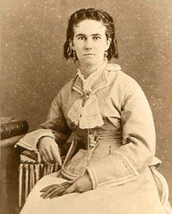
A lack of emotion
Silences within the narrative
    Women
    Non-White perspectives
Language
Content demands
People named/language used in the specification
Notes:
Image: https://cattleraisersmuseum.org/wp-content/uploads/2020/03/Life-on-the-Trail.pdf

Slide 2
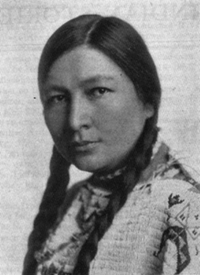
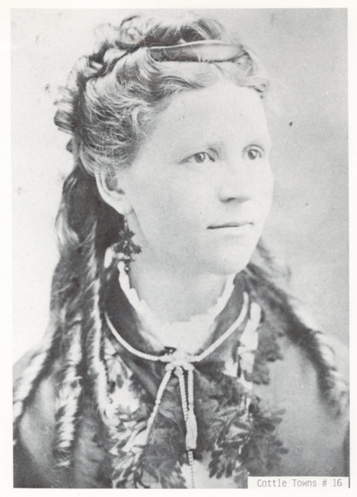
Within a new, restructured scheme…
Focus on the point of analysis, not the event itself
In the same way, focus on the analysis and not the name
Enquiry questions that include women’s names:
Why did Buffalo Calf Road Woman decide to fight at Wounded Knee?
Enquiry questions that encourage you to analyse a cross-section of groups:
What was the impact of… on… ?
Notes:
Images: https://conservancy.umn.edu/bitstream/handle/11299/166100/Bonnin,%20Gertrude%20.%20Zitkala-Sa.pdf;sequence=1; www.kshs.org/p/abbie-bright-papers/13986

Slide 3
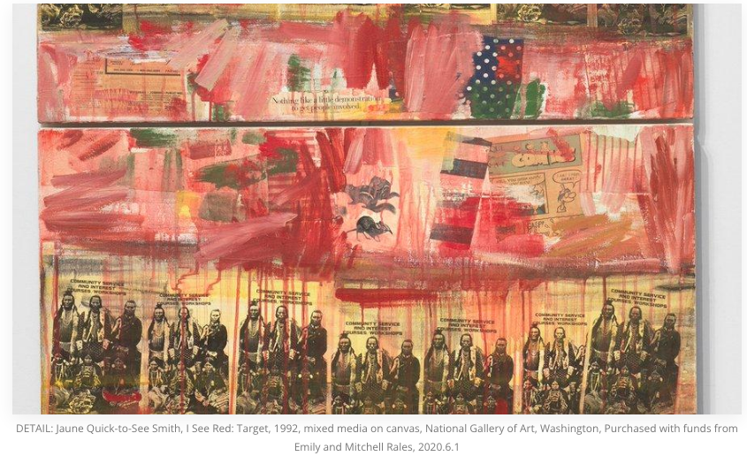
Within a new, restructured scheme…
Wider range of sources and illustrations that link to the present day
Jaune Quick-to-See-Smith:
See Red: Target (1992)
Notes:
Image: Twitter/National Gallery of Art, DC, via www.artfixdaily.com/artwire/release/1265-national-gallery-of-art-adds-its-first-ever-painting-by-a-native-

