Slide 1
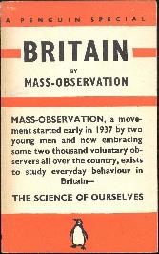
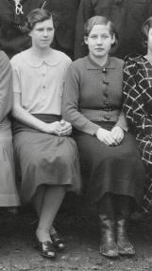
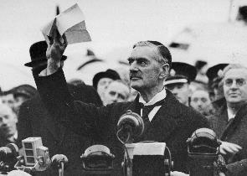
Reflections and guidance for teachers on new perspectives for teaching the history of appeasement in the classroom
Andrew Wrenn Teacher Fellow of the Historical Association andrew_wrenn@btinternet.com

Slide 2
Contents
Introduction: Slide Three
How does Trouillot claim history is produced?: Slide Four
Points for reflection: Slide Ten
Using Original Sources in the classroom: Slide Twelve
Lesson Example: Slide Seventeen
Source Extracts (without citations for classroom use): Slide Twenty-Nine
Source Extracts (with citations): Slide Thirty-Six
Dodgy Enquiry Questions: Slide Forty-Six

Slide 3
Introduction
This document is based on a presentation made to teachers on 7 June 2023 as part of the project New Approaches to Teaching the History of Appeasement in the Classroom, based at the University of Sheffield, led by Prof. Julie V. Gottlieb. It aims to support teachers in thinking about how to make best use of a range of previously neglected sources that reveal popular reactions to the policy of appeasement in Britain in the late 1930s. It draws on Gottlieb’s history from below/ history from within approach to the Munich Crisis. This includes evidence from the Mass-Observation Archive and F L. Lucas’s Journal Under the Terror, 1938 (1939). Lucas was a vocal critic of appeasement.
In considering how teachers might plan to incorporate these fresh sources in to schemes of work, the author was struck by the opportunity to consider the general relationship between historians and source material and whether reflecting on this might support different possible planning approaches.
The thinking of the Haitian historian Michel Rolph-Trouillot has become influential in history education in recent years. He asserts that “any historical narrative is a bundle of silences” (M. R. Trouillot, Silencing the Past ; Power and the Production of History (Beacon Press, 1995). By this he partly means that historians make choices about whose voices and experiences will be included in any historical narrative they create (and whose will not). However, Trouillot uses his experience of writing black history to make universal claims about how history itself is produced. In likening the process of writing history to a factory production line, Trouillot considers how a historian’s account of events might be influenced by the availability of source material and he claims that silences enter the process of historical production at four crucial moments.

Slide 4
How does Trouillot claim history is produced?

Slide 5
Stages of `historical production`
Stage One
Fact creation (making sources- not everyone records their experiences)
Stage Two
Fact Assembly (making archives by selecting surviving sources but excluding others)
Stage Three
Fact Retrieval (making narratives from selected sources from the archive)
Stage Four Ascribing Significance (making history)
Silence One
Silence Two
Silence Three
Silence Four

Slide 6
Fact creation
The first is “the moment of fact creation (the making of sources)”. By this Trouillot means any record or sources of evidence left behind by those alive in a particular period. Throughout history there are massive gaps in the record of evidence. Not everyone is able or wishes to record their experiences. For example, the voice of the illiterate poor and the enslaved are usually missing. With a few notable exceptions, the historian has to draw on surviving accounts produced by those sufficiently motivated to record their experiences.
These may be from the educated or privileged few. Their accounts may not only be skewed by their social and economic status, but also limited by their personal attitudes and the breadth of their experience.

Slide 7
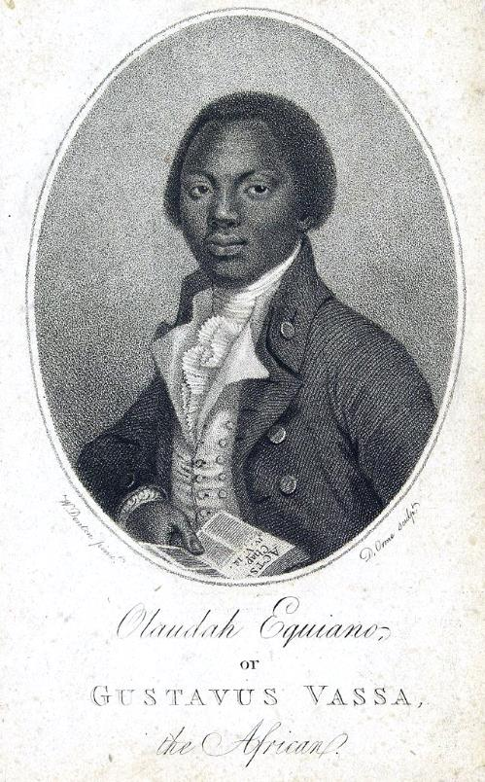
It means any surviving evidence from the point of view of those who did not usually record their experiences (or whose evidence did not survive) becomes particularly significant and is required to do much of the historian’s heavy lifting for them. Generalisations are sometimes made from sources such as the surviving narratives of enslaved Africans, so that they can stand in for the majority of their silent fellows. However, this is in itself a problematic approach for such narratives may be limited because of their lack of typicality and because of the particular purpose and intended audience of the text.
For example, The Interesting Narrative by enslaved African Olaudah Equiano includes a harrowing account of the middle passage of the Transatlantic Slave Trade (The Interesting Narrative of the Life of Olaudah Equiano, Or Gustavus Vassa, The African, London, 1789). It is invaluable to historians because of its rarity. Yet the narrator was writing about his childhood experiences from an adult perspective and to elicit the sympathy of white Britons, who might be co-opted to the abolitionist course. The possibility has also been raised that Equiano was actually born in North America and may not have been writing from personal experience of the middle passage at all.
Public Domain

Slide 8
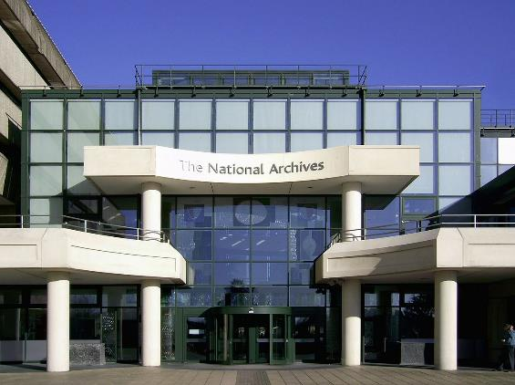
Fact assembly and fact retrieval
Trouillot’s second stage of historical production (i.e the process of creating history) is what he calls fact assembly, namely the creation of archives. Those who create archives both select and exclude what will be preserved. This may not be just because the archive creators deliberately wish to expunge a point of view or the experience of a particular individual or category of people. Material might appear to be too trivial or may be regarded as irrelevant at the time the archive is created. In addition, war, revolution or natural disasters may result in the destruction of valuable evidence.
The third stage of historical production is identified as fact retrieval. This marks the entry of the historian themselves into the creation of history. The historian selects sources from the archive of surviving evidence to create a narrative. In so doing, they may leave out or neglect certain sources. This may be the result of conscious bias. However, it may also be because evidence appears to be irrelevant to inform the historical problems or questions the historian is posing at the time they are completing their research.

Slide 9
Making history
Trouillot identifies the final stage of the production of history as the moment of ascribing retrospective significance to events, what he calls the “making of history in the final instance”.

Slide 10
Points for reflection
How convincing do you find Trouillot’s model of historical production?
In reflecting on this, I considered my own personal experience as an amateur family historian following my father’s recent death. My starting point was as an archivist of his possessions, whittling down vast amounts of evidence of his life from a house occupied by my parents for 54 years. In selecting sample materials for a “memory box“ I tried to reflect his most important traits, interests and experiences. However, the majority of material was discarded or later sold (what might a receipt for a pair of shoes purchased in a sale of 1962 really tell me for example? The answer would be his shoe size, the price of shoes at the time, his love of a bargain and what I already knew- that he was meticulous in throwing nothing away. But I did not choose to archive this evidence!)
At the funeral, I chose to give a brief valedictory account of his life, which was shaped by the nature of the occasion and by my bereaved feelings at the time. There are some things I did not say. There were some things that I did not include at the time because I didn’t know about them. Some of what I didn’t know at the time would not have been included anyway. If I ever wrote a biography of my father’s life, it would be different in length and tone.

Slide 11
How does Trouillot’s model of historical production measure up to our personal experience?
The process of production, as we have seen, involves several potential silences at each stage and part of our role as history teachers can be to ensure that these silences are recognised. In doing so we create a more rounded view of events for pupils, giving a voice to those who may have been silenced, deliberately or otherwise.
In some cases, this process may involve informed speculation about common experiences, bordering on historical fiction. In other cases, it may involve giving prominence to neglected, original sources, as is the case with the history of appeasement in the late 1930s.

Slide 12
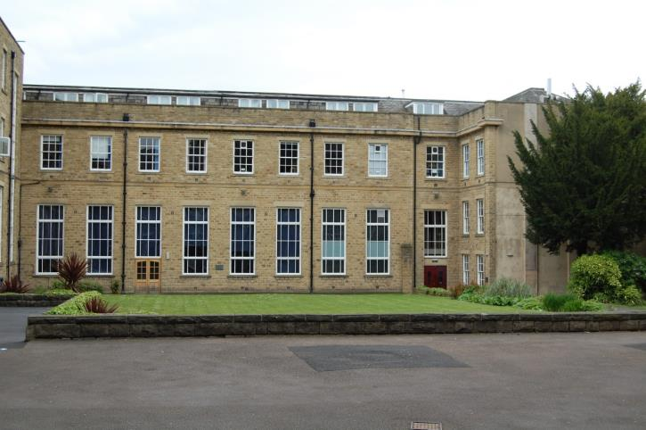
Using Original Sources (primary material) in the classroom
History teachers have been making use of original source material in the classroom for many decades.
As part of this project, history teacher, Donna Shoesmith-Evans of Woodhouse Grove School used extracts of evidence from the Mass Observation Archive and a published letter of F. L Lucas to create a high - quality test paper in the style of the history GCSE her school offers. She was excited by the opportunity of introducing her pupils to unfamiliar material about a well- studied topic.
Lesson observations of Donna’s teaching and the test paper she wrote are included in the project resources. However, Donna’s use of the source material was limited by the classroom time she could afford to devote to the study of it and the constraints of fitting it into a traditional GCSE format. One of the limitations of asking a series of questions comparing and contrasting relatively short extracts or gobbets of original evidence is that it can lead to some common pupil misconceptions (these were not evidenced in Donna’s teaching!).

Slide 13
One misconception that pupils may have is that original (primary) sources are always more reliable than historical interpretations (secondary sources). An assumption is made that an eyewitness is always more reliable than someone writing later who did not experience the events concerned. Of course, the opposite can quite easily be true. An historian, for example may have access to a far greater range of evidence that an eyewitness ever encountered.
The second pupil misconception is that if a source is biased (often misspelt as biast) then this means it is less useful or useless as evidence (this stems from the powerful and important motivation of an historian to be striving for some kind of objective truth, however, elusive, that might prove to be). The point is missed, of course, that however partial a source might be, it can still be useful as evidence of a particular attitude or viewpoint.
“All sources are biased.
Get over it!”
Andrew Payne, The National Archives

Slide 14
Enquiry questions
KS3 history can allow more planning freedom than a crowded GCSE specification. A good starting point can be the generation of a range of possible enquiry questions for debate among colleagues in a department. This was likened by Michael Riley and Jamie Byrom to professional wrestling.
M. Riley and J. Bryom, ‘Professional wrestling in the history department: a case study of teaching the British Empire at KS3’, Historical Association, 8th December 2008, https://www.history.org.uk/secondary/resource/1628/professional-wrestling-in-the-history-department [accessed 21/09/23].
Which questions pose the most interesting problems, challenges or puzzles for pupils to answer?
Which are the best worded?
Which are directed at particular disciplinary concepts?
Which questions might potentially build into a lesson sequence?
Are any questions “dodgy”? If so, why?
The list in the next slide are of potential enquiry questions I devised which could be used to lead study of British public opinion about appeasement in 1938 and 1939, including extracts from Mass-Observation and the writing of FL Lucas. They assume that pupils will already have covered an overview of appeasement itself and its chronology.

Slide 15
Potential enquiry questions
Who spoke to the British people about crises in foreign policy in Britain in 1938 and 1939?
Why did the British people only hear some voices on appeasement in 1938 and 1939?
What opinions did British people hear about appeasement in 1938 and 1939?
Why were some voices about appeasement louder than others in Britain in 1938 and 1939?
Which sources can we trust most for telling us about British attitudes towards appeasement in 1938 and 1939?
From whom did British people hear about appeasement between 1938 and 1939?
From whom did British people not hear about appeasement and why not?
Why did the British people support appeasement?*
To what extent can we tell what ordinary people felt about appeasement?
Which original sources about appeasement have an historian and playwright used to write about it?
How typical were F.L. Lucas’s views about appeasement?
How useful are Mass-Observation and F.L. Lucas’s Journal for telling us about appeasement?
Why are all sources about appeasement biased?*
What can a 1938 Christmas card tell us about attitudes towards Neville Chamberlain’s actions during the Munich Crisis?
*The questions with astericks are deliberately weakly worded for weeding out in departmental discussion. Why did the British people support appeasement? assumes they did which is not proven. Why are all sources about appeasement biased? is a valid question but may reinforce pupil misconceptions that all sources are therefore of no use or value.

Slide 16
Potential enquiry questions
If I had to choose one question from the list, it would be ‘To what extent can we tell how ordinary people thought about appeasement during the Munich Crisis?’
My reasoning behind this choice was because the question
challenges pupils to reach a nuanced response in answer to it
keeps the breadth of source material that could be included wide. However, the focus of study is deliberately narrow by concentrating on the reaction to appeasement at its apogee during the Munich Crisis of 1938. I chose not to widen the question to take in the whole period when appeasement was in operation because the intention is to take a snapshot of public attitudes at a particular time, rather than track how public opinion changed which would be a different question.

Slide 17
Lesson example
The following is a description of a lesson or learning episode based on answering the above enquiry question (the rationale behind particular activities is given in italics in brackets).
Starter
Display the photograph of Neville Chamberlain and his wife, pictured with King George VI and Queen Elizabeth at the time of the Munich Crisis, explaining that this was sent as a Christmas card in 1938 by a member of the public to someone they knew (the source is cited in Gottlieb’s research). Allow limited time to discuss why someone might do this and then take comments from individuals.
(The point of the starter is to remind pupils of prior learning about Chamberlain’s role during the Munich Crisis, and to show that some British people were deeply supportive of appeasement. In the short term, public opinion seems to have been on Chamberlain’s side as many people felt relief that his negotiations with Hitler had averted another world war. Why else would someone send this photograph as a Christmas card?)
The photograph can be viewed here: https://www.npg.org.uk/collections/search/portrait/mw185228/King-George-VI-Neville-Chamberlain-Annie-Vere-Chamberlain-ne-Cole-Queen-Elizabeth-the-Queen-Mother

Slide 18
Activity 1
Give pairs or small groups a copy of this continuum, which summarises the polarisation of British public opinion during the Munich Crisis (quotes are made up to summarise particular viewpoints but reflect the language and attitudes of the period). Then give out some or all of the unattributed extracts contained in slides 30 to 35 as a card sort, explaining that these are statements of opinion by members of the British public at the time. Ask pairs/small groups to read each one in turn and place them on the continuum.
A sample extract could be read by the teacher initially for whole class discussion, deciding together where it might be placed on the continuum. For purposes of adaptive teaching, the number of extracts could be limited and the meanings of words or phrases placed in brackets. Some would require an explanation of particular references , for example to Oswald Mosley, the leader of Britain’s fascist movement.
Strongly in favour
Uncertain/Anxious
Strongly against
Appeasement is the best way of avoiding another terrible war. Mr Chamberlain is right to seek a political agreement with Herr Hitler.
Appeasement may be right and it may be wrong. I’m scared war will break out.
Appeasement is a terrible policy. We are betraying Czechoslovakia by giving in to a bully (Germany) who will never be satisfied. We will still have to fight Hitler in the end.

Slide 19
(The reasons for completing the above exercise using a large number of deliberately unattributed quotes are;
For pupils to sample a range of contemporary opinions, reading and analysing the arguments they present
For pupils to see that there was a genuine range of opinion
For pupils to concentrate on the opinions themselves, deliberately not focusing at this stage on the provenance of a source)
The teacher can then lead discussion, asking for examples of particular opinions and challenging pupils to justify where they placed them on the continuum.
Activity 2
Next, display the boxes below which describe headings for particular types of source. Give these out to pairs/small groups and ask pupils to re-read and reorganise the extracts of opinion so that they placed under a particular heading. A sample extract could be read out by the teacher for the whole class discussion about where it might be placed.
(The reason for completing this exercise at this point is for pupils to re-read each source in turn, but this time looking for any indications from within the text as to the possible social class or background of the individual e.g. through the use of particular vocabulary or turns of phrase)
Extracts from memoirs written by upper class people writing after the event and reflecting back on it
Comments from ordinary people recorded by Mass Observation at the time
Extracts from a journal written by an opponent of appeasement at the time and meant for publication afterwards
Quotes from the speeches of politicians at the time
Quotes from newspaper articles at the time

Slide 20
Lead class discussion, challenging pupils as to why they have placed particular sources under particular headings.
Lastly, from slides 37 to 45, reveal the provenance of the sources and collections of sources in turn, carefully explaining the circumstances in which they were produced and who the intended audiences were. Lead discussion about how many could be said to be evidence of the thinking of ordinary people given what pupils now know about who wrote the extracts and for what purpose. Pupils could then reorganise any sources they placed under the wrong heading.
(The revelation of the provenance of the sources shows pupils that the opinions expressed sometimes directly reflected the political or social background of the writer. However, in some cases, as in the views of Churchill and F.L. Lucas, it was possible to share an opposition to appeasement from different points on the political spectrum).
Lastly, display the statements on the next slide for discussion about the extent to which pupils might agree or disagree with each one in turn based on the evidence they have seen so far.
(The point is for pupils to understand that a generalisation is only valid to the extent to which there is sufficient evidence to support it).

Slide 21
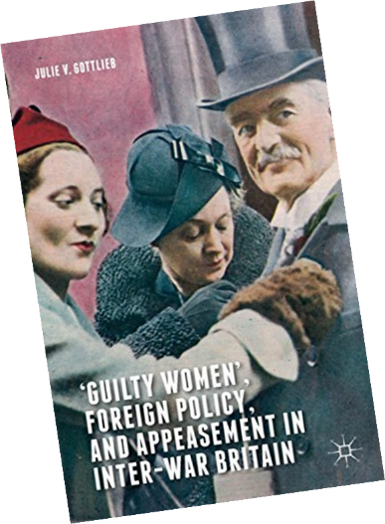
To what extent can we tell how ordinary people felt about appeasement during the Munich Crisis?
The majority of ordinary people opposed appeasement during the Munich Crisis. (Not proven, many supported it)
The majority of ordinary people supported appeasement during the Munich Crisis. (Possibly true but not proven, some did not)
The majority of ordinary people were scared and uncertain during the Munich Crisis. (Probably true)
The majority of ordinary people were terrified and uncertain during the Munich Crisis. (Possibly true)
We don’t have enough evidence to tell how ordinary people felt about appeasement during the Munich Crisis. (A weak argument as we have the Mass Observation extracts as sample opinions, however, it depends how representative these really were)
Having concentrated upon the mostly original sources which contribute to an overview of British public opinion during the Munich Crisis, it would be possible to follow this up with a question, focusing on historical interpretations, reflecting back on the period from a later time.
This question “Which original sources about appeasement have a playwright and a historian working together used to write about it?” could feature the published academic work of Gottlieb, alongside the play The Nervous State by playwright Nicola Baldwin, which is a dramatic adaptation of F L. Lucas‘s Journal Under the Terror, 1938. An extract from Gottlieb’s work such as that on the next slide from a draft History Today article called “Waiting for the End of the World” could be given for pupils to read, skim and scan with a teacher explaining particular vocabulary and phrases.

Slide 22
Draft History Today article “Waiting for the End of the World” by Julie V. Gottlieb
This is a familiar story most often told from the point of view of the great and ‘guilty’ men who acted in the unfolding drama. But what about the masses? The anxiety, relief and shame of what was immediately dubbed the Munich Crisis had a profound impact on every strata of the population. These weeks, and especially the four days from 25 September, saw a population in hand-wringing, edge-of-their-seats suspense, waiting to hear if it would be peace or war…. The impact of the Munich Crisis did not discriminate between rich and poor, women and men, the powerful and the disenfranchised, the young and the old, or city folk, suburbanites and rural dwellers… Different sources, and ones not much referred to so far in appeasement scholarship, reveal the true state of the nation and of collective feeling. Press reporting of the crowd unwittingly preserved a history from below, although it was the new techniques of polling and social surveys that documented the popular response to international events. Only established in 1937, the British Institute of Public Opinion (BIPO) or British Gallup’s polls revealed the impact of political crisis on people’s lives. Also founded in 1937, Mass-Observation’s dedicated study of the Crisis was part of its innovative ‘anthropology of ourselves’ – social scientific surveying, which captured the response of working-class and local communities to the Munich Agreement. The psychological and emotional repercussions were also collected and analysed by a new branch of psychiatric and medical clinicians. These were medical psychologists influenced by Sigmund Freud, who had himself arrived in London as a refugee in June 1938. The British psychoanalyst Edward Glover studied the collective response to the Crisis and concluded: ‘The general populace ... celebrated their temporary relief from anxiety in an almost hysterical outburst when Chamberlain returned with “peace in our time”.’ Glover argued that this was not necessarily an indication of widespread antiwar feeling, or of pacifism per se, but rather sudden relief from the anxiety of impending war.
Julie Gottlieb, ‘The Munich Crisis: Waiting for the End of the World’, History Today 68.9 (September 2018) https://www.historytoday.com/archive/feature/munich-crisis-waiting-end-world [accessed 14 August 2023].

Slide 23
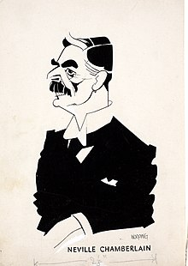
In answer to the sub question What claims is Gottlieb making in her work and which sources is she relying on? could lead onto discussion of the following questions based on the extract.
What does Gottlieb claim about the way the history of appeasement has been told in the past? How is her approach different?
How does she imply that newspaper articles can be used even though they usually supported Chamberlain?
What does she claim about the evidence of opinion polling, Mass Observation and of psychiatrists and psychologists? How convincing does this sound?
The extract would be a useful reminder to pupils of Lucas‘s Journal and Mass-Observation extracts. They could be introduced to the full range of original evidence to which Gottlieb refers in her work. These include photographs showing crowds welcoming Chamberlain back to Downing Street after his return from Munich, cartoons featuring him, and even a Toby Jug of the Prime Minister‘s head (the handle consists of his famous black umbrella which was synonymous with him).
See Julie V. Gottlieb, Neville Chamberlain’s Umbrella: ‘Object’ Lessons in the History of Appeasement, Twentieth Century British History, 27.3 (2016), pp. 357–388. https://doi.org/10.1093/tcbh/hww030

Slide 24
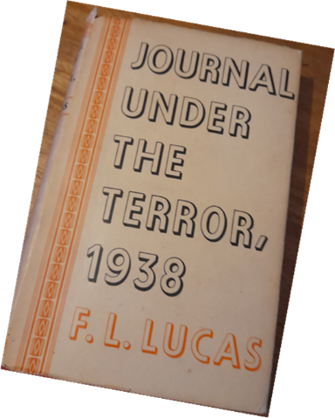
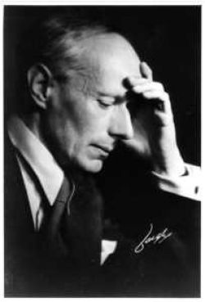
Using Drama to Teach History
Excerpts from Baldwin’s play could be compared with extracts from Journal Under the Terror, 1938 on which it is based. The point is to see that both a historian and playwright, producing different kinds of history, make direct use of original source material in their work. By highlighting which sources writers choose to use, what material they chose to use from them (and what they choose to leave out), pupils might be asked to identify possible silences in their narratives.
A specific silence that the play addresses is around the role F.L. Lucas’s wife Prudence who is specifically mentioned in the journal only four times (and only as ‘P’). By using a range of other sources and her imagination, Baldwin gives Prudence a prominent role and voice in the play, and the story of her descent into mental illness during the period Lucas was writing his journal. Indeed, Prudence has been virtually written out of history—otherwise left silent– due to her gender and as someone suffering from mental illness.

Slide 25
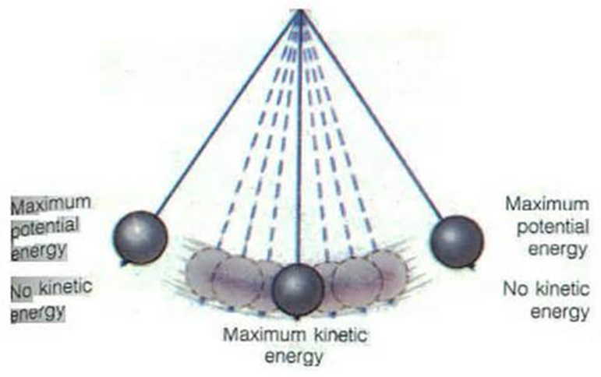
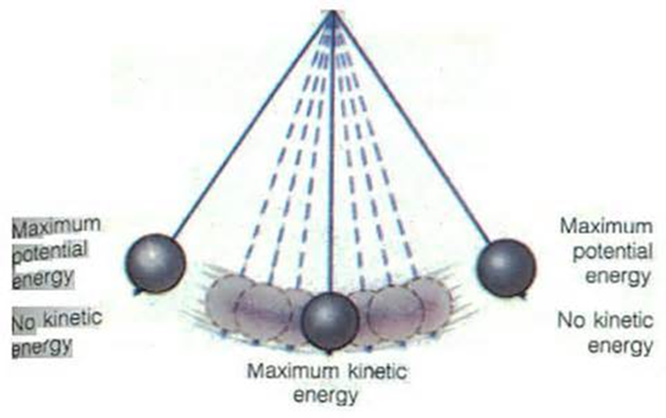
Historiography of appeasement
If time allows, as it might at A-level, pupils might be taught about the historiography of appeasement and where Gottlieb’s work sits within it. Professor Richard Evans’s useful blog summarises the swings in opinion about Chamberlain and appeasement since 1938, from his lionization at the time through to his characterisation as a “guilty man” and then, from the 1960s onwards, as the object of revisionist and counter revisionist arguments. The swings could be depicted on pendulum diagram like these ones.
Chamberlain saves the day – Man of peace – 1938-1939
The Guilty Men
1940-1960s
Revisionists and Counter-
Revisionists
e.g. AJP Taylor, RAC Parker, John Charmley
1960s-1990s
The Guilty Men 1940-1960s
Richard J Evans, ‘Chamberlain and Appeasement: the Differing Views of Historians’, Richard J Evans, https://www.richardjevans.com/lectures/chamberlain-appeasement-differing-views-historians/ [accessed 14 August 2023].

Slide 26
Competing historical judgements of Britain’s appeasement policy
Reference could be made to the schools of historiography below which Gottlieb herself describes as framing Chamberlain in different ways:
Wicked – Chamberlain wanted to aid Hitler and actively colluded with European Fascism. The British government consciously wished to aid Hitler.
Misguided – Appeasers sincerely sought peace and were sympathetic to German demands for self-determination and grievances against the conditions of the Treaty of Versailles It was outright collusion with European Fascism.
Dishonourable – Appeasers knew their policy was morally wrong but were afraid of war and did not believe that Britain was strong enough to fight one then.

Slide 27
Feature film extracts
Showing extracts from the recent feature film “Munich– The Edge of War” (2022, Netflix), based on Robert Harris‘s novel, and his favourable view of Chamberlain could show that debate about him and appeasement continues to divide opinion, with interpretations drawing on different evidence in support of a viewpoint.
Professor Julie Gottlieb suggests some potential talking points on the film:
What were your main impressions of the film?
How did you view the film differently because of your knowledge of the Munich Crisis?
What did you feel the film did well?
How believable was the plot?
How should/can fictional film be used when studying history?
What parallels do you think the filmmakers were trying to make between 1938 and the present?
For more information, see: http://www.historymatters.group.shef.ac.uk/netflixs-munich-the-edge-war-film-time/
“Chamberlain is a tragic hero to me. He fails, but there’s something noble in the attempt – not squalid, which is the way it’s normally written.” Robert Harris

Slide 28
What is interesting about Gottlieb`s work (as can be seen in her draft article for History Today in Slide Twenty-Two of this presentation) is that while it sits within the wider historiography of appeasement, it is much less concerned with Chamberlain as a great or guilty man. Rather, it is part of the trend to view history from below, seeking to find the voices, experiences, and opinions of those who have not usually been included in the traditional historiography, looking through lenses of gender, psychology (internalisation of political crisis), and minoritized communities.
In referencing Mass-Observation, the work of Lucas and other neglected sources, Gottlieb’s interpretation of history is characterised by Tony Macaleavy‘s features of any interpretation. He claims that they include fact, fiction, imagination and a point of view.(Interpretations of History and Issues for teachers in the development of Pupils` understanding, R.Williams and I. Davies, Teaching History 91, The Historical Association, London, 1998). Having become familiar with the work of both Gottlieb and Baldwin, pupils could plot where they might be positioned as interpretations of history on a diagram like this.
Lastly, taking into account what they now know about the historiography of appeasement, pupils could consider whether Trouillot’s hypothesis of how history is produced is echoed in the historiography of appeasement.
Fiction/Imagination
Fact
Point of View

Slide 29
Source
Extracts (without citations for classroom use)

Slide 30
Source Extracts
“nobody wants a war, but Hitler seemed mad, and it all depended on him… But if we don’t resist, if we and the world give in to Fascism, if Oswald Mosley becomes our king under Hitler, wouldn’t that have been worth fighting to prevent?”
“Last week I felt ill with worry and not much better when Chamberlain came to his agreement with Hitler, for I felt if Hitler was allowed to get strong enough to dominate Europe we should have a war sooner or later and I would rather have it now, before he is too strong”.
“Friday: Early morning. Peace declared, what a relief for everyone, and what a triumph for Mr Chamberlain and Herr Hitler. I most sincerely hope that England and Germany will remain great friends, my husband always says, you can trust a German anywhere, but only trust a Frenchman as far as you can see him. One school teacher told me that the children were very disappointed that there was no war, they were quite enjoying the excitement and were anxious to try out their gas masks…”
‘Everybody feels as though a weight has been lifted…Satisfaction expressed that in event of more war fears, we are well equipped now”
“I may say that on Sunday I thought that we should have peace; on Wednesday morning I thought that war was almost inevitable; and on Wednesday evening it seemed that we should have peace after all. Next week, perhaps, war may again appear to be certain”

Slide 31
Source Extracts
“On my way to work this morning I made a particular point of noting the attitude of the people to the crisis. It was evident from facial expressions that most of them were greatly perturbed. It was difficult to find a smiling face. This was most noticeable at the station where there were some 100-150 people waiting for the train up to London. The majority of the waiting passengers were busily studying newspapers but here and there small groups were talking in subdued tones and were evidently discussing the situation. At the office most people were discussing the crisis and many of us found it extremely difficult to get down to work. There was a terrible feeling of uneasiness and the majority of the people appeared to be anxious to discuss events and hear one another’s opinion. This feeling of unrest remained throughout the day… Another clerk (Male aged 28 years) said “Frankly, I’m scared. I hardly know what to think. War cannot come, we can’t stand it. I think we shall find a way out.”’
“I was sitting in an A.B.C having my lunch during the time when the war strain was at its highest. Suddenly there was a crash as a waitress dropped a pile of plates. Normally this would have gone unnoticed but on this occasion the effect was electrical. Strangely enough it was the men who were most affected, not so much surprise as actual anticipation of something dreadful was registered on their faces”.

Slide 32
Source Extracts
“among my own acquaintance, twelve happily married couples…were divided on the issue of Munich, and in every case it as the husband who supported and the wife who opposed Chamberlain. Many would have expected that women would have been more ready than men to accept the spurious peace at its face value. But it was not so.”
“The country remains admirably calm in these hours of deepening crisis. It is the steady spirit of the nation that has made up its mind and faces the future unafraid…The British nation unreservedly places its complete trust in the Prime Minister, Mr Neville Chamberlain”.
‘“All sorts of people have said to me in the last few days that they do not ‘feel’ as though the present crisis over Czechoslovakia would lead to war; I have myself, what I can describe as a ‘feeling’ that there will be no war”’.
“What I find unendurable is the sense of our country falling into the power, into the orbit and influence of Nazi Germany and of our existence becoming dependent on their good will or pleasure”.
“Great admiration for Chamberlain—is a nation’s hero. Have noticed spontaneous clapping in cinemas whenever he is shown in news reel. Have not found great sympathy for Czechs, or attitude of “back them up at all costs”. My personal opinion is that the Treaty of Versailles was very unjust, a wrong that needs righting…”

Slide 33
Source Extracts
“Great admiration for Chamberlain—is a nation’s hero. Have noticed spontaneous clapping in cinemas whenever he is shown in news reel. Have not found great sympathy for Czechs, or attitude of “back them up at all costs”. My personal opinion is that the Treaty of Versailles was very unjust, a wrong that needs righting…”
“Everybody today feels as though a weight has been lifted…Satisfaction expressed that in event of more war fears, we are well equipped now”.
“My own condition was deteriorating fast. Fear did more harm to my physique than to my morale. Sleep was murdered for ever. My heart quaked, yet I must appear valiant. My hands shook, so work must be found to steady them. Always a pessimist, I could imagine nothing worse than what must happen perhaps tomorrow – war, death, London utterly demolished, frantic crowds stampeding, famine and disease ...”
“They don’t believe in Chamberlain at the mill- they think he’s a bit of a fascist. But he’s kept us out of war, hasn’t he, we don’t want war. Sometimes I like him, sometimes I don’t. I alter my views a lot”.

Slide 34
Source Extracts
“I was on the bus coming home from Manchester last night and there were two men talking behind me about the traitors in the government- Chamberlain included. I think he should be shot out.”
“You know what I think of Chamberlain. I think he should have been shot out, a long time ago.”
‘My own condition was deteriorating fast. Fear did more harm to my physique than to my morale. Sleep was murdered for ever. My heart quaked, yet I must appear valiant. My hands shook, so work must be found to steady them. Always a pessimist, I could imagine nothing worse than what must happen perhaps tomorrow – war, death, London utterly demolished, frantic crowds stampeding, famine and disease ...’

Slide 35
Source Extracts
“The country remains admirably calm in these hours of deepening crisis. It is the steady spirit of the nation that has made up its mind and faces the future unafraid”.
“The British nation unreservedly places its complete trust in the Prime Minister, Mr Neville Chamberlain”.
“All sorts of people have said to me in the last few days that they do not ‘feel’ as though the present crisis over Czechoslovakia would to war; I have myself, what I can describe as a `feeling` that there will be no war”.
“What I find unendurable is the sense of our country falling into the power, into the orbit and influence of Nazi Germany and of our existence becoming dependent on their good will or pleasure”.
But the best comment on today was made to a friend of mine by her postman. “Are they still cheering?” she asked him, as he brought the evening-mail. “Yes. Cheering a traitor.”
“And he waves a piece of paper with Herr Hitler’s signature – the signature of that hand which has sent to death, or to torture worse than death, so many innocent men and women, so many comrades of his own; the hand that has written one of the vilest and cruellest books in history”.

Slide 36
Source
Extracts
(with citations)

Slide 37
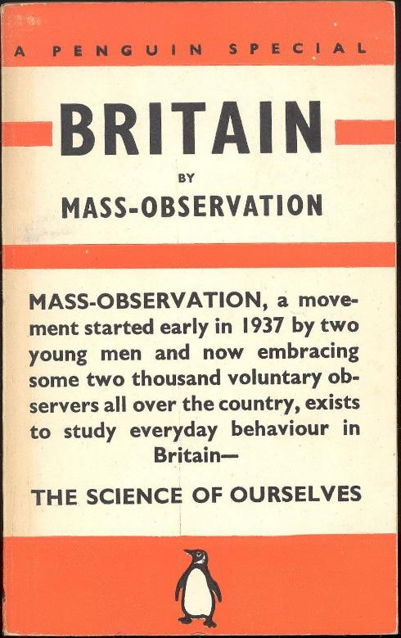
Mass Observation Extracts with Citations
“nobody wants a war, but Hitler seemed mad, and it all depended on him… But if we don’t resist, if we and the world give in to Fascism, if Oswald Mosley becomes our king under Hitler, wouldn’t that have been worth fighting to prevent?” Margot Jones NW3, Day Survey Respondent 097, July 1937-September 1938, Mass Observation Archive, University of Sussex.
“Last week I felt ill with worry and not much better when Chamberlain came to his agreement with Hitler, for I felt if Hitler was allowed to get strong enough to dominate Europe we should have a war sooner or later and I would rather have it now, before he is too strong”. Blackwell, I 3568, “Comments on the Crisis”, September 28, 1938, M-OA: Directive Replies 1938, Box 11 of 13, Munich Crisis, Sept.-Oct.—Women.
“Friday: Early morning. Peace declared, what a relief for everyone, and what a triumph for Mr Chamberlain and Herr Hitler. I most sincerely hope that England and Germany will remain great friends, my husband always says, you can trust a German anywhere, but only trust a Frenchman as far as you can see him. One school teacher told me that the children were very disappointed that there was no war, they were quite enjoying the excitement and were anxious to try out their gas masks…” M.E. Grant 2251, Sept. 1938, Ramsgate, M-OA: Directive Replies 1938, Box 11 of 13, Munich Crisis, Sept.-Oct.—Women.

Slide 38
Mass Observation Extracts with Citations
“‘Everybody feels as though a weight has been lifted…Satisfaction expressed that in event of more war fears, we are well equipped now” Day Survey 804 - Single female office worker, Westcliff, 30 September 1938.
“I may say that on Sunday I thought that we should have peace; on Wednesday morning I thought that war was almost inevitable; and on Wednesday evening it seemed that we should have peace after all. Next week, perhaps, war may again appear to be certain” Day Survey 718 - Single Male, Essex, 29 September 1938.
“On my way to work this morning I made a particular point of noting the attitude of the people to the crisis. It was evident from facial expressions that most of them were greatly perturbed. It was difficult to find a smiling face. This was most noticeable at the station where there were some 100-150 people waiting for the train up to London. The majority of the waiting passengers were busily studying newspapers but here and there small groups were talking in subdued tones and were evidently discussing the situation. At the office most people were discussing the crisis and many of us found it extremely difficult to get down to work. There was a terrible feeling of uneasiness and the majority of the people appeared to be anxious to discuss events and hear one another’s opinion. This feeling of unrest remained throughout the day… Another clerk (male 28 years) said “Frankly, I’m scared. I hardly know what to think. War cannot come, we can’t stand it. I think we shall find a way out.”’ Day Survey 650 - Male, 25, Local Government Officer, 28 September 1938.

Slide 39
Mass Observation Extracts with Citations
“I was sitting in an A.B.C having my lunch during the time when the war strain was at its highest. Suddenly there was a crash as a waitress dropped a pile of plates. Normally this would have gone unnoticed but on this occasion the effect was electrical. Strangely enough it was the men who were most affected, not so much surprise as actual anticipation of something dreadful was registered on their faces”. Gussman, B 1123, Day Survey Respondent 639, September 1938, Mass Observation Archive, University of Sussex Special Collection.
“The country remains admirably calm in these hours of deepening crisis. It is the steady spirit of the nation that has made up its mind and faces the future unafraid…The British nation unreservedly places its complete trust in the Prime Minister, Mr Neville Chamberlain”. Charles Madge and Tom Harrison, Britain by Mass Observation (Middlesex, 1939), p. 36, Mass Observation Archive, University of Sussex Special Collections.

Slide 40
Mass Observation Extracts with Citations
‘“All sorts of people have said to me in the last few days that they do not ‘feel’ as though the present crisis over Czechoslovakia would lead to war; I have myself, what I can describe as a ‘feeling’ that there will be no war”’.Quote from Candidus, leader-writer for The Sketch in Charles Madge and Tom Harrison, Britain by Mass Observation (Middlesex, 1939), p. 39, Mass Observation Archive, University of Sussex Special Collections.
What I find unendurable is the sense of our country falling into the power, into the orbit and influence of Nazi Germany and of our existence becoming dependent on their good will or pleasure”.46-2-D Kinross & Western, 21.12.38, “Britain’s Peril”, BY-ELECTIONS 1936-1947, January 1936-December 1947, Mass Observation Archive, University of Sussex Special Collections.
“Great admiration for Chamberlain—is a nation’s hero. Have noticed spontaneous clapping in cinemas whenever he is shown in news reel. Have not found great sympathy for Czechs, or attitude of “back them up at all costs”. My personal opinion is that the Treaty of Versailles was very unjust, a wrong that needs righting…” Margot Edgelow, “Mass Observation Report. Date of sending Sept 28.”, Day Survey Respondent 801, September 1938, Mass Observation Archive, University of Sussex Special Collections.
“Everybody today feels as though a weight has been lifted…Satisfaction expressed that in event of more war fears, we are well equipped now”. Flavelle 2327, Day Survey Respondent 804, September 1938, Mass Observation Archive, University of Sussex Special Collections.

Slide 41
Mass Observation Extracts with Citations
“They don’t believe in Chamberlain at the mill- they think he’s a bit of a fascist. But he’s kept us out of war, hasn’t he, we don’t want war. Sometimes I like him, sometimes I don’t. I alter my views a lot”. Re-: Czech occupation“, 4.4 39, Worktown Collection, Box 50, W 50/A Churchill and Chamberlain
“I was on the bus coming home from Manchester last night and there were two men talking behind me about the traitors in the government- Chamberlain included. I think he should be shot out.” “Re: Chamberlain, Bolton”, 3/7/40, Worktown Collection, Box 50, W 50/A Churchill and Chamberlain, Mass-Observation Archive, University of Sussex
“You know what I think of Chamberlain. I think he should have been shot out, a long time ago.” Re: Chamberlain, Bolton”, 3/7/40, Worktown Collection, Box 50, W 50/A Churchill and Chamberlain, Mass-Observation Archive, University of Sussex

Slide 42
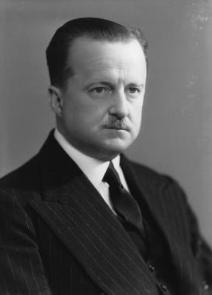
Extracts from memoirs written by upper class people writing after the event and reflecting back on it
‘My own condition was deteriorating fast. Fear did more harm to my physique than to my morale. Sleep was murdered for ever. My heart quaked, yet I must appear valiant. My hands shook, so work must be found to steady them. Always a pessimist, I could imagine nothing worse than what must happen perhaps tomorrow – war, death, London utterly demolished, frantic crowds stampeding, famine and disease ...’
Diana Cooper, wife of Duff Cooper, a Conservative Minister and MP who resigned in protest over appeasement.
Diana Cooper, The Light of Common Day (Penguin, 1959), pp. 202-203.
“among my own acquaintance, twelve happily married couples…were divided on the issue of Munich, and in every case it as the husband who supported and the wife who opposed Chamberlain. Many would have expected that women would have been more ready than men to accept the spurious peace at its face value. But it was not so.”
Duff Cooper, Old Men Forget (London, 1953), p. 251.

Slide 43
Quotes from newspaper articles at the time
“The country remains admirably calm in these hours of deepening crisis. It is the steady spirit of the nation that has made up its mind and faces the future unafraid”.
The Star, 5th September, 1938.
“The British nation unreservedly places its complete trust in the Prime Minister, Mr Neville Chamberlain”.
The Daily Mail, 19th September, 1938.
“All sorts of people have said to me in the last few days that they do not ‘feel’ as though the present crisis over Czechoslovakia would to war; I have myself, what I can describe as a `feeling` that there will be no war”.
The Daily Sketch, 22nd September, 1938.

Slide 44
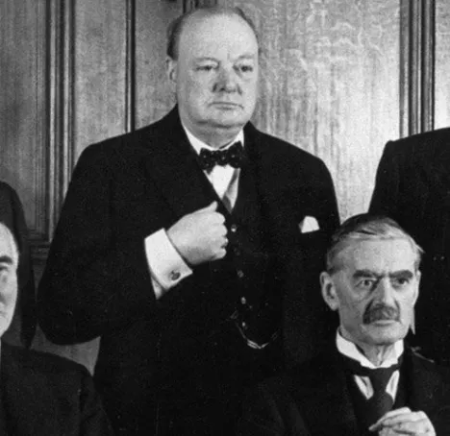
Quotes from the speeches of politicians at the time
“What I find unendurable is the sense of our country falling into the power, into the orbit and influence of Nazi Germany and of our existence becoming dependent on their good will or pleasure”.
Excerpt from Churchill’s Speech in the Munich Debate in the House of Commons, October 5th,1938.

Slide 45
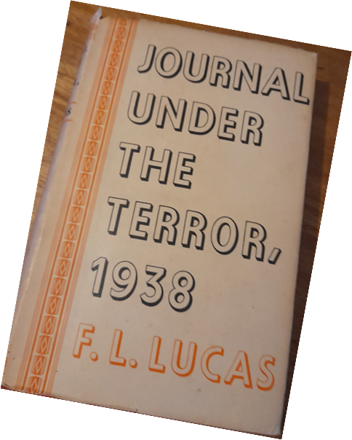
Extracts from a journal written by an opponent of appeasement at the time and meant for publication soon afterwards
But the best comment on today was made to a friend of mine by her postman. “Are they still cheering?” she asked him, as he brought the evening-mail. “Yes. Cheering a traitor.”
“And he waves a piece of paper with Herr Hitler’s signature – the signature of that hand which has sent to death, or to torture worse than death, so many innocent men and women, so many comrades of his own; the hand that has written one of the vilest and cruellest books in history”.
September 30th (1938), F.L.Lucas, Journal Under the Terror, 1938 (1939), p. 277.

