Slide 1
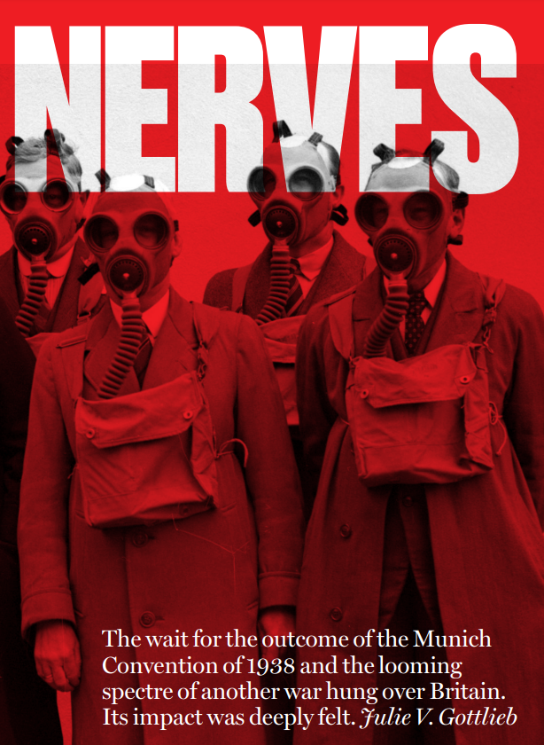
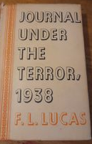
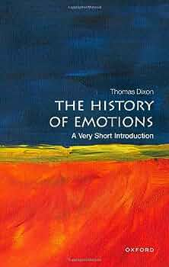
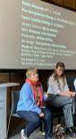
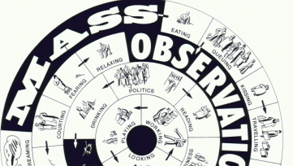
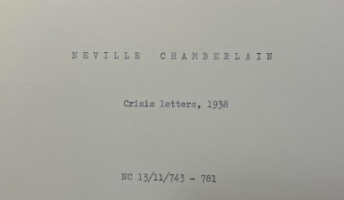
Enquiry Question | Rationale
Y9: How did Gottlieb explore what ‘permacrisis’ might have felt like in 1938? | This enquiry is designed to help students to understand the turbulent political and social atmosphere of 1938 and develop their understanding of what mattered to people in the past. It builds on their work on World War One and gives them a flavour of the experiences of different people during the interwar period in preparation for studying WW2 and the legacies of global conflicts in the C20th. By examining this period through a new lens of emotion history, students will also have the opportunity to develop their disciplinary understanding of similarity and difference. The enquiry lessons will allow students to ‘Think like an historian’ and will curate rather than narrate the process that Gottlieb has undertaken. The enquiry will include FL Lucas’ diary, Mass Observation and Nicola Baldwin’s play to enrich student appreciation of different experiences of the ‘permacrisis’ of 1938 and the importance of reconstructing hidden voices from the past.
Key Takeaway | Subject Knowledge Development
The year 1938 was a full of political and international tension that heightened nerves. People experienced the events in different ways but were all connected by the shared experience of ‘permacrisis’. | https://drive.google.com/drive/u/0/folders/0AO9wqZVLN1kKUk9PVA
Links to previous enquiries | Next enquiry
Y9 Edward and causes of WWI Y9 Why are the world wars so remarkable? Part 1: WW1 Y9 What do sources tell us about the interwar period? | Y9 Why are the world wars so remarkable? Part 2: WW2
Key Scholarship & Sources
Suggested Lesson Schedule
1 | Why is Gottlieb so interested in foreign policy in 1938?
2 | What sources are useful to Gottlieb in exploring what ‘permacrisis’ might have felt like in 1938?
3 | Why is Mass Observation useful to Gottlieb in exploring what ‘permacrisis’ might have felt like in 1938?
4 | How did Gottlieb explore what ‘permacrisis’ might have felt like in 1938? | ET Write a playbill that answers the key takeaway questions

Slide 2
Content
 | Residual Prior Knowledge | Key Takeaway Knowledge | Fingertip Knowledge
Substantive Knowledge | The competition between Kaiser Wilhelm II and Edward VII was one of the causes of WW1. WW1 was a global conflict because of the involvement of soldiers from the European empires fighting on fronts all over the world. The terms of the Treaty of Versailles were harsh on Germany. WW1 and the failure of the League of Nations influenced the way that we try to keep the peace in the world today. | 1938 was a moment of heightened tensions in international relations because Hitler had broken the terms of the ToV and the policy of Appeasement had failed. Historians have looked at 1938 from the perspective of High Politics, but looking through the lens of history from below and history from within, we can understand the experiences of a wider range of people from the past. Permacrisis means ‘a long period of great difficulty, confusion, or suffering that seems to have no end’. | The Munich Agreement was reached in 1938 by Hitler and Chamberlain. It was unsuccessful and war was eventually declared. The Chamberlain Papers, A FL Lucas’ journal and extracts from Mass Observation provide great sources for historians to explore this time period.
Disciplinary Knowledge | Students should be able to appreciate that people in the past experienced the same event/ phenomenon differently. | Historians can tentatively reconstruct the experiences of people that have previously been hidden from history through knowledge exchange projects. This can help us to understand the experiences of a wider range of people from the past.
Procedural Knowledge | Students can use phrases like ‘Different things mattered to different people during the reign of Edward VII…’ and ‘Some themes connect what mattered to people…’ in their written work and in discussion. This shows an understanding of the diversity of experience but also an ability to characterise the mood of the period. Explicit teaching of what mattered in Britain and in the British Empire will be needed in order to secure this. | Historians use a range of sources to find out about the past. JG uses newspapers, cartoons, mass observation, FL Lucas, material culture, suicide stats (to name a few) to conduct her research. We need to be careful to make only tentative claims when using sources to investigate how people felt (and always!) as we need to be careful not to over generalise. Students should be able to use phrases like ‘Some people might have felt like …’ to express their understanding of the way that historians construct arguments about the past.

