Slide 1
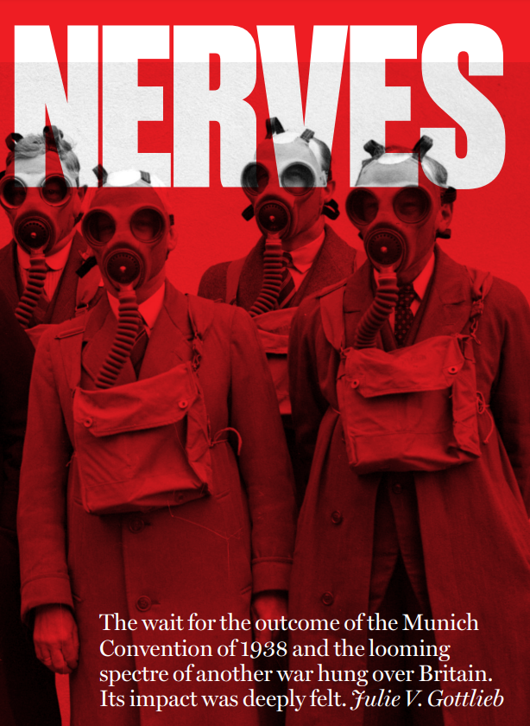

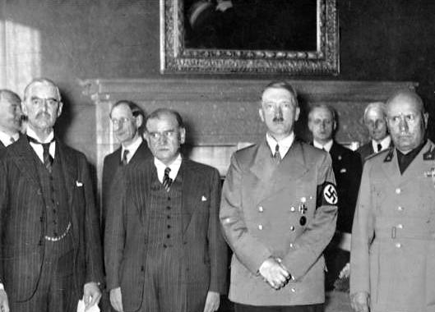
How did Gottlieb explore what ‘permacrisis’ might have felt like in 1938?
In this unit you will study a key episode in the history of international relations. You will study the 20th Century. See the timeline below to see how this fits into the chronological sweep of time. This is called a depth study. You will develop your skills as an historian by using sources to investigate the past.
Key Words
Permacrisis
Appeasement
Munich Crisis
Gender History
History from Below
History from Within
High Politics
Foreign Policy
Key Questions | Whose stories were told in Rainbow City? | How did the audience react to Rainbow City?
What happened in 1938 that interests Gottlieb? What does the word ‘permacrisis’ mean and why can it be applied to that year? | What historical lenses has Gottlieb looked through to better understand this period? What sources did Gottlieb use to explore how people might have felt? | Why do we need to be careful about the claims we can make when examining ‘history from within’? Who has Gottlieb worked with to reconstruct hidden voices from the past? Why is this type of work so important?
Key Scholarship
Key Source
Key People
1938 Munich Crisis
Ancient |  |  |  |  | Middle Ages |  |  |  |  |  |  |  |  | Renaissance |  |  | Enlightenment |  | Modern
0 | 100 | 200 | 300 | 400 | 500 | 600 | 700 | 800 | 900 | 1000 | 1100 | 1200 | 1300 | 1400 | 1500 | 1600 | 1700 | 1800 | 1900 | 2000
C1st | C2nd | C3rd | C4th | C5th | C6th | C7th | C8th | C9th | C10th | C11th | C12th | C13th | C14th | C15th | C16th | C17th | C18th | C19th | C20th | C21st
Notes:
In our school, we like students to fill in knowledge organisers themselves, rather than giving them completed ones. We print them onto A4 and ask them to stick them into their books at the beginning of each enquiry. We then use them flexibly, depending on the needs of the class. For example, sometimes we use them to activate prior knowledge at the beginning of the lesson (i.e. can you define the key words from last lesson?), sometimes as homework and sometimes of the plenary in individual lessons. Sometimes, we just use them to revise an entire enquiry at the end before the completion of an end of enquiry task. Within the main lesson resources, we’ve included some suggested places to use this one, but it is not essential that it is used at those points.
We ask students to fill these resources in briefly and to use them as an aide-memoire, rather than as a space to write in detail. However, it could be printed on A3 to offer additional space if you felt that was best for your students and you felt that they would benefit from that.
The slide that follows is an example of a completed knowledge organiser from this enquiry. I have typed it up from a range of student responses. We did not share this with our students, it has been included for illustrative purposes as part of the enquiry resources for this project.

Slide 2
How did Gottlieb explore what ‘permacrisis’ might have felt like in 1938?
In this unit you will study a key episode in the history of international relations. You will study the 20th Century. See the timeline below to see how this fits into the chronological sweep of time. This is called a depth study. You will develop your skills as an historian by using sources to investigate the past.
Key Words
Permacrisis | A long period of suffering that seems to have no end
Appeasement | Giving someone what they want in order to avoid conflict
Munich Crisis | Events in 1938 that led to Hitler being given the Sudetenland by Britain and France
Gender History | History that seeks to understand the experiences of different genders
History from Below | History that seeks to understand the experiences of ordinary people
History from Within | History that seeks to understand how people felt in the past
High Politics | Studying the decisions and actions of leaders and politicians
Foreign Policy | The way one country decides to interact with other countries
Key Questions | Whose stories were told in Rainbow City? | How did the audience react to Rainbow City?
What happened in 1938 that interests Gottlieb? What does the word ‘permacrisis’ mean and why can it be applied to that year? The Munich Crisis Turning point in build-up to WW2 Very tense- people felt anxious about another war | What historical lenses has Gottlieb looked through to better understand this period? What sources did Gottlieb use to explore how people might have felt? History from Below History from Within FL Lucas journal Mass Observation Diaries Newspaper surveys | Why do we need to be careful about the claims we can make when examining ‘history from within’? Who has Gottlieb worked with to reconstruct hidden voices from the past? Why is this type of work so important? We have to be careful because not everyone feels the same way- we need to respect individual experiences Nicola Baldwin (playwright) Helps us to understand our own world and helps us to tell previously hidden stories.
Key Scholarship
Key Source
Key People
1938 Munich Crisis
Ancient |  |  |  |  | Middle Ages |  |  |  |  |  |  |  |  | Renaissance |  |  | Enlightenment |  | Modern
0 | 100 | 200 | 300 | 400 | 500 | 600 | 700 | 800 | 900 | 1000 | 1100 | 1200 | 1300 | 1400 | 1500 | 1600 | 1700 | 1800 | 1900 | 2000
C1st | C2nd | C3rd | C4th | C5th | C6th | C7th | C8th | C9th | C10th | C11th | C12th | C13th | C14th | C15th | C16th | C17th | C18th | C19th | C20th | C21st
Notes:
In our school, we like students to fill in knowledge organisers themselves, rather than giving them completed ones. We print them onto A4 and ask them to stick them into their books at the beginning of each enquiry. We then use them flexibly, depending on the needs of the class. For example, sometimes we use them to activate prior knowledge at the beginning of the lesson (i.e. can you define the key words from last lesson?), sometimes as homework and sometimes of the plenary in individual lessons. Sometimes, we just use them to revise an entire enquiry at the end before the completion of an end of enquiry task. Within the main lesson resources, we’ve included some suggested places to use this one, but it is not essential that it is used at those points.
We ask students to fill these resources in briefly and to use them as an aide-memoire, rather than as a space to write in detail. However, it could be printed on A3 to offer additional space if you felt that was best for your students and you felt that they would benefit from that.
The slide that follows is an example of a completed knowledge organiser from this enquiry. I have typed it up from a range of student responses. We did not share this with our students, it has been included for illustrative purposes as part of the enquiry resources for this project.

