Slide 1
Was 1973 a turning point for economic power in the Middle East?
Lesson 1: What was the balance of economic power in the Middle East, 1900–50?
Alex Benger, Chesterton Community College

Slide 2
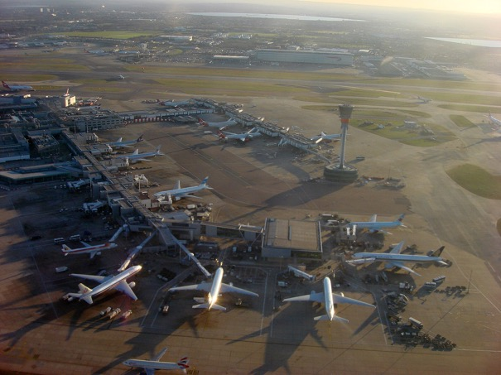


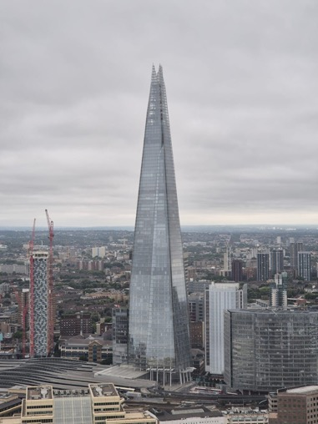
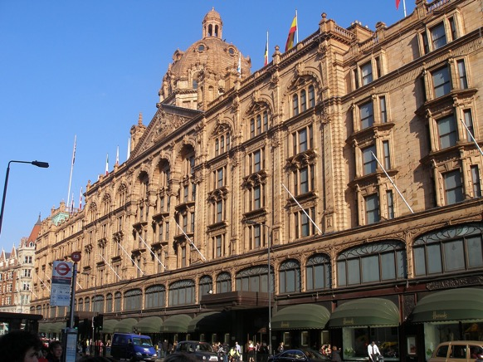

What are these pictures showing?
Notes:
Images (clockwise from top left): https://en.wikipedia.org/wiki/File:Manchester_City_FC_badge.svg; https://commons.wikimedia.org/wiki/File:Sainsbury%27s_Logo.svg; https://commons.wikimedia.org/wiki/File:Heathrow_Airport_010.jpg; https://en.wikipedia.org/wiki/Harrods#/media/File:Harrods_(London).jpg; https://commons.wikimedia.org/wiki/File:The_Shard_-_22.08.2024.jpg; https://en.wikipedia.org/wiki/File:Newcastle_United_Logo.svg

Slide 3
Can you think of any connections between them?
Sainsbury’s supermarket
Heathrow airport
Manchester City and Newcastle United football clubs
The Shard, London
Harrods (famous store in London)
Notes:
Images (clockwise from top left): https://en.wikipedia.org/wiki/File:Manchester_City_FC_badge.svg; https://commons.wikimedia.org/wiki/File:Sainsbury%27s_Logo.svg; https://commons.wikimedia.org/wiki/File:Heathrow_Airport_010.jpg; https://en.wikipedia.org/wiki/Harrods#/media/File:Harrods_(London).jpg; https://commons.wikimedia.org/wiki/File:The_Shard_-_22.08.2024.jpg; https://en.wikipedia.org/wiki/File:Newcastle_United_Logo.svg

Slide 4
All of them are owned, either mostly or partly, by Middle Eastern countries.
How do Middle Eastern countries have the money to invest in all of these things?
Majority-owned by the United Arab Emirates
Part-owned by Qatar
Part-owned by Qatar and Saudi Arabia
Majority-owned by Saudi Arabia
Majority-owned by Qatar
Owned by Qatar
Notes:
Images (clockwise from top left): https://en.wikipedia.org/wiki/File:Manchester_City_FC_badge.svg; https://commons.wikimedia.org/wiki/File:Sainsbury%27s_Logo.svg; https://commons.wikimedia.org/wiki/File:Heathrow_Airport_010.jpg; https://en.wikipedia.org/wiki/Harrods#/media/File:Harrods_(London).jpg; https://commons.wikimedia.org/wiki/File:The_Shard_-_22.08.2024.jpg; https://en.wikipedia.org/wiki/File:Newcastle_United_Logo.svg

Slide 5
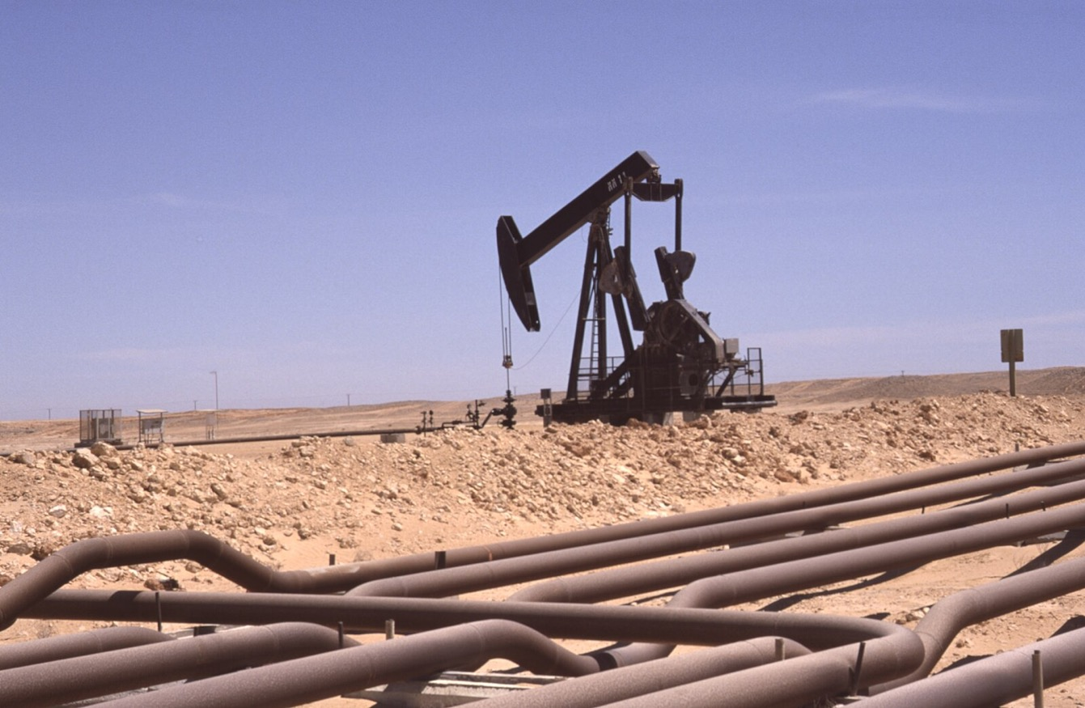
Notes:
Image: https://commons.wikimedia.org/wiki/File:Dunst_Oman_scan0321_-_%C3%96lfeld_Marmul.jpg

Slide 6
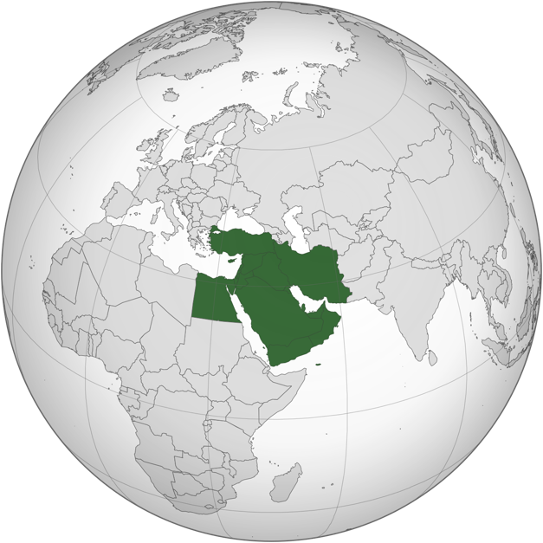
The Middle East region is the world’s largest producer of oil.
Notes:
Image: https://commons.wikimedia.org/wiki/File:Middle_East_(orthographic_projection).svg

Slide 7
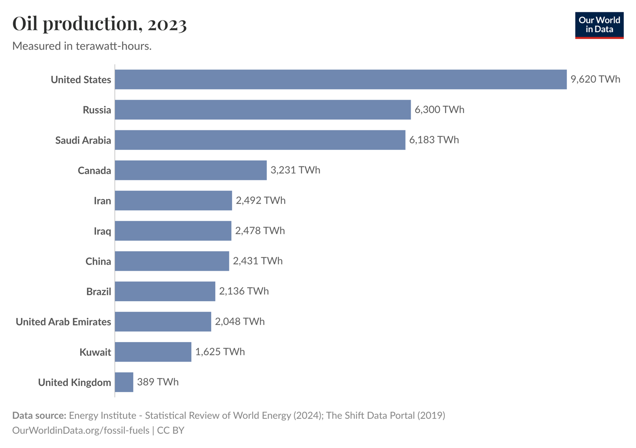
Which of these top oil-producing countries are in the Middle East?
Notes:
Globe image: https://commons.wikimedia.org/wiki/File:Middle_East_(orthographic_projection).svg
Bar chart previously available from: https://ourworldindata.org/grapher/oil-production-by-country?tab=discrete-bar&time=latest&country=

Slide 8
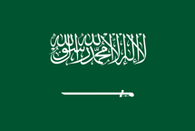
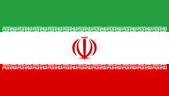
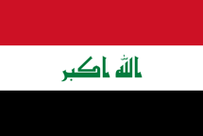
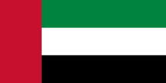
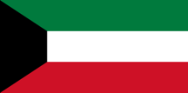
Notes:
Bar chart previously available from: https://ourworldindata.org/grapher/oil-production-by-country?tab=discrete-bar&time=latest&country=
Flags (top to bottom): https://commons.wikimedia.org/wiki/File:Flag_of_Saudi_Arabia.svg; https://commons.wikimedia.org/wiki/File:Flag_of_Iran.svg;
https://commons.wikimedia.org/wiki/File:Flag_of_Iraq.svg; https://commons.wikimedia.org/wiki/File:Flag_of_the_United_Arab_Emirates.svg; https://commons.wikimedia.org/wiki/File:Flag_of_Kuwait.svg

Slide 9
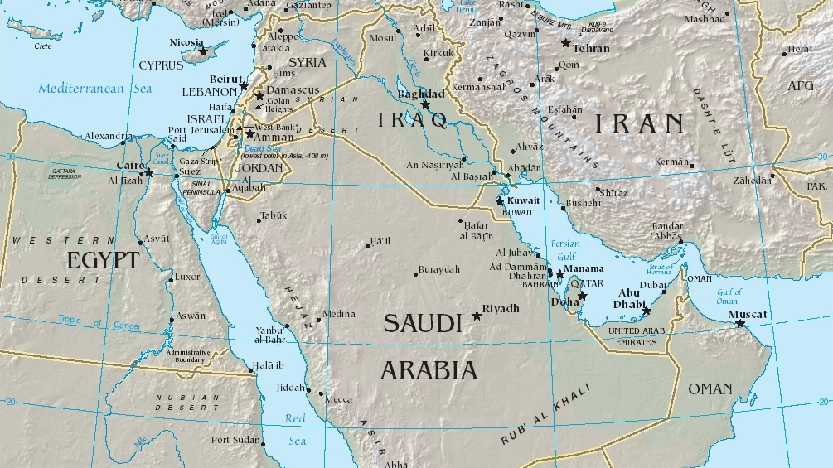
Notes:
Map: https://commons.wikimedia.org/wiki/File:Middle_east.jpg
Flags: https://commons.wikimedia.org/wiki/File:Flag_of_Saudi_Arabia.svg; https://commons.wikimedia.org/wiki/File:Flag_of_Iran.svg;
https://commons.wikimedia.org/wiki/File:Flag_of_Iraq.svg; https://commons.wikimedia.org/wiki/File:Flag_of_the_United_Arab_Emirates.svg; https://commons.wikimedia.org/wiki/File:Flag_of_Kuwait.svg

Slide 10
Why has oil made some countries in the Middle East so rich?
What is oil used for today?
Oil
?

Slide 11
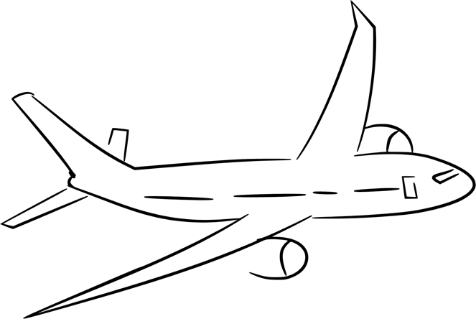



Oil
Notes:
Images (clockwise from top left): https://svgsilh.com/image/2098593.html; https://openclipart.org/detail/170118/pet-bottle-by-netalloy; https://openclipart.org/detail/9794/car-front-view-by-anonymous; https://openclipart.org/detail/262344

Slide 12
The economic power gained from oil has allowed Middle Eastern countries to increase their influence around the world, including in the UK.
Notes:
Images (clockwise from top left): https://en.wikipedia.org/wiki/File:Manchester_City_FC_badge.svg; https://commons.wikimedia.org/wiki/File:Sainsbury%27s_Logo.svg; https://commons.wikimedia.org/wiki/File:Heathrow_Airport_010.jpg; https://en.wikipedia.org/wiki/Harrods#/media/File:Harrods_(London).jpg; https://commons.wikimedia.org/wiki/File:The_Shard_-_22.08.2024.jpg; https://en.wikipedia.org/wiki/File:Newcastle_United_Logo.svg

Slide 13
Throughout the twentieth century, Britain played a big role in developing the oil industry in the Middle East. What do you think the balance of power might have been like in the early 1900s? Would Britain or the Middle Eastern countries have been more powerful?
British economic power
Middle Eastern economic power

Slide 14
Lesson 1: What was the balance of economic power in the Middle East, 1900–50?

Slide 15
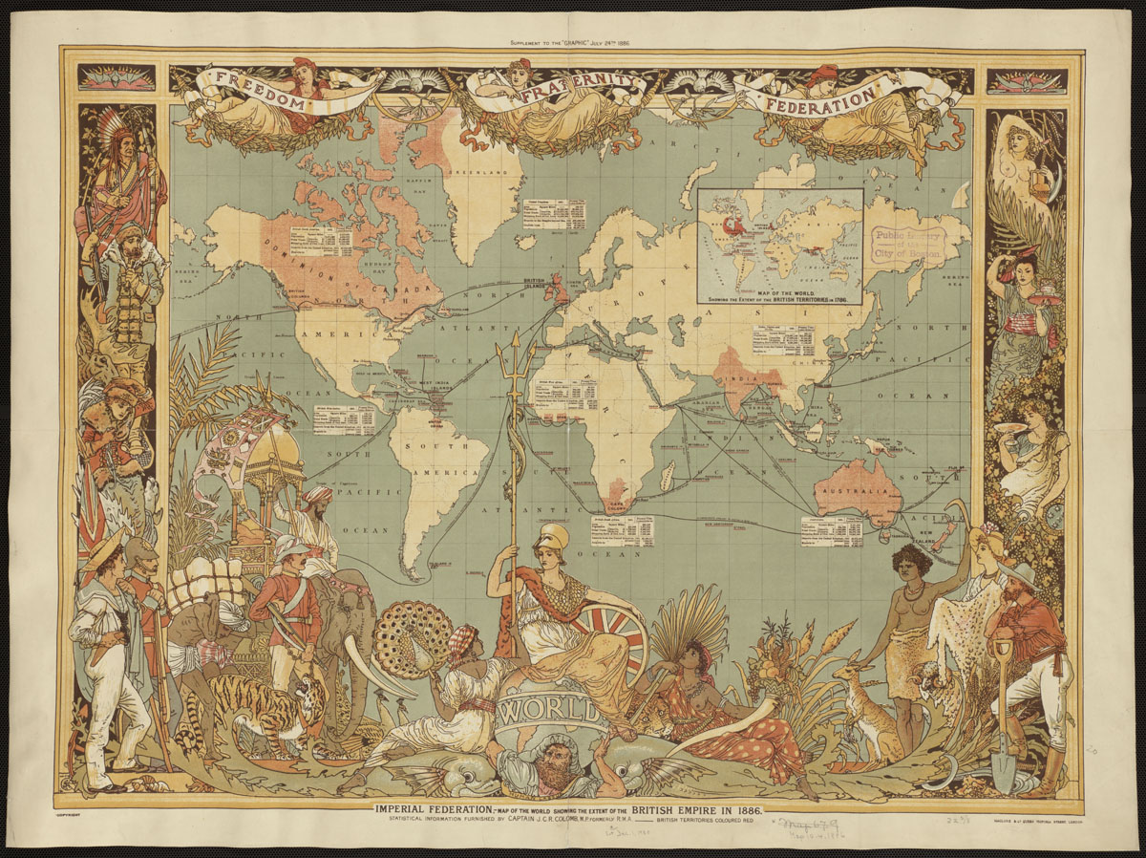
Activity 1:
This is a map showing the British Empire in 1886. Britain’s colonies (the countries that it officially governed) are shaded in red.
Where is the Middle East on this map?
According to the map, was it colonised by Britain in 1886?
Notes:
Image: https://commons.wikimedia.org/wiki/File:Imperial_Federation,_map_of_the_world_showing_the_extent_of_the_British_Empire_in_1886_-_Norman_B._Leventhal_Map_Center_at_the_BPL.jpg

Slide 16
Britain did not officially rule the Middle East as colonies.
Despite this, British influence in the Middle East became so strong in the twentieth century that many considered it colonialism, because the extent of foreign power was so great.
How and why did Britain exert power over the Middle East?
Notes:
Image: https://commons.wikimedia.org/wiki/File:Imperial_Federation,_map_of_the_world_showing_the_extent_of_the_British_Empire_in_1886_-_Norman_B._Leventhal_Map_Center_at_the_BPL.jpg

Slide 17
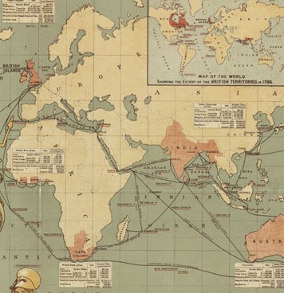
Britain wanted to protect the trade route to India, its most valuable colony.
Britain wanted to protect India from the influence of the Russian Empire.
Notes:
Image: https://commons.wikimedia.org/wiki/File:Imperial_Federation,_map_of_the_world_showing_the_extent_of_the_British_Empire_in_1886_-_Norman_B._Leventhal_Map_Center_at_the_BPL.jpg

Slide 18
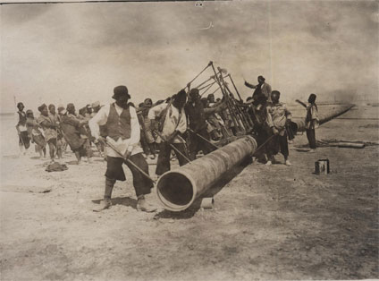

The importance to Britain of the Middle East increased further when oil was discovered in Persia (now Iran) by a British company in 1908.
The company was called the Anglo-Persian Oil Company. It later renamed itself ‘British Petroleum’ (BP).
Notes:
Images: https://commons.wikimedia.org/wiki/File:Anglo-Persian_Oil_Company_workers_(1).jpg; https://en.wikipedia.org/wiki/File:BP_Helios_logo.svg

Slide 19
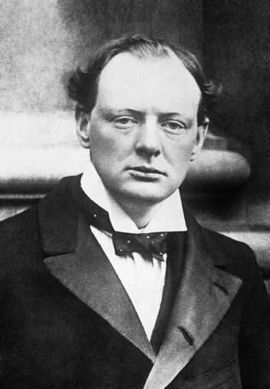
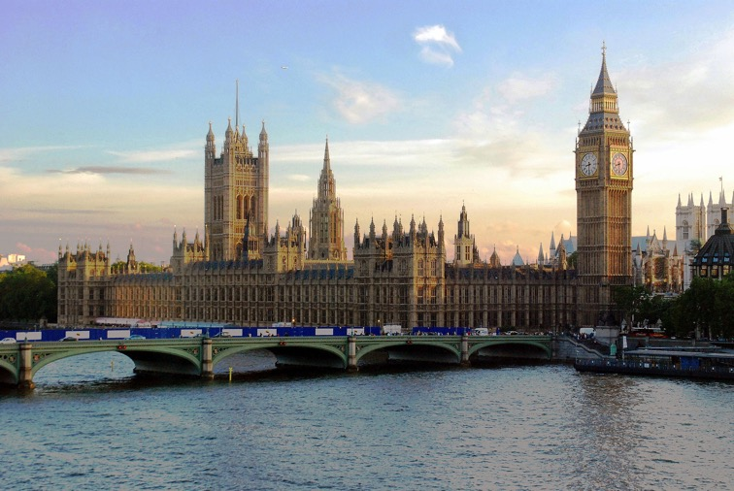
In 1914, Winston Churchill persuaded Britain’s Parliament to agree to buy 51% of the Anglo-Persian Oil Company. This was very unusual – the British government almost never owned private companies.
Why would the British government want to own an oil company in the Middle East in 1914?
Notes:
Images (left to right): https://commons.wikimedia.org/wiki/File:Churchill_1904_Q_42037.jpg; https://commons.wikimedia.org/wiki/File:Parliament_at_Sunset.JPG; https://commons.wikimedia.org/wiki/File:Anglo-Persian_Oil_Company_workers_(1).jpg

Slide 20
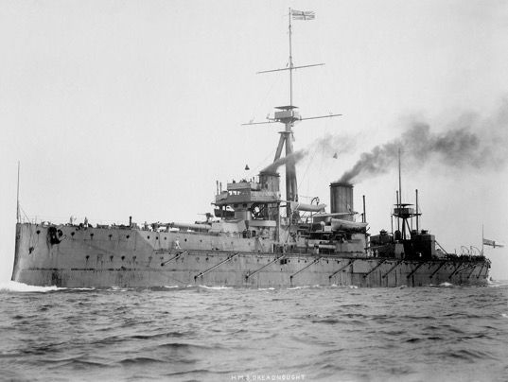
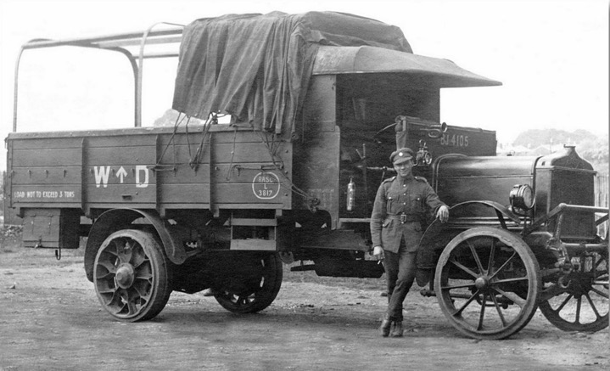
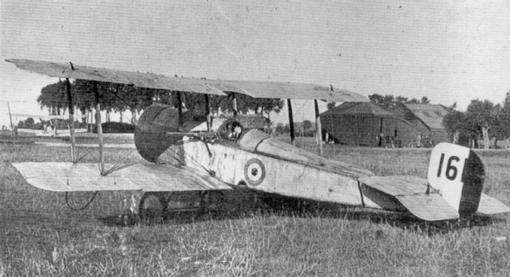
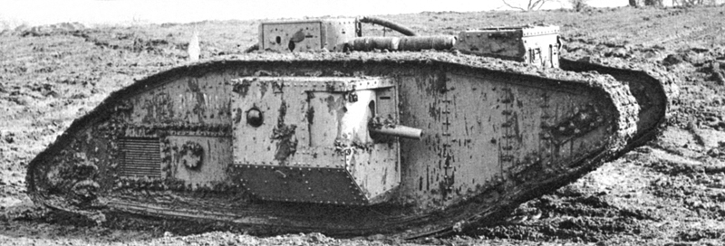
The answer is war and defending the British Empire.
What role did oil-powered vehicles play in World War I?
Notes:
Images (clockwise from top left): https://en.wikipedia.org/wiki/File:HMS_Dreadnought_1906_H61017.jpg; https://commons.wikimedia.org/wiki/File:AEC_Y_Type.jpg; https://commons.wikimedia.org/wiki/File:British_Mark_V_(male)_tank.jpg; https://commons.wikimedia.org/wiki/File:Bristol_Scout_C_(1611)_flown_by_Lanoe_Hawker_in_his_Victoria_Cross-earning_military_engagement_on_July_25th,_1915._(49177372226).jpg

Slide 21
The quest for oil after World War I
World War I saw the first experiments in using oil-powered military vehicles. The British government was convinced that oil would be even more important in future wars. They were determined to secure as much oil as possible for Britain.
The collapse of the Ottoman Empire in World War I presented a perfect opportunity for Britain to secure more oil in the Middle East.

Slide 22
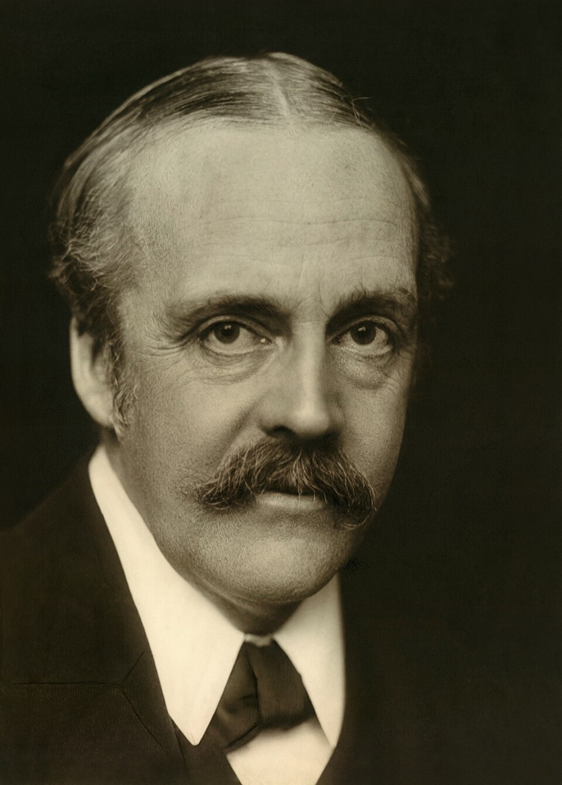
‘I do not care under what system we keep the oil but I am quite clear it is all important for us that this oil should be available.’
Arthur Balfour, British Foreign Secretary, 1918
Notes:
Image: https://en.wikipedia.org/wiki/File:Arthur-James-Balfour-1st-Earl-of-Balfour.jpg
Balfour to Prime Ministers of the Dominions, August 1918. Quoted in: https://archive.globalpolicy.org/component/content/article/185-general/40479-great-power-conflict-over-iraqi-oil-the-world-war-i-era.html

Slide 23
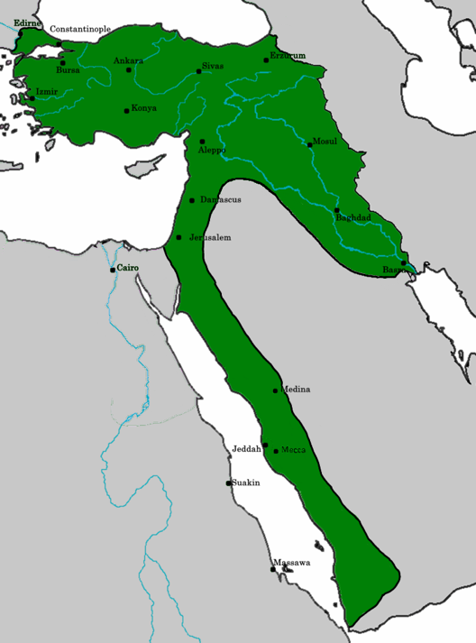
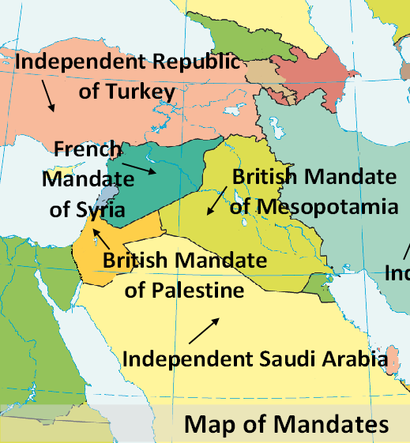
What changed in the Middle East after World War I?
Ottoman Empire before World War I (green)
Middle East after World War I
Notes:
Images: https://commons.wikimedia.org/wiki/File:OttomanEmpire1914.png; https://infogram.com/the-mandate-system-1h7k230p0q1ev2x

Slide 24
The mandate system after World War I
After World War I, Britain and France said that the people of the Middle East were not ready to rule themselves. The former Ottoman Empire was divided into different states, and each one was ‘guided’ by either Britain or France. These were known as mandates and covered:
Syria and Lebanon
Palestine and Transjordan
Mesopotamia (Iraq)

Slide 25
The mandate system after World War I
Britain created the borders of Iraq to ensure that it contained valuable oil reserves. This created problems for the future, however, as Iraq grouped together three former Ottoman provinces containing many different ethnic groups, sowing the seeds of instability.
There was also resentment against foreign rule. Even though Britain did not directly rule Iraq, Britain decided who the king of Iraq would be and had a lot of influence over its government.

Slide 26
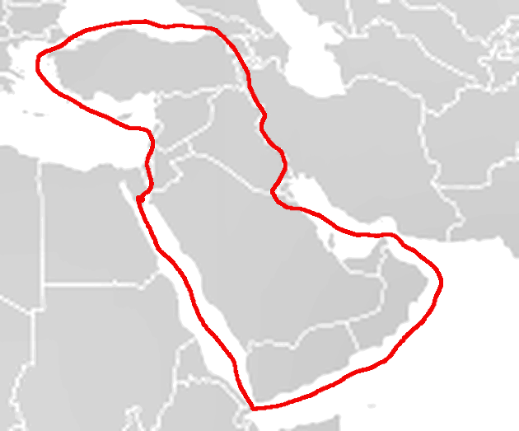
With their security in the region seemingly guaranteed by the British military presence, a group of British, French and American oil companies agreed to work together to control and develop oil in the region. This was known as the Red Line Agreement (1928).
Notes:
Image: https://commons.wikimedia.org/wiki/File:LineaRoja.png

Slide 27
Activity 2: How far did Britain dominate economic power in the Middle East before 1940?
Review the actions of Britain in the Middle East from 1900 to the 1930s.
Which of these actions provided economic power to Britain?
Which of these actions may have also provided economic power to parts of the Middle East?

Slide 28
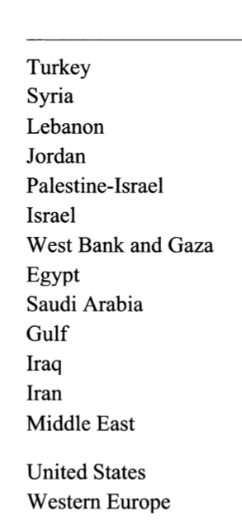
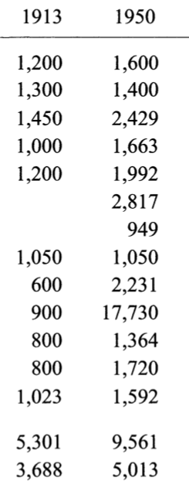
Activity 3: Did the oil-producing countries benefit economically from oil development by 1950?
GDP per capita (adjusted for inflation)
Were the economies of the oil-producing countries growing more quickly or more slowly than the Middle East average?
Major oil-producing countries
Average for the Middle East region as a whole
Notes:
Source: Pamuk, S. (2006) ‘Estimating economic growth in the Middle East since 1820’ in Journal of Economic History, 66, no. 3, pp. 809–828.

Slide 29
Activity 3: Did the oil-producing countries benefit economically from oil development by 1950?
GDP per capita (adjusted for inflation)
Middle East average: 1.5 x increase
Saudi Arabia: almost 4 x increase
Gulf states: almost 20 x increase
Iraq: 1.7 x increase
Iran: more than 2 x increase
Major oil-producing countries
Average for the Middle East region as a whole
Notes:
Source: Pamuk, S. (2006) ‘Estimating economic growth in the Middle East since 1820’ in Journal of Economic History, 66, no. 3, pp. 809–828.

Slide 30
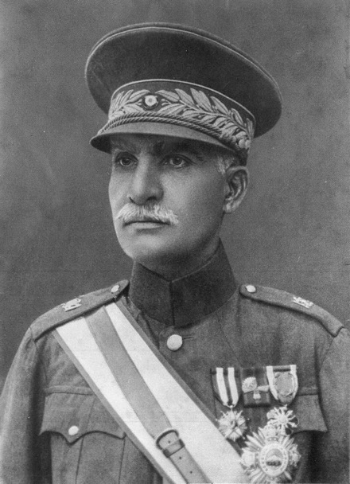
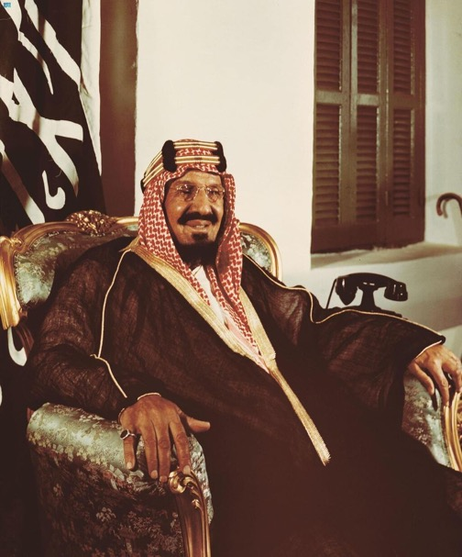
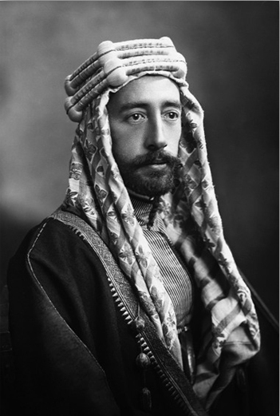
It’s important to remember that even as some Middle Eastern countries increased their wealth through oil, most of these countries were ruled by monarchies. Ordinary people did not have much say over how the wealth was used.
Reza Shah, King of Iran, 1925–41
Ibn Saud, King of Saudi Arabia, 1932–53
Faisal I, King of Iraq, 1921–33
Notes:
Images (from left): https://commons.wikimedia.org/wiki/File:Reza_shah_uniform.jpg; https://commons.wikimedia.org/wiki/File:Official_Portrait_of_King_Abdulaziz.jpg; https://commons.wikimedia.org/wiki/File:1307109799_king-faisal-i-of-iraq-kopiya.jpg

Slide 31
Judgement: What was the balance of economic power in the Middle East, 1900–50?
Log the key evidence and your judgement in the Lesson 1 row of your overview table.
British economic power
Evidence:
Middle East economic power
Evidence:
Colonial domination?
National power?

Slide 32
By 1950, Britain had a large degree of control over the Middle East’s main economic resource – oil. The extent of Britain’s economic power (as well as its political influence and military presence) could be seen as colonial, despite not officially ruling countries in the region. When did the balance of power change?
Middle East economic power
British economic power
Colonial domination?

Slide 33
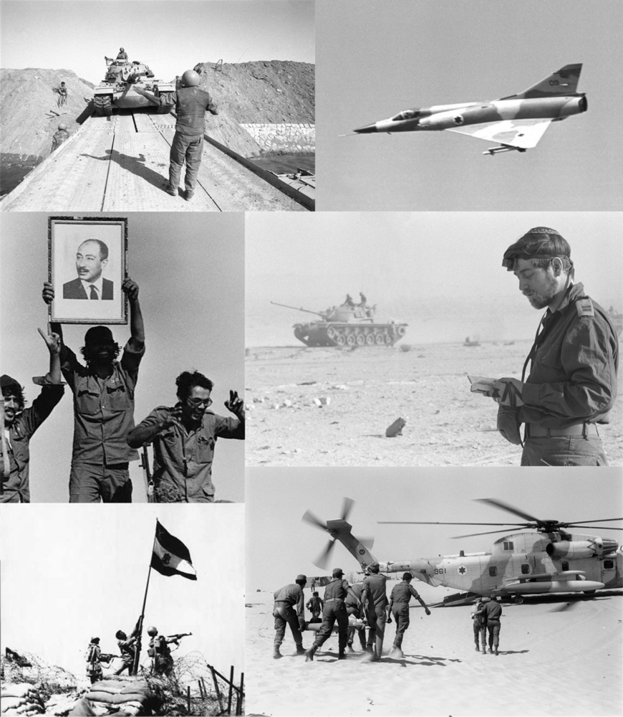

The year 1973 was dramatic, a year that many people think transformed the Middle East and the balance of economic power around the world. In this enquiry, we’ll decide whether 1973 really was the main turning point for economic power in the Middle East.
Notes:
Images: https://commons.wikimedia.org/wiki/File:Yom_Kippur_War_Montage.png; https://commons.wikimedia.org/wiki/File:Gas_Stealers_Beware_1974.jpg

Slide 34
Enquiry question:
Was 1973 a turning point for economic power in the Middle East?

Slide 35
Foreign economic power
Evidence:
Middle East economic power
Evidence:
Colonial domination?
National power?

