Slide 1
Was 1973 a turning point for economic power in the Middle East?
Lesson 2: Had the balance of economic power in the Middle East already turned before 1973?
Alex Benger, Chesterton Community College

Slide 2
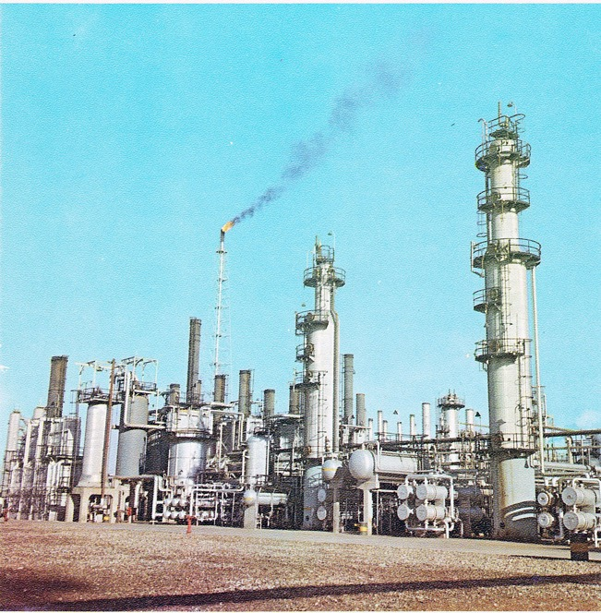
As a leader of a country, would you be happy if…
a foreign company agreed to invest money in your country to develop a big new industry?
your country was gaining millions of pounds from the industry, but almost three-quarters of the profits were going to a foreign country?
Notes:
Image: https://commons.wikimedia.org/wiki/File:Abadan_Catalitic_facilities.jpg

Slide 3
This was the situation in Iran by 1950
Britain’s Anglo-Iranian Oil Company had invested to develop Iran’s oil industry since 1908. They had built the Abadan oil refinery, one of the largest in the world.
The Anglo-Iranian Oil Company was making £250 million per year in profit, compared with £90 million for the Iranian government.
As the majority owner of the AIOC, and through taxes, the British government was receiving more money from Iranian oil than the Iranian government was.
Notes:
Image: https://commons.wikimedia.org/wiki/File:Abadan_Catalitic_facilities.jpg

Slide 4
Britain had also intervened in Iranian politics to protect its oil interests.
1906–10: Britain unsuccessfully opposed democratic reforms in Iran by supporting the monarch against the creation of a parliament.
1921: Britain supported the overthrow of the old royal family and its replacement by a new shah (king), called Reza Shah Pahlavi.
1941: Britain overthrew Reza Shah Pahlavi and replaced him with his son, Mohammad Reza Pahlavi.
Notes:
1906–10: Britain saw democratic reforms as a threat to stability and its oil concession.
1921: The old royal family was seen as weak and inefficient – supporting a new, stronger leader would be better for stability and thus the oil industry.
1941: Reza Shah claimed neutrality in World War II and refused to cut ties with Nazi Germany – Britain and the USSR invaded the country. Its oil was of particular importance in World War II.

Slide 5

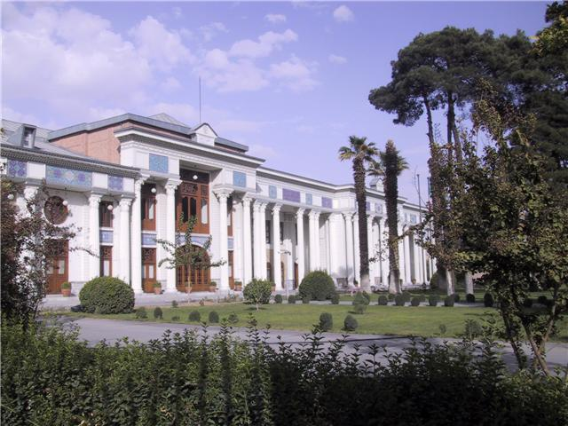
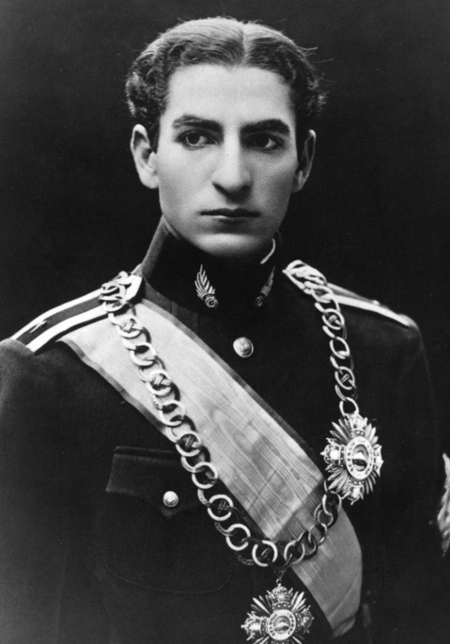

Politics of Iran in 1950
Anglo-Iranian Oil Company
The Shah, Mohammad Reza Pahlavi
Iranian Parliament
Notes:
Parliament had been weak under the previous shah (Mohammad Reza Pahlavi’s father), who ruled in an authoritarian manner (suppressing free speech and maintaining tight control over parliament). The new shah was a weaker leader. A greater degree of democracy characterised Iranian politics, and Iranian parliament had its own power alongside the shah. In the background, Britain remained influential through its control over Iranian oil. America was also increasingly interested in Iran, due to the Cold War and its desire to support Britain against Soviet influence.
Images (from left): https://commons.wikimedia.org/wiki/File:Parliamenttehran.jpg; https://commons.wikimedia.org/wiki/File:CrownPrinceMohammadRezaPahlavi1.jpg; https://en.wikipedia.org/wiki/File:Flag_of_the_United_Kingdom.svg; https://en.wikipedia.org/wiki/Flag_of_the_United_States

Slide 6
What was the balance of economic power in Iran in 1950?
British economic power
Evidence:
Iranian economic power
Evidence:
Colonial domination?
National power?

Slide 7
Many in Iran believed that the country’s oil was not benefiting the country enough. The wealth was being taken by Britain. Hatred of Britain was growing.
There was discussion in the Iranian parliament that they should nationalise the oil industry. This meant taking it away from the Anglo-Iranian Oil Company and putting the industry under Iranian government ownership.

Slide 8
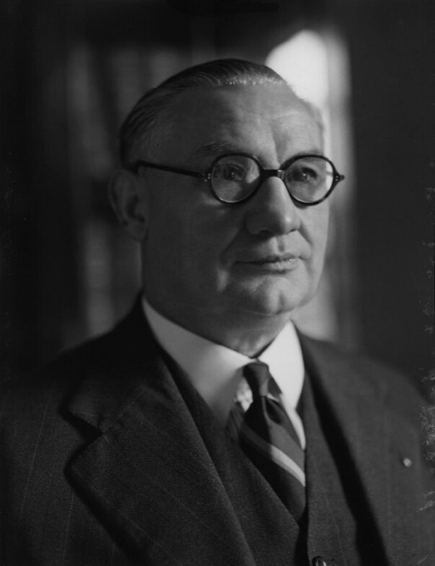
If Iran nationalised the oil industry, then this would have been seen as a disaster and humiliation for Britain.
Britain needed Middle Eastern oil for its military security (to power its army, navy and air force).
Oil was also becoming more and more important to Britain’s way of life. Britain’s Foreign Secretary, Ernest Bevin, said: ‘Without the Middle East and its oil, there is no hope of our being able to achieve the standard of living at which we are aiming in Britain.’
Notes:
Image: https://commons.wikimedia.org/wiki/File:Ernest_Bevin_MP.jpg

Slide 9
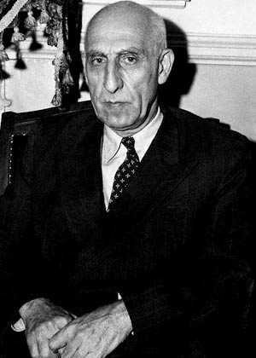
In 1950, Mohammed Mossadegh, the chairman of the oil committee in Iran’s parliament said: ‘The source of all the misfortunes of this tortured nation is only the oil company.’ He pushed for Iran to nationalise the oil industry and kick out the British.
Another Iranian politician declared that it would be better for the oil industry to be destroyed by an atomic bomb than to remain British.
When the new prime minister, General Ali Razmara, declared that he opposed nationalising the oil industry, he was assassinated just four days later.
In 1951, Mohammad Mossadegh was chosen by Iran’s parliament as the new prime minister. With the Shah now humiliated and lacking support, Mossadegh was effectively the leader of the country.
Notes:
Image: https://commons.wikimedia.org/wiki/File:Dr_Mohammad_Mosaddeq.jpg

Slide 10
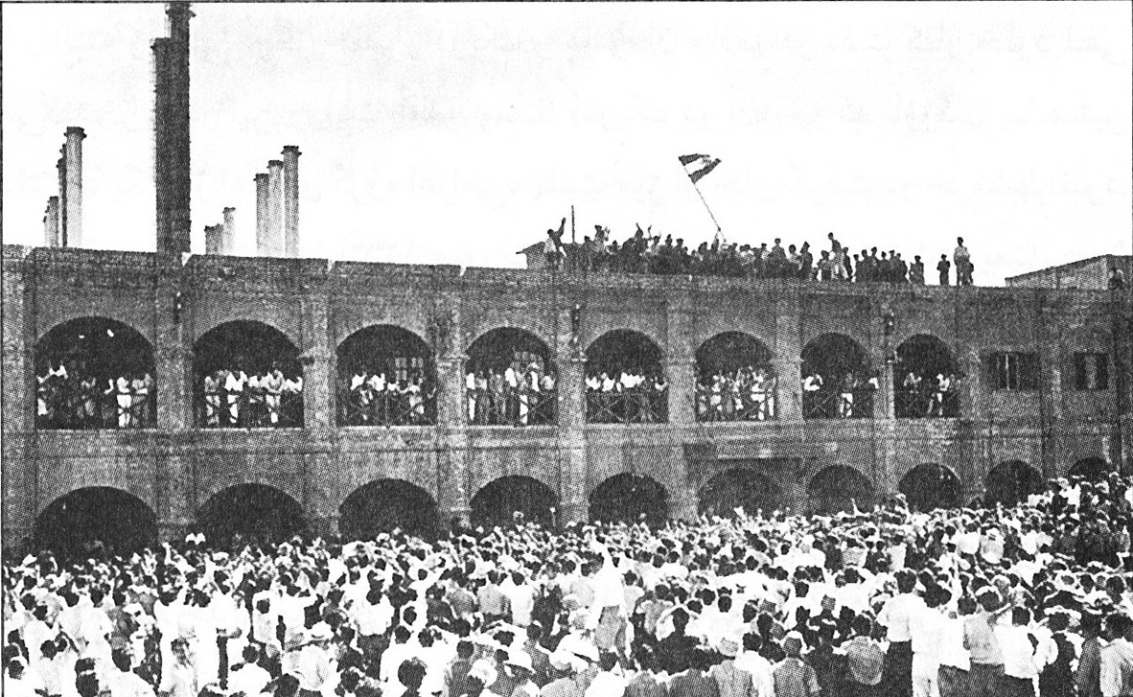
Iran nationalised the oil industry. All British oil facilities were taken over and renamed as the Iranian National Oil Company.
Notes:
Image: https://commons.wikimedia.org/wiki/File:AIOC741330.jpg

Slide 11
What was the balance of economic power in Iran in 1951?
How might Britain react to this situation?
British economic power
Evidence:
Iranian economic power
Evidence:
Colonial domination?
National power?

Slide 12
Britain did not accept that the oil industry should be controlled by Iran. In their eyes, Iran’s oil industry had been built up by a British company and therefore should remain British. Britain needed access to that oil for its living standards and security.
Britain thought about executing Plan Y: sending its military to seize back the oil assets – such as Abadan refinery – that had been taken by Iran.
Notes:
Image: https://commons.wikimedia.org/wiki/File:Abadan_Catalitic_facilities.jpg

Slide 13
However, the Americans strongly opposed Plan Y. They persuaded Britain to allow the Americans to try to negotiate a compromise with Iran’s Prime Minister Mossadegh.
The Americans believed that a military conflict could spiral out of control and give the Soviets (Russians) an opportunity to intervene and gain influence over Iran. They wanted American allies – or America itself – to maintain control over Iran’s oil.
Meanwhile, there were doubts over Britain’s ability to fight a war: Britain’s finances were weak after World War II and Britain had been weakened further by the loss of India from its empire in 1947.
Would America’s negotiations with Iran succeed?

Slide 14
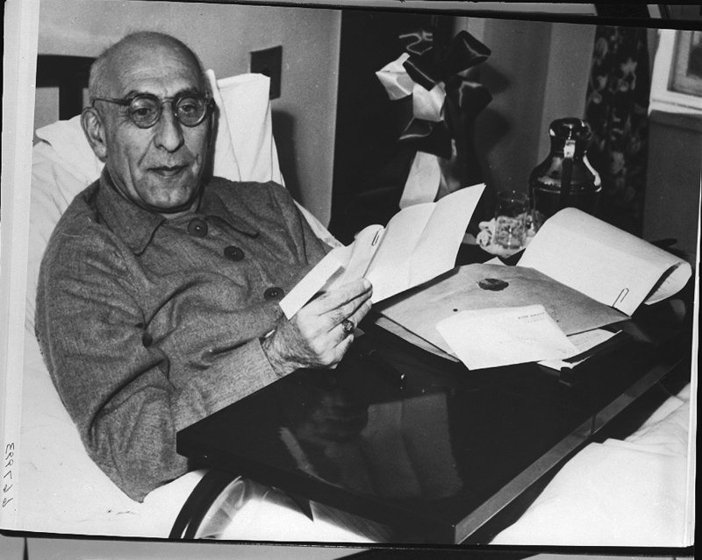
The American negotiations with Mossadegh were strange. Mossadegh insisted on negotiating while lying down in his bed.
Mossadegh said of the British: ‘You do not know how crafty they are. You do not know how evil they are.’
Harriman, the American negotiator, replied: ‘I assure you they are good and bad and most of all in between.’
It was impossible to reach an agreement that involved giving oil back to the British.
Notes:
Image: https://commons.wikimedia.org/wiki/File:Prime_Minister_Mohammad_Mossadegh_of_Iran_in_hospital_bed_in_New_York_City.jpg

Slide 15
Decision: Negotiations with Iran’s Prime Minister Mossadegh to reach a compromise over Britain’s involvement in the Iranian oil industry were going nowhere. What would Britain do next?
Finally give up on the oil; there was nothing that Britain could do.
Execute Plan Y and take back the oil industry by force.
Secretly work together with the Americans to overthrow Mossadegh and restore the power of the Shah.

Slide 16
Decision: Negotiations with Iran’s Prime Minister Mossadegh to reach a compromise over Britain’s involvement in the Iranian oil industry were going nowhere. What did Britain do next?
Finally give up on the oil; there was nothing that Britain could do.
Execute Plan Y and take back the oil industry by force.
Secretly work together with the Americans to overthrow Mossadegh and restore the power of the Shah.

Slide 17
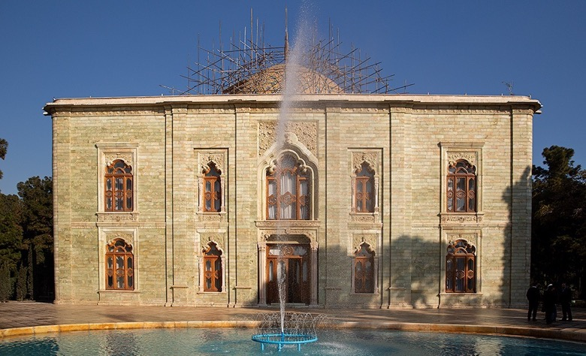
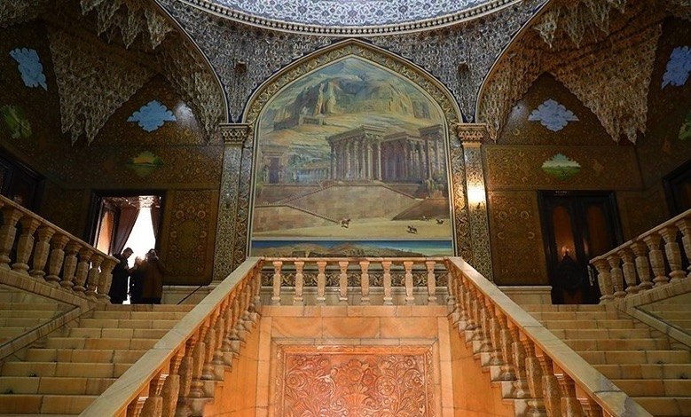
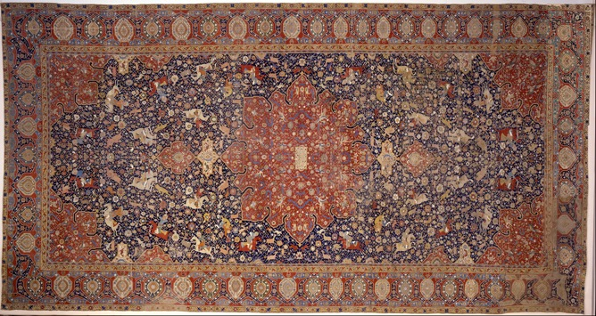
In 1953, an American CIA agent snuck into the royal palace at night, hidden under a carpet in a car. He met with the Shah and persuaded him to fire Mossadegh as prime minister.
Notes:
Images (clockwise from left): https://commons.wikimedia.org/wiki/File:Ghyas_el_Din_Jami_-_Tabriz_(%3F)_-_Google_Art_Project.jpg; https://commons.wikimedia.org/wiki/File:Marmar_Palace_43906.jpg; https://commons.wikimedia.org/wiki/File:Marmar_Palace_1398110615003146819495814.jpg

Slide 18
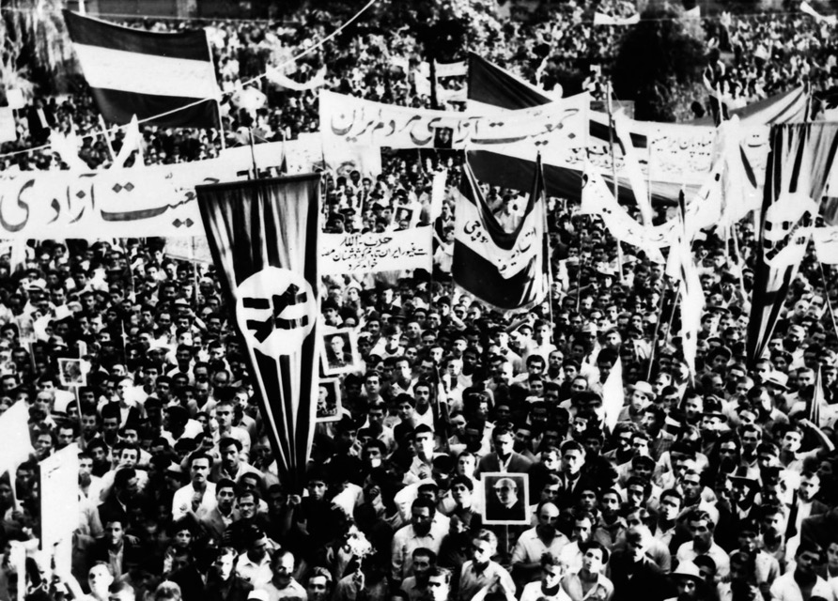
However, Mossadegh learned of this plan to remove him and started his own campaign to remove the Shah. His supporters started attacking and destroying statues of the Shah’s father.
Notes:
Image: https://commons.wikimedia.org/wiki/File:1953_Iranian_coup_d%27%C3%A9tat_-_Tehran_rally.jpg

Slide 19
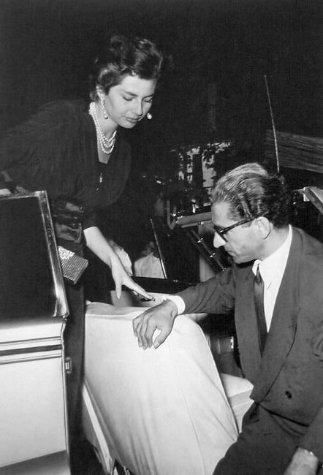
The Shah quickly fled to Rome with his wife, where they waited in a hotel with no spare clothes and no money. The Queen spent her days wandering around the shops in Rome, with no money to buy anything.
It seemed like the plan had failed.
Notes:
Image: https://commons.wikimedia.org/wiki/File:Mohammadreza_pahlavi_and_soraya_esfandiary.jpg

Slide 20
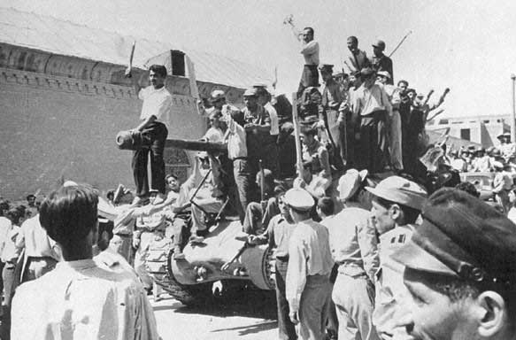
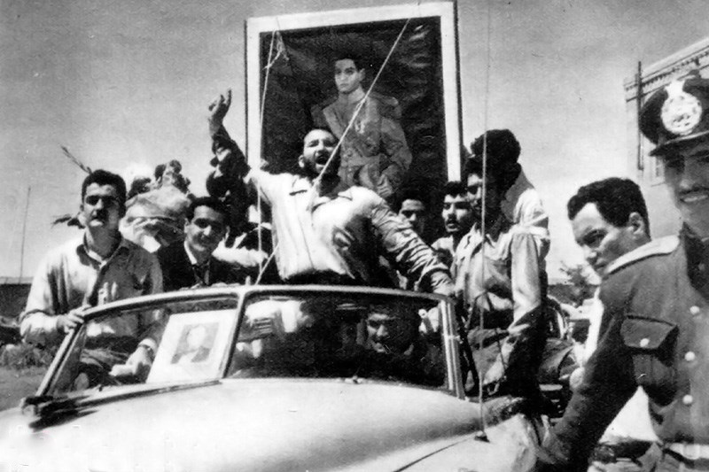
The British and Americans were not ready to admit defeat yet. They bribed people and gangs to protest for the Shah and put up pro-Shah propaganda. They defeated the supporters of Mossadegh.
Notes:
Images: https://en.wikipedia.org/wiki/1953_Iranian_coup_d%27%C3%A9tat#/media/File:Operationajax.jpg; https://commons.wikimedia.org/wiki/File:Shaban_Jafari.jpg

Slide 21

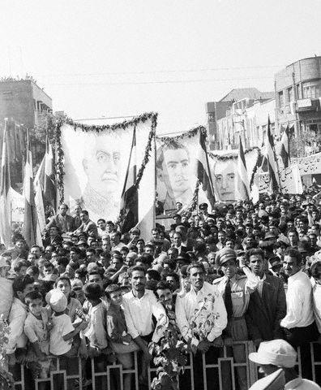
The Shah then returned to Iran. ‘I knew they loved me,’ he said, when he saw people supporting him.
Notes:
Images: https://commons.wikimedia.org/wiki/File:Portrait_of_a_Young_Mohammad_Reza_Shah_Pahlavi_in_Full_Military_Dress.jpg; https://commons.wikimedia.org/wiki/File:Proshah1954.jpg

Slide 22
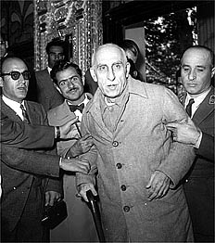
Mossadegh was placed under arrest for the rest of his life.
Notes:
Image: https://commons.wikimedia.org/wiki/File:Mossadegh_Trial_28_Amordad_1332.jpg

Slide 23
What happened to the oil?
A new agreement was made in which:
Britain was forced to accept that all of the oil officially belonged to Iran.
The Anglo-Iranian Oil Company kept 40% of the rights to manage (but not own) Iranian oil. The other 60% was managed by seven different companies, including American companies.
Iran would receive a roughly 50% share of profits from oil sales.
Notes:
Image: https://commons.wikimedia.org/wiki/File:Abadan_Catalitic_facilities.jpg

Slide 24
Activity 1: How far had the events of 1950–53 shifted the balance of economic power in Iran?
Use the summary on the worksheet to remind you of the key events.
British economic power
Evidence:
Iranian economic power
Evidence:
Colonial domination?
National power?

Slide 25
Even though Britain and America did not directly rule the countries of the Middle East, the control that their companies had over the region’s main economic resource (oil) was seen by many as colonial. So was British and American intervention in Middle Eastern politics, usually to defend their oil interests.

Slide 26
Iran’s nationalisation of the oil industry was part of a wider rise of anti-colonial nationalism in the Middle East from the 1950s.
Anti = against
Colonial = foreign domination
Nationalism = belief in one’s own country
Anti-colonial nationalists wanted to increase the strength and independence of their nations by reducing the influence of foreign powers. In the Middle East, this meant challenging the power of Britain and the USA over the oil industry.

Slide 27
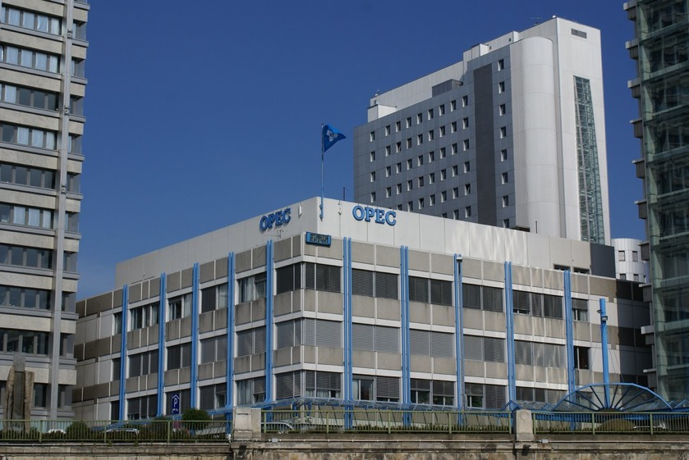
The creation of OPEC
In the 1960s, the oil-producing countries created OPEC (Organisation of the Petroleum Exporting Countries). Its founding members were Iran, Iraq, Saudi Arabia, Kuwait and Venezuela (the only non-Middle Eastern member).
They wanted to pursue the following aims:
To take national ownership over the oil from the British and American companies
To increase the price of oil
To increase their countries’ profits and wealth from oil production
Notes:
Image: https://live.staticflickr.com/6048/6379201779_189efed046_b.jpg

Slide 28
Activity 2: How successful were the Middle Eastern oil-producing countries at achieving their economic aims between 1950 and 1973?
Look at Figures 1, 2 and 3. Put a tick next to the aims that you think they were achieving by 1973 and a cross next to those that you think they were not yet achieving.
Aim 1: To take national ownership over the oil from the British and American companies
Aim 2: To increase the price of oil
Aim 3: To increase their countries’ profits and wealth from oil production

Slide 29
Before 1950, the oil industry had been owned and developed (mostly) by British and American oil companies.
The countries of the Middle East gained a share of the profits through deals with the companies.
To what extent had the deals improved by the early 1970s?
To what extent does this suggest that the balance of economic power had shifted?
Country | Share of oil profits before 1950 (typical price of a barrel of oil was around $2.50) | Share of oil profits 1950–70 | Share of oil profits 1971
Iran | 16.5 cents per barrel | 50/50 split in profits (+ took national ownership of oil) | At least 55% share of profits
Saudi Arabia | 33 cents per barrel | 50/50 split in profits | At least 55% share of profits
Iraq | 16.5 cents per barrel | 50/50 split in profits (+ took national ownership of oil) | At least 55% share of profits
Kuwait | 15–35 cents per barrel | 50/50 split in profits | At least 55% share of profits

Slide 30
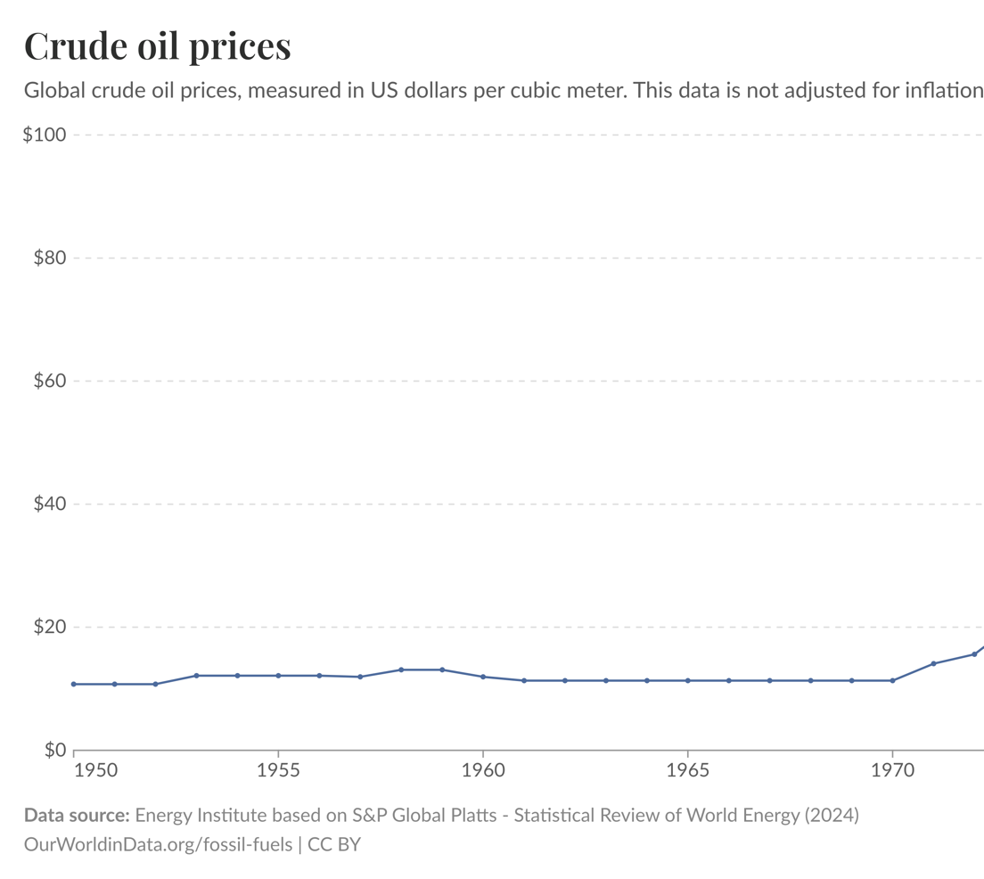
Why would the oil-producing countries want oil prices to be higher?
Why would Britain and the USA prefer oil prices not to get too high?
Which side was succeeding?
Notes:
Graph: https://ourworldindata.org/fossil-fuels

Slide 31
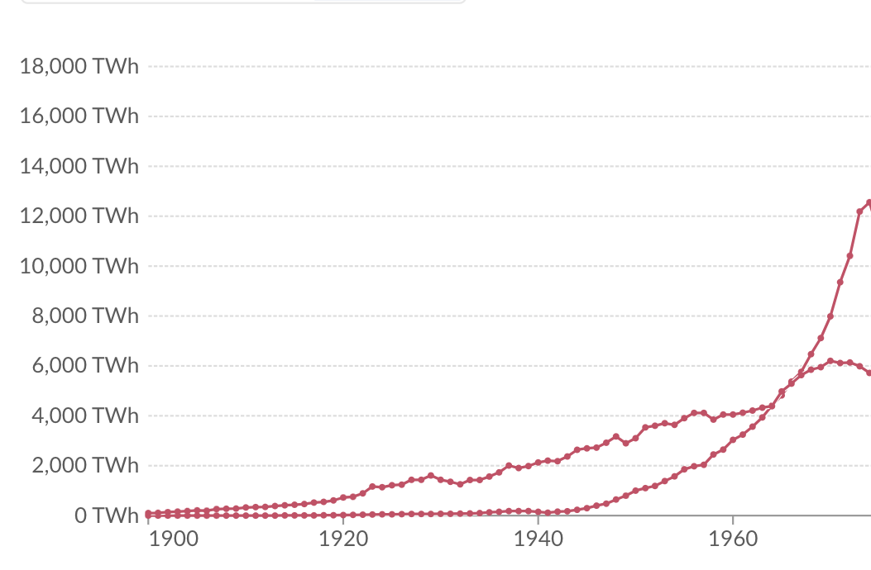
Middle East vs USA oil production
Why might it be important that the Middle East had overtaken the USA as the world’s largest oil-producing region?
Notes:
Oil production measured in terawatt-hours. Graph: https://ourworldindata.org/fossil-fuels

Slide 32
Was 1973 a turning point for economic power in the Middle East?
Had the balance of economic power in the Middle East already turned before 1973?

Slide 33
Judgement: Had the balance of economic power already turned before 1973?
Consider the case study of Iran and the information about the broader Middle East region. Log the key evidence and your judgement in the Lesson 2 row of your overview table.
Foreign economic power
Evidence:
Middle East economic power
Evidence:
Colonial domination?
National power?

