Slide 1
Was 1973 a turning point for economic power in the Middle East?
Lesson 6: Conclusions
Alex Benger, Chesterton Community College

Slide 2
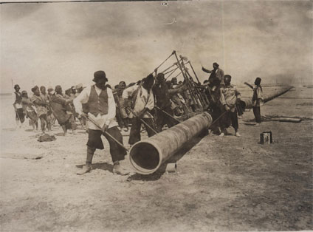
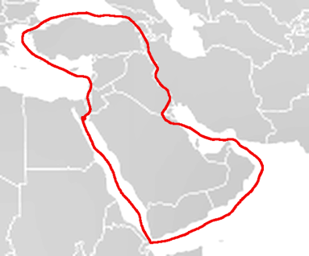
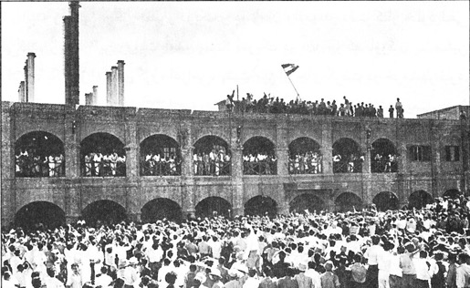
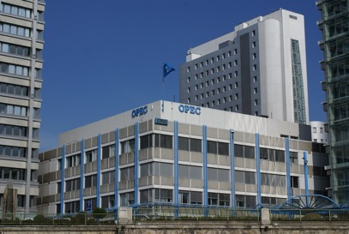
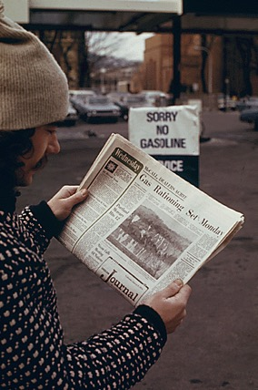
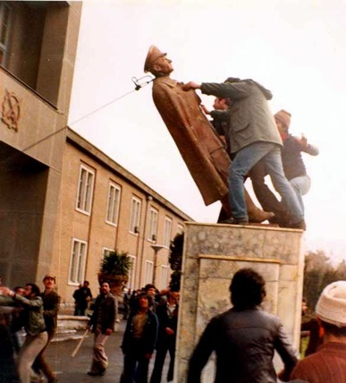
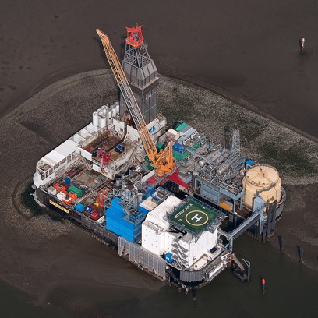
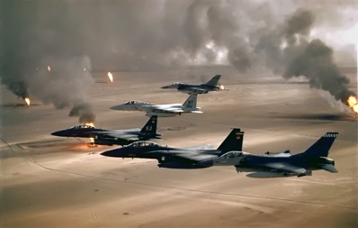

1
2
3
Activity 1: Match the event to the photo.
Gulf War, 1990–91
Iranian Revolution, 1978–79
Nationalisation of Iranian oil industry, 1951
Red Line Agreement, 1928
Oil discovered in Persia (Iran), 1908
OPEC created, 1960
Arab oil embargo, 1973–74
North Sea oil production expanded, 1980s
Iraq War, 2003–11
4
5
6
7
8
9
Notes:
Images (in numerical order): https://commons.wikimedia.org/wiki/File:Anglo-Persian_Oil_Company_workers_(1).jpg; https://commons.wikimedia.org/wiki/File:LineaRoja.png; https://commons.wikimedia.org/wiki/File:AIOC741330.jpg;
https://live.staticflickr.com/6048/6379201779_189efed046_b.jpg; https://commons.wikimedia.org/wiki/File:No_gas_1974.gif; https://commons.wikimedia.org/wiki/File:Statue_of_Shah_Revolution.jpg; https://en.wikipedia.org/wiki/File:11-09-fotofluege-cux-allg-25a.jpg; https://en.wikipedia.org/wiki/File:USAF_F-16A_F-15C_F-15E_Desert_Storm_edit2.jpg; https://commons.wikimedia.org/wiki/File:L_company_3rd_Battalion_3rd_Marines_search_house.jpg

Slide 3
Oil discovered in Persia (Iran), 1908
Red Line Agreement,1928
Nationalisation of Iranian oil industry, 1951
Activity 2: Match the event to its description.
USA and Britain invaded Iraq without international support.
Iran took control of its oil industry away from the Anglo-Iranian Oil Company. Britain and the USA responded by removing Iran’s prime minister.
An organisation was created to campaign for increased economic power for oil-producing countries.
Arab oil-producing countries supported Egypt and Syria in their war with Israel by refusing to sell oil to allies of Israel.
The Anglo-Persian Oil Company was created to manage the first discoveries of oil in the Middle East.
British, American and French companies agreed to co-ordinate efforts to control the Middle East’s oil.
A 42-country coalition led by the USA stopped Iraq’s invasion of Kuwait.
Oil production increased in the seas off the UK and Norway.
The Shah of Iran was overthrown due to backlash against his rule and modernisation programme.
OPEC created, 1960
Arab oil embargo, 1973–74
Iranian Revolution, 1978–79
North Sea oil production expanded, 1980s
Gulf War, 1990–91
Iraq War, 2003–11
Notes:
This could be printed for students.
Images: https://commons.wikimedia.org/wiki/File:Anglo-Persian_Oil_Company_workers_(1).jpg; https://commons.wikimedia.org/wiki/File:LineaRoja.png; https://commons.wikimedia.org/wiki/File:AIOC741330.jpg;
https://live.staticflickr.com/6048/6379201779_189efed046_b.jpg; https://commons.wikimedia.org/wiki/File:No_gas_1974.gif; https://commons.wikimedia.org/wiki/File:Statue_of_Shah_Revolution.jpg; https://en.wikipedia.org/wiki/File:11-09-fotofluege-cux-allg-25a.jpg; https://en.wikipedia.org/wiki/File:USAF_F-16A_F-15C_F-15E_Desert_Storm_edit2.jpg; https://commons.wikimedia.org/wiki/File:L_company_3rd_Battalion_3rd_Marines_search_house.jpg

Slide 4
Oil discovered in Persia (Iran), 1908
Red Line Agreement,1928
Nationalisation of Iranian oil industry,1951
Activity 2: Match the event to its description.
USA and Britain invaded Iraq without international support.
Iran took control of its oil industry away from the Anglo-Iranian Oil Company. Britain and the USA responded by removing Iran’s prime minister.
An organisation was created to campaign for increased economic power for oil-producing countries.
Arab oil-producing countries supported Egypt and Syria in their war with Israel by refusing to sell oil to allies of Israel.
The Anglo-Persian Oil Company was created to manage the first discoveries of oil in the Middle East.
British, American and French companies agreed to co-ordinate efforts to control the Middle East’s oil.
A 42-country coalition led by the USA stopped Iraq’s invasion of Kuwait.
Oil production increased in the seas off the UK and Norway.
The Shah of Iran was overthrown due to backlash against his rule and modernisation programme.
e
f
b
OPEC created, 1960
Arab oil embargo, 1973–74
Iranian Revolution, 1978–79
c
d
i
North Sea oil production expanded, 1980s
Gulf War, 1990–91
Iraq War, 2003–11
h
g
a
Notes:
This could be printed for students.
Images: https://commons.wikimedia.org/wiki/File:Anglo-Persian_Oil_Company_workers_(1).jpg; https://commons.wikimedia.org/wiki/File:LineaRoja.png; https://commons.wikimedia.org/wiki/File:AIOC741330.jpg;
https://live.staticflickr.com/6048/6379201779_189efed046_b.jpg; https://commons.wikimedia.org/wiki/File:No_gas_1974.gif; https://commons.wikimedia.org/wiki/File:Statue_of_Shah_Revolution.jpg; https://en.wikipedia.org/wiki/File:11-09-fotofluege-cux-allg-25a.jpg; https://en.wikipedia.org/wiki/File:USAF_F-16A_F-15C_F-15E_Desert_Storm_edit2.jpg; https://commons.wikimedia.org/wiki/File:L_company_3rd_Battalion_3rd_Marines_search_house.jpg

Slide 5
Oil discovered in Persia (Iran), 1908
Red Line Agreement, 1928
Nationalisation of Iranian oil industry, 1951
Activity 3: Match the event to its impact on economic power in the Middle East.
Expansion of foreign interest in controlling the Middle East’s oil resources.
Demonstrated America and Britain’s will to secure economic interests in the Middle East through direct intervention in politics.
By 1971, had helped to negotiate agreements for oil-producing countries to keep at least 55% of oil profits.
Oil industry taken under national ownership.
Led to significant increase in oil price.
Led to OPEC taking control of setting the oil price.
Demonstrated the growing power and global influence of oil-producing countries in the Middle East.
Foreign involvement in oil industry ended completely.
Reduced control of the Middle East over the oil industry.
OPEC created, 1960
Arab oil embargo, 1973–74
Iranian Revolution, 1978–79
North Sea oil production expanded, 1980s
Gulf War, 1990–91
Iraq War, 2003–11
Notes:
This could be printed for students.
Images: https://commons.wikimedia.org/wiki/File:Anglo-Persian_Oil_Company_workers_(1).jpg; https://commons.wikimedia.org/wiki/File:LineaRoja.png; https://commons.wikimedia.org/wiki/File:AIOC741330.jpg;
https://live.staticflickr.com/6048/6379201779_189efed046_b.jpg; https://commons.wikimedia.org/wiki/File:No_gas_1974.gif; https://commons.wikimedia.org/wiki/File:Statue_of_Shah_Revolution.jpg; https://en.wikipedia.org/wiki/File:11-09-fotofluege-cux-allg-25a.jpg; https://en.wikipedia.org/wiki/File:USAF_F-16A_F-15C_F-15E_Desert_Storm_edit2.jpg; https://commons.wikimedia.org/wiki/File:L_company_3rd_Battalion_3rd_Marines_search_house.jpg

Slide 6
Oil discovered in Persia (Iran), 1908
Red Line Agreement, 1928
Nationalisation of Iranian oil industry, 1951
Activity 3: Match the event to its impact on economic power in the Middle East.
Expansion of foreign interest in controlling the Middle East’s oil resources.
Demonstrated America and Britain’s will to secure economic interests in the Middle East through direct intervention in politics.
By 1971, had helped to negotiate agreements for oil-producing countries to keep at least 55% of oil profits.
Oil industry taken under national ownership.
Led to significant increase in oil price.
Led to OPEC taking control of setting the oil price.
Demonstrated the growing power and global influence of oil-producing countries in the Middle East.
Foreign involvement in oil industry ended completely.
Reduced control of the Middle East over the oil industry.
a
a
b, d
OPEC created, 1960
Arab oil embargo, 1973–74
Iranian Revolution, 1978–79
c
e, f, g
e, h
North Sea oil production expanded, 1980s
Gulf War, 1990–91
Iraq War, 2003–11
i
b
b
Notes:
This could be printed for students.
Images: https://commons.wikimedia.org/wiki/File:Anglo-Persian_Oil_Company_workers_(1).jpg; https://commons.wikimedia.org/wiki/File:LineaRoja.png; https://commons.wikimedia.org/wiki/File:AIOC741330.jpg;
https://live.staticflickr.com/6048/6379201779_189efed046_b.jpg; https://commons.wikimedia.org/wiki/File:No_gas_1974.gif; https://commons.wikimedia.org/wiki/File:Statue_of_Shah_Revolution.jpg; https://en.wikipedia.org/wiki/File:11-09-fotofluege-cux-allg-25a.jpg; https://en.wikipedia.org/wiki/File:USAF_F-16A_F-15C_F-15E_Desert_Storm_edit2.jpg; https://commons.wikimedia.org/wiki/File:L_company_3rd_Battalion_3rd_Marines_search_house.jpg

Slide 7
Was 1973 a turning point for economic power in the Middle East?
Foreign economic power
Middle East economic power
Colonial domination?
National power?

Slide 8
Was 1973 a turning point for economic power in the Middle East?
Arguments that 1973 was a turning point | Arguments that 1973 was not a turning point
What changed as a result of the events of 1973? How important were these changes? | What changes were a result of other events, either before or after 1973? Were these more important than the changes in 1973? Was there anything that did not change or was reversed after 1973? Do these mean that 1973 did not change enough to be called a turning point?

Slide 9
Oil discovered in Persia (Iran), 1908
Red Line Agreement, 1928
Nationalisation of Iranian oil industry, 1951
Was 1973 a turning point for economic power in the Middle East?
Was 1973 a clear turning point?
Was another year or event the main turning point?
Was there no clear turning point at all?
Were there different turning points for different countries in the Middle East?
OPEC created, 1960
Arab oil embargo, 1973–74
Iranian Revolution, 1978–79
North Sea oil production expanded, 1980s
Gulf War, 1990–91
Iraq War, 2003–11
Notes:
Images: https://commons.wikimedia.org/wiki/File:Anglo-Persian_Oil_Company_workers_(1).jpg; https://commons.wikimedia.org/wiki/File:LineaRoja.png; https://commons.wikimedia.org/wiki/File:AIOC741330.jpg;
https://live.staticflickr.com/6048/6379201779_189efed046_b.jpg; https://commons.wikimedia.org/wiki/File:No_gas_1974.gif; https://commons.wikimedia.org/wiki/File:Statue_of_Shah_Revolution.jpg; https://en.wikipedia.org/wiki/File:11-09-fotofluege-cux-allg-25a.jpg; https://en.wikipedia.org/wiki/File:USAF_F-16A_F-15C_F-15E_Desert_Storm_edit2.jpg; https://commons.wikimedia.org/wiki/File:L_company_3rd_Battalion_3rd_Marines_search_house.jpg

Slide 10
Your conclusion: Was 1973 a turning point for economic power in the Middle East?
Create a piece of work to demonstrate your conclusion. This could be a piece of writing or it could include pictures or diagrams with labels to explain. For example:
If you think that 1973 was a turning point, you could split your page in two, with one half showing what the situation was before 1973 and the other half showing how it was different afterwards.
If you think that a different event was the turning point, you could do the same for that event.
If you think that there was no clear turning point, you could draw a timeline showing how economic power shifted gradually over time.

