Slide 1
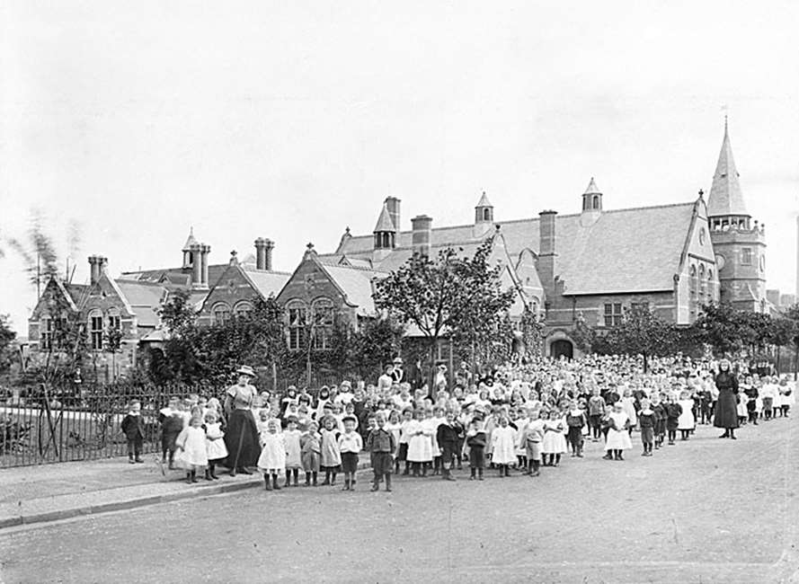
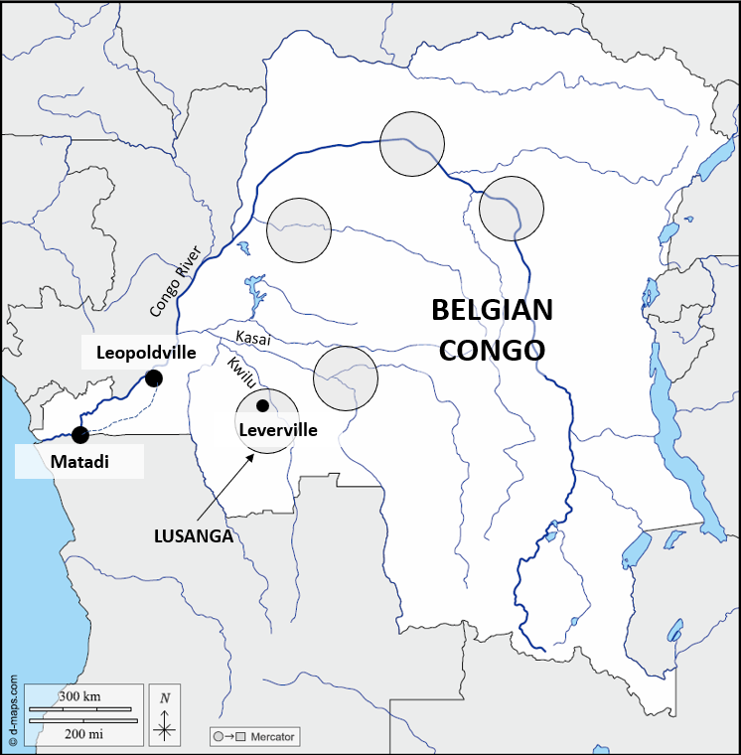
William Lever, Port Sunlight and the Belgian Congo
The story of Sunlight soap began in 1885, when William Lever and his brother James, grocer’s sons from Bolton, entered the soap business. Lever Brothers invented a new way of making soap, using vegetable oils instead of animal fat. The resulting soap washed well, produced a good lather and, importantly, smelled clean and fresh. William Lever branded it Sunlight soap.
The growing popularity of Sunlight
soap forced Lever Brothers to build
a larger factory on the banks of the
River Mersey in 1888. William Lever
built a model village for his workers,
which he named Port Sunlight, on the
land surrounding the factory. Lever’s
employees were given spacious,
well-built homes with large gardens,
as well as schools, parks, libraries,
gymnasiums, a large parish church and
even an art gallery. This was a sharp contrast to the run-down slums of nearby Birkenhead and Liverpool.
In 1911, Lever Brothers were approached by the Belgian government with an unusual offer. Aware of William Lever’s reputation as a philanthropist, they wondered whether his firm would like to take control of large areas of the Belgian Congo. The Congo was home to vast numbers of oil palm trees, the source of valuable palm oil,
which Lever Brothers used to make
their soap. In return, Belgium hoped
that William Lever would be able to
improve the lives of the Congolese
workers that he employed.
William Lever visited the Belgian Congo
and signed a contract to take control of
five concessions. The first of these was
named Leverville, with others named
after the Belgian royal family.
Despite the chaos of the First
World War (1914–1918) and the Great
Depression of the 1930s, Lever Brothers kept control of their Congolese concessions, importing huge quantities of palm oil to Port Sunlight throughout the inter-war years.
1 2 3 4 5 6
7 8 9 10 11 12 13 14 15 16 17 18 19
20 21 22 2423 24 25 26 27 28
29 30 31 32 33
34 35 36 37 38
Photograph taken Jan 1906 – Apr 1907 © Reproduced by permission of Historic England Archive ref: al1914_002_01
Above: Children outside the Port Sunlight school
https://d-maps.com/carte.php?num_car=1242&lang=en
Above: Lever Brothers’ five concessions in the Belgian Congo

