Slide 1
Working at Port Sunlight and Leverville
 | Port Sunlight | Leverville
Types of work done
Male and female roles
Use of child labour?
Wages
Working conditions
Benefits (pensions, co-partnership, etc.)

Slide 2
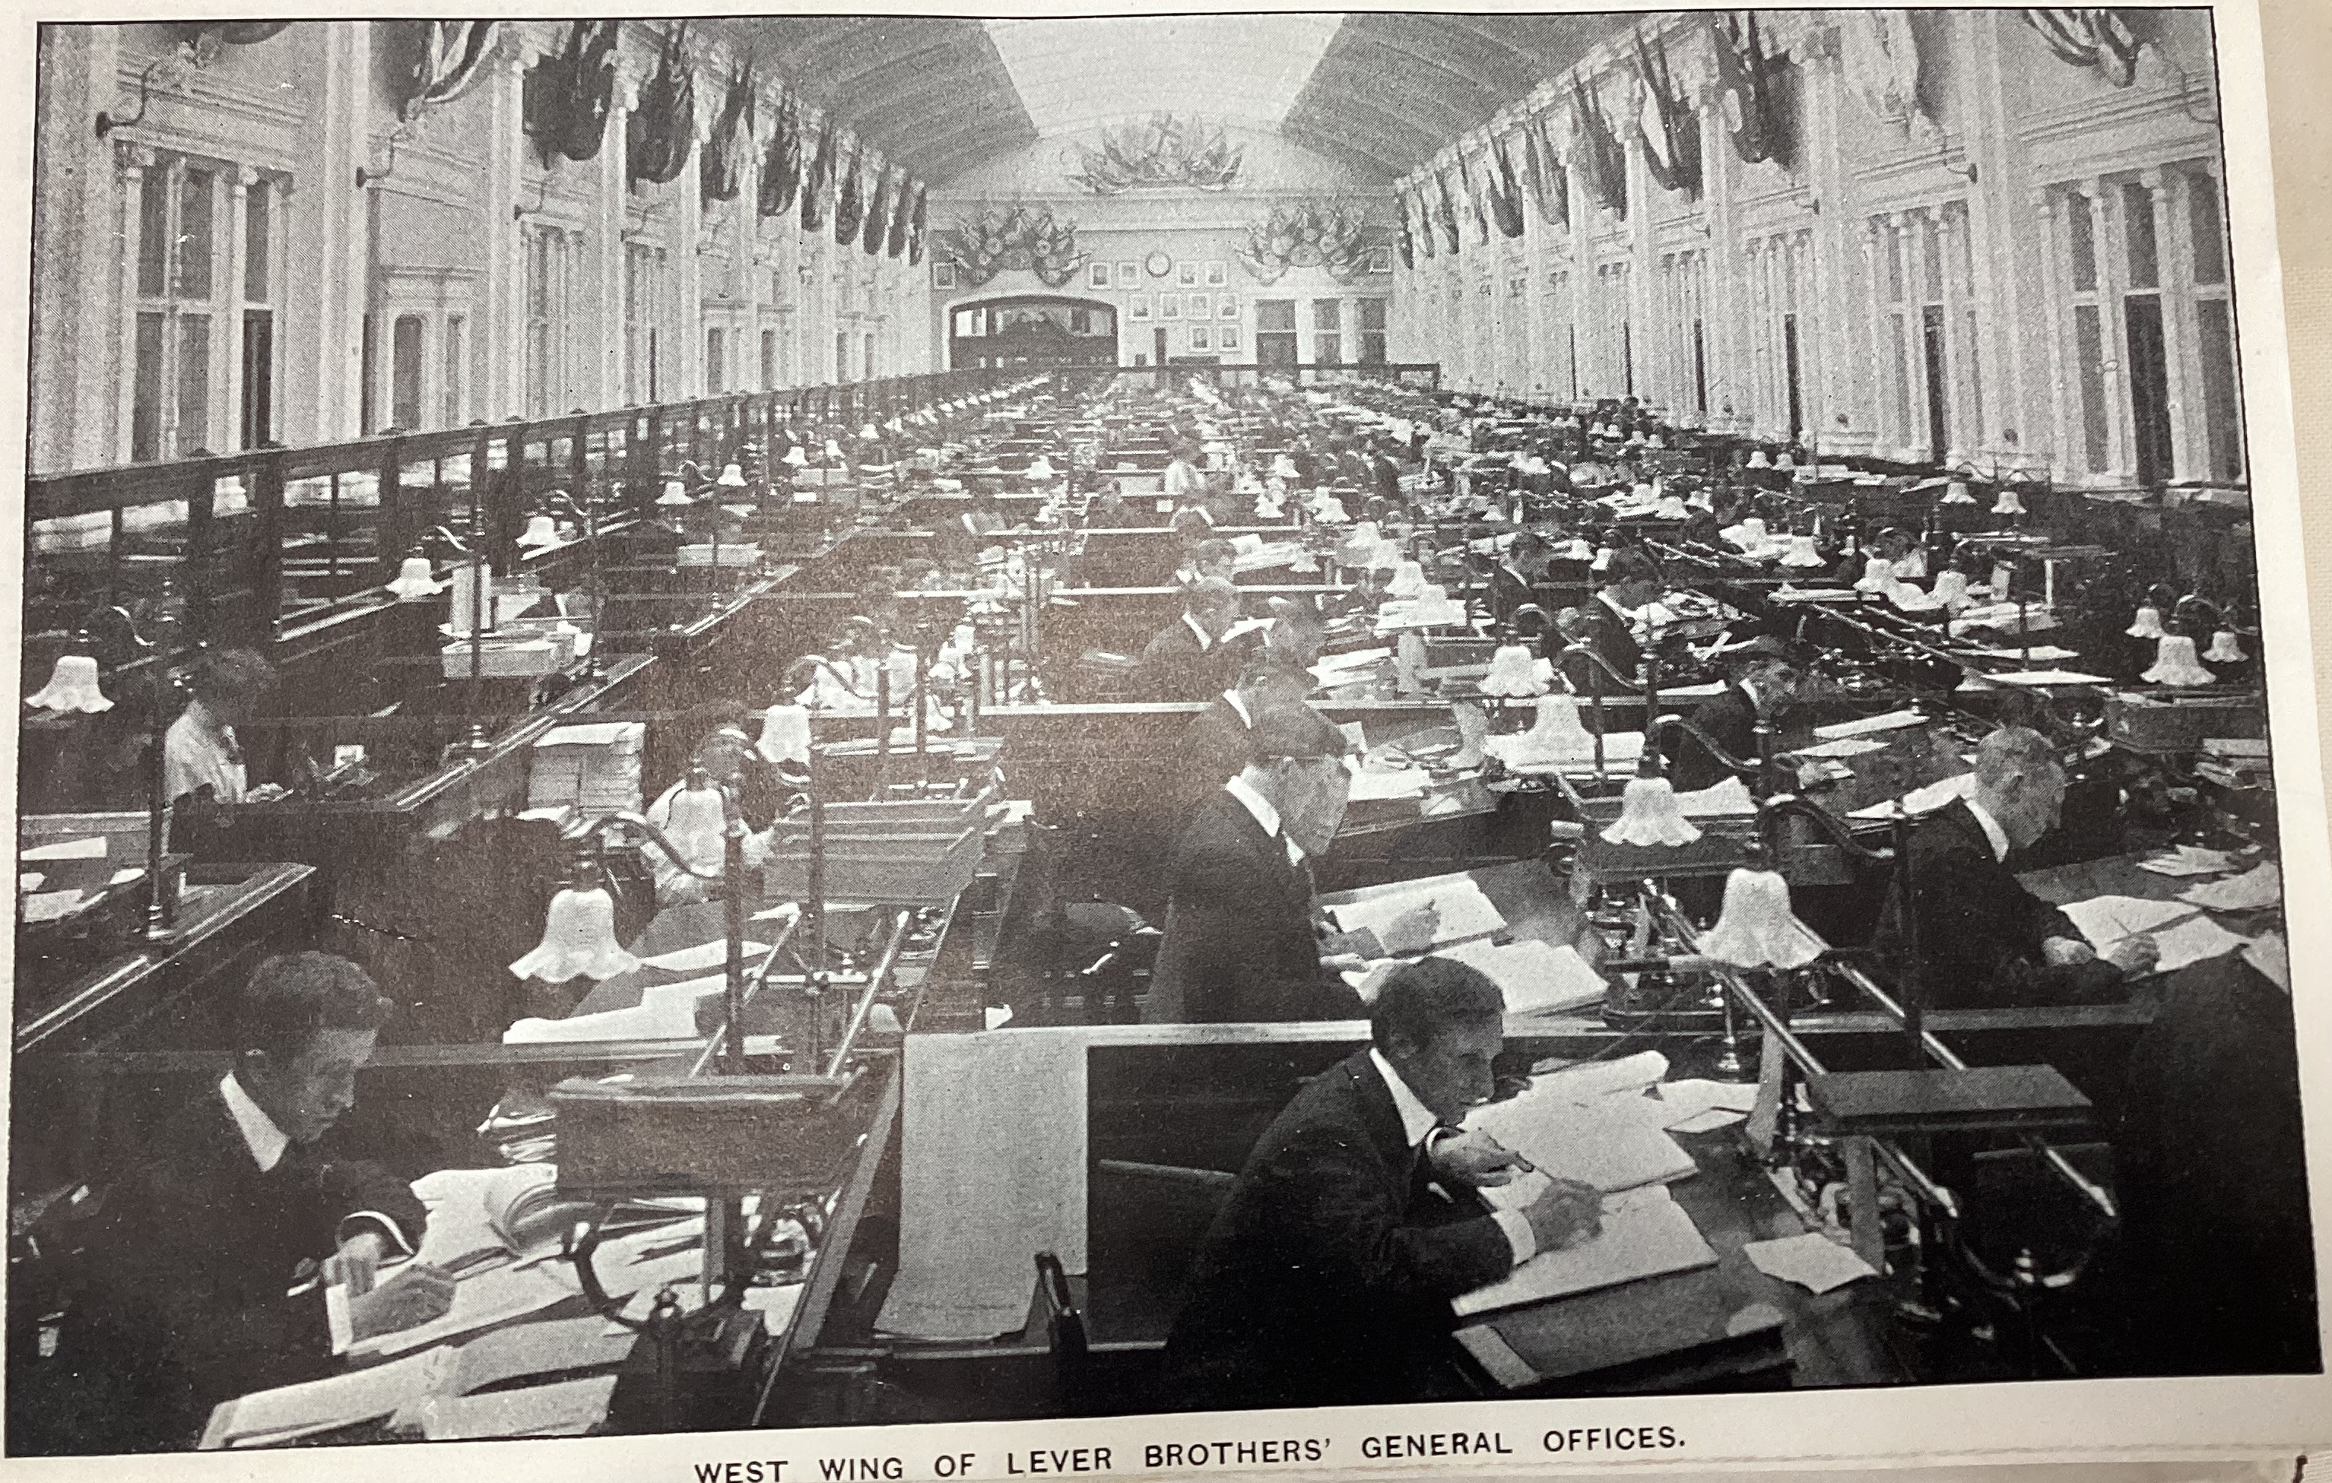
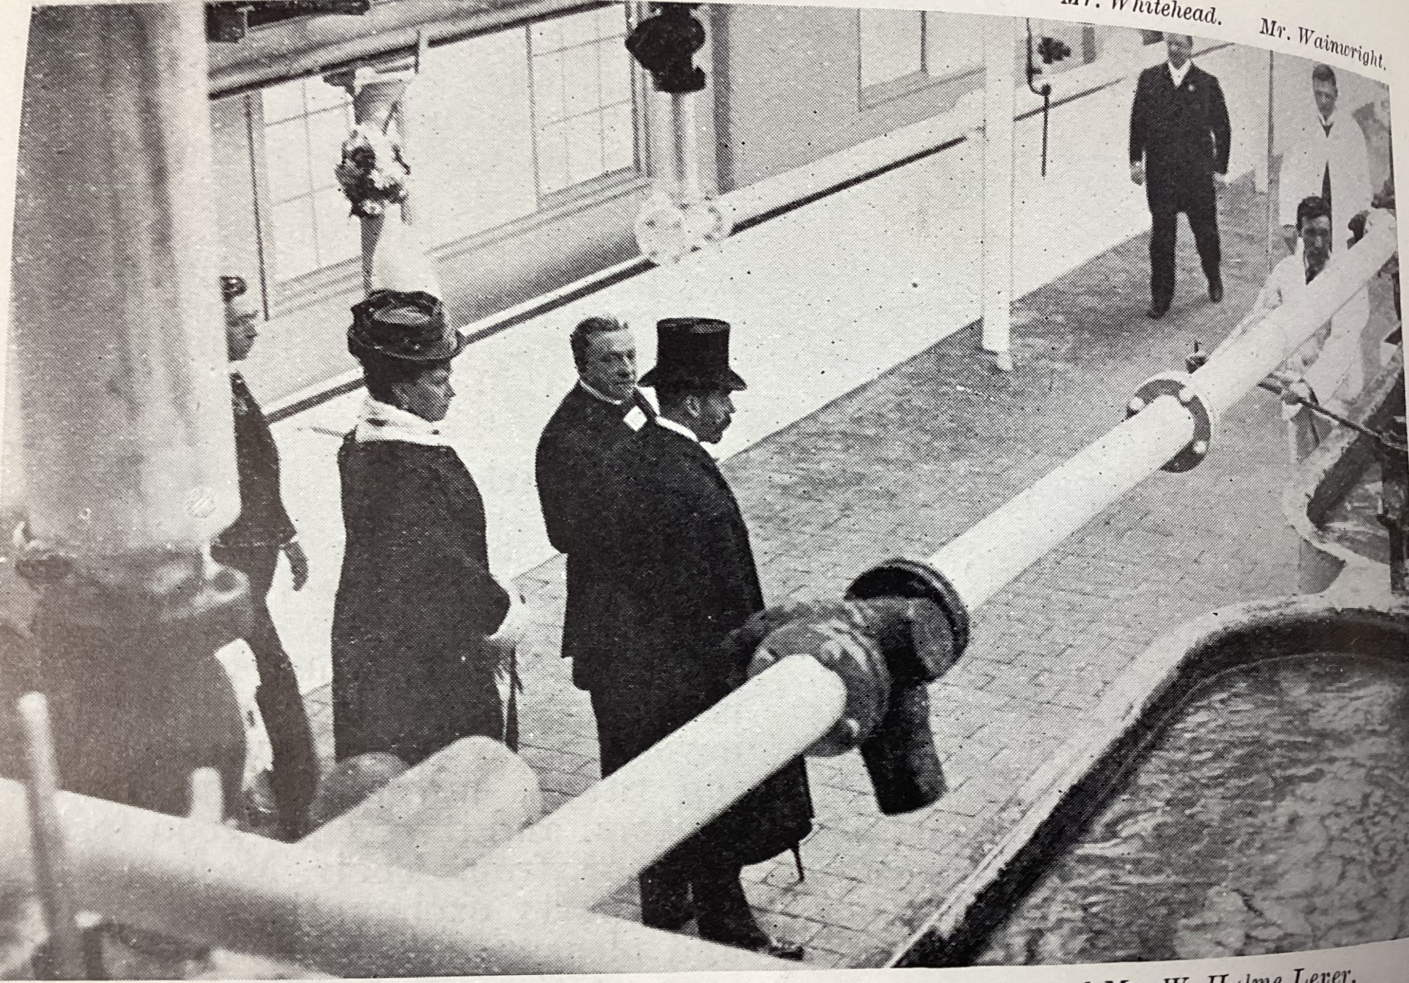
Working for Lever Brothers at Port Sunlight
1 2 3 4 5
6 7 8 9 10 11
12
13 14 15
16
17 18 19 20
21
22 23 24 25
The roughly 3,500 employees of Lever Brothers at Port Sunlight in
1910 worked in a range of professions. Hundreds of clerks and
secretaries worked in large offices; soap-boilers filled and churned
the huge pans in the soaperies; girls and women wrapped thousands of
bars of Sunlight soap in cardboard sleeves.
Lever’s employees were treated much better than those in other
British factories. Huge windows allowed daylight into the heart of
each room, while men who worked with harmful chemicals were given
respirators. Lever Brothers had a full-time safety inspector and there
were alarms and sprinklers in each department, many years before
this became a requirement.
Children worked at Port Sunlight from the age of 13 onwards. This
might seem surprising, but school in Britain was only compulsory up to
the age of ten, and many younger children were employed in the
countryside.
In 1889, Britain’s first major strike demanded a reduction in working
hours from 12 to eight – a luxury that Lever Brothers employees
already enjoyed. In the same year, 10,000 dock workers in Liverpool
went on strike, asking for sixpence a day; Sunlighters already took
home more than two shillings.
In 1909, Lever Brothers employees were offered the opportunity to
become ‘co-partners’ in the firm and receive a share in the company’s
annual profits. However, any employee could have their share removed for ‘neglect of duty, dishonesty, drunkenness… or disloyalty to employers’. The annual dividends were not large – an average of £20 per employee in 1910 – but this was still far better than the non-existent schemes in place in other firms.
Above: Port Sunlight office workers
Above: The King and Queen inspecting the No. 1 Pan Room in 1914
Notes:
Images from Port Sunlight Museum’s collection. Not for re-use outside of educational purposes.

Slide 3
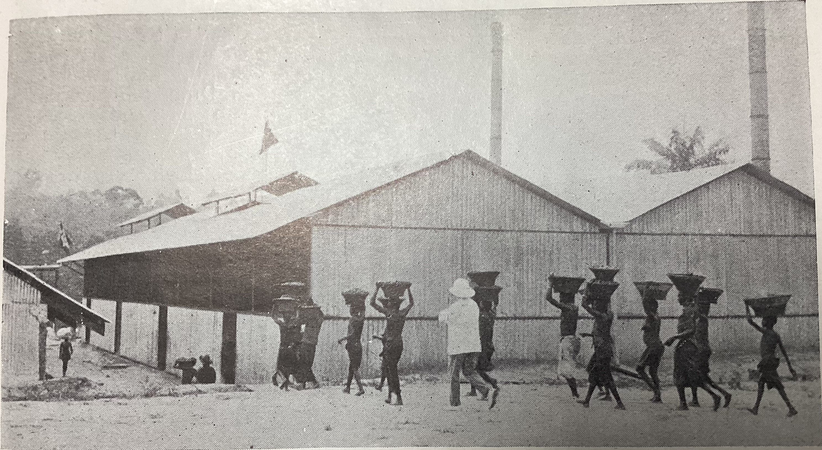
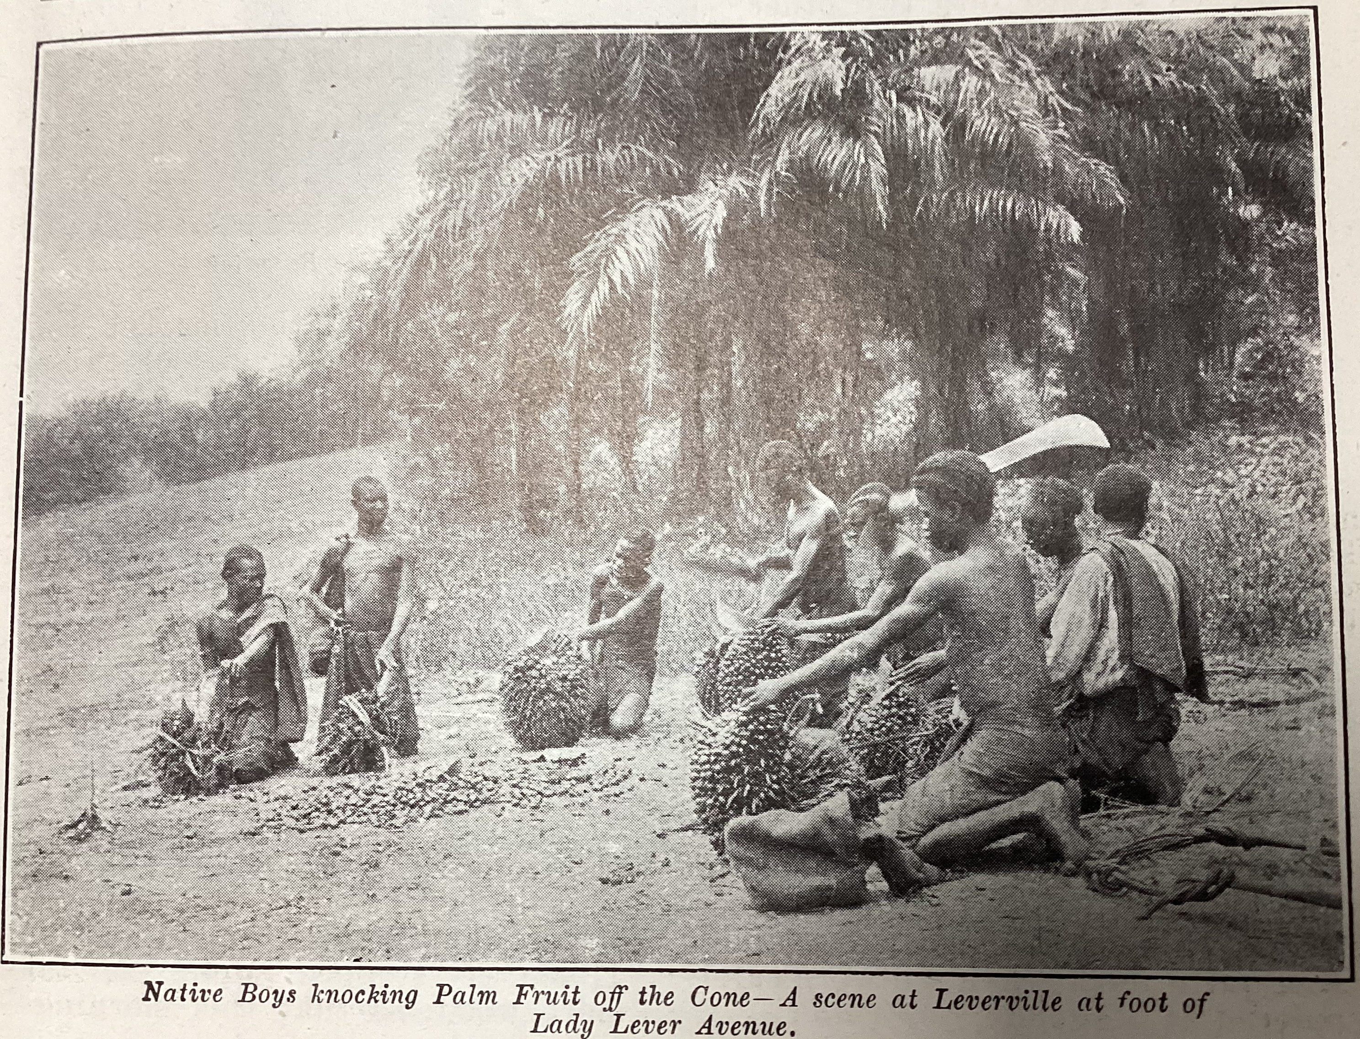
Working for Lever Brothers at Leverville
1 2 3 4 5
6 7 8
9 10 11
12
13 14 15
16
17
18 19 20
21
22
23 24 25
Lever Brothers’ subsidiary, H.C.B., employed around
6,500 workers in the Leverville/Lusanga circle in
1923. Most of the work done was hard and physically
demanding. Fruit cutters cleared palm groves and
scaled oil palms to cut down the fruit heads, porters
carried fruit for many kilometres to fruit stations and
the crews of river steamers were responsible for
loading heavy logs on to the boats to be burned as fuel.
Porterage of the heavy baskets of oil palm fruit was
often done by women. An H.C.B. doctor explained that
‘There is… a daily walk of 10 to 30 kilometres, half of
it with a heavy basket on the head. We see old women
deformed by illness, women with children on their
backs, pregnant women and pre-adolescent girls aging
prematurely.’ H.C.B. refused to ban this practice on the
grounds that it was a ‘tradition’ for the Indigenous people of
the Congo basin.
Children were also employed by H.C.B.; teenagers assisted with
clearing palm groves and underage children (under the age of
12) worked in the industrial posts and on the fleet of river
steamers, despite this being forbidden by the terms of Lever
Brothers’ contract with the Belgian government.
An H.C.B. official justified child labour in 1924 by arguing that
‘pushing [railway] wagons does not require much force. Our
young workers treat it as a game.’
Above: Porters bringing in oil palm fruit at Leverville
Above: Young men cutting fruit away from the fruit head at Leverville
Notes:
Images from Port Sunlight Museum’s collection. Not for re-use outside of educational purposes.

Slide 4
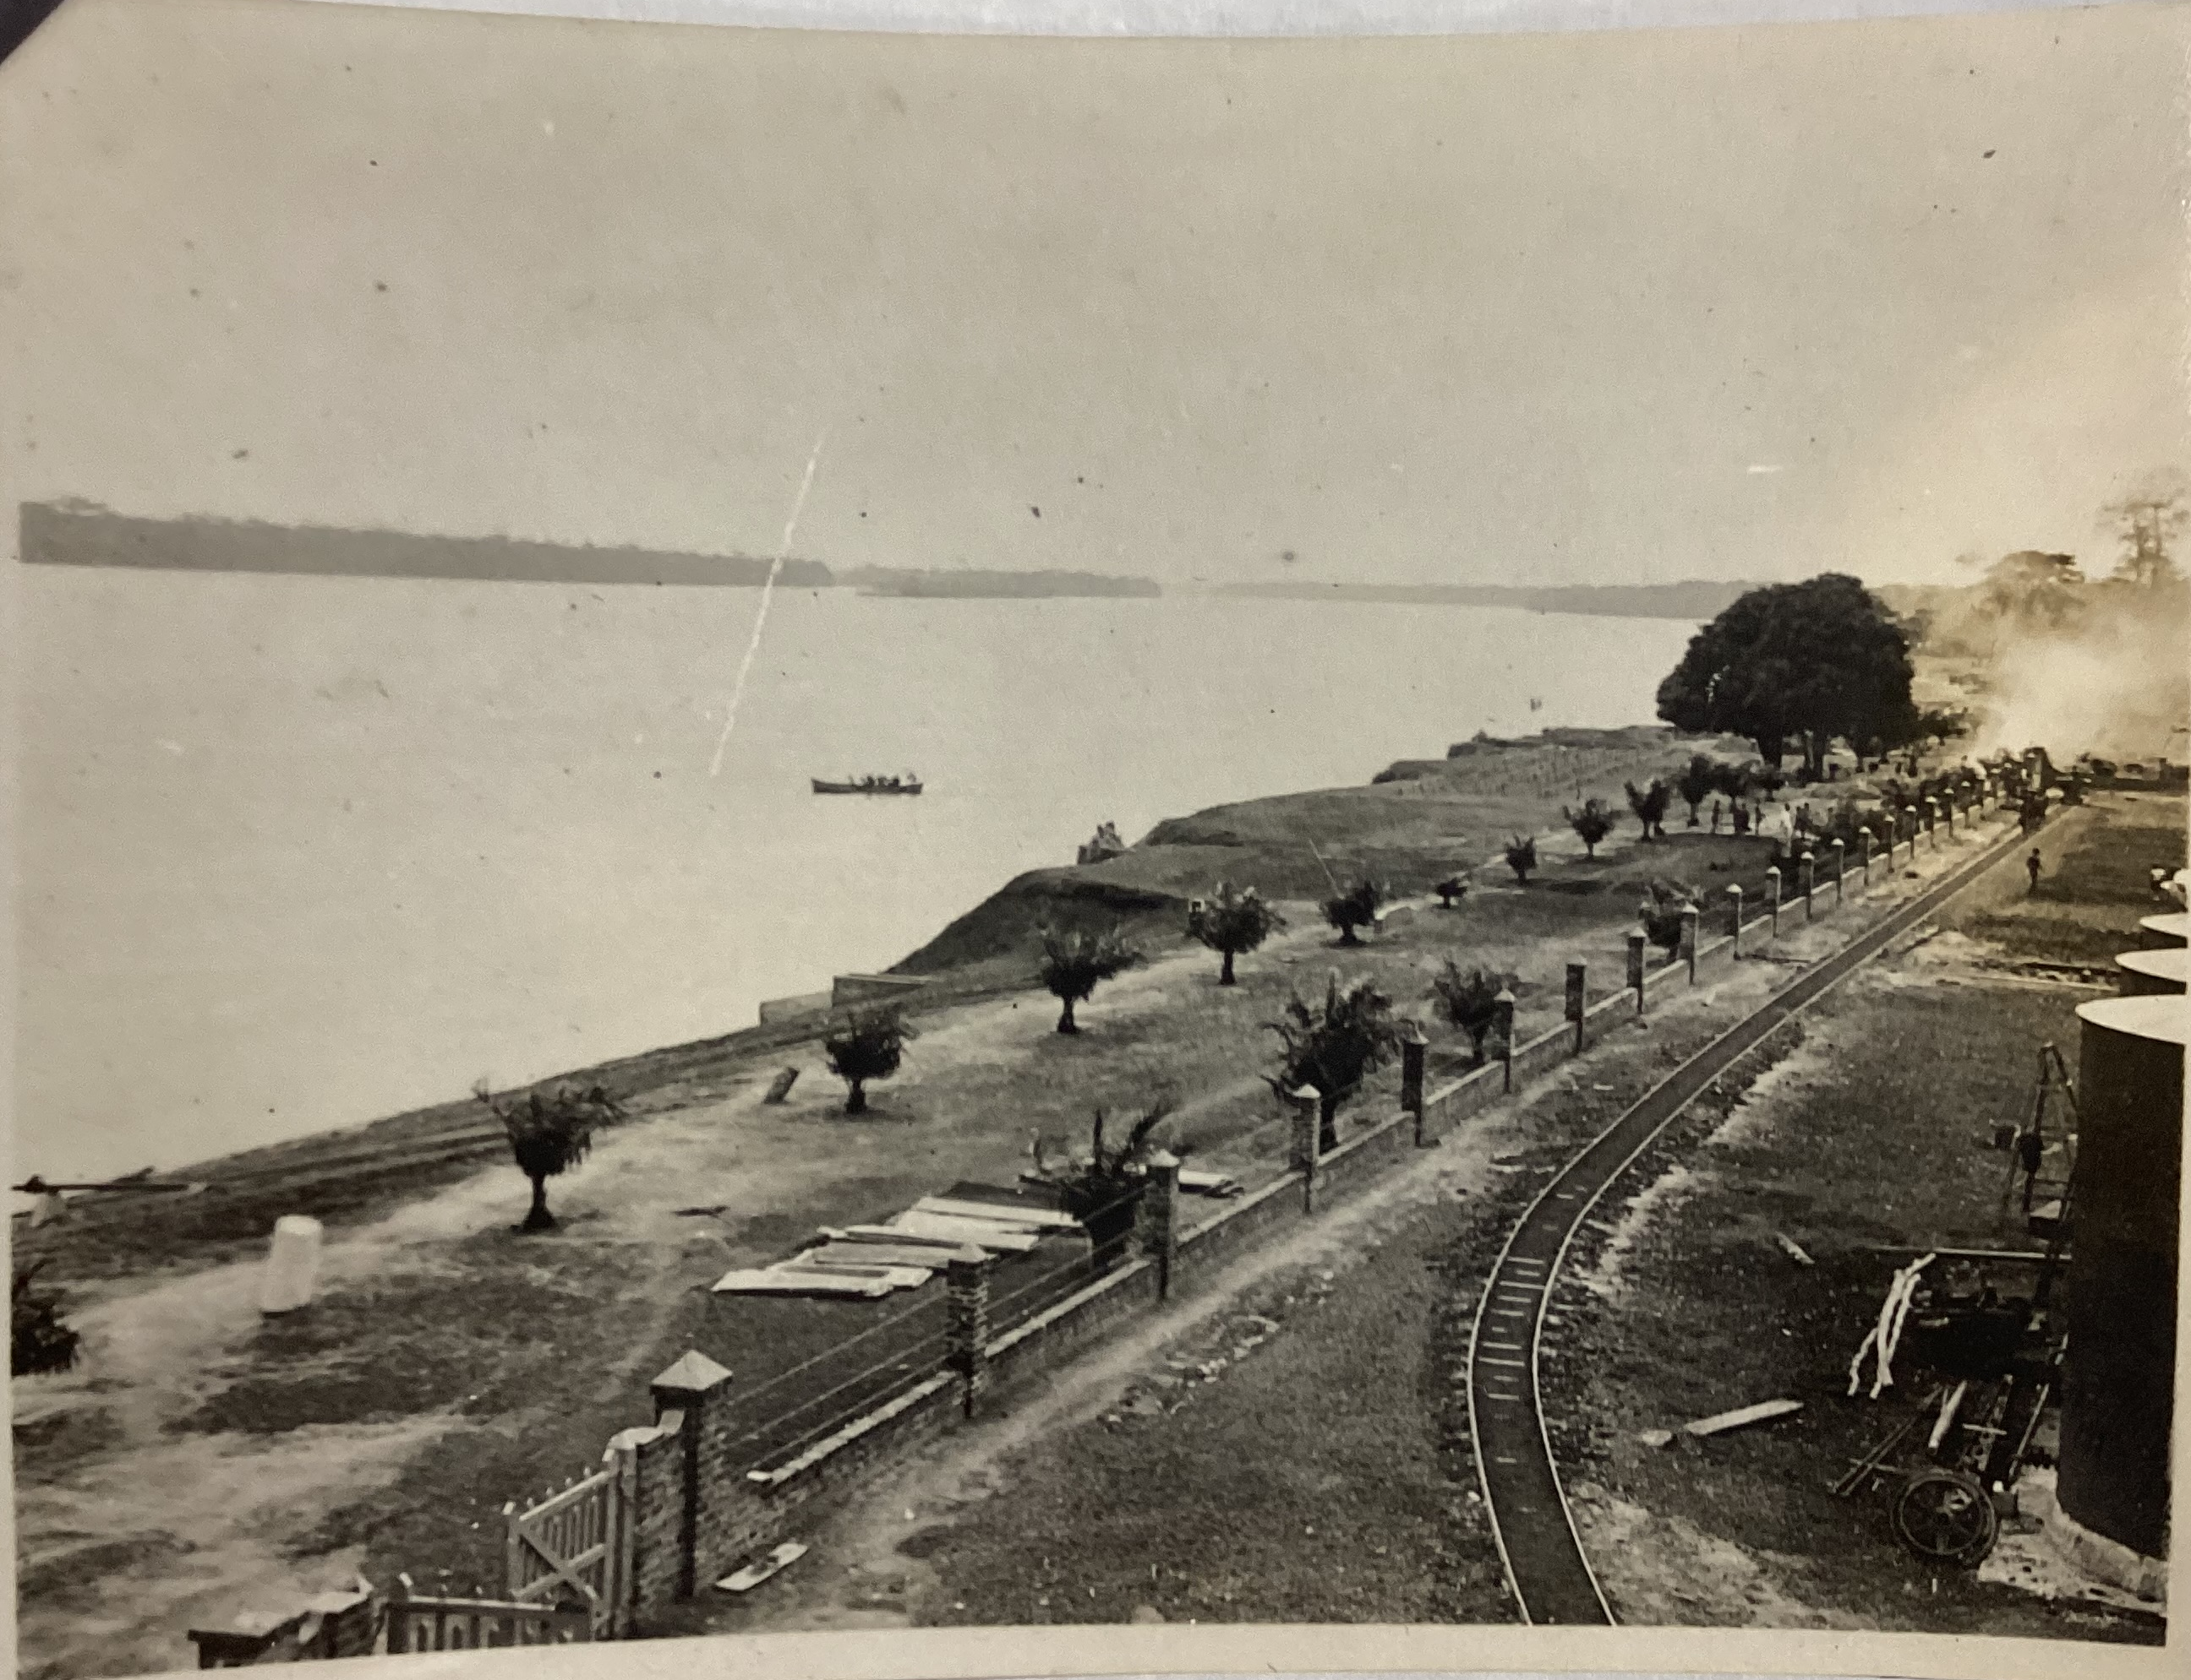
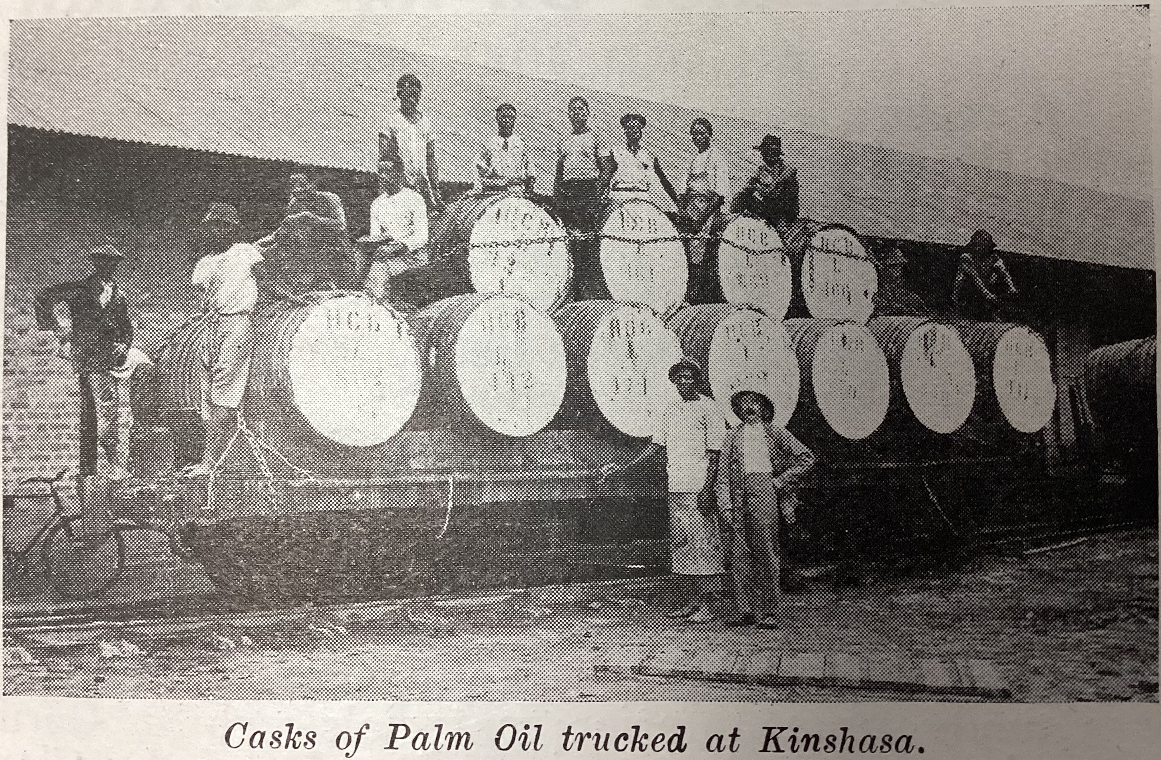
Working for Lever Brothers at Leverville
26 27 28 29 30 31
32 33 34 35 36
37 38 39
Despite signing an agreement with the Belgian government to pay a
minimum wage per eight-hour day, H.C.B. seems to have underpaid its
workers at least some of the time. The average wage for an
agricultural labourer in Britain in 1922 was 6–7 shillings per day. The
average wage for a fruit cutter in Leverville in the same year was 1–2
francs per day, or about 0.8–1.7 shillings.
Belgian officials estimated (accurate figures were proved impossible
to calculate) the death rate for H.C.B.’s workers in this period to be
around 9% per year – a startlingly high figure compared to Port
Sunlight. This was, in part, due to living conditions in the concession
(see Lesson 4).
As for co-partnership, William Lever wrote regretfully that
Congolese workers could not qualify for shares in the company’s
profits as they had ‘no address’ to write on the certificate.
Above: The narrow-gauge railway at Leverville used for transporting palm oil fruit
Above: Congolese workers loading barrels of palm oil on to railway wagons for the journey to Matadi
Notes:
Images from Port Sunlight Museum’s collection. Not for re-use outside of educational purposes.

