Slide 1
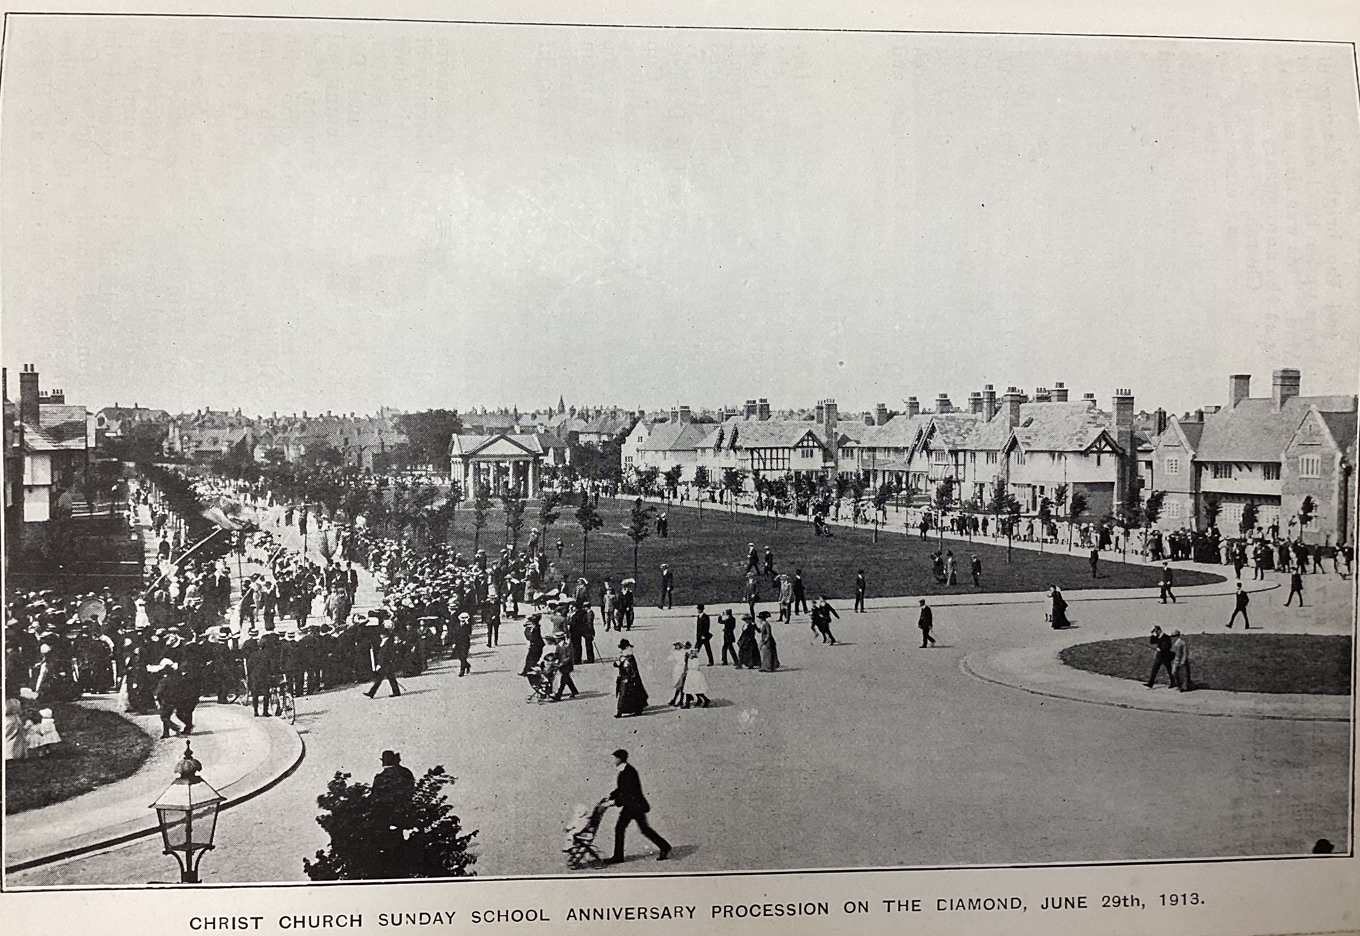
From The King of Sunlight by Adam Macqueen (2011)
1 2 3 4 5 6 7 8 9
10 11 12 13 14 15
In 1889 William Lever had two new families: his own newborn son, and the villagers of Port Sunlight, whom he intended to bond together as tightly as any clan. They would work together, live together, and even eat together – vast dining-halls were provided, dishing out over a thousand hearty meals at three pence a time for man and manager alike (though the managers got tablecloths and waitress service in a special room at the back). Every employee of Lever Brothers was free to apply for a house in the village, and the rules stated that they should be assigned ‘irrespective of an applicant’s position in the company'.
The villagers were provided with every facility they could possibly want, and several they probably didn’t. A primary school was built for their children. Shops and a post office sprang up. Tennis courts, bowling greens, a football and cricket pitch were installed, and the company provided equipment and refreshments during matches. Before long Port Sunlight boasted more clubs and societies than a university campus.
Above: Christ Church anniversary procession, 29 June 1913
Notes:
Image from Port Sunlight museum’s collection

Slide 2
16 171819 20
21 22 23 2425 26
27 28 29 30
3132 33 34 3536
People here behaved differently: they were healthier and better-off than those in the suburbs that surrounded them. Port Sunlight’s death rate was way below the national average: in 1909 it stood at nine in the 1,000 while in Liverpool across the river it was over twenty per 1,000. Lever’s experiment in the ‘science of life’ had proved a success.
Naturally, it had not been achieved without some serious social engineering. Not everyone was welcome in this benevolent kingdom. Port Sunlight might have had an unemployment rate of zero, but only because anyone who left Lever Brothers or was sacked (as two chemists were at an early stage for gossiping about the top-secret formula for Sunlight Soap in public) was required to leave their home.
Workers could be sacked for objectionable habits. ‘Objectionable habits’ could include laziness, drinking, gambling, dishonesty or simply a failure to play a full part in the extra-curricular activities that were laid on in the village.
This was Lever’s village, his creation, paid for by his cash, and here he could indulge his control-freakery to the full. Lever was patronising, perhaps, but he also showed very real generosity. Lever Brothers’ staff knew just how lucky they were, and Lever’s generosity was much appreciated in the village (although possibly not always quite as much as a bottle of whisky or a bag of sweets would have been).
Macqueen, A. (2011) The King Of Sunlight: how William Lever cleaned up the world, London: Corgi.
Notes:
Extract adapted from Macqueen, A. (2011) The King Of Sunlight: how William Lever cleaned up the world, London: Corgi, Chapter 6.

