Slide 1
Extracts from the Lejeune Report, 1923
1
2 3
4 5
6 7 8
9
10
11
12 13 14 15 16
17
18
19 20
21 22
23
24
25
26
27
28 29
30 31
The HCB employ 3,000 workers in Leverville and its environs… The company itself differentiates between workers who are local, and workers who have been imported.
Local workers are not issued with rations and earn a little more; the imported workers are issued with rations and earn a little less. Camps are built for imported workers whereas local workers house themselves, often in the neighbourhood of work centres, where they set up unofficial villages. [See villages doublures in Lesson 5.]
Recruitment
Recruits are hired for three months and are given neither blanket or pagne [loin cloth or grass skirt] – the equipment stipulated under Ordinance 47 [Belgian colonial rules]. Nights are cold in the Kwilu… sometimes a thick mist covers the riverbed until late in the morning and the Europeans… have to wrap up warm. Furthermore, the majority of deaths are due to respiratory ailments. I regard blankets as an absolute necessity.
The workers are not always adults. A very large number of adolescents, and even children, are employed by the HCB. This work… is permitted in certain circumstances… but I have observed children or young adolescents, at Leverville itself, pushing wagons and on boats on the river Kwilu loading timber and fruit. They are not of an age to do such work.
Rations
The four types of rations… consisting of rice, dried fish, meat and oil, all provide far too few proteins, carbohydrates, fats and calories. I have discovered that, generally speaking, oil is not issued. Furthermore, the ration is not issued on Sundays.
At midday, the cooked rice is handed round on palm leaves and consumed straight away in the open air, with a little dried fish. The blacks have just this one meal a day. The Europeans generally claim that the ration is quite sufficient!

Slide 2
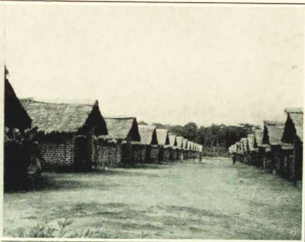
Accommodation
In Leverville there is a brick-built
camp, which would be good if there
were latrines (toilets), kitchens and
a rubbish pit, and if it were fenced
in, cleared of brushwood and
regularly whitewashed. Besides, this
camp is only large enough for a
fraction of the workers.
I have seen the camp of the
imported workers. The camp
consists of straw houses in which
from 10 to 20 men sleep in cramped
conditions, on pallets upon which 7
or 8 at the most should be accommodated. The camp is, in reality, little better than a simple night shelter of poor quality.
Local workers settle in the vicinity of the central posts or the fruit posts. These small villages are very dirty, unplanned and unhygienic. An analogous situation is to be found at the fruit posts: houses that are neither clean nor cared for, too small for the number of men who live there, and camps without latrines, fences, incinerators, etc.
Healthcare
The hospital in Leverville is brick-built, with wooden beds for 30 patients… The wards, very good when all is said and done, were very badly looked after and inadequately cleaned. The dispensary is too small and was dirty and badly organised. It seemed to be impossible to do serious work there.
I have seen the nurse at [Fruit] Post 6 in the Kwilu. He has no shelter-infirmary and has the most rudimentary equipment and dressings. In such circumstances the medicine he practises is obviously laughable. At Post 8, which is maintained by a European, there was not even the means to dress a wound.
Conclusions
To sum up, I have found things to be in a deplorable state… It is to be deeply regretted that… the real situation in Lusanga is not more satisfactory. Rations, accommodation and clothing are inadequate, and on each count the company [H.C.B.] is to blame.
32 3334 35 36 37 38 39
40 41
42 43 44 45 46
47 48
49 50 51
52
53
54
55 56
57 58 59
60 61
62
62 63
64
65
Above: Brick-built houses for African workers in Flandria, another of H.C.B.’s Congo concessions
Notes:
Image from Port Sunlight museum’s collection

