Slide 1
Agency and resistance: Port Sunlight case studies
A. ‘You lived in Port Sunlight and so you must be the son of a workman – a second-class workman, moreover, because you lived under patronage in a tied and subsidised house. Some people in Port Sunight felt this second-class status so strongly that they gave their postal address as Bebington [the town over the road from Port Sunlight]. It delayed their letters but no doubt it gave them a feeling of respectability.’
From the memoirs of Andrew Knox, a Lever Brothers (now Unilever) executive who retired in the 1970s
B. ‘Originally [the Bridge Inn] was run on strictly temperance lines, but an official request was made to the Viilage Society (run from within Lever Brothers) that it should be allowed to sell beer. [William] Lever seldom drank himself – “I am fond of champagne, but it is not fond of me”, he declared after an early hangover – and he shared the popular view among the better-off that alcohol was a luxury when they chose to imbibe it, but a vice when it went down the throats of the working class. He did, however, agree to bow to democracy and put the issue to a vote of all villagers. Eighty per cent of the villagers voted to end the booze ban, and in 1903 the Bridge Inn received its licence, though it was to remain dry on Sundays for a further seventy years.’
From The King of Sunlight by Adam MacQueen
C. ‘The first (and only) serious strike at Lever Brothers took place in 1920. Warehouse workers were ordered out on strike because of a dispute between two rival unions. The strike collapsed after just 21 days and the men returned to work on the same jobs and wages as before but lost their rights to co-partnership. Local newspapers pointed out that employees at Port Sunlight “have had so little to complain of wages or working conditions… it is no question of betterment that has produced this stoppage at Port Sunlight.’
From an academic paper written in 2003 at Louisiana State University, USA
Notes:
From: Brian Lewis's So Clean, p. 122, quoting: Knox, A.M. (1976) Coming Clean: a postcript after retirement from Unilever, London: Heineman, pp. 7–9.
B. From: Macqueen, A. (2011) The King Of Sunlight: how William Lever cleaned up the world, London: Corgi
C. From: Rowan, J.D. (2003) 'Imagining corporate culture: the industrial paternalism of William Hesketh Lever at Port Sunlight, 1888–1925', Louisiana State University and Agricultural and Mechanical College.

Slide 2
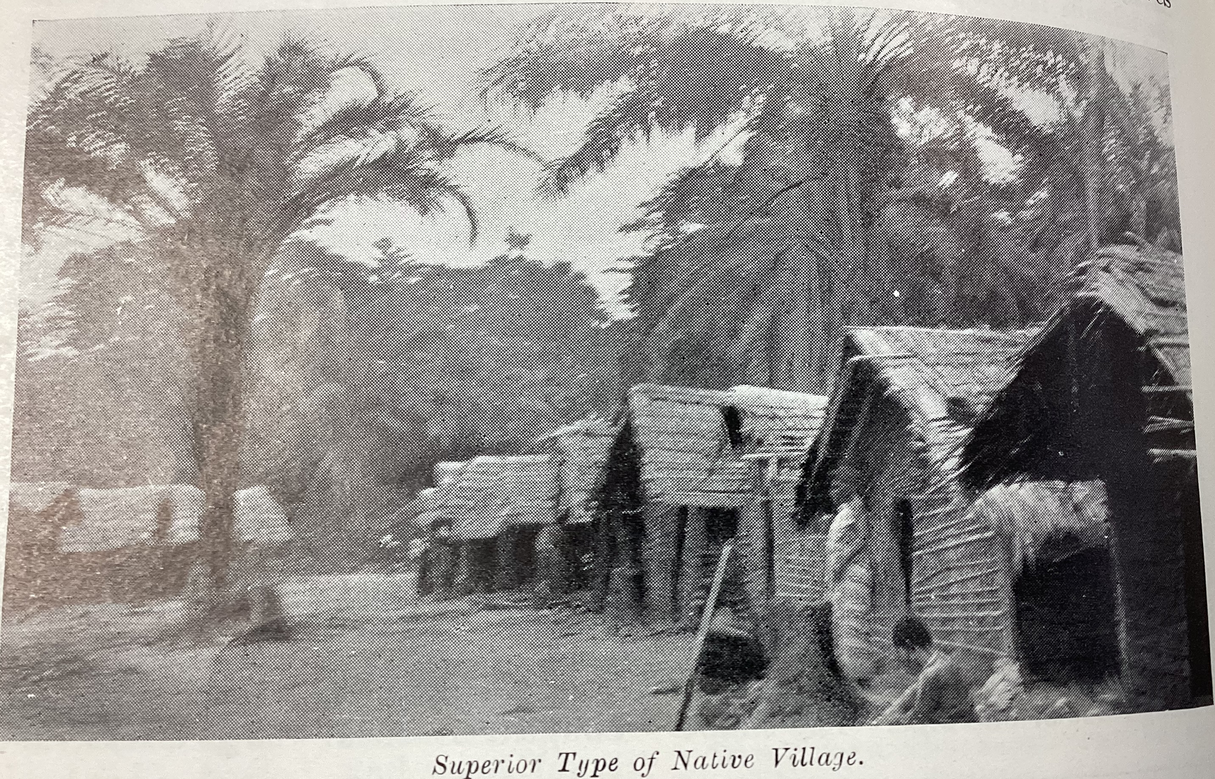
Agency and resistance: Leverville case studies (1)
D. Villages Doublures
‘The workface available to HCB in the Lusanga circle was not enough to meet their need for fruit cutters. HCB therefore depended on workers recruited predominantly from 50–150 km south of Leverville.
Officially, these workers had to obtain a “passport” from the Belgian authorities to leave their villages for work. In practice, however, they simply migrated without permission with their families and lived in temporary, unofficial villages – villages doublures - in the oil palm groves of Lusanga.
These “double villages”
(so-called because the
workers were still
officially living in their
home village) were very
concerning to the
Belgian authorities
because their
residents were not supervised by their government-appointed chiefs and thus avoided paying tax and the vaccination programme against sleeping sickness.
HCB approved of the villages doublures; the company did not have to provide expensive medical and social care to their inhabitants.’
E. Falsifying tribal histories
‘The Belgian authorities and HCB agents envisioned displacing entire communities and moving them closer to the palm groves to alleviate the ever-present shortage of labour in the concessions.
Although this was technically illegal, Belgian government officials aimed to cluster communities together based on a supposed analysis of their “shared ethnicity”. One administrator reported, for example, that “the Bahnungana are blacksmiths while the Batsamba are specialized in the extraction of iron ore”.
As the authorities knew nothing about the history of Congolese communities, they relied on village elders to tell them about their tribal or clan history. Afraid of being displaced, the chiefs ensured that the stories they told of their history were completely different to those of neighbouring tribes, thus thwarting Belgian attempts to conduct large scale migrations of Congolese workers.
Omitting or concealing information was thus a powerful tool to use against the colonial authorities.’
Notes:
D. and E. From: Henriet, B. (2023) Colonial Impotence: virtue and violence in a Congolese concession (1911–1940), Berlin/Boston: de Gruyter, Ch. 3.

Slide 3
Agency and resistance: Leverville case studies (2)
F. Lukusu
‘Communities in the Congo river basin believed in “spiritual medications” known as bwanga. One of these was called Lukusu. Lukusu spread rapidly through the Leverville concession in 1933. According to historian Benoit Henriet, Lukusu was an “attempt to respond to the havoc from colonialism in Central Africa”.
Communities who adopted Lukusu were forbidden to eat bananas or any other fruit and were instructed to eat only white goats and hens. They were not allowed to wear white clothes and women were not allowed to cook within the village (men were forbidden from watching women cooking).
The main purpose of Lukusu was to expel evil spirits and witchcraft from the community. The Belgian authorities were very worried by Lukusu because of its potential to spill over into violence. Official investigations by agents of H.C.B. and the Belgian authorities were met by silence from communities, as this exchange from the archives shows:
Belgian gov’t official: “You claim not to know the reason for the introduction of Lukusu?”
Group leader Okubongo: “I assure you that I do not know.”’
G. Insurrection (the Pende Revolt)
‘The most serious outbreak of violence in the Leverville concession during the colonial period was carried out by the Pende people in 1931. The causes of the revolt are hard to pin down, but probably involve H.C.B. increasing taxes while reducing wages and various thefts and abuses by H.C.B. and Belgian government authorities.
The spark that lit the fuse of the revolt was the killing of a Belgian government agent by a Pende man called Matemo after a confrontation over the forced recruitment of labourers. Following this, Pende fruit cutters and porters refused to work and labour came to a complete standstill in the region.
After a series of aggressive confrontations, Belgian soldiers and Congolese recruits were ordered by the Belgian colonial government to open fire with machine guns on an army of several thousand Pende people armed mostly with knives and bows. Historians estimate that between 500 and 1,000 Pende were killed, with perhaps 2 or 3 government soldiers killed.’
Notes:
F. and G. From: Henriet, B. (2023) Colonial Impotence: virtue and violence in a Congolese concession (1911–1940), Berlin/Boston: de Gruyter, Ch. 3.

