Slide 1
How similar were workers’ experiences in Port Sunlight and the Belgian Congo?
Joseph Cauldwell – The Mosslands School

Slide 2
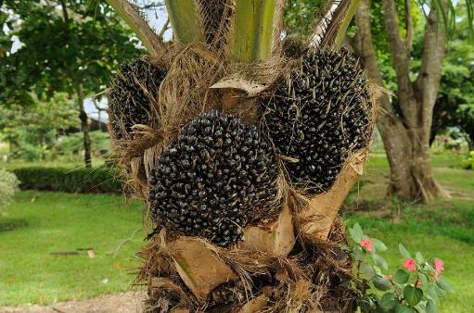
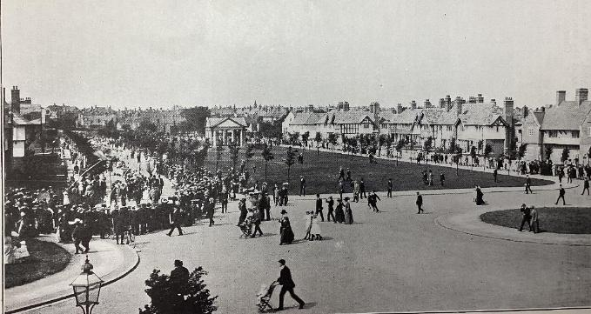
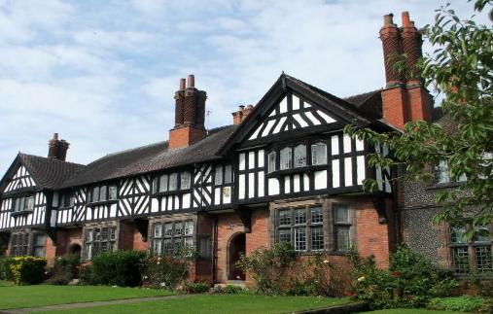
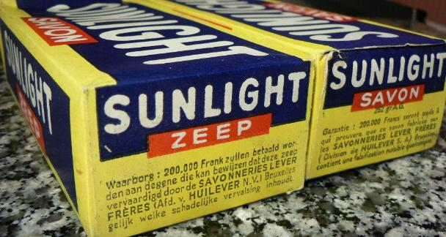
What do these images have in common?
Images: Top left and bottom left – Wikimedia Commons
Images: Bottom right – Wikimedia Commons; top right – Port Sunlight Museum’s collection
Notes:
Images (clockwise from top-left): https://commons.wikimedia.org/wiki/File:Elaeis_guineensis_oil_palm_fruit_Portoviejo_Ecuador.jpg; Port Sunlight Museum; https://en.wikipedia.org/wiki/Sunlight_%28cleaning_product%29; https://commons.wikimedia.org/wiki/File:19_and_21_Park_Road,_Port_Sunlight.jpg

Slide 3
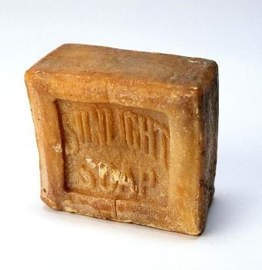
Sunlight soap
Images: Top left, bottom left and centre – Wikimedia Commons
Images: Bottom right – Wikimedia Commons; top right – Port Sunlight Museum’s collection
Notes:
Images: (clockwise from top-left) https://commons.wikimedia.org/wiki/File:Elaeis_guineensis_oil_palm_fruit_Portoviejo_Ecuador.jpg; Port Sunlight Museum; https://en.wikipedia.org/wiki/Sunlight_%28cleaning_product%29; https://commons.wikimedia.org/wiki/File:19_and_21_Park_Road,_Port_Sunlight.jpg; (centre) https://commons.wikimedia.org/wiki/File:Ongebruikt_stuk_zeep,_waarop_in_reli%C3%ABf_%E2%80%9CSunlight_Soap%E2%80%9D,_objectnr_30704.JPG

Slide 4
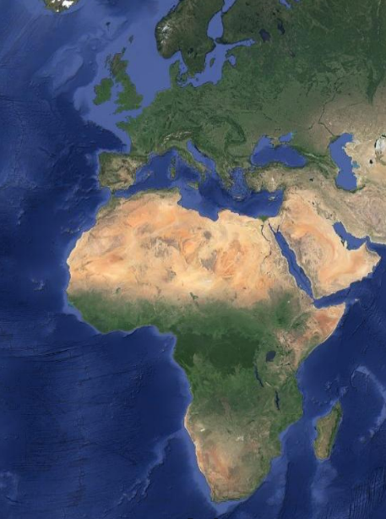
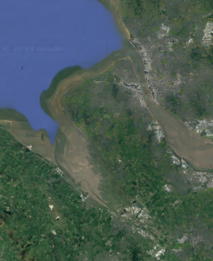
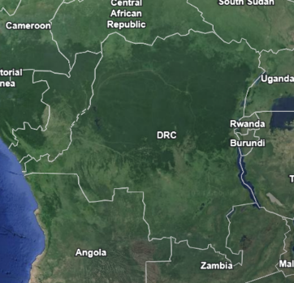
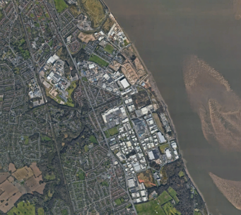
Our enquiry will take us from Port Sunlight, in Merseyside, to what was then the Belgian Congo in West Africa.
Images © 2025 Airbus, Bluesky, Infoterra Ltd & COWI A/S, Landsat / Copernicus. Maxar Technologies, Map data © 2025
Belgian Congo
Google Maps: Images ©2025 TerraMetrics, Map data © 2025

Slide 5
Lesson 1: Who contributed to a bar of Sunlight soap?
To answer our big question, we must:
Understand the story of William Lever, Port Sunlight and the Belgian Congo
Describe how Sunlight soap was made, from the Belgian Congo to Port Sunlight
Key concepts:
Paternalism: When a leader provides guidance and care in exchange for loyalty and obedience
Notes:
This lesson might well take place over two periods. It will be important for students to understand the role of palm oil in the soap-manufacturing process in order for them to appreciate the distinctions between labour in future lessons.

Slide 6
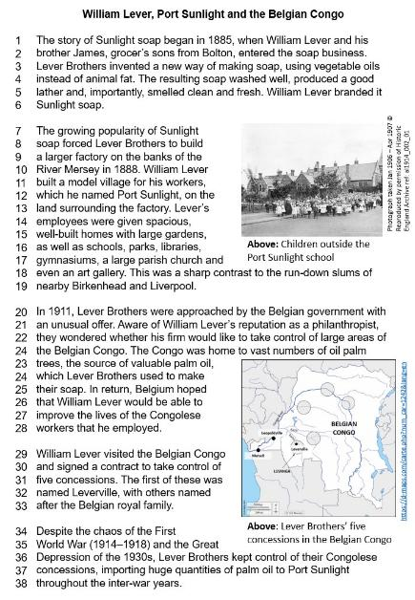
Reading task: Read the story of Lever Brothers, Port Sunlight and the Belgian Congo and answer the questions below:
  Why did Sunlight soap become so popular?
  Describe Port Sunlight.
  What did the Belgian government offer to William Lever? Why?
  How did Lever Brothers benefit from their concessions in the Belgian Congo?

Slide 7
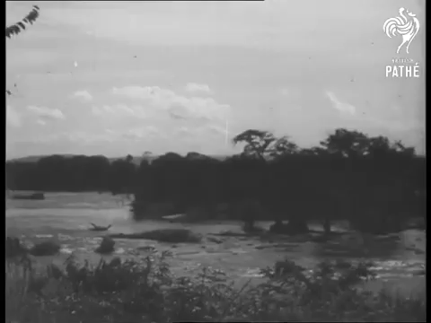
Before you watch: This video is from the 1950s. What would you expect the tone of this video to be? Why? How might you expect to see people from the Congo portrayed?
The documentary says that the Congo’s wealth ‘lay wasted’. Would William Lever have agreed with this?
According to the documentary, what did William Lever bring to the Congo?
Notes:
Video: www.youtube.com/watch?v=th4Zwv5pvFg&t=194s

Slide 8
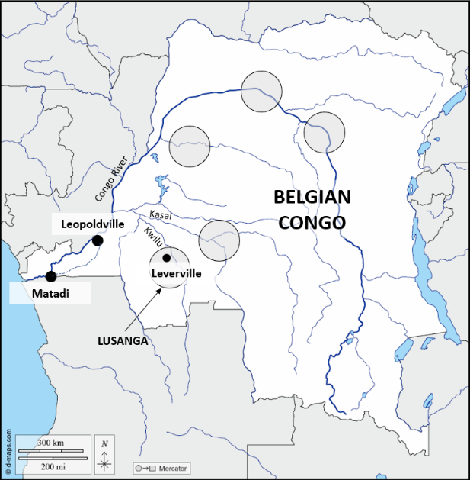
Lever’s soap-manufacturing process in Congo
Lever Brothers owned five concessions in the Belgian Congo. Each concession contained groves of oil palm trees.
The fruit of these trees, once cut down, contained palm oil, which could be extracted by crushing it in a mill.
Once extracted, barrels of palm oil were transported downriver on steamboats to Leopoldville, where they were loaded into rail trucks for the journey to the port of Matadi. At Matadi, the barrels were loaded onto ocean-going steamships for the long journey to Port Sunlight.
https://d-maps.com/carte.php?num_car=1242&lang=en

Slide 9
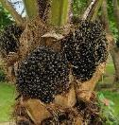
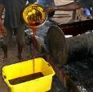
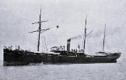
Lever’s soap-manufacturing process in the Belgian Congo
?
?
?
In which order did these steps happen?
Transportation
The oil was taken downriver to Kinshasa (Leopoldville) and then to Matadi, and loaded on to ocean-going steamers for the voyage to Port Sunlight.
Processing oil palm fruit
Machinery crushed the fruit and extracted the oil, which was pumped into storage tanks.
Harvesting oil palm fruit
An oil palm tree yields four to eight heads on average, each containing about 1,200 fruits.
Notes:
Images: “PALITANA” by TimWebb, CC BY-NC-SA 2.0 www.flickr.com/photos/42117802@N06/52118959376; https://pixnio.com/people/male-men/skimming-refined-palm-oil; https://commons.wikimedia.org/wiki/File:Elaeis_guineensis_oil_palm_fruit_Portoviejo_Ecuador.jpg

Slide 10
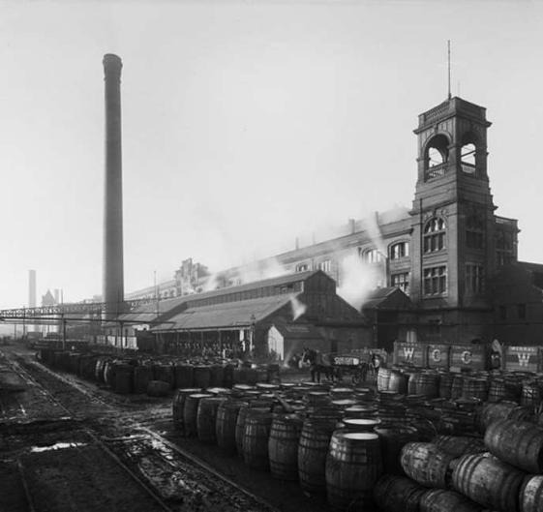
Lever’s soap-manufacturing process in Port Sunlight
After being unloaded at the docks at Port Sunlight, the palm oil was mixed with chemicals (including lye, a strong alkali) and boiling water in large pans.
Once this lengthy process was complete, the resulting bars of soap were extracted from the pans and cut into small tablets.
Each of these blocks was wrapped in branded Sunlight soap carboard packaging and loaded on to lorries or railway trucks for their journey to grocer’s shops in Britain or overseas.
Photograph taken Apr 1897 © Reproduced by permission of Historic England Archive ref: BL14041_004

Slide 11
Lever’s soap-manufacturing process in Port Sunlight
In which order did these steps happen?
?
?
?
Cooling and cutting
After five or six days in a giant cooling frame, the soap was ready to be cut into slabs by machines with cutting wires, and then into bars.
Packing
After being put through a stamping machine, the bars of soap were transported on conveyor belts to female workers, who wrapped them in printed boxes or wrappers, to be taken to shops around Britain and the world.
Boiling in the soaperies
Once unloaded, palm oil was boiled with caustic soda, lye and then salt, using steam heat. Soap curd rose to the surface, where it could be skimmed off.

Slide 12
Lever’s soap-manufacturing process in the Congo and Port Sunlight
?
?
?
?
?
?
Write out the soap-manufacturing process for Lever’s Sunlight soap in the right sequence, using headings and one sentence for each step.
Which of the processes do you think would have been the hardest for the workers to do? Was it in the Belgian Congo or in Britain?

