Slide 1
How similar were workers’ experiences in Port Sunlight and the Belgian Congo?
Joseph Cauldwell – The Mosslands School

Slide 2
Lesson 4: What was it like to live in Leverville?
To answer our big question, we must:
Discuss William Lever’s intentions for Leverville
Compare and contrast official and independent reports of life in Leverville
Try to explain differences between these reports
Key concepts:
Living standards: Your quality of housing, comfort and wealth
Paternalism: When a leader provides guidance and care in exchange for loyalty and obedience

Slide 3
‘… apart from the building of Port Sunlight and the creation of Lever Brothers, the development of the Huileries du Congo Belge was [William Lever]’s greatest commercial achievement. My visit to the Congo has more than confirmed me in my belief. In every year area, in the plan of every mill and station, in the company’s native villages, with their trim rows of neat brick houses, in the layout of each mission school and of the hospital buildings his individual touch is recognised.’
From Progress, April 1928
Discuss: Read this extract from Progress.
According to the extract, did Lever Brothers have the same aims for their Congolese concessions as they did for Port Sunlight?
How involved was William Lever with the construction of the Congolese mills, stations and villages?

Slide 4
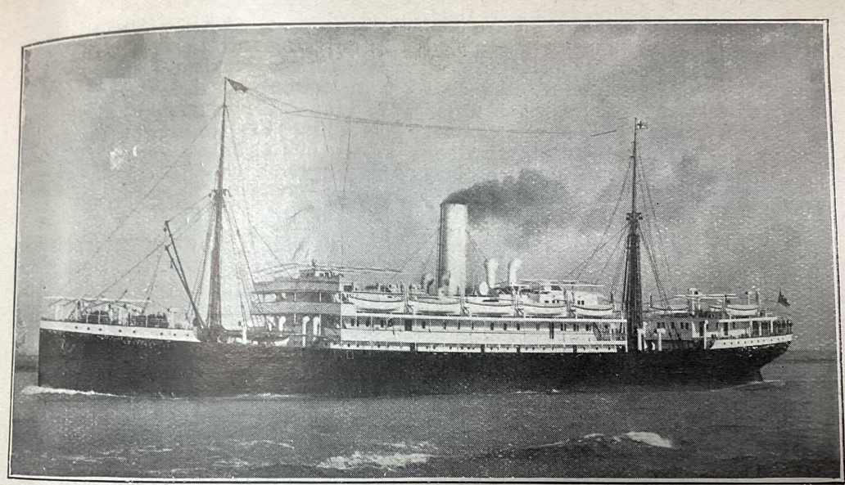
In 1913, Harold Greenhalgh, a Lever Brothers executive, travelled to Leverville to tour and inspect the concession. He wrote an account of his visit in Progress, the Lever Brothers company journal.
Discuss: Read Greenhalgh’s account of his arrival at Leverville and discuss the questions below:
Why is his arrival at Leverville a ‘great and pleasant surprise’?
What work is being done at Leverville that will benefit the ‘African native’?
What does Greenhalgh blame for native diseases?
Image from Port Sunlight Museum’s Collection
Above: The SS Leopoldville, an ocean-going steamer that carried passengers to the Belgian Congo

Slide 5
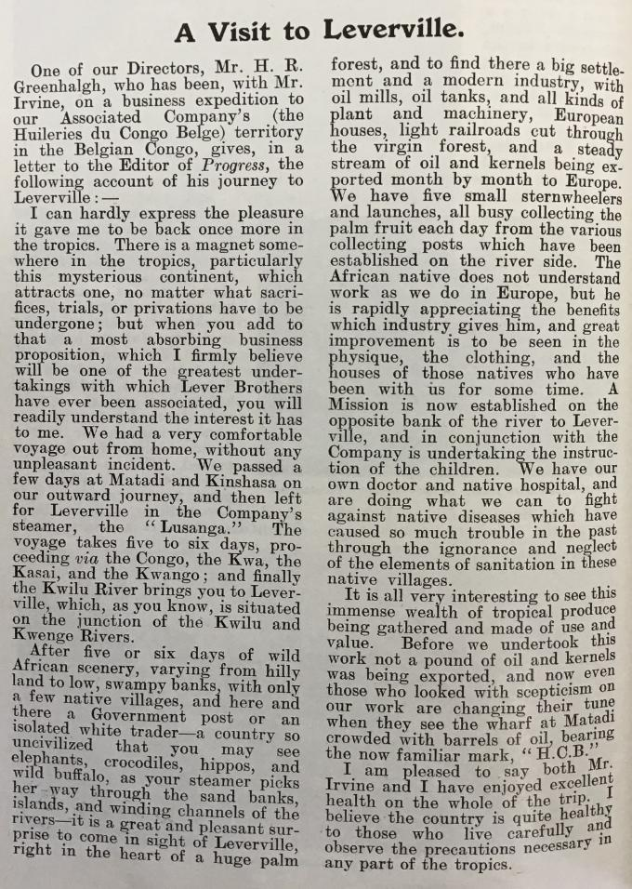
‘After five or six days of wild African scenery… a country so uncivilised that you may see elephants, crocodiles, hippos, and wild buffalo, as your steamer picks her way through the sand banks, islands and winding channels of the rivers – it is a great and pleasant surprise to come in sight of Leverville right in the heart of a huge palm forest, and to find there a big settlement and a modern industry, with oil mills, oil tanks, and all kinds of plant and machinery, European houses, light railroads cut through the virgin forest and a steady stream of oil and kernels being exported month by month to Europe.’
Image from Port Sunlight Museum’s collection

Slide 6
‘The African native does not understand work as we do in Europe, but he is rapidly appreciating the benefits which industry gives him, and great improvement is to be seen in the physique, the clothing, and the houses of those natives who have been with us for some time. A Mission is now established on the opposite bank of the river to Leverville, and in conjunction with the Company is undertaking the instruction of the children. We have our own doctor and native hospital and are doing what we can to fight against native diseases which have caused so much trouble in the past through the ignorance and neglect of the elements of sanitation in these villages.’
Image from Port Sunlight Museum’s collection

Slide 7
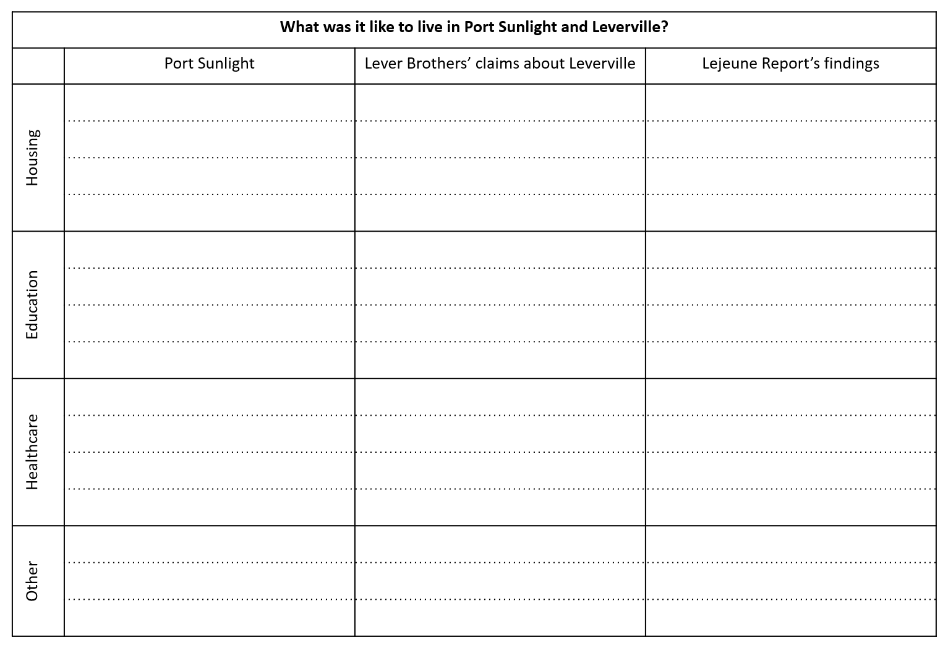
Based on Lever Brothers’ reports about Leverville, complete the second column of your table.

Slide 8
Discuss: Lever Brothers’ reports of life in Leverville are very positive about workers’ accommodation, healthcare, etc.
What might historians have to bear in mind when consulting official Lever Brothers documents about Leverville?
What might affect the reliability of Lever Brothers’ reports?

Slide 9
Reading task: In 1923, Dr Émile Lejeune, a Belgian colonial medical officer, conducted a detailed six-day tour of inspection of H.C.B.’s Lusanga circle. His report was very critical of H.C.B.’s provisions for their Congolese workers.
Read Dr Lejeune’s report and complete the final column of your table.

Slide 10
‘Lever made no attempt to view the continent through African eyes. How could he? He was merely dipping into a culture and seeing what he wanted to see and what his handlers wanted to show him. On this last visit, in the Autumn of 1924… native health had improved dramatically… “twelve years ago in villages and in wooding posts [Lever wrote]… the sight of so many sick and underfed people was most distressing. Today one sees healthy people, men, women and children happy, contented and well-fed.”’
So Clean (Brian Lewis, 2008, p. 177)
Optional task: Consider the following questions:
How could we explain the difference between Lever Brothers’ claims about living conditions at Leverville and the claims of the Lejeune Report?
How could we explain the differences between living conditions in Port Sunlight and Leverville?
Notes:
Lewis, B. (2008) So Clean: Lord Leverhulme, soap and civilisation, Manchester: Manchester University Press.

