Slide 1
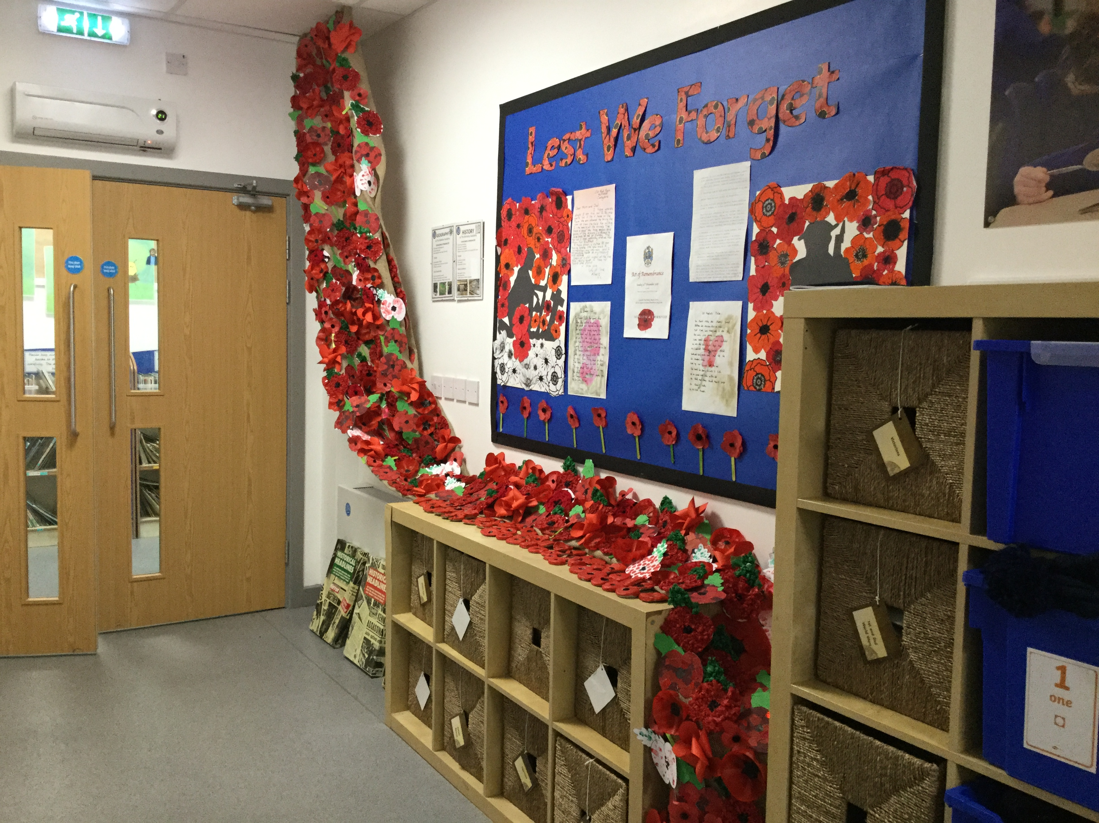
5.1 Enriching the curriculum life of the whole school.

Slide 2
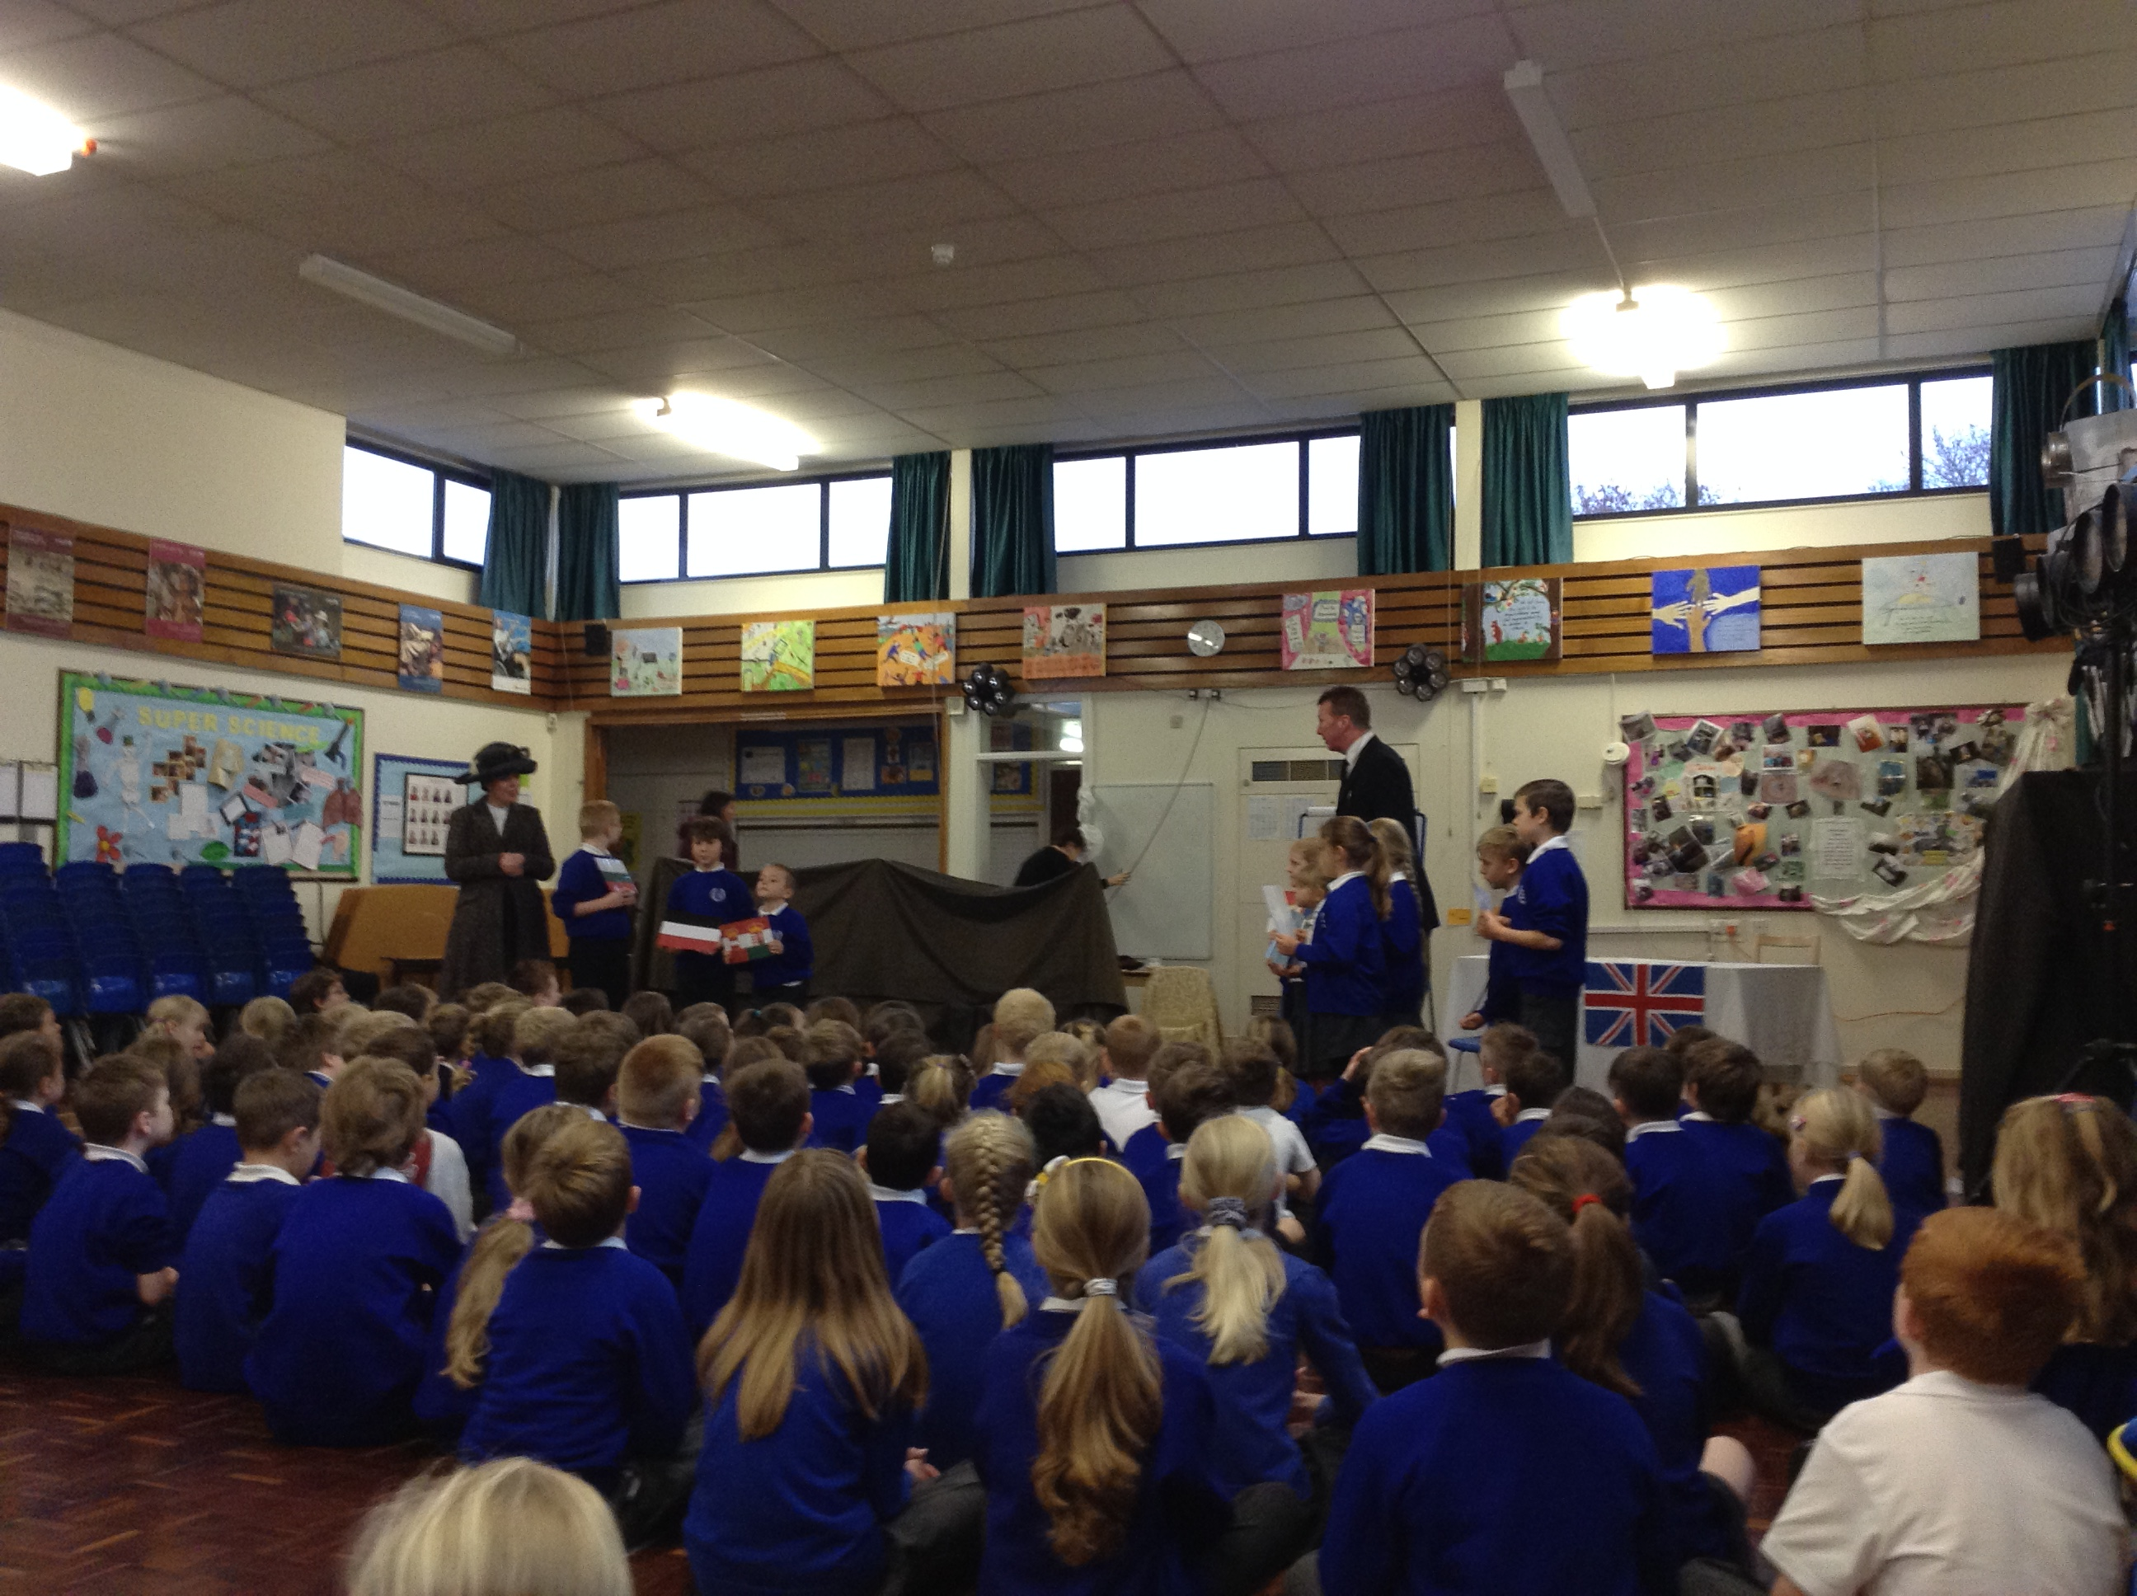
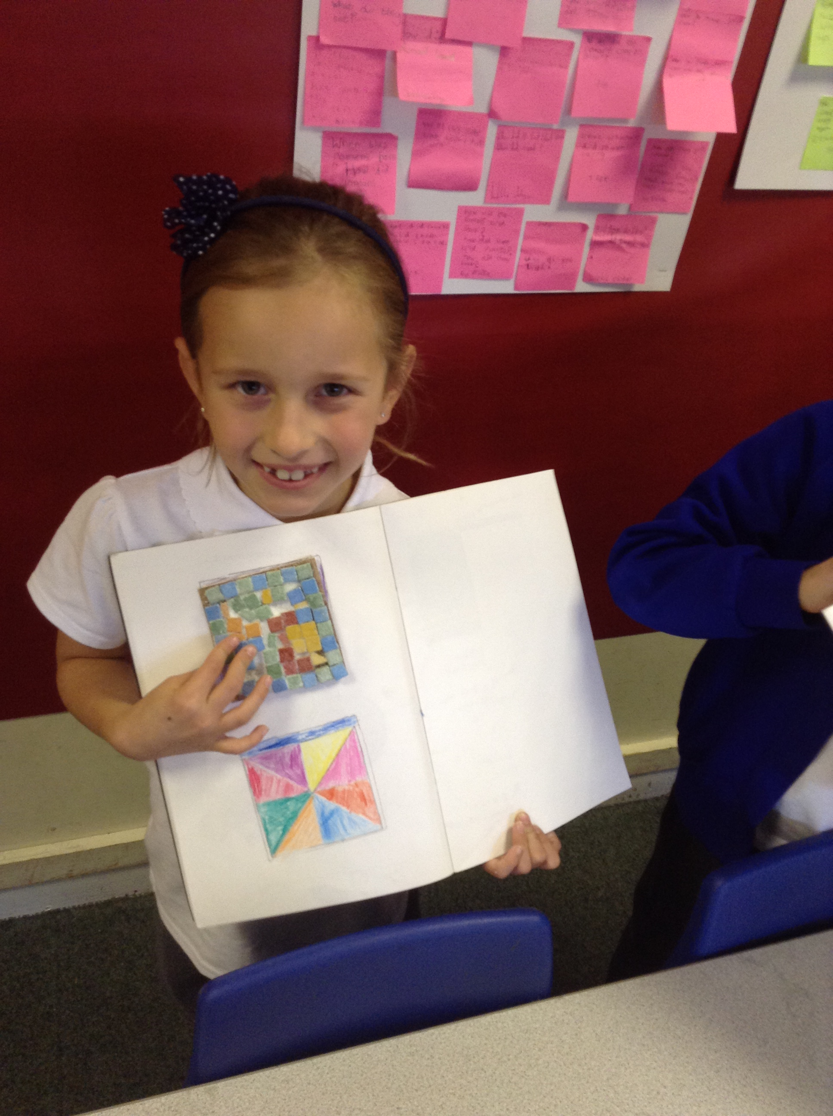
5.1 Enriching the curriculum life of the whole school.

