Slide 1
Evidence for Criteria 3
Curriculum

Slide 2
3.1 Curriculum design
Following the new national curriculum and my appointment as coordinator the curriculum at The Berkeley was redesigned to fit around local events and trying to develop a further chronological understanding. The curriculum was originally disorganised with subjects taken based on teachers preferences but now it has been organised to follow the chronological timeline.
Year Two for example were organised into teaching The Great Fire of London as this allowed us to access the local museums and knowledge around the Fire of Nantwich. This has proven to be very effective with children being very enthusiastic about the work.

Slide 3
3.2 Enquiry
Children use a range of enquiry skills throughout history at The Berkeley.
We use enquiry grids to develop children's enthusiasm and excitement about a topic, showing images or artefacts to get the children asking questions about what it might be, or what they would want to know about it.
We also use the children themselves to develop their own questions that they would like to learn the answer to, harnessing the enthusiasm we have developed through other means.
Furthermore, through the use of the history association schemes of work, our planning structures many opportunities for enquiry.

Slide 4
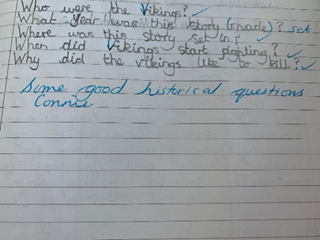
Evidence
Examples of Year 5 children generating questions to develop their own learning.
Examples of children starting an enquiry on Anglo-Saxon artefacts.

Slide 5
3.3 Broad and balanced curriculum
There is a focus on linking the teaching of historical skills and knowledge with other aspects of the curriculum, particularly English. In any cross-curricular work the history skills are always made explicit.
There are strong likes with Geography, with the impact of the local emphasis being linked with the land use and the history of the town.
For example, in a recent unit on the Stone age, a cross curricular unit of English and history was taught using the schools development of talk for writing and a combination of historical fiction and texts, to enhance both the teaching of history and literacy skills. Strong links are also made with geography, these have been strengthened by the new emphasis on local history.

Slide 6
3.3 Broad and balanced curriculum
In Year 2 children designed and created Tudor houses, which were then set on fire in the ‘Great Fire of Berkeley’.
In Year 3 the children performed Stone Age drama. They have also designed and made replica Egyptian Death masks.
In Year 4 children experienced, compared and contrasted Roman foods. They also mapped out Roman roads and compared them to existing major routes.
In Year 5 children mapped out the Viking invasion of Britain, created replica shields and performed Viking drama activities.
In Year 6 the children have written historical pieces in Literacy about evacuees.
Over the next few slides there will be examples of the children’s work.

Slide 7
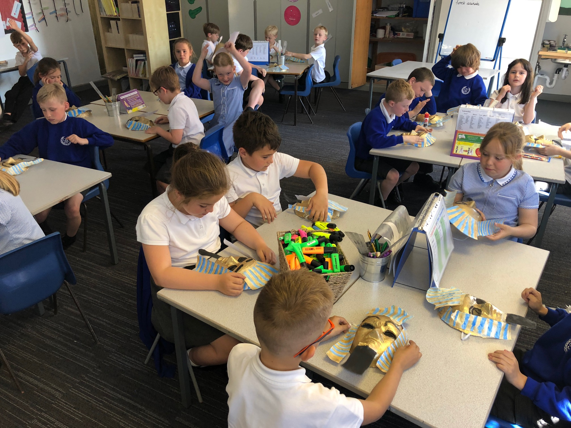
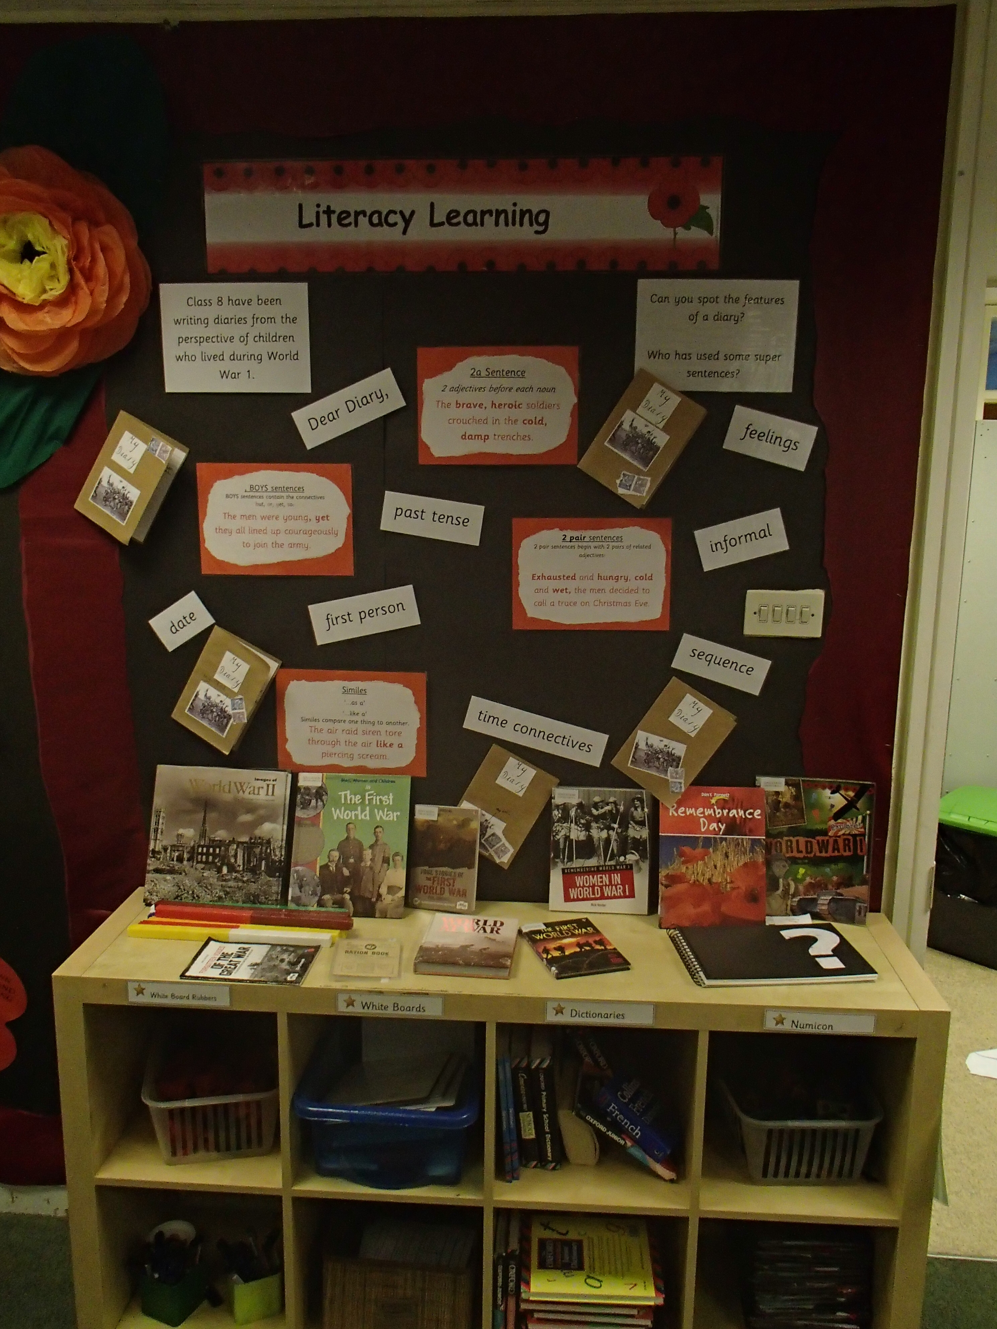
Year 3 planning, designing and creating of replica Egyptian death masks.
Year 6 History themed Literacy display.

Slide 8
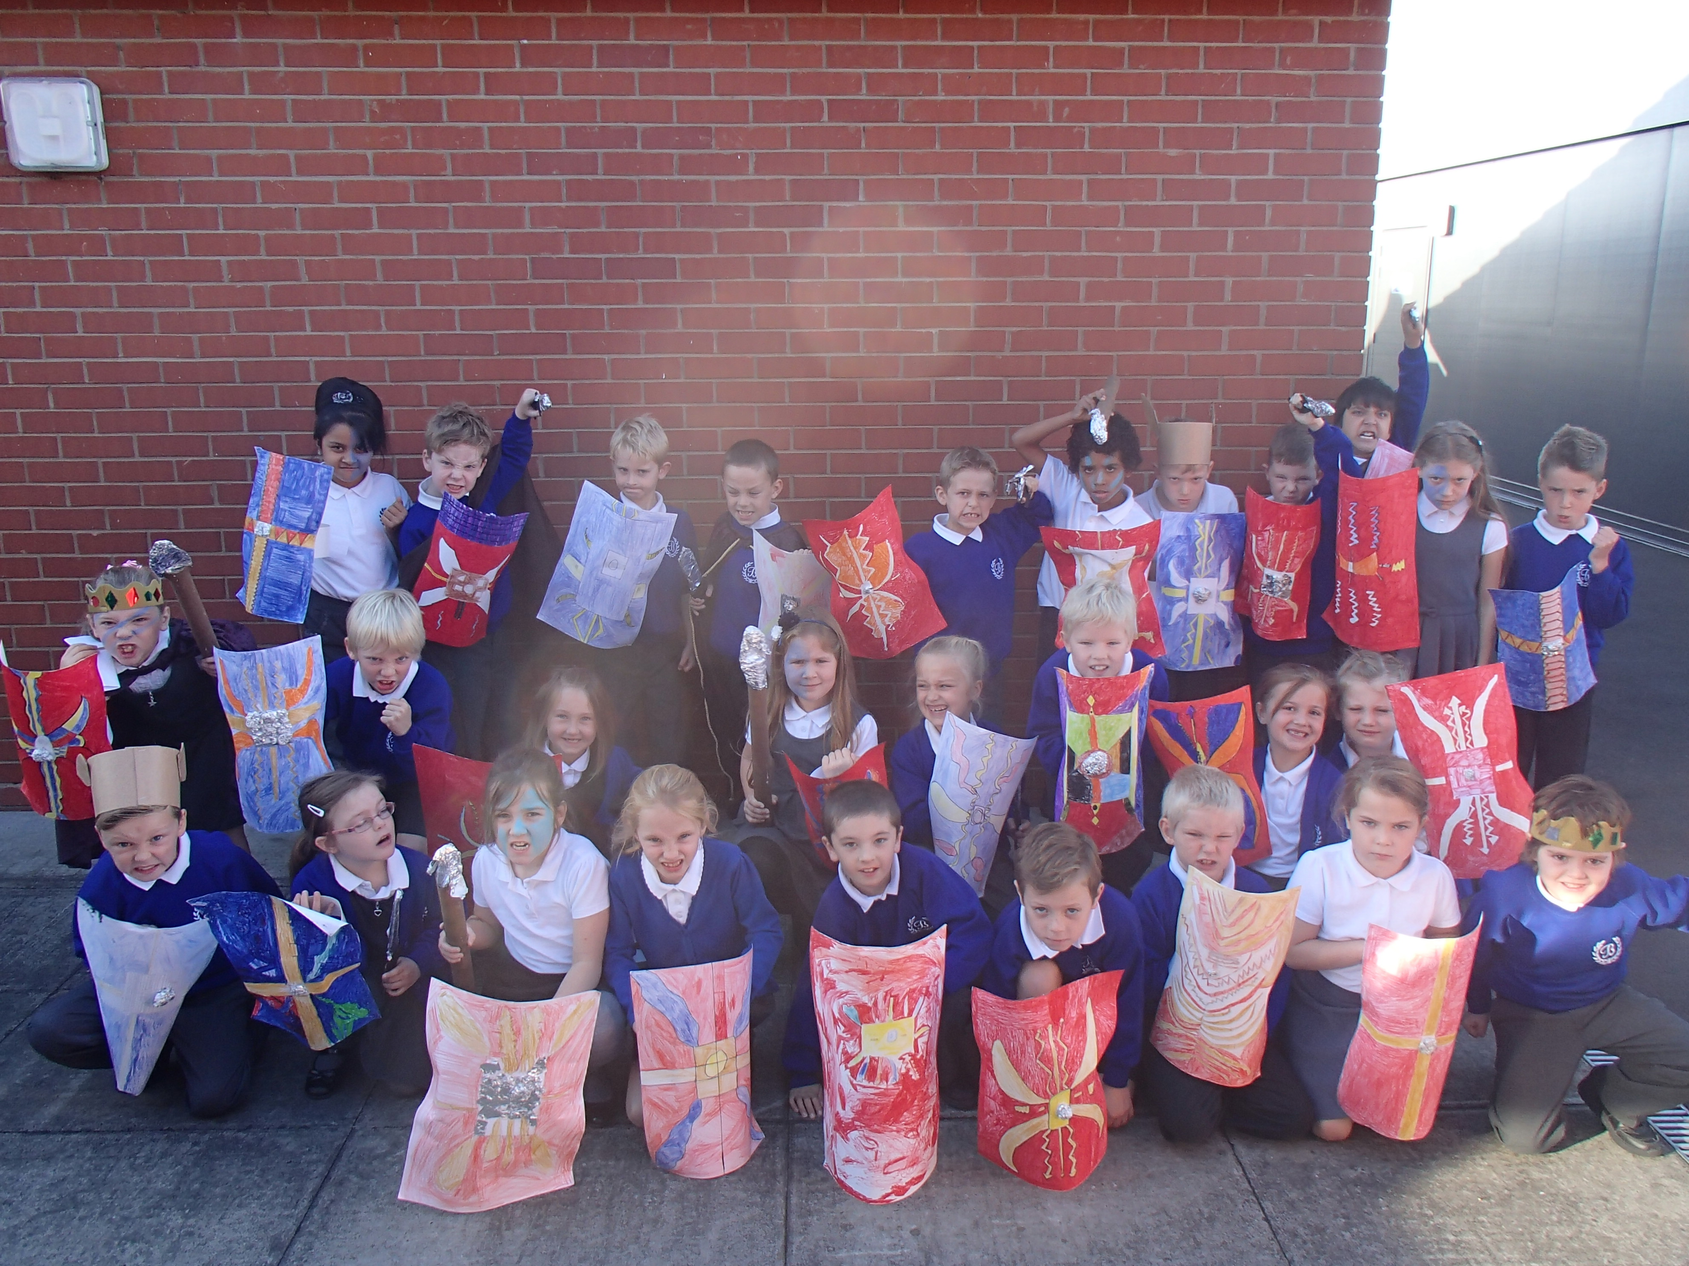
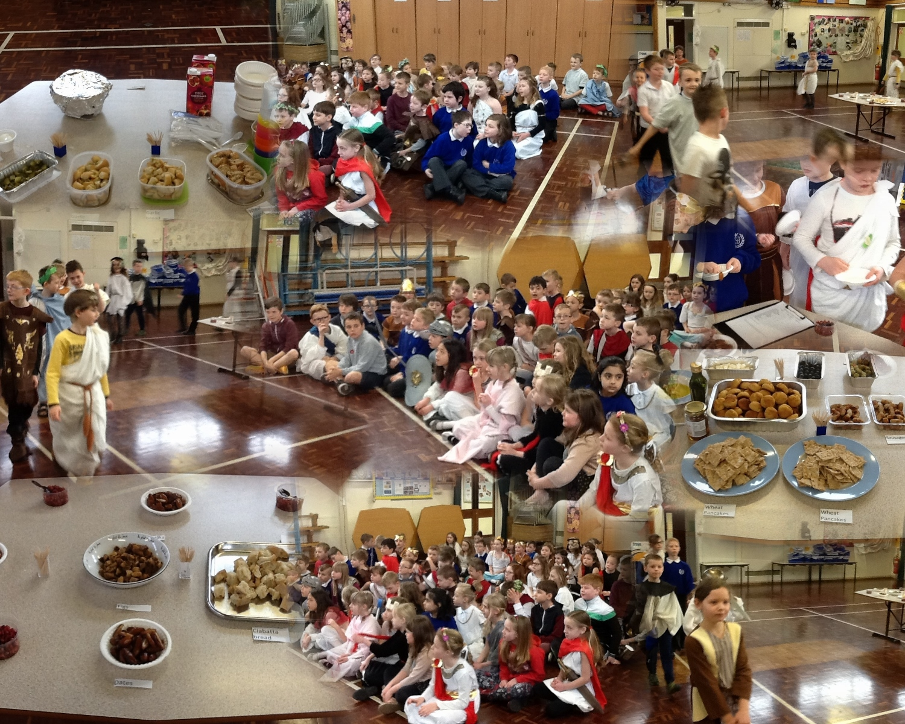
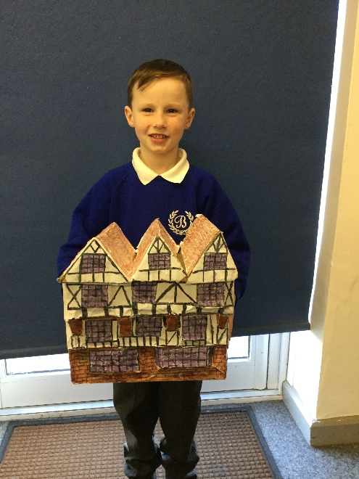
Year 4 drama.
‘The Class testudo’
Year 2 design of a Tudor building.
Year 4 Roman mosaic planning, designing, creating and evaluating
Year 4 drama and food tasting.

Slide 9
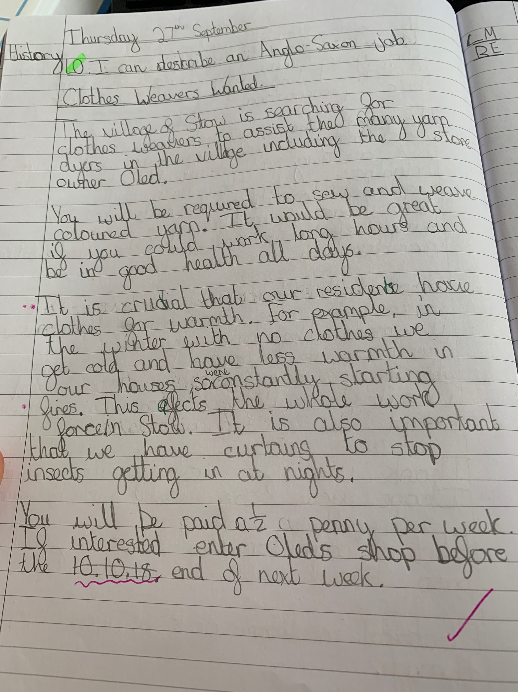
Year 2 recount of a history trip in Literacy.
Year 5 advert using historical knowledge in Literacy.

Slide 10
3.4 Time allocation
Staff take History, as a subject within the curriculum, seriously throughout the school. The focus on history has increased since the September 2014 curriculum, with new units and schemes of work being introduced. Each Year group is allocated topics to work through throughout the year and the skills are mapped out to support their progression and learning.
Often these units form a focal point for the wider curriculum. For example, the Anglo Saxons and Vikings impacting the English planning or the Stone Age with Year 3.

Slide 11
3.5 Historical thinking
A clear path of progression in historical knowledge, skills and concepts is ensured through the schemes of work and the progression in skills document. The balance between local, national and international is built into the schemes of work which are both created internally and combined with the History association schemes of work.
The path is developed with other members of the curriculum project team, in which we have developed a curriculum web which shows how it develops throughout the school whilst ensuring that the children aren’t being taught and retaught the same skill at the expense of others.

Slide 12
3.6 Community
For the last year the local dimension has been a major area for development; with new local schemes of work being developed specifically to tie in with the curriculum. For example, the EYFS take a trip to the local railway and transport museum to discover about changes not within their lifetime.
Also the Year 2 children access the local Nantwich museum whilst learning about the Great fire of London and compare it with the fire of Nantwich that happened the same year.
Year 4, whilst studying the Romans, use the local city of Chester as a basis for learning about the impact the invasion and conquest of Britain had, and still has today.
The whole school community is involved with wider topics, such as Black History Month and Remembrance. With members of the school community attending the remembrance service in

