Slide 1
Evidence for Criteria 5
Enrichment

Slide 2
5.1 Enriching the curriculum life of the whole school.
Below is the vast amount of pictorial evidence with regards to how history enriches the whole curriculum at the school.
Evidence includes, themed days such as Stone Age days, Roman days, Viking and Anglo Saxon days.
It also includes examples of how history is used as the hook for literacy, design and technology, geography, art, PHSCE, RE and PE.
There are further examples of how history is used as the basis of assemblies.
It shows how history is at the heart of things here at The Berkeley and it is something I am immensely proud of.

Slide 3
5.3 Website and communications
We frequently advertise and share what we have done in history on our website and social media platforms.
Also, in communicating and reflecting on our practise parents were asked for feedback with regards to what their children enjoyed or would like to learn more about.

Slide 4
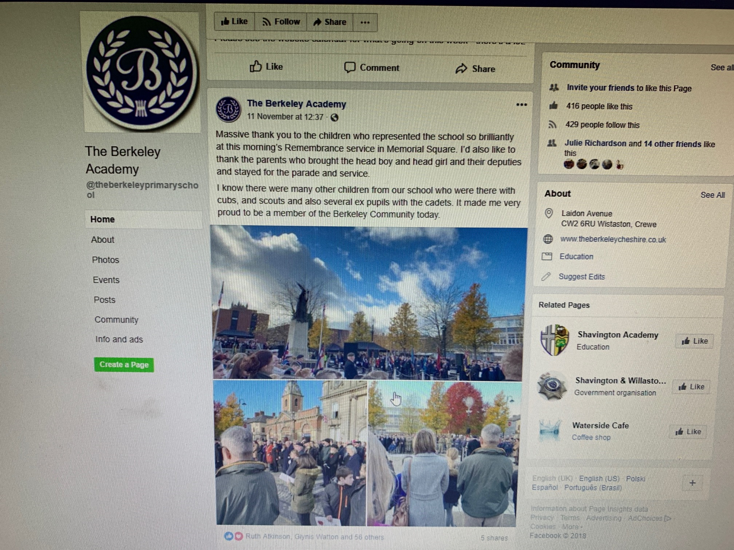
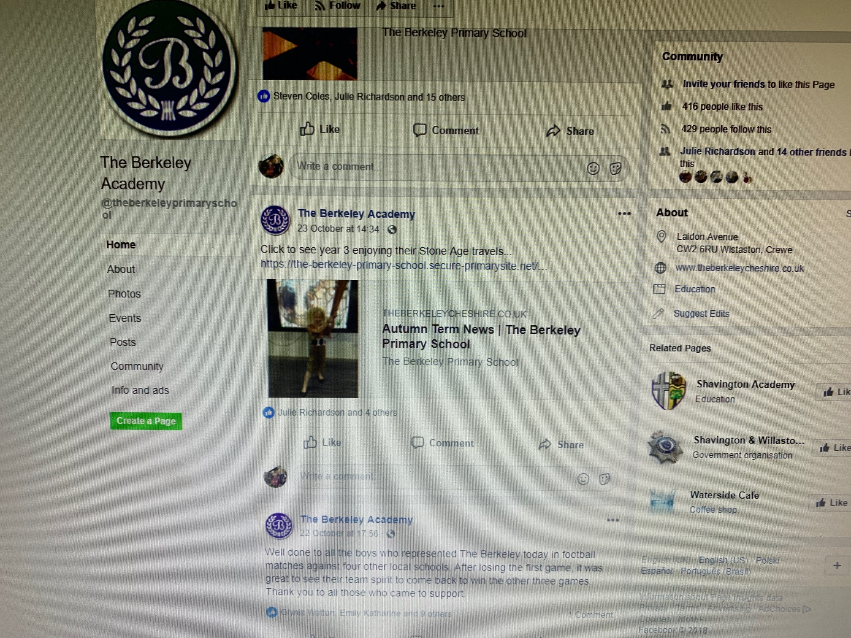
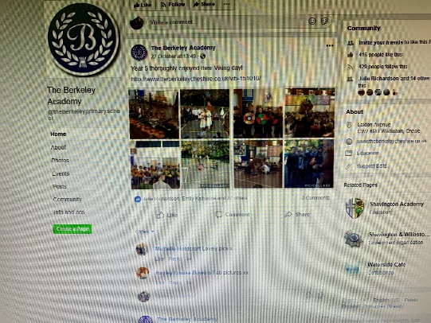
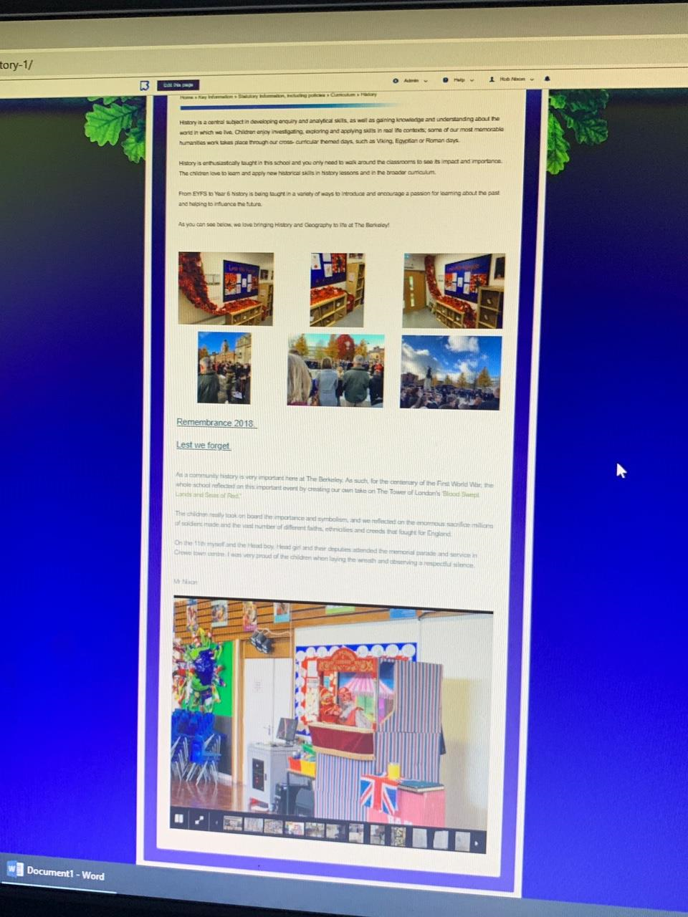
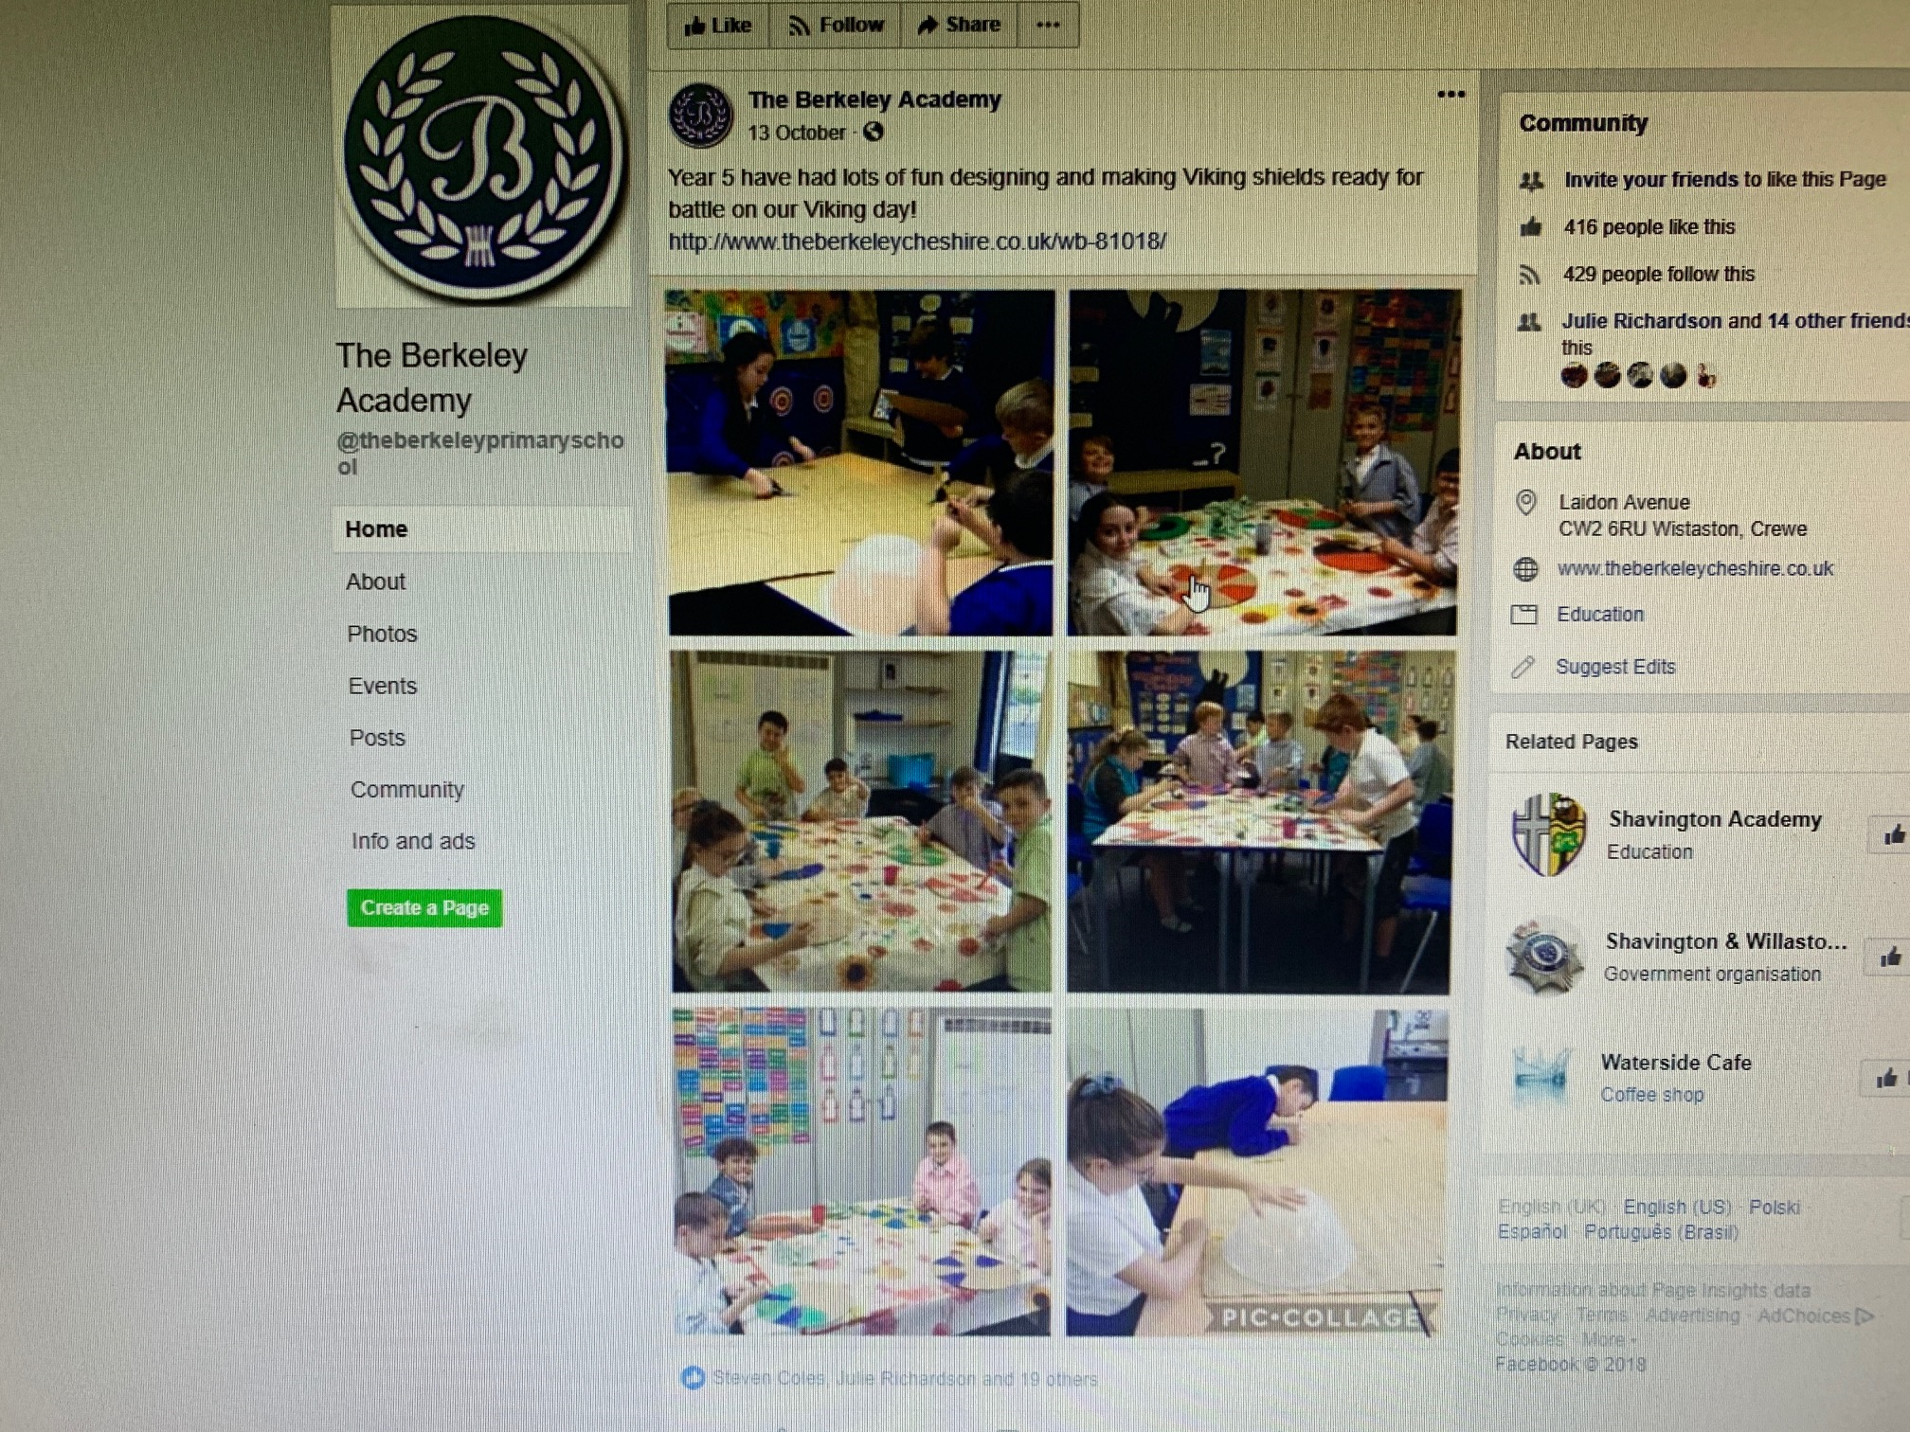
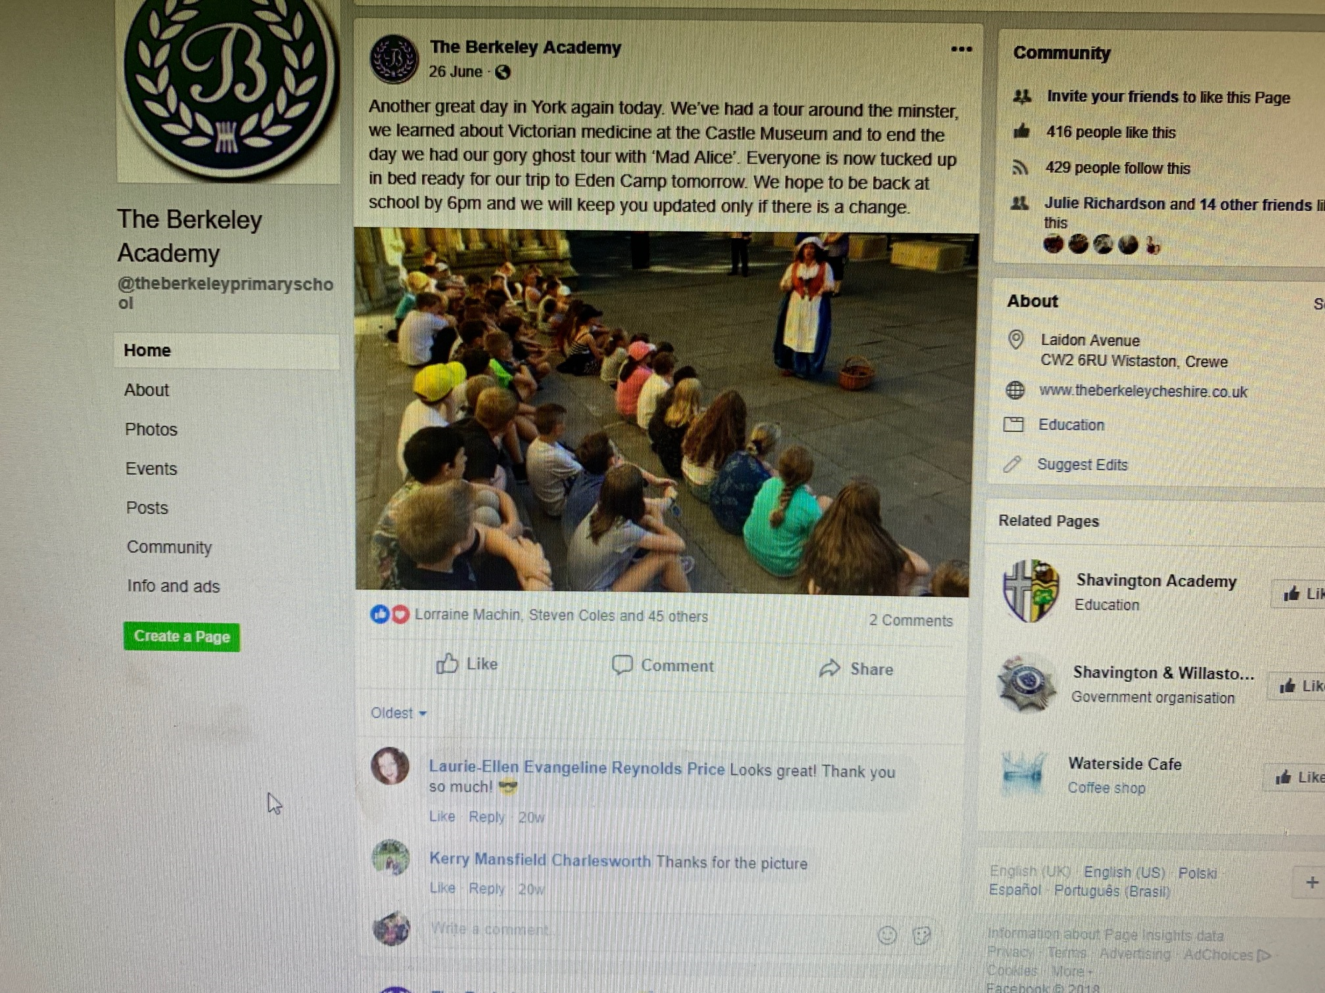
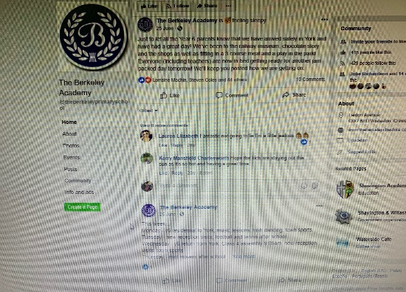
5.3 Website and communications

Slide 5
5.4 Links with other subjects within the school and beyond.
As noted above, there are many pictures attached which shows how important history is at the Berkeley and how it impacts throughout the curriculum.
Furthermore, as seen in other evidence packs, it shows how history at the Berkeley has an impact on the wider community, ranging from the Berkeley wreath laid at the memorial for remembrance, to the visits to community

