Slide 1
HA QM
01 Learning and Teaching evidence

Slide 2
1.1
Item 1
History Faculty results review document shows outstanding results (significantly above national averages) for all teaching groups, and shows no significant gaps for PP or SEN pupils.
2022 document is saved as “1.1 History Faculty results 2022.docx”
Item 2
Example of internal Academy QA representing high standards throughout the faculty, saved as “1.1 QA example from Closer Look for lessons.docx”

Slide 3
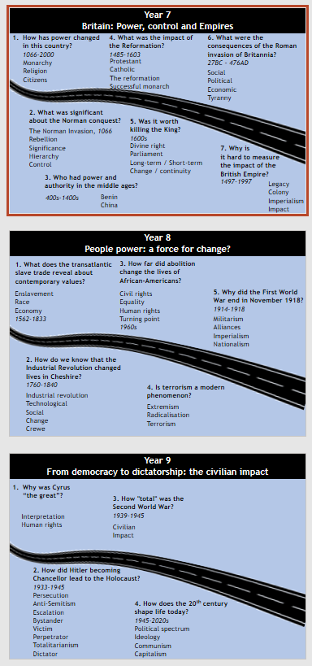
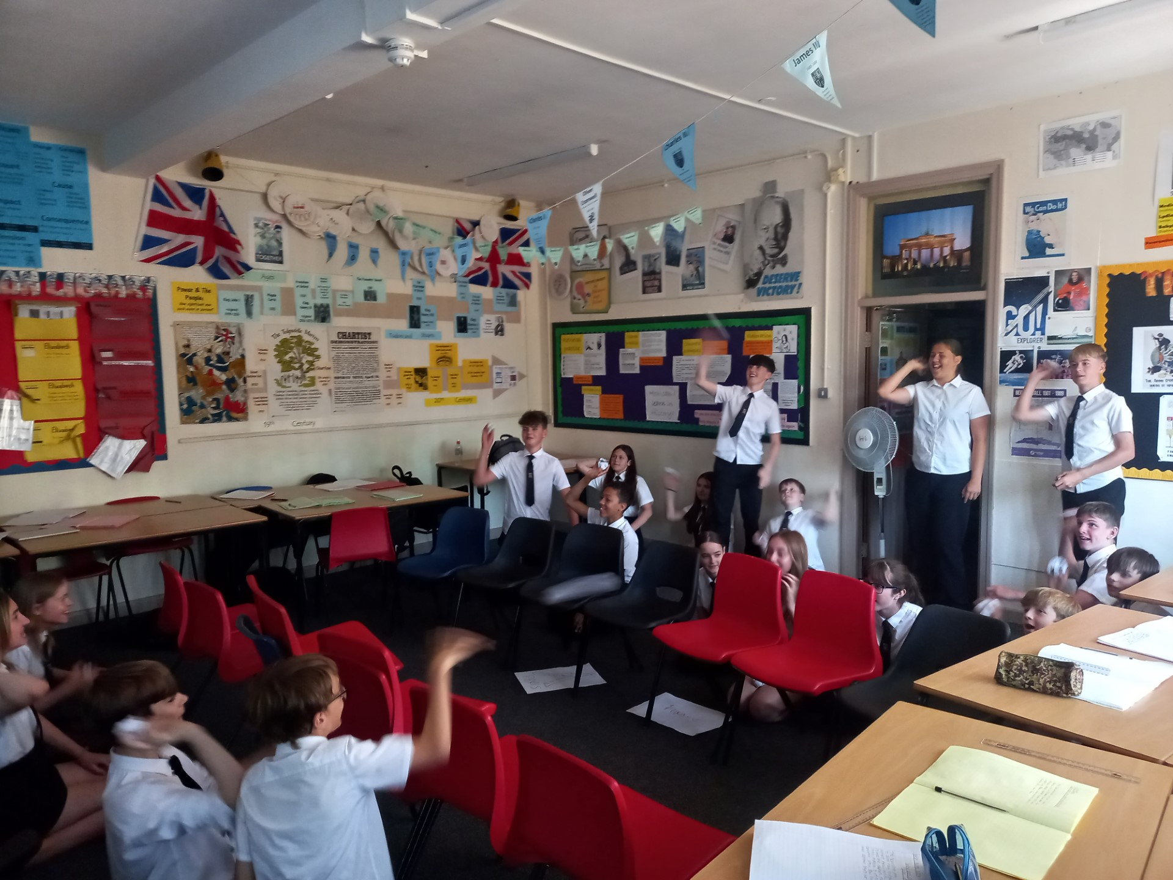
1.2
Lower school end of year exams include short-answer knowledge recall tasks, chronology tasks and extended writing, based on the whole of lower school history so far. As well as individual pupil tracking, we track general achievement of groups as a department on tracking spreadsheets, to enable us to discuss and improve strategies for progress. See example file “1.2 Y8 exam analysis.xlsx”
First World War: Example photo from “Schlieffen Plan to trench warfare” lesson demonstrating a range of teaching and learning styles– some teachers use a decision-making task, others use a walk through to achieve the same purpose.
The curriculum is designed around the key concepts that form the basis of long-term knowledge retention for pupils – matching end of year exams, knowledge recall in lessons and homework tasks – see right for key concept road maps.

Slide 4
1.3
See example scheme of work “1.3 Industrial Revolution scheme.docx” In this scheme of work for Year 8 (Industrial Revolution) I have highlighted evidence showing the wide range of resources that we have utilised within one unit of work. Many are from the local area including places that pupils live in or experience in their lives, and have been gathered and adapted by our own staff to create this bespoke unit – similar to other units.
All History classrooms have bespoke displays that support understanding of the chronological and conceptual frameworks of the curriculum, as well as subject-specific use of tier 2 vocabulary.
Pictures on the next slide.

Slide 5
1.3 Examples of curriculum overview and keywords, as well as Tier 2 words as displayed in all History classrooms.

Slide 6
1.4
Item 1
Pupil voice – see next two slides for evidence of pupil voice gathered over the last two years showing a pattern of seeking pupil voice within the faculty.
Item 2
“1.4 Learning Walks pupil understanding March 2023 document”
Highlighted areas show evidence of high engagement, purpose and motivation – from Senior Leadership Team’s learning walks and pupil voice meetings across the whole faculty.

Slide 7
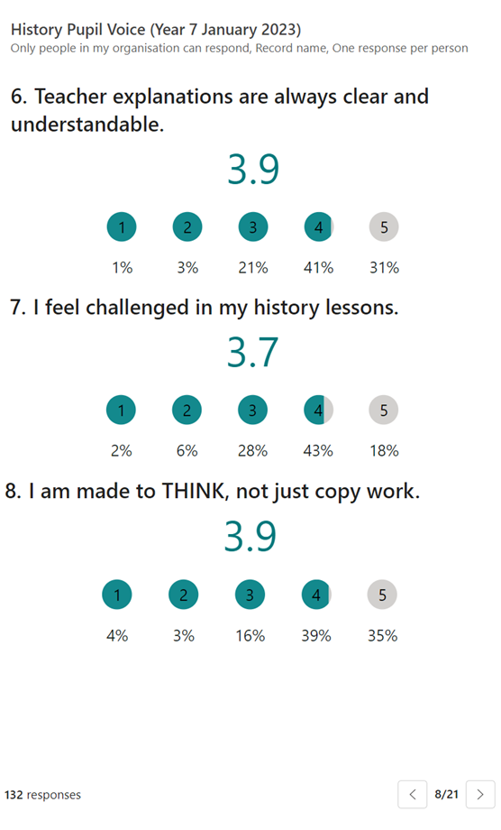
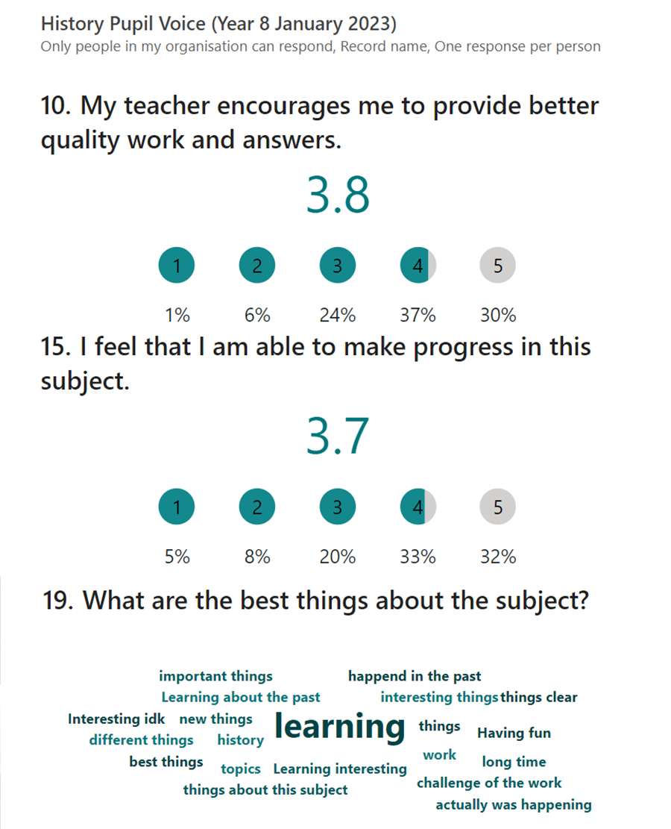
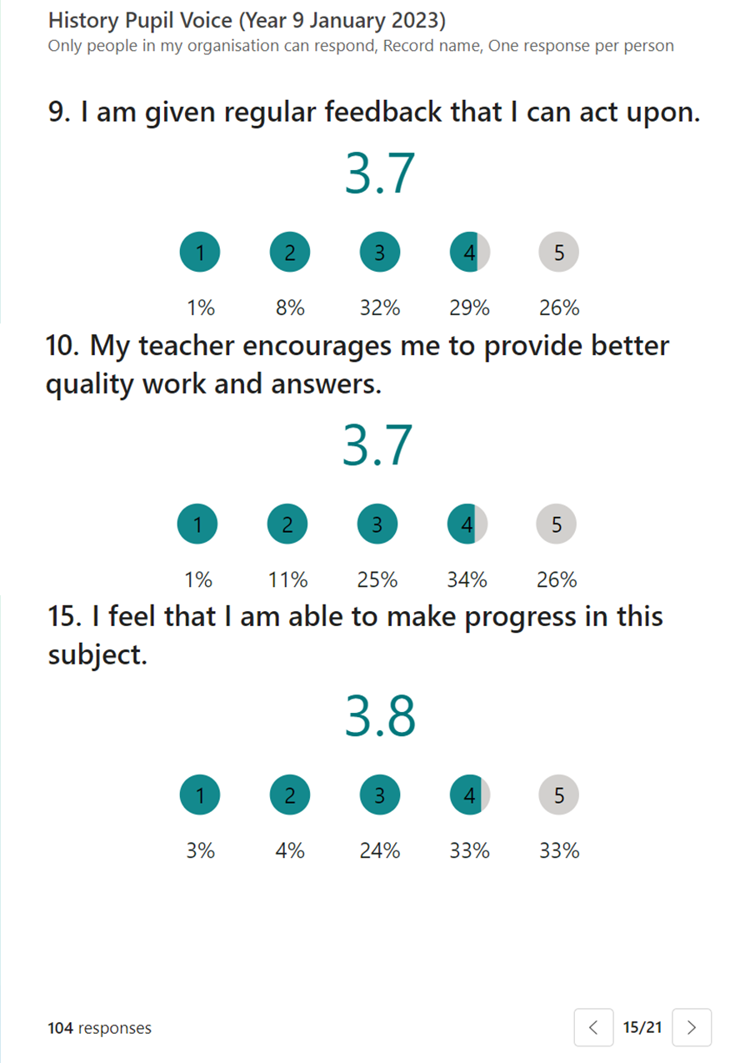
Selected results from lower school pupil voice, January 2023.
The survey consisted of 20 questions and received 366 responses spread across the years 7-9.
As a result we have held discussions in morning briefing about what progress means and how to ensure pupils feel they are making progress in our lessons – more is planned on this in 2023-24.

Slide 8
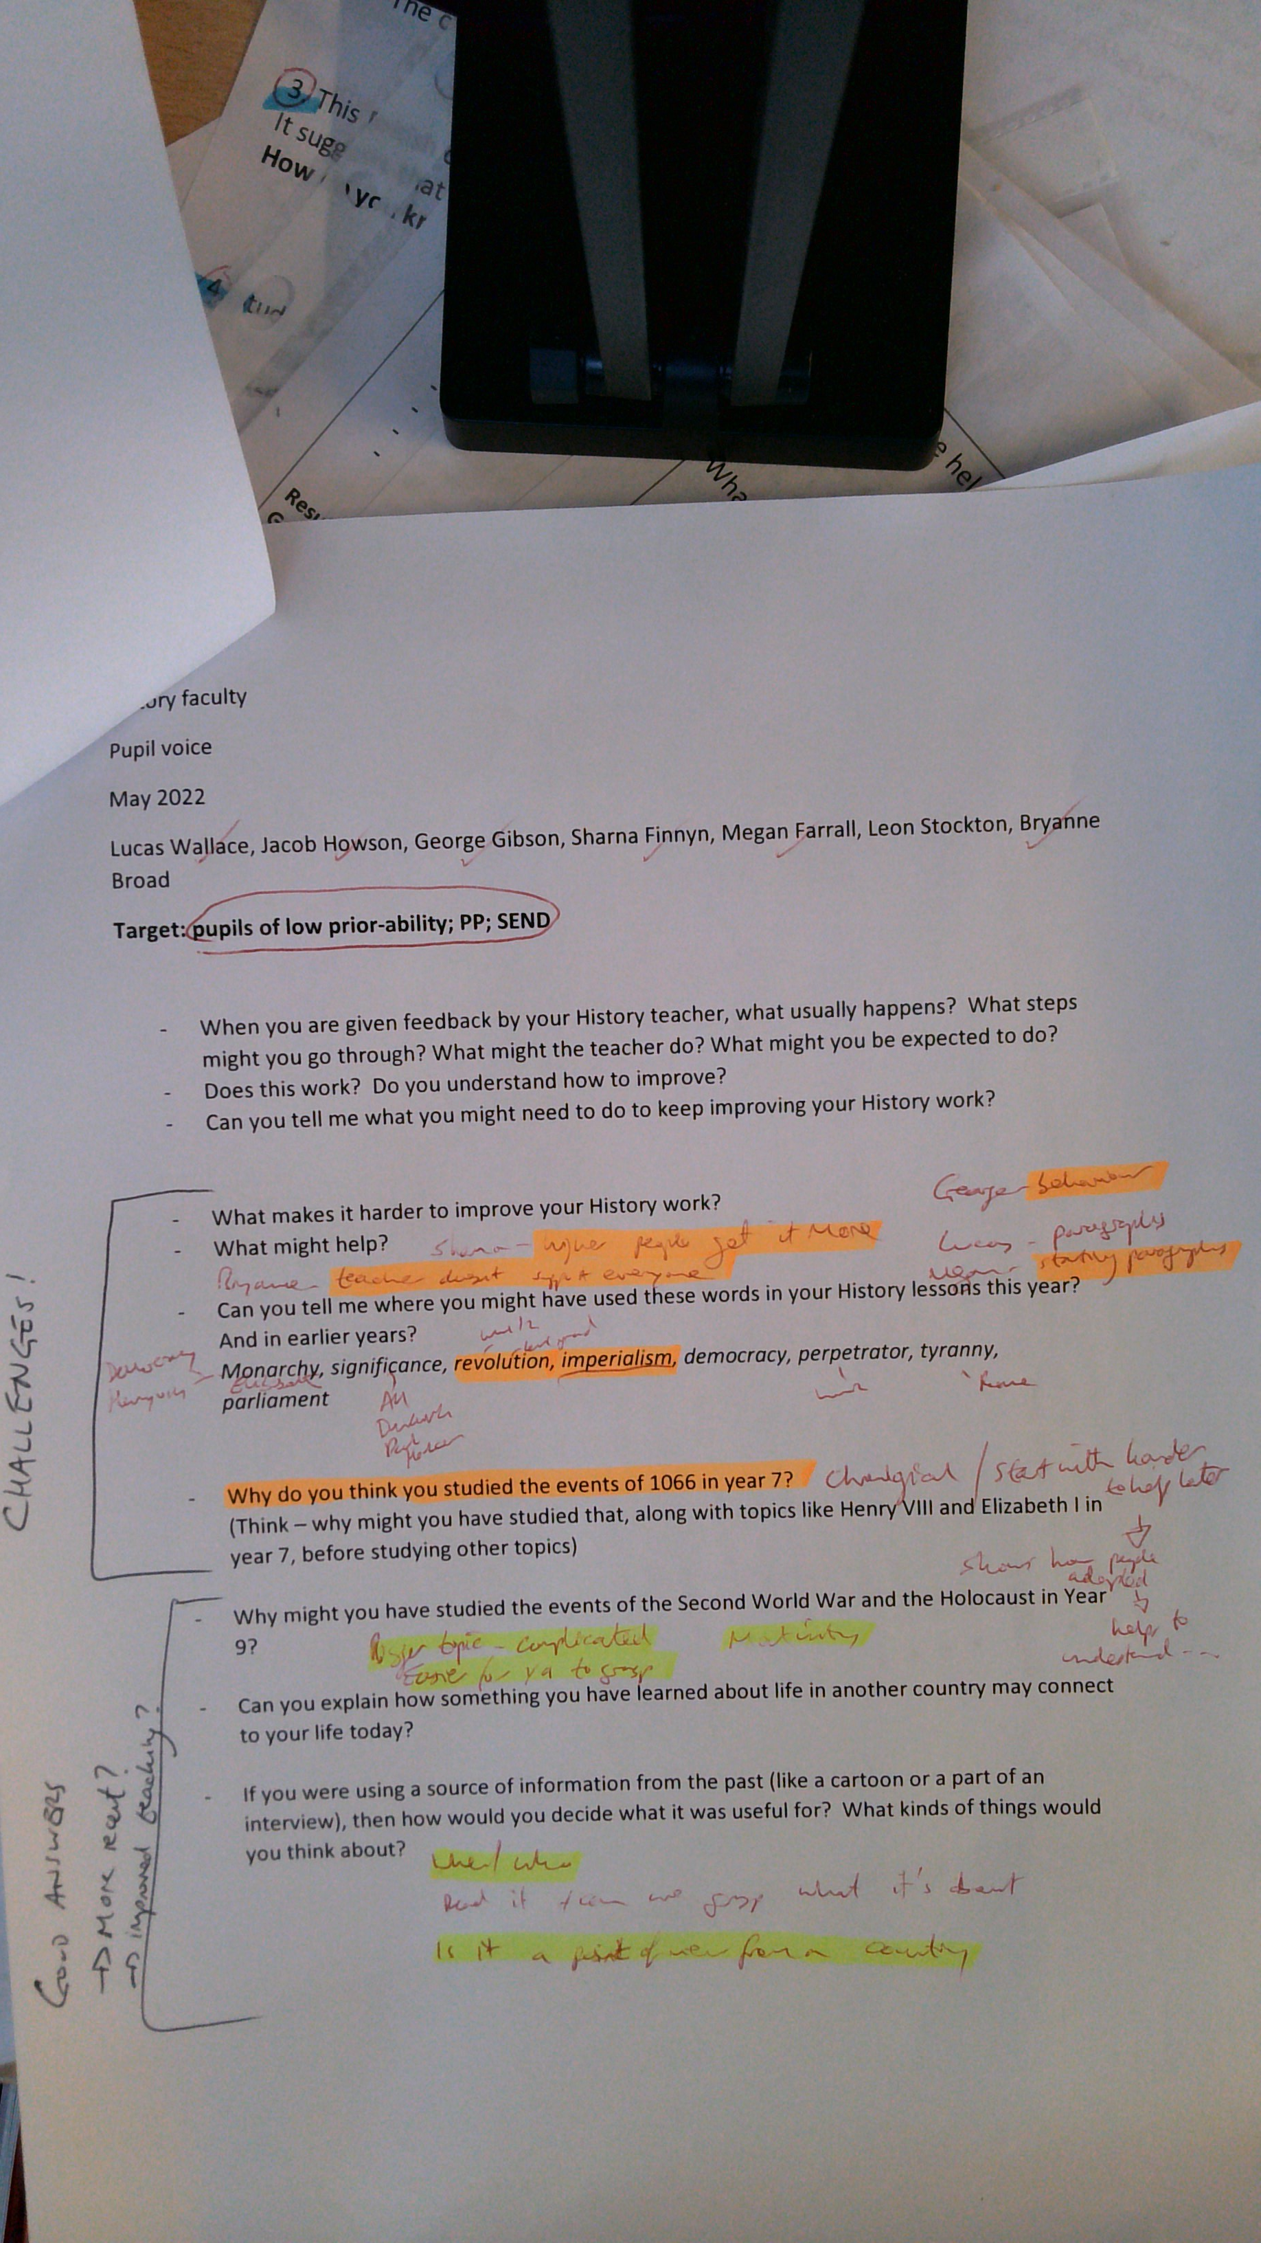
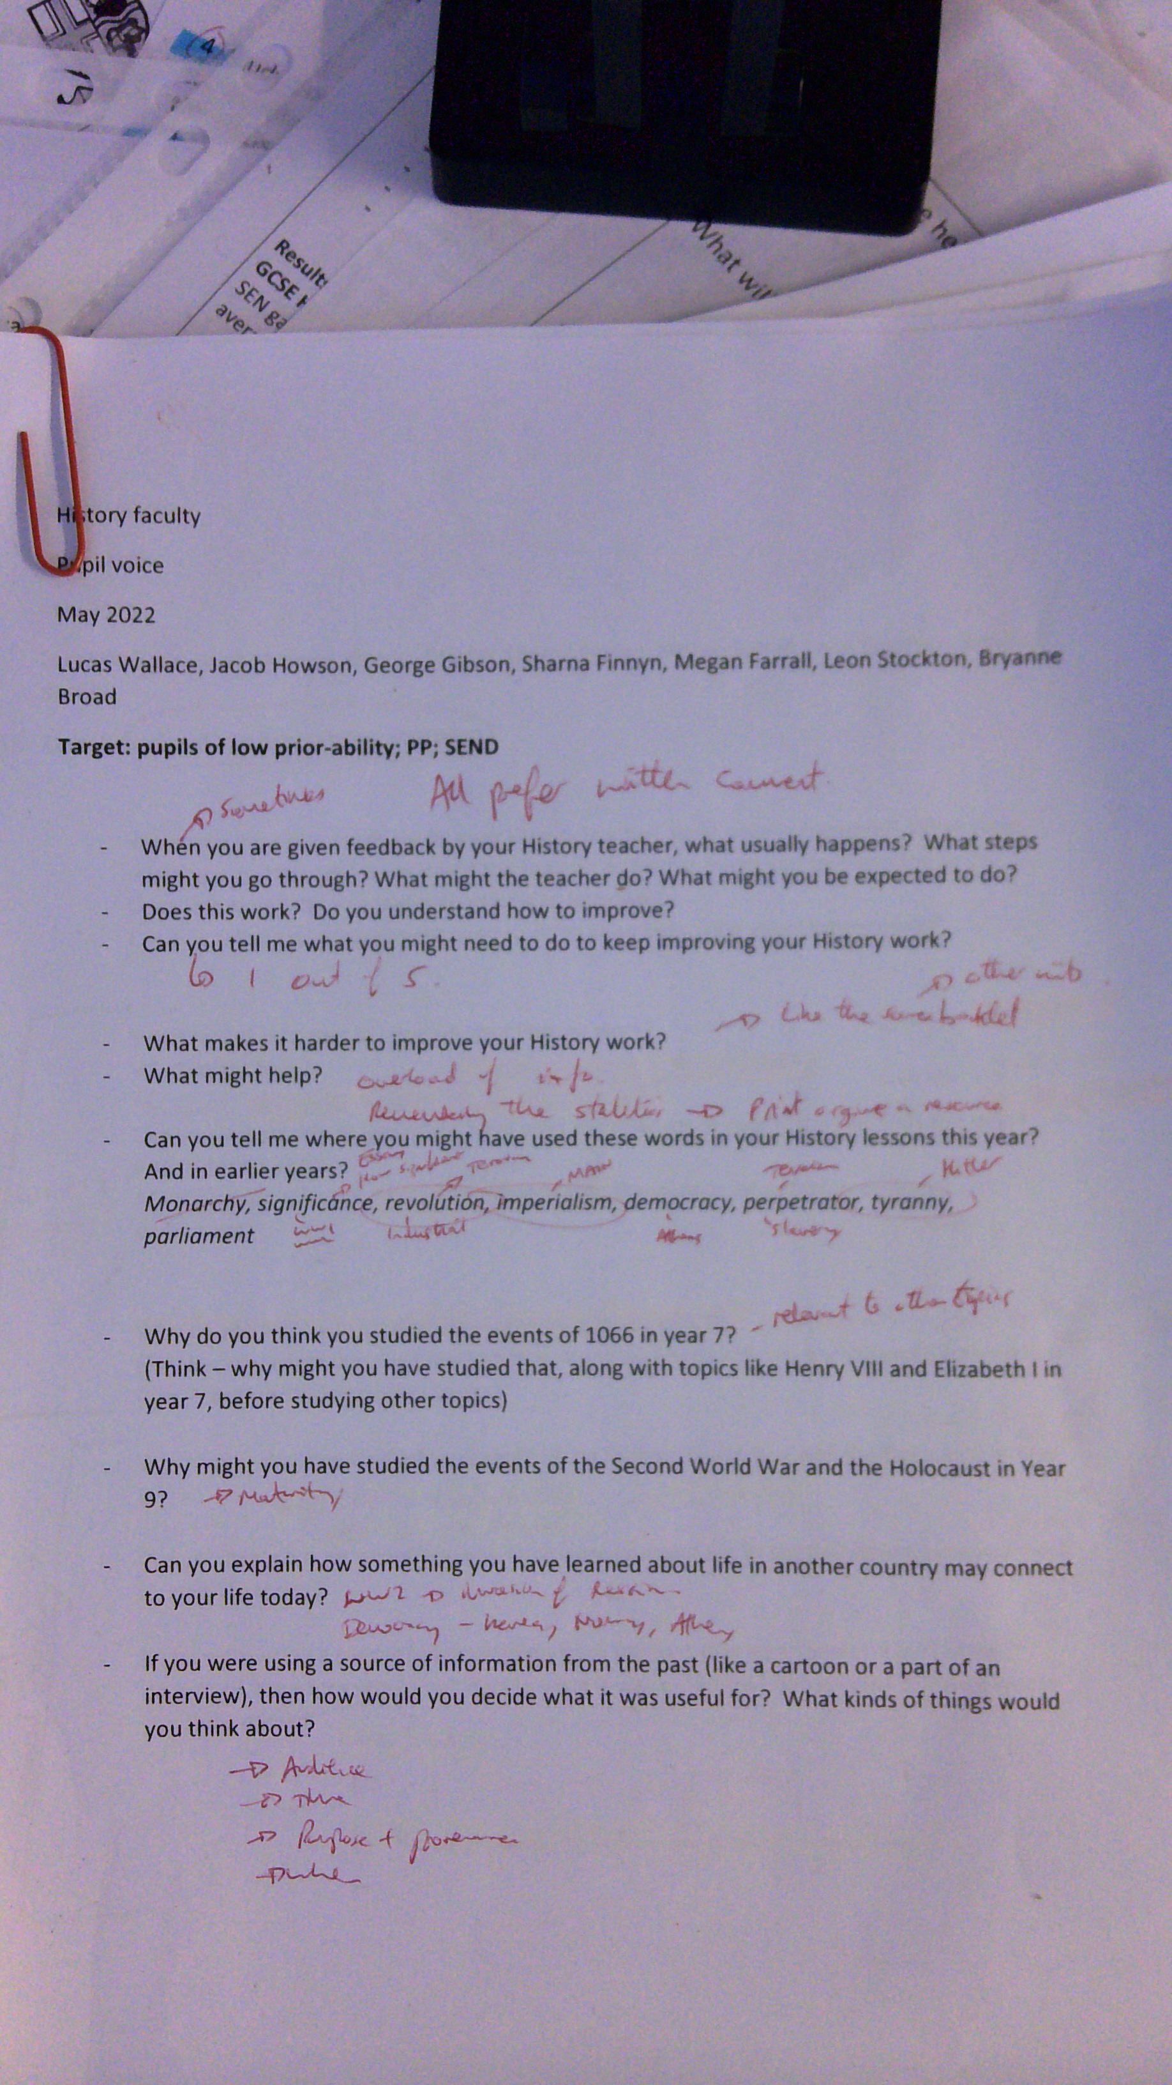
TOL handwritten notes from pupil voice May 2022.
This showed a discrepancy between disadvantaged pupils and their peers in understanding the concepts and organisation of the curriculum. As a result we created wall displays and altered some enquiry questions.

Slide 9
1.5
Item 1
Examples of feedback using verbal feedback, annotation of peer examples and/or written feedback – on the following slides.
Item 2
“1.5 Learning Walks assessment and feedback March 2023 document”
Highlighted area shows evidence from Senior Leadership Team’s notes from a series of learning walks and book scrutinies of pupils’ engagement with assessment and feedback as routine, with bespoke feedback and quality responses.

Slide 10
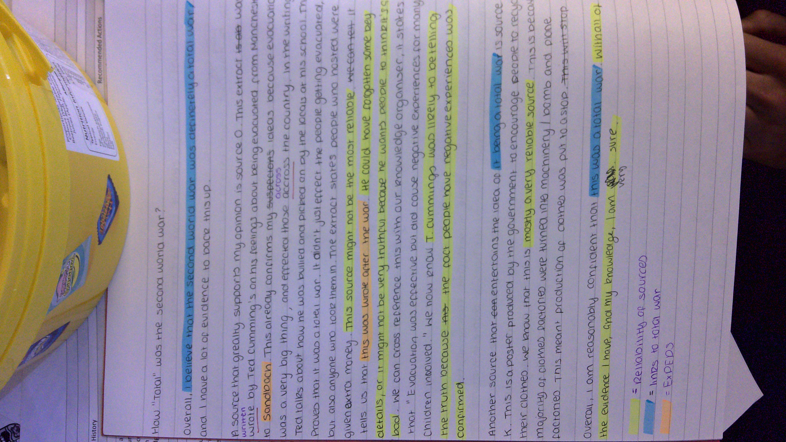
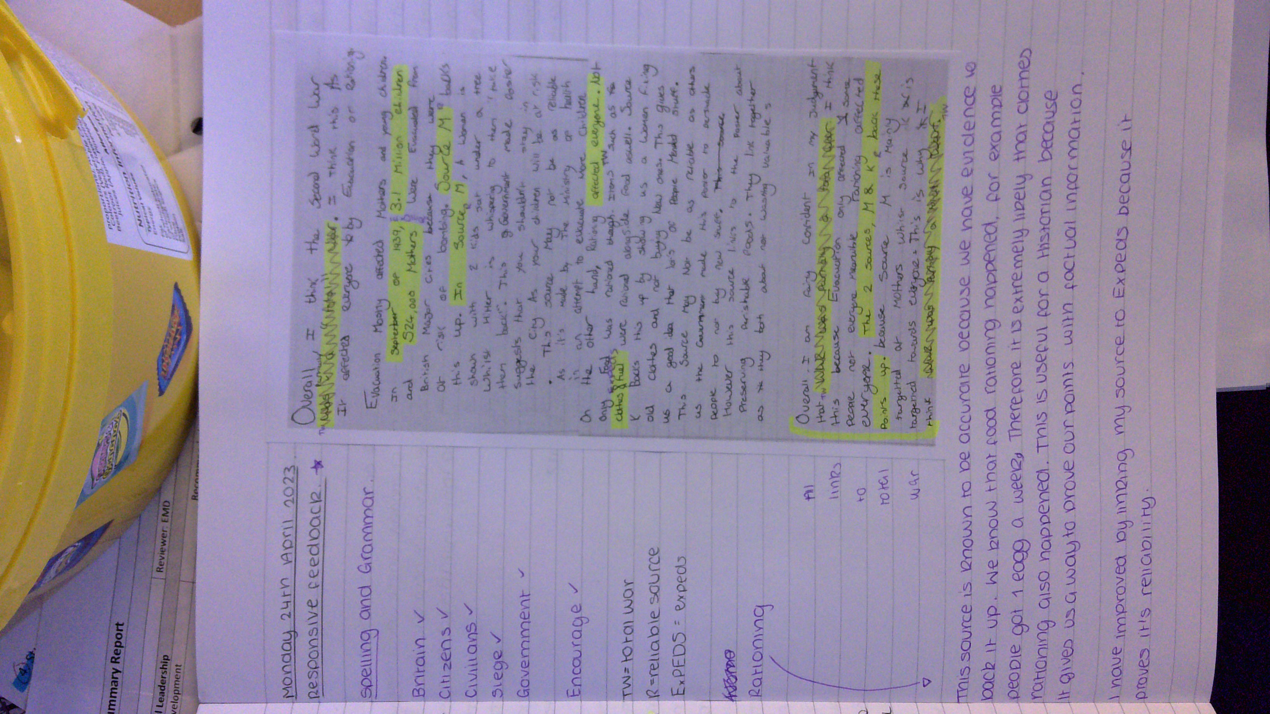
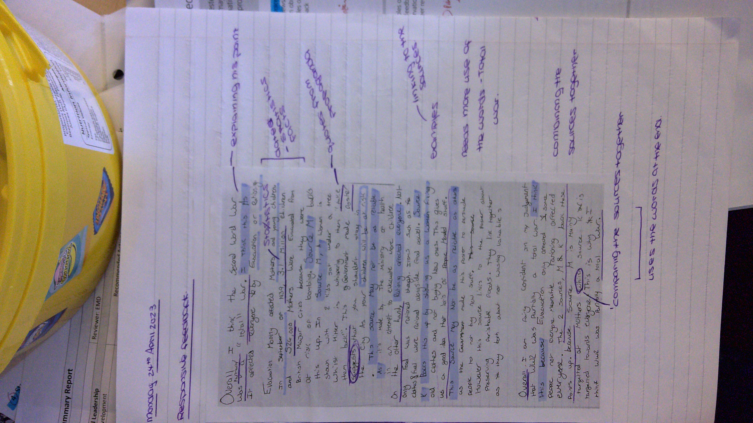
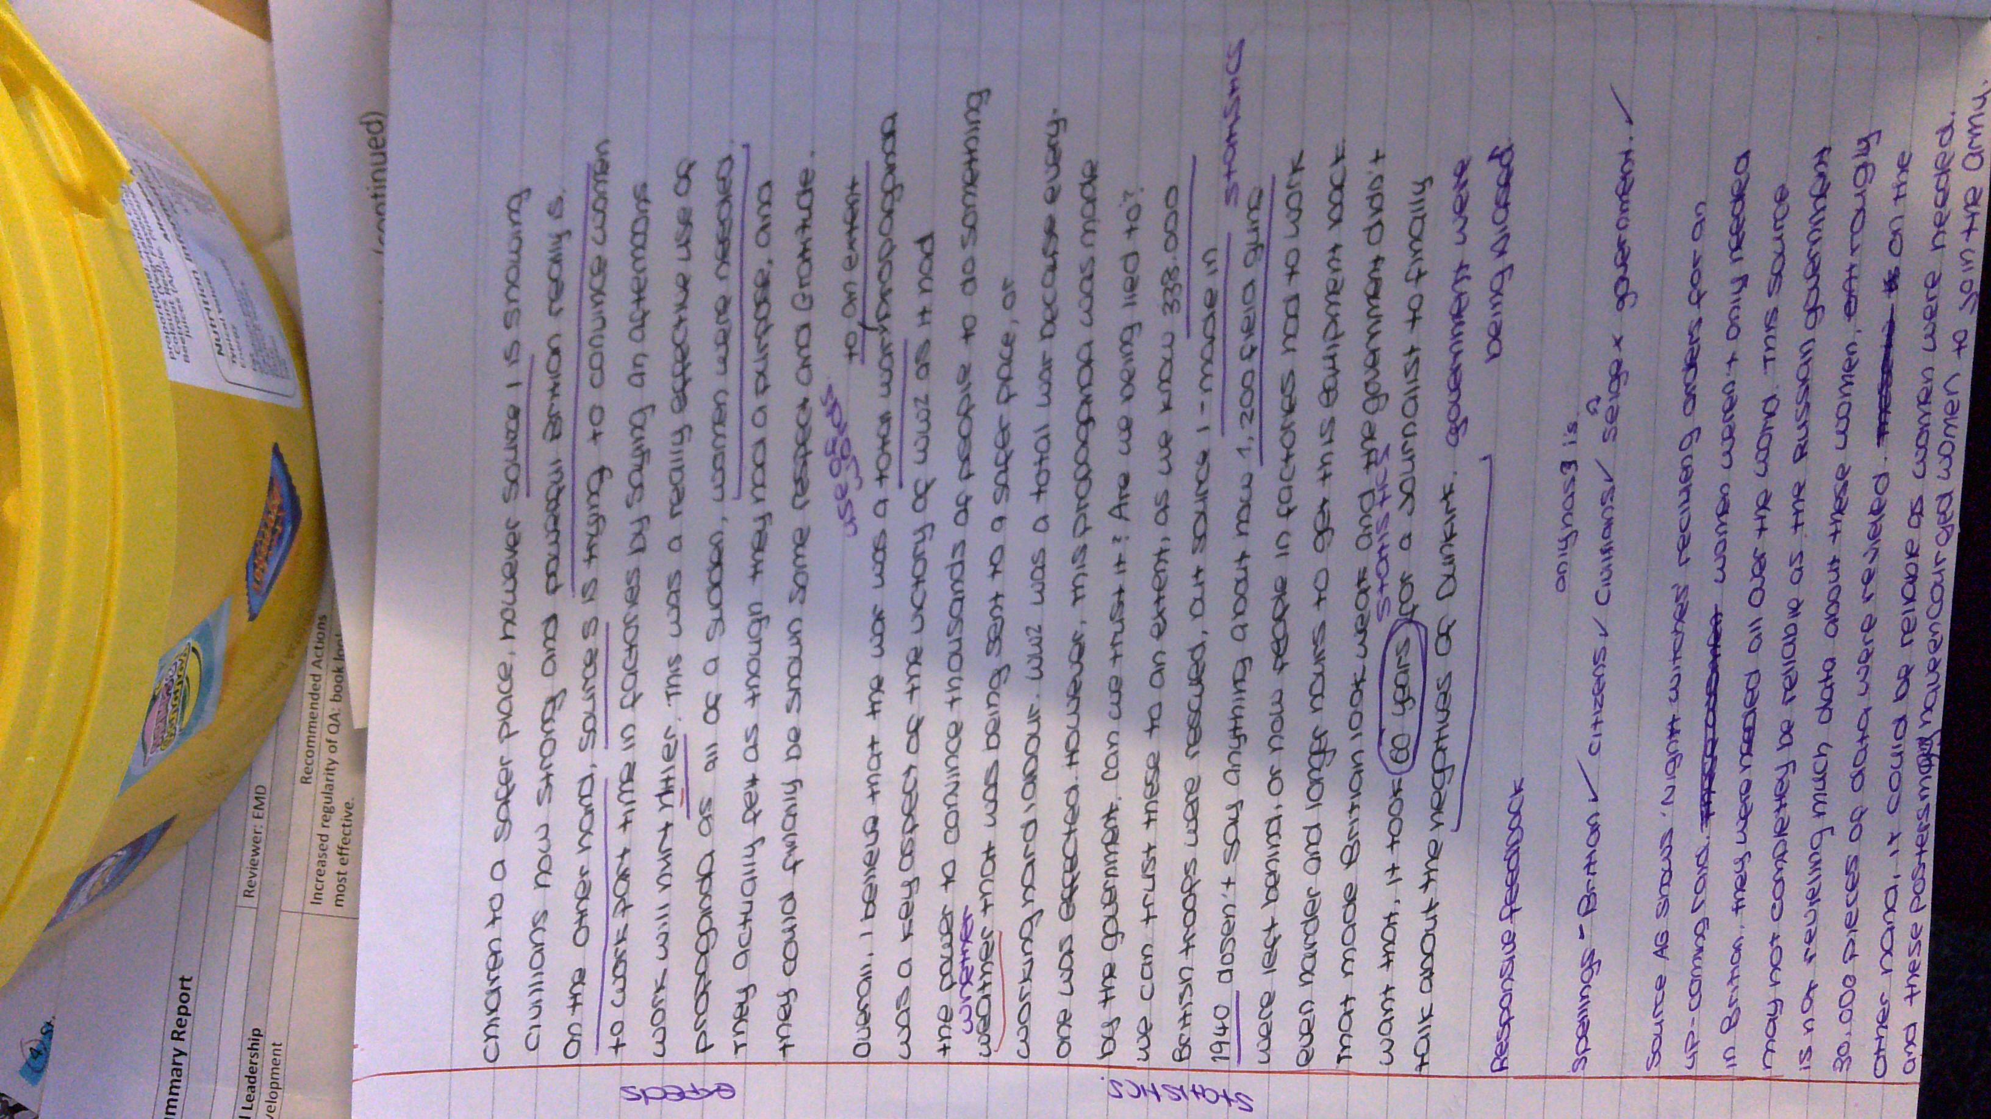
1.5
Year 9 – verbal feedback, use of a photocopied peer’s example, annotation of peer’s work and annotation of own work followed by improvements to own work with individual relevance.

Slide 11
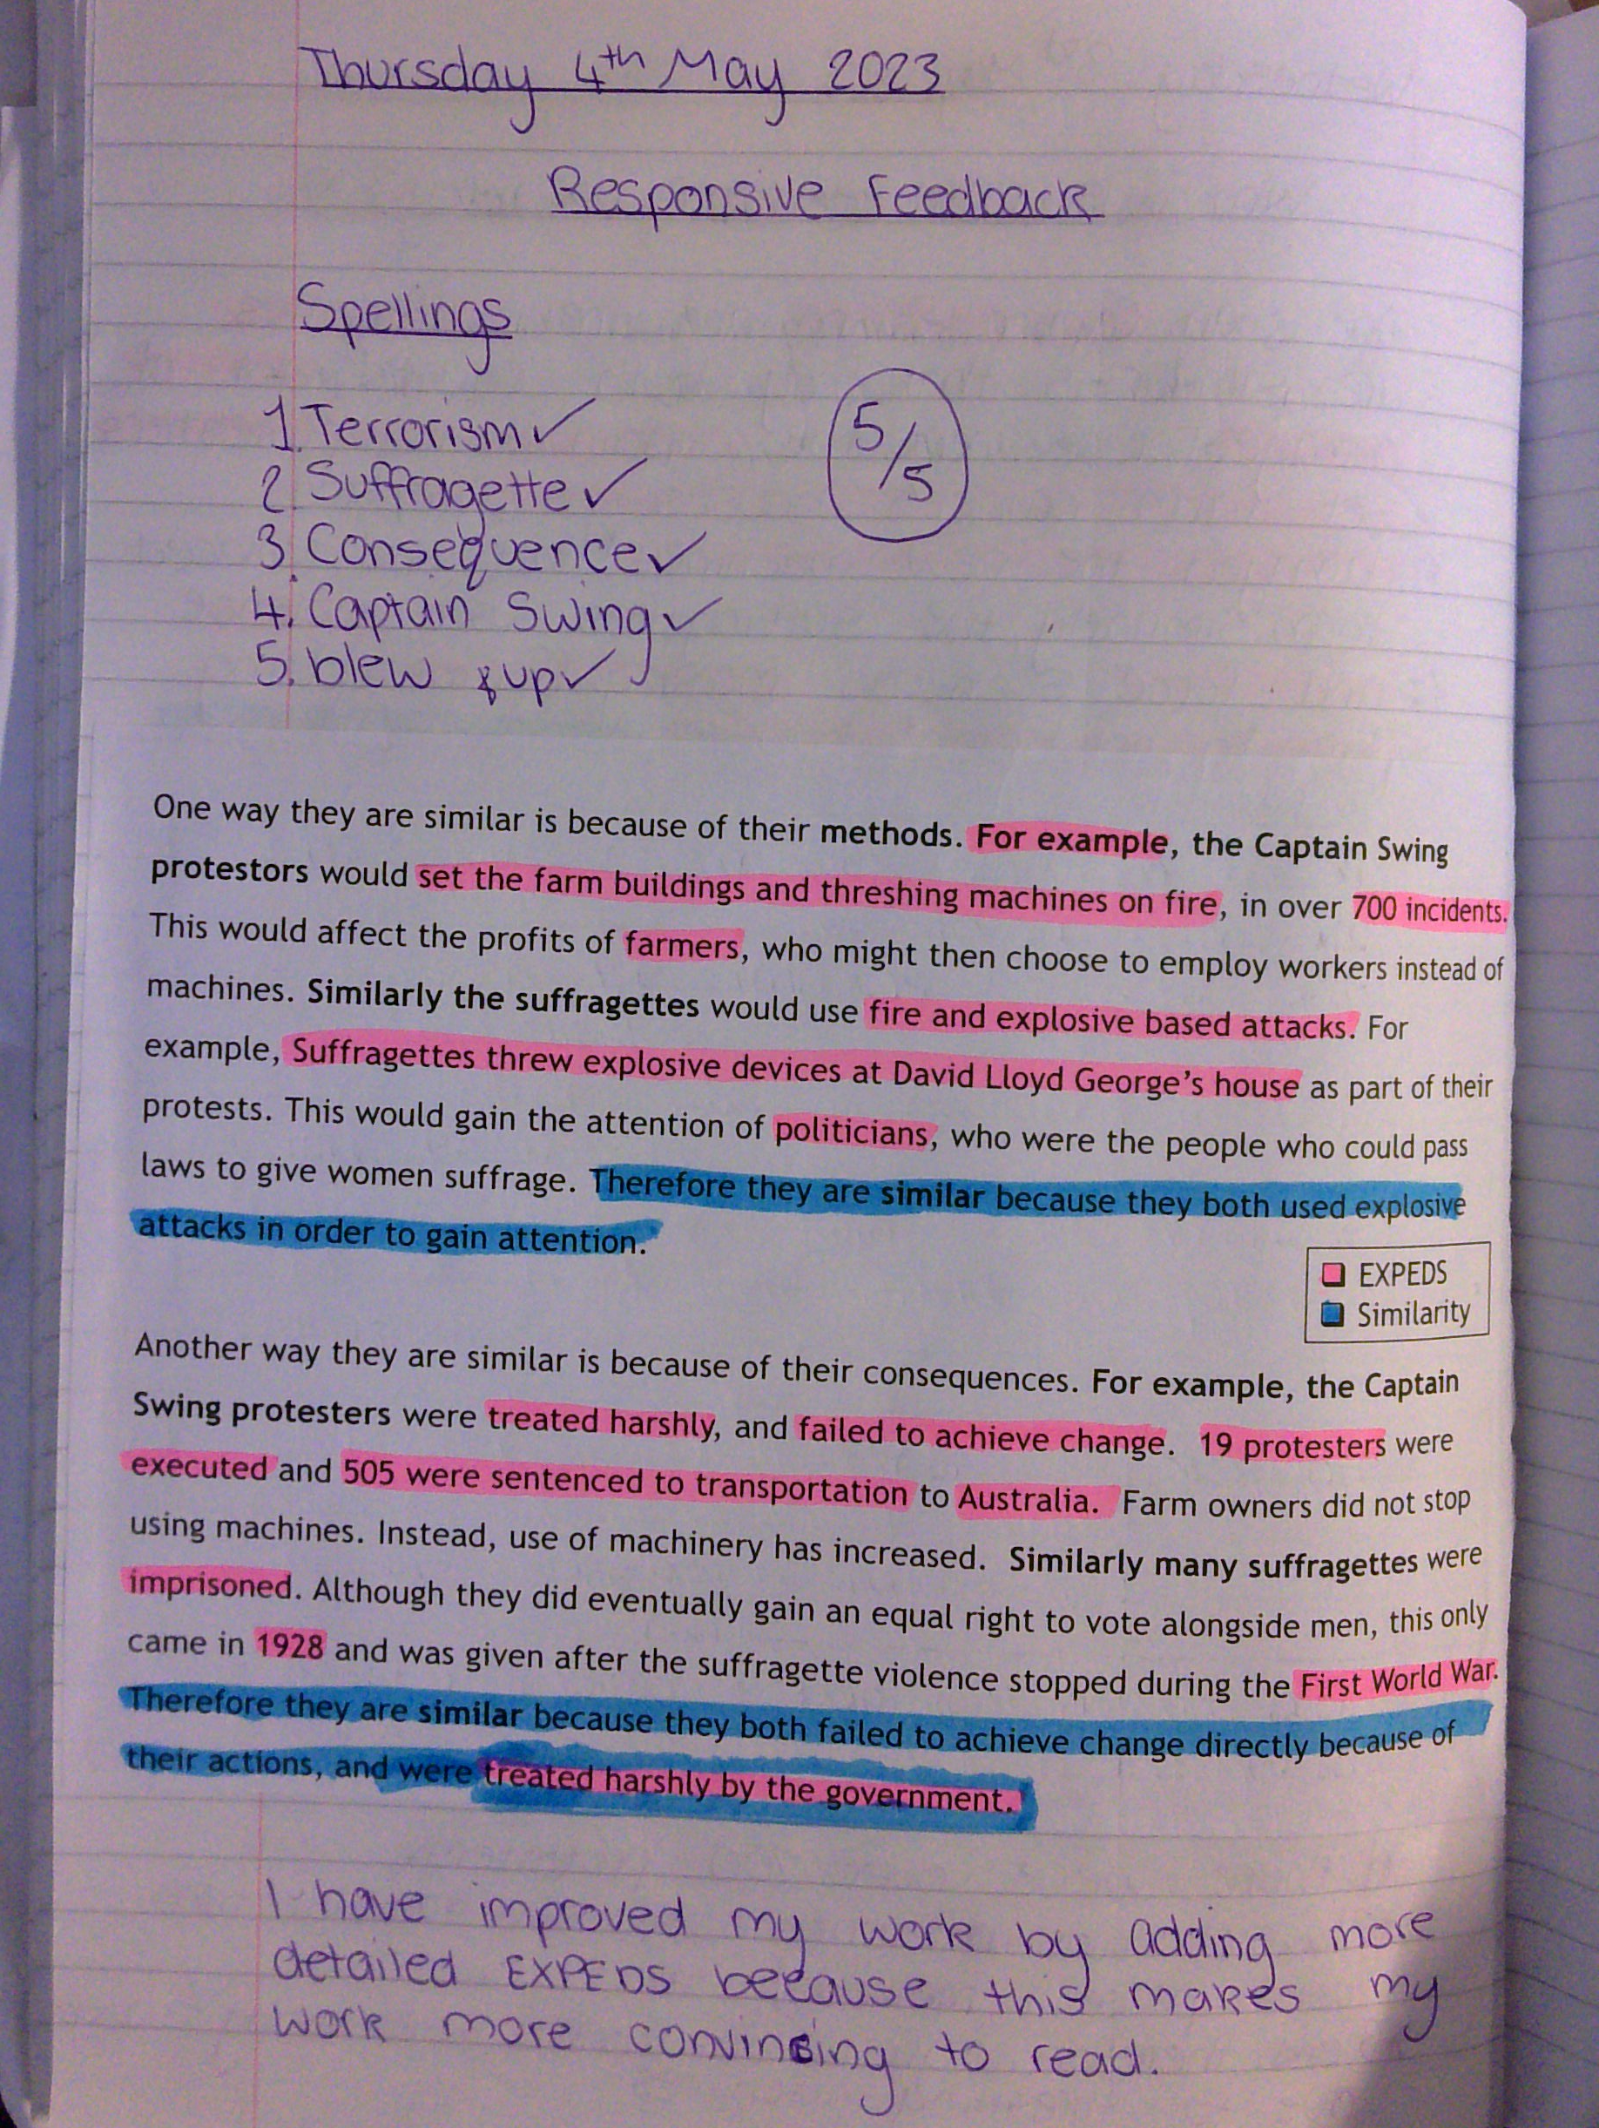
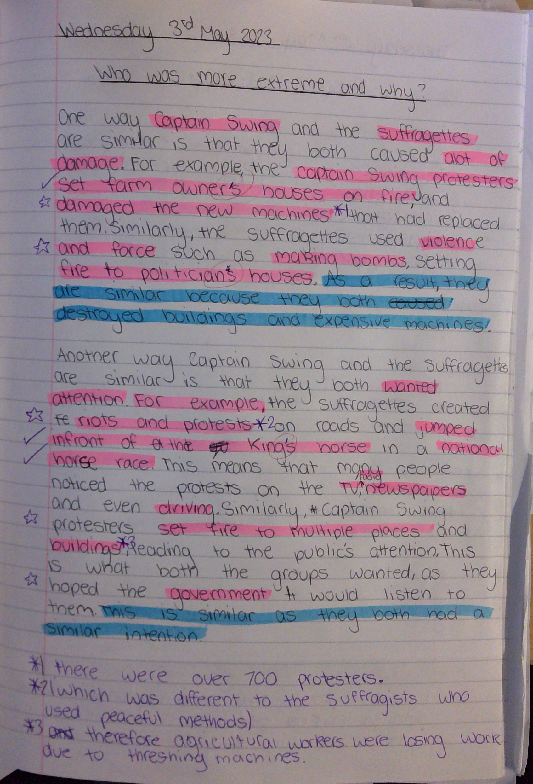
1.5
Year 8 – verbal feedback, use of a teacher-produced model to target, annotation of model and own work, improvement to own work and understanding of improvement.

