Slide 1
HA QM
02 Leadership

Slide 2
2.1
Item 1
“2.1 History Faculty CPDL log 2022-23”
Shows that all staff are supported with a range of subject-specific CPD opportunities, many bespoke and in-house, others through the HA or otherwise. The in-house sessions are linked to needs identified by our own self-evaluation of the department, staff and school context. This is in addition to whole-school CPDL opportunities.
Example of impact:
November 2022 attendance at Classics for All CPD day at Parrs Wood. One session had a focus on Depth study source evaluation questions with suggested strategies to improve attainment. Strategies were implemented at the next opportunity. (Evidence of attendance on next slide.)
Evidence of impact then shown on the following slide showing an average +0.4 and +1.5 mark increase in source related questions for the cohort.

Slide 3
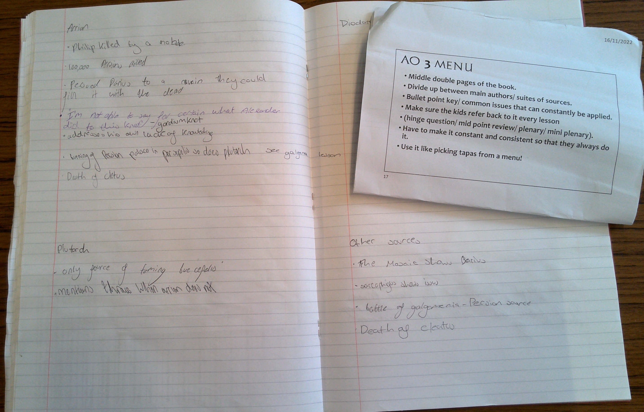
Below: Booking confirmation for the November Classics for All CPD day at Parrs Wood.
Right: Slide detailing one of the strategies suggested at the CPD session overlaid onto a pupil work book showing the strategy starting to be implemented.

Slide 4
Shows 2022 vs 2023 averages for question types in the Alexander paper.
Source questions were highlighted as a weakness in 2021-22 and so for the 2022-23 year they became a focus in teaching, as well as primary focus for a trip to the British Museums Alexander the Great exhibit.
As a result of the focus there is a +0.4 increase in the shorter question and a +1.5 for the long essay question.

Slide 5
2.1 item 2 – statement from Assistant Headteacher reflecting the department’s engagement and contributions to local ITT networks.

Slide 6
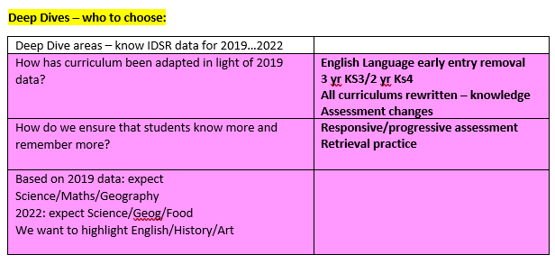
2.2
Item 1
Screenshots below from whole-school document preparing for Ofsted inspection in 2022-23, showing that History has consistently been well organised and managed, and SLT saw the History team as an exemplar department.

Slide 7
2.3
Items 1, 2, 3
The department creates a Self Evaluation and an improvement plan annually, which are edited and evaluated throughout the year, including in line management meetings with SLT link. In addition, the department reports to the governors’ SEF committee. See “2.3 History SEF 2022-23”, “2.3 History DIP 2022-23” and “2.3 Governors SEF report” documents.

Slide 8
Screenshots of powerpoint slides shared with the department at meeting on 25/1/23 modelling the process to be followed, in response to learning walks carried out previously.

Slide 9
2.5
The department actively encourage all pupils to take part in internal, local and national competitions.
The department have hosted the local heat of the Great Debate and are set to again this year, regularly entering two participants. Pupils have entered the “Classics For All” and the Lytham St Annes Classics competitions on a number of occasions, most recently 2023 where the entrant received a Highly Commended award. Pupils have also represented the Academy locally in the DebateMate competition organised and reported on (attached) by a local MP.
All of these activities as well as extra-curricular clubs and trips are actively supported by the Academy SLT with the head often personally in attendance. Cards from SLT to staff show the support and cards to staff from pupils show the impact and importance of these opportunities.
3rd place in the DebateMate competition, organised and judged by the local MP.
Source: https://www.drkieranmullan.org.uk/news/newsletter-126

Slide 10
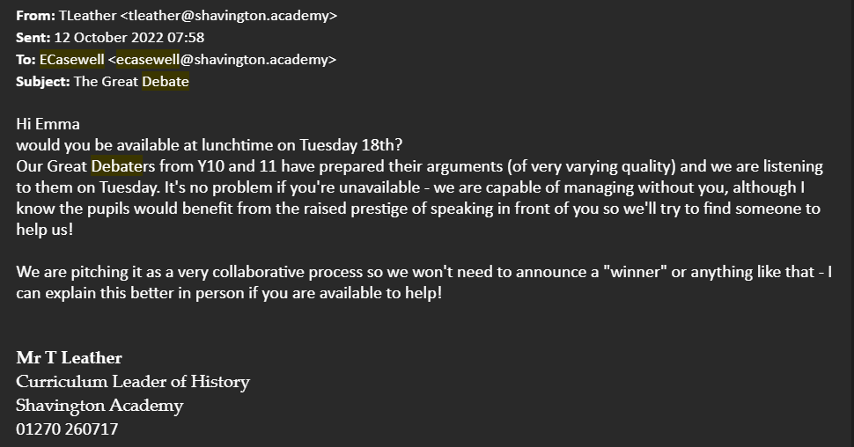
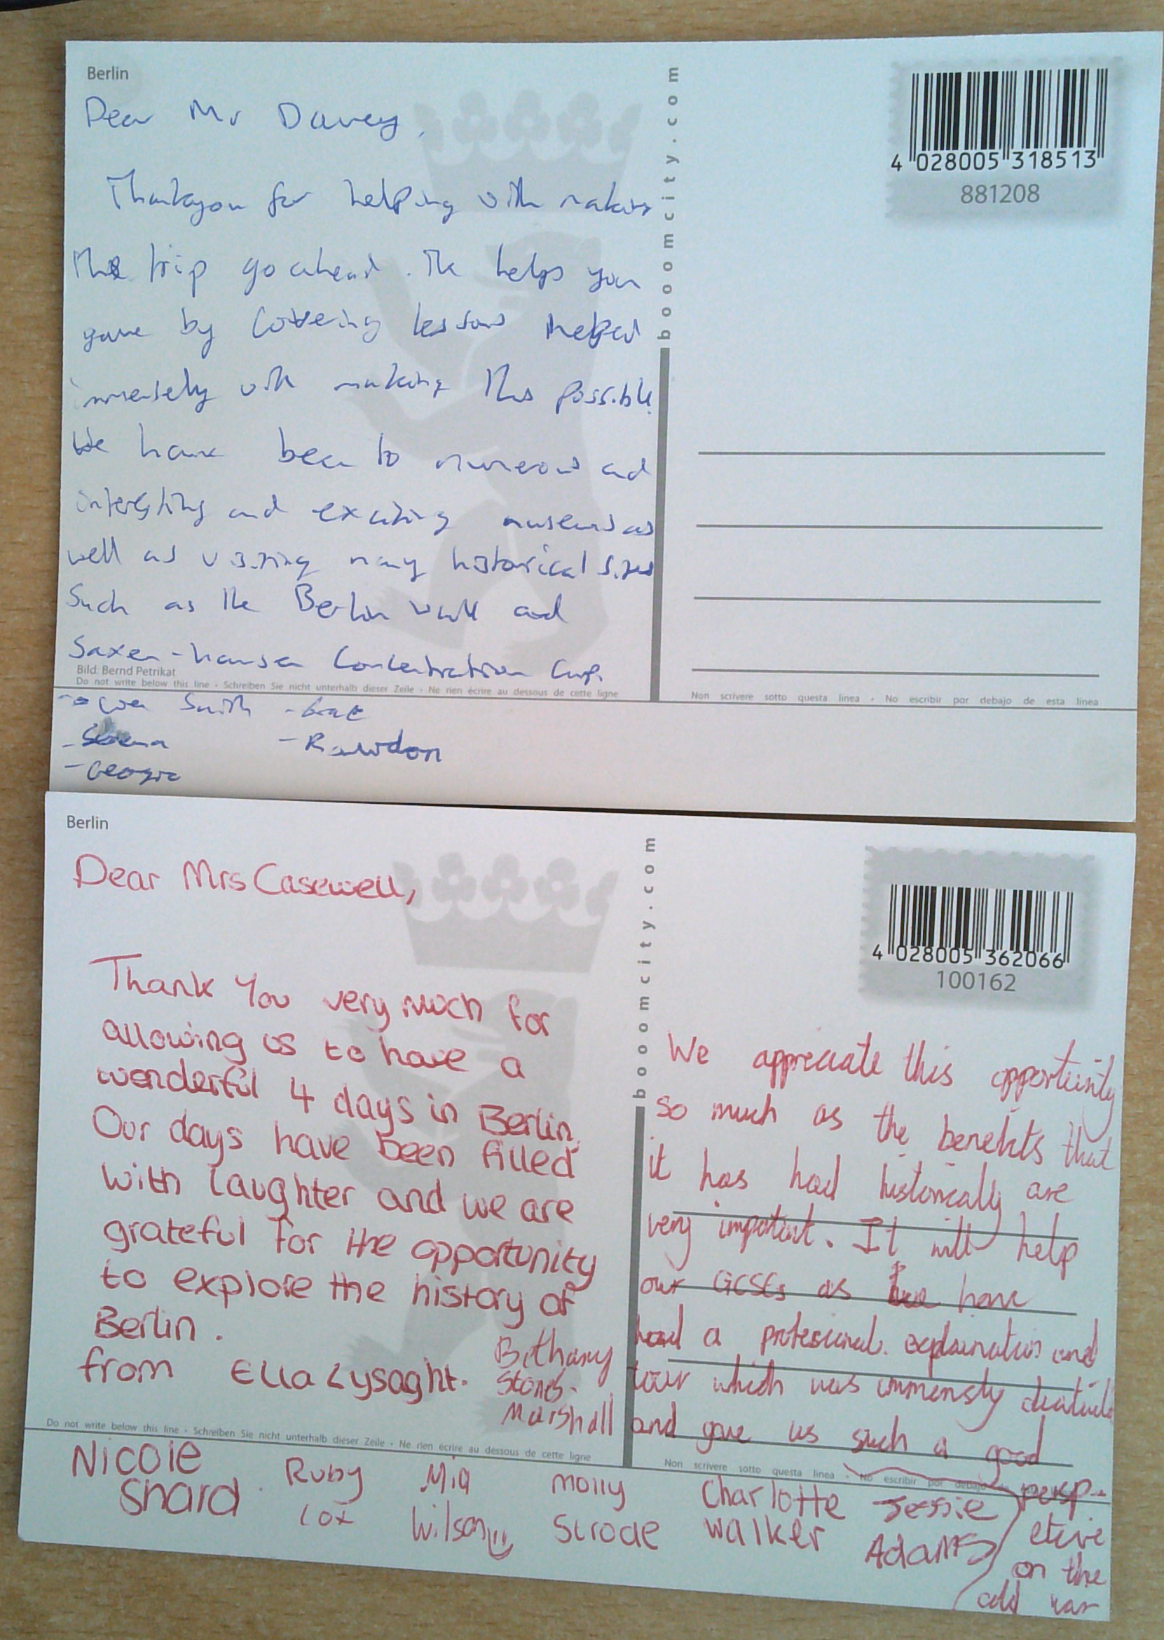
Above: Evidence of appreciation from the headteacher for running a trip.
Left: Postcards from pupils on a residential trip to staff.
Right and below: Evidence of the headteacher supporting The Great Debate internal judging process and the local Debatemate competition.

Slide 11
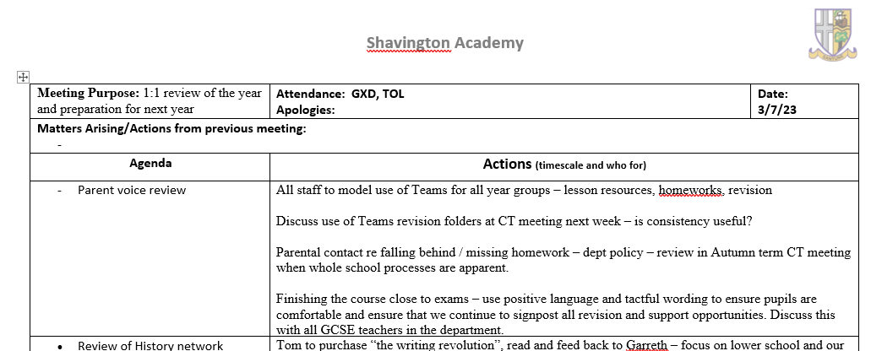
2.6
Responses to the survey are collated in this powerpoint: “2.6 Parent voice survey results June 2023”.
They were discussed at departmental briefing and in 1-1 staff meetings, including a focus on communicating course requirements to Y11 pupils, and identifying and taking relevant action when underperforming pupils earlier – example from the minutes of one 1-1 meeting below.
Email message sent to parents of Y11 pupils in 2023: Dear parent/carer
As the Curriculum Leader of the History Faculty, it has been a pleasure to work with your son/daughter on their History, Ancient History and/or Citizenship course over the last two years of their GCSE, as well as in their whole five years at Shavington Academy. I have met many of you at parents' evenings, although not all, and as you have been on "the other side of the desk" to us, I would really value your feedback on our faculty, before we say farewell to you!
I have created a survey that will take you an average of 2 minutes to complete: https://forms.office.com/e/YqDdXFhCL4
This will help us to learn from your experiences and to continue striving to enthuse and support pupils in future.
We are proud of the attitude, effort and achievements of our pupils, and consequently we are applying for a "Quality Mark" from the Historical Association - all feedback we receive from you will help us to evidence our application.
Many thanks, and I wish you and your son/daughter the very best for the next steps,
Mr T Leather
Curriculum Leader of History
Shavington Academy
01270 260717

