Slide 1
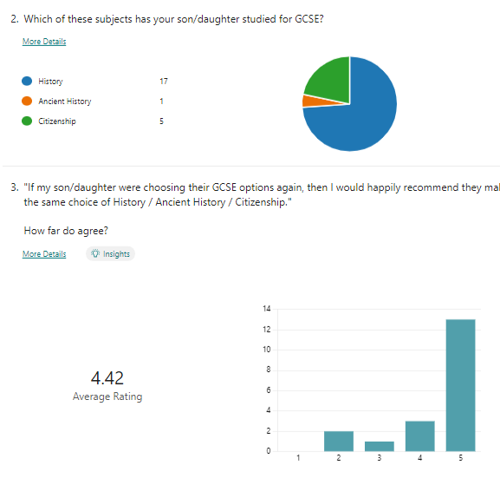
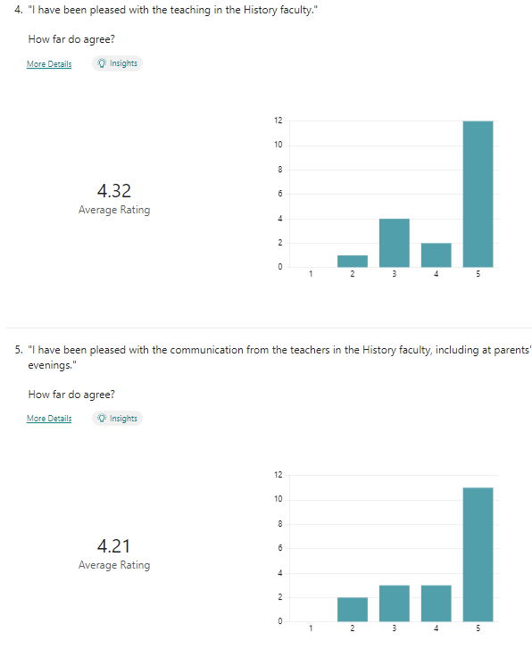

Slide 2
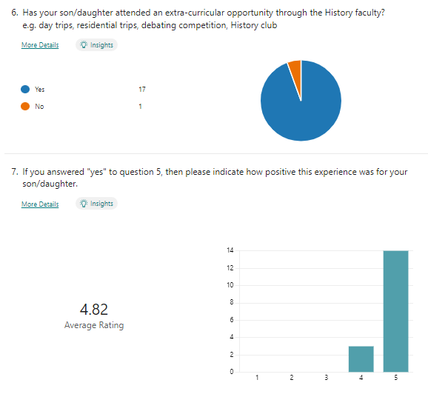

Slide 3
EXTRA-CURRICULAR
Great way of bringing the subject to life and creating genuine interest and enthusiasm in a way that pure classroom teaching cannot always do The opportunity for an overseas residential trip which brought some of the cold war history to life
He really enjoyed visiting The House of Commons and all. In future: Explore opportunities with local council - visits? - to widen a more local aspect of democracy.
She loved the British Museum visit. She has competed in some debating contests and has done herself and the school proud . Again, encouraged by yourselves she has risen to the challenge in her ability to articulate herself well and with passion. We saw for ourselves her speaking at the school earlier in the school year in one such contest and to this day I don’t know how the judges didn’t vote her the winner. She was quite clearly the best speaker but that’s history now.
She particularly loved going to Berlin on the school trip & talked to us extensively about what she had seen & learnt while over there. Trip to London was memorable and enjoyable, whilst learning more about the subject. Son enjoyed the opportunity for Q & A with MP and would have liked another chance to grill him!
She really enjoyed her trip to Germany and their teacher has supported her throughout her time at Shavington High
He really enjoyed the Berlin trip - it was an excellent experience for him and improved his confidence greatly.
Berlin trip was very informative. Even though she had already visited with ourselves, she got more knowledge on the trip
In year 10 there was a personality clash I feel with the teacher and he lost some enthusiasm for the subject, however they both worked hard and I hope this will show in his final result
He really enjoyed the Berlin Trip.

Slide 4
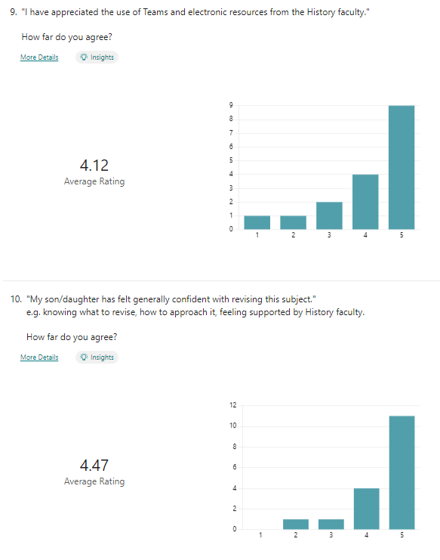

Slide 5
She has really enjoyed her history learning with both their teachers throughout her time at Shavington Academy.
We have always been delighted with the approach taken in both History and Citizenship. Their teacher has really managed to grab my son's attention and create genuine interest and passion in the subjects
He felt very supported By his teacher, his methods and the way lessons were delivered gave him Confidence to work well in his GCSE. He really enjoyed the subject and is due to take Law at sixth form.
My son has been lucky enough to have been taught by the same inspirational teacher for... He has made the subjects so interesting and relevant and the obvious passion he has for them has really brought the subjects alive and made the learning experience thoroughly enjoyable.
She lost confidence in her learning, but her teacher took the time to explain ways of revising that would benefit her more. Which have hopefully worked.
Honesty and openness to us as parents. Often going above and beyond.
The teacher
Very happy with my son’s experience. Relationships that experienced staff build together with interesting lessons are key to getting the best from the children.
He and also his brothers before him have all enjoyed learning history at Shavington and found it interesting and talk about what they've learnt. All have chosen to carry on to A level afterwards.
He has enjoyed the History curriculum, especially the American civil war and world war 1.
Her teacher has left a lasting impression on her, she has thoroughly enjoyed her time learning with him.
The extra classes put on after Christmas
I don't know what is offered, if I'm honest.
She has enjoyed it and so much so that she will be studying at A level standard at South Cheshire College. Her enthusiasm for the subject has been helped by the teaching given and in particular their teacher. Great effort by her and with some find support from him has made the last two years most enjoyable.
Thanks again for your support and your expertise in giving her a great two years. Give yourselves a pat on the back .

Slide 6
I feel that this is the stronger area within the school with teachers who are passionate about their subject matter and great communicators. I would not feel that there are areas here I could point out to do better
From my experience and listening from my son, he struggled with History, and for the content still being learnt two weeks prior to exams starting did not do well for his confidence. I understand that there's a lot of content of History to get through, but it could be looked at to be delivered better, as it can make pupils uneasy as there's so many other subjects to cover.
Try to finish the curriculum earlier to give more time for consolidation
We found on line some revision resources produced by other schools that really supported the revision process. They were question frames for the different types of questions and were a great scaffold. Would have been great to have had this provided by school as we found them for three out of the four themes but really missed having them to support the fourth theme revision.
Keep up the good work.
He has been ill prepared for this subject. I understand that they were still learning new content just a few weeks up until the actual exam, this was focused around power of the people (I think) This isn’t acceptable! The school needs to be better prepared and sufficient time needs to be allocated to all topics. Unnecessary extra pressure has been placed on the pupils due to the lack of time given to this final topic. My daughter also experienced the same situation a couple of years ago for history. Hopefully through my son’s commitment through revising, he should at least pass this subject but more support and revision clubs should be offered by the school and teachers .
If there are problems, ie homework not being turned in or it being obvious that little effort has been made, contacting parents early doors to enable a parent teacher partnership to support the pupil.
Nothing
Keep on doing what you do! Retaining staff is key to better knowing students.
Only concern is history teachers often booked up at parents evening so unable to see them.
Not really got anything to add.
Teachers contacting parents quicker if their child is failing and have more communication with the parents so they call all support the child when they are failing

