Slide 1
HA QM
03 Curriculum

Slide 2
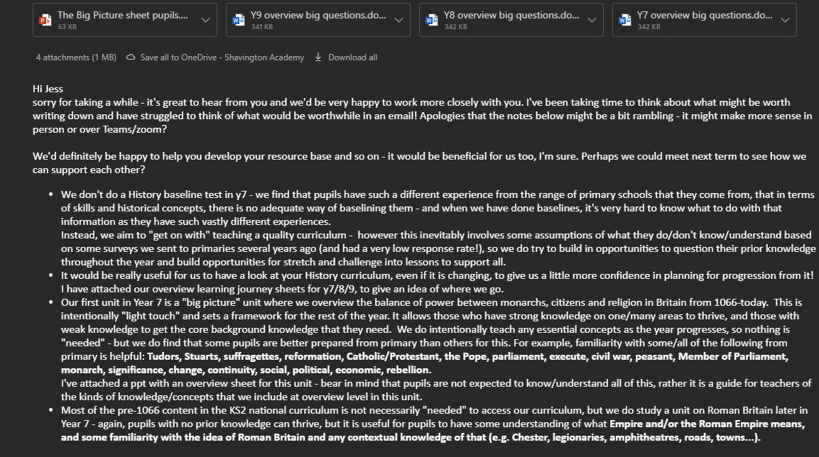
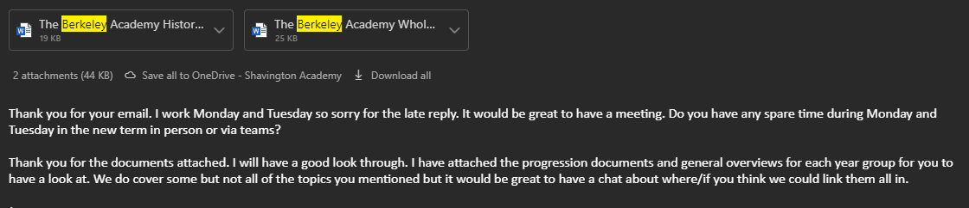
3.1
Item 1
Sample documentation from emails of ongoing relationship with one of our feeder Primary schools, including sharing resources, informing practice at both schools, and working with their pupils and teachers. Some screenshots below, continued on next slide.
Item 2
Cross-curricular: example on following slide.

Slide 3
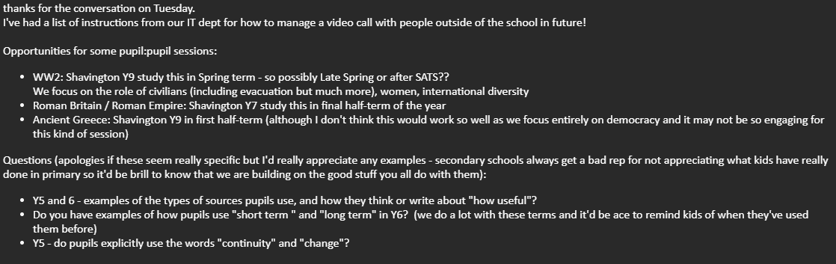
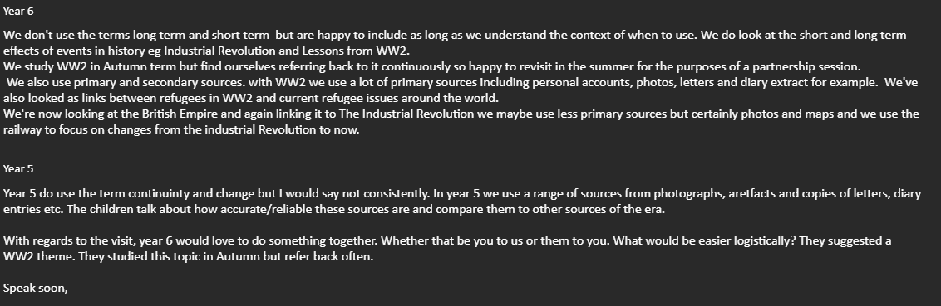
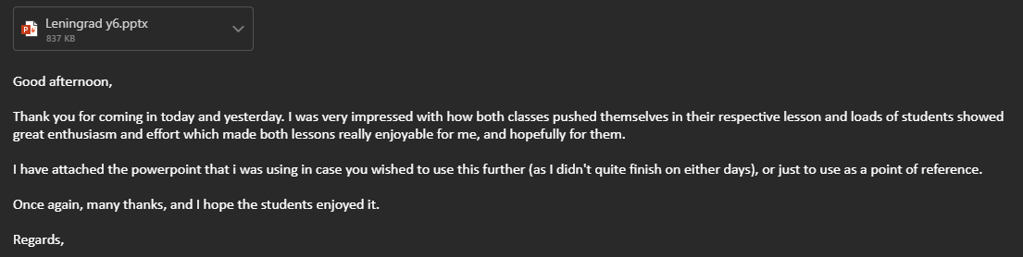

Slide 4
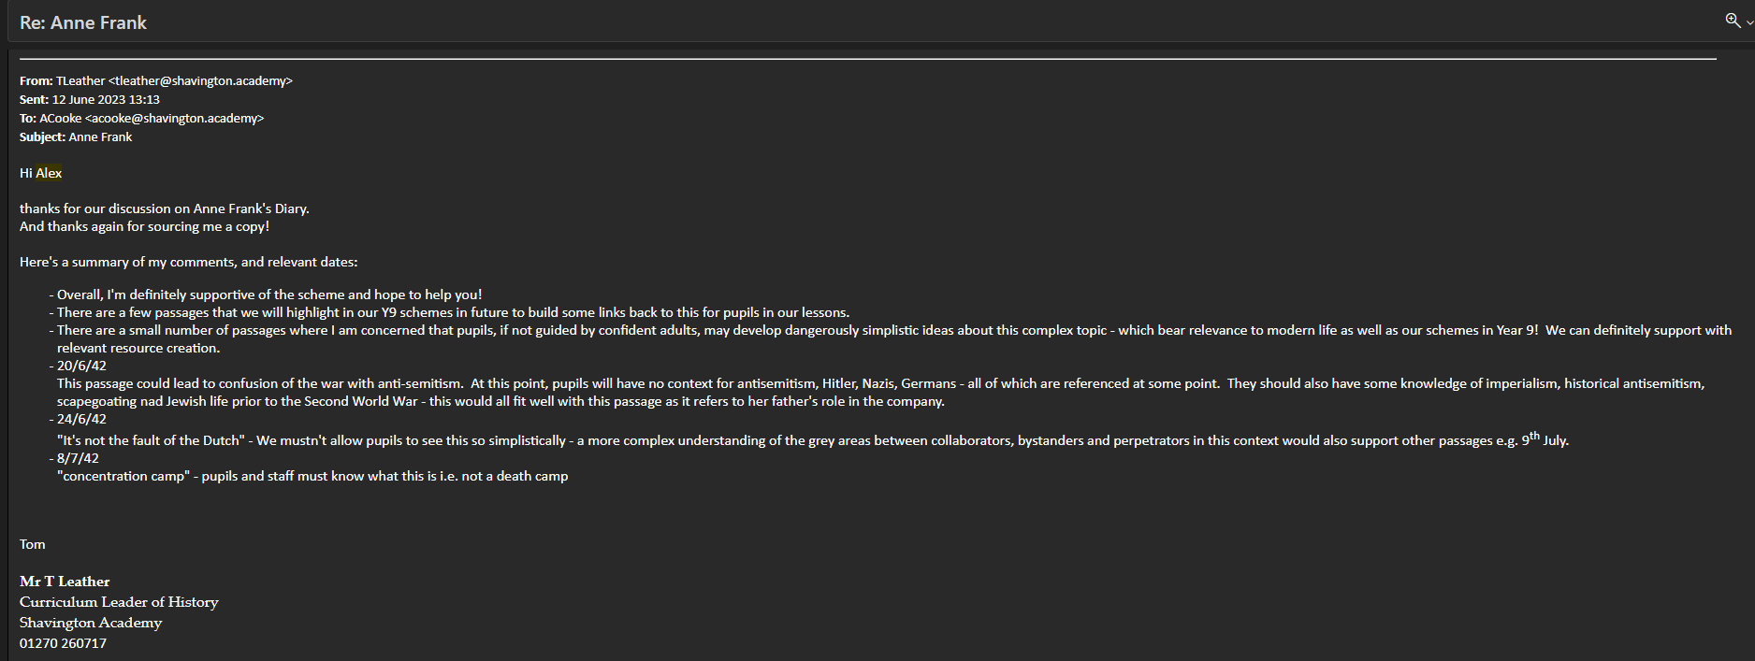
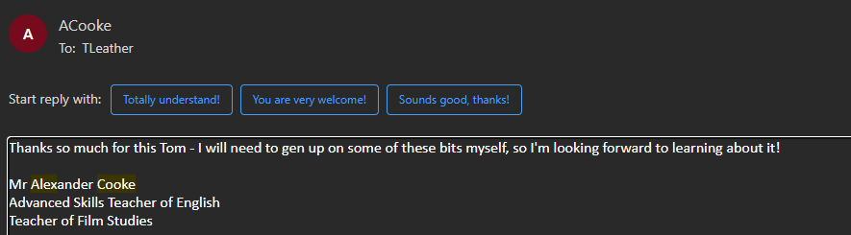
Example of evidence of ongoing cross-curricular links to inform and improve a whole-school focus on reading in form time – follow up work and resources are being worked on in autumn term 2023.

Slide 5
3.2
Item 1
“3.2 History curriculum road maps.pptx”
This is a curriculum overview document, which when viewed alongside the disciplinary concepts progression grid – on next slide – shows how the substantive and disciplinary concepts are planned to be built upon and developed in a complex curriculum that balances a range of chronological and geographical contexts.
Item 2
Department overview planning document shows how substantive concepts are planned for “revisiting” throughout the curriculum – example of Year 8 in 2 slides time.

Slide 6
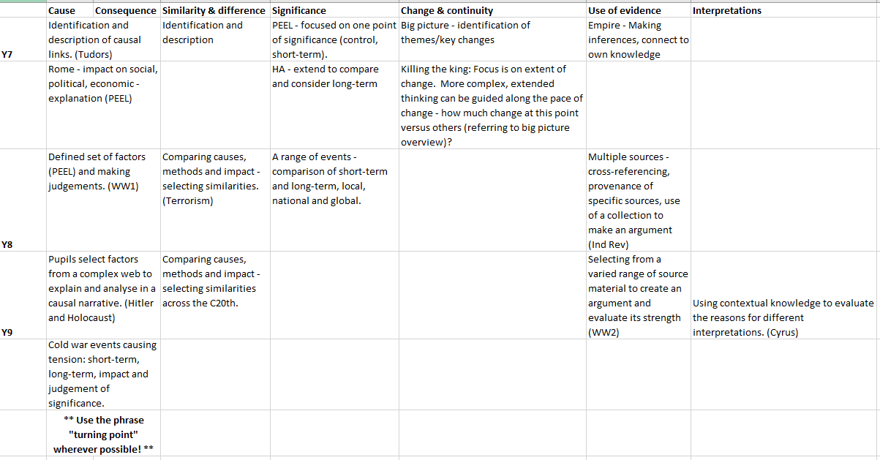

Slide 7
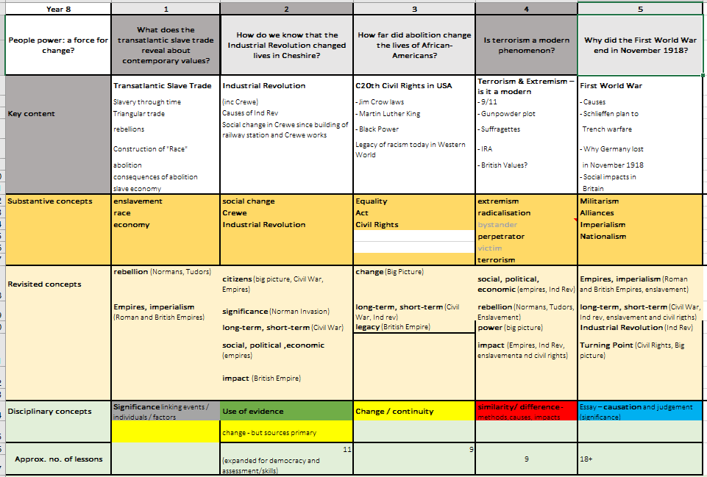

Slide 8
3.3
Item 1
“3.3 History curriculum learning journey document”
This shows how all of our schemes are planned around enquiry questions, including “big questions” and smaller questions for lessons or sections of a scheme.
A variety of enquiry approaches are used as each enquiry question is considered in terms of relevant content and disciplinary concepts.
Item 2 – on following slide
Homework task for Year 9 pupils with two example responses from Spring 2023 – showing independent engagement with an enquiry question “How ‘total’ was the Second World War?”
In these responses, pupils have used their increased depth of knowledge gained throughout the scheme, their source analysis skills, and independent research skills to produce their own individual response.

Slide 9
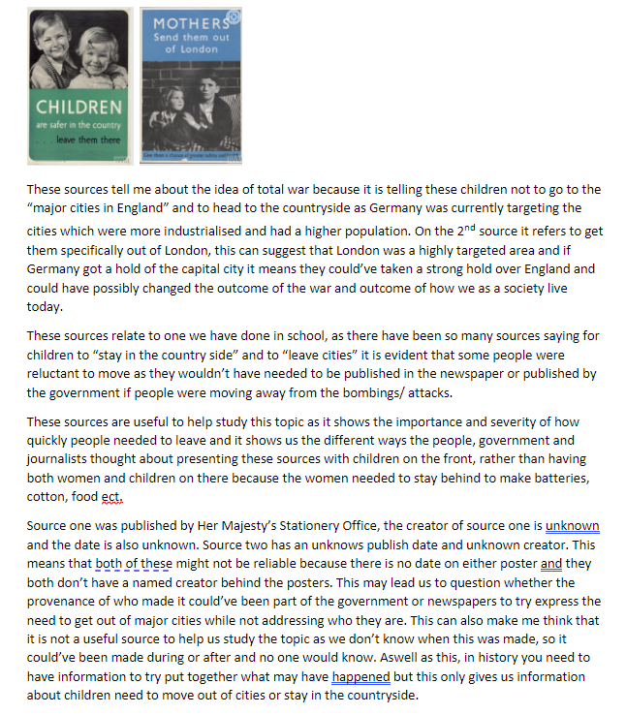
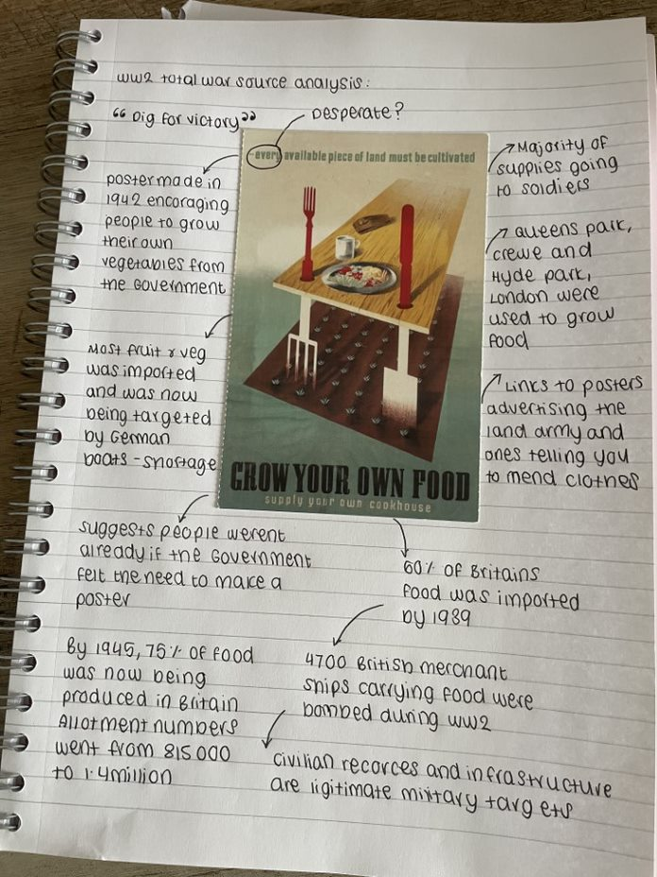
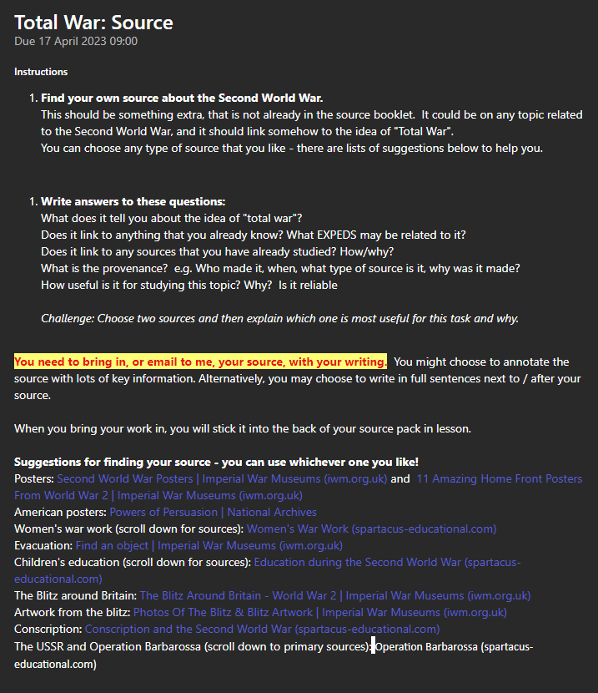
3.3
Item 2 – task instructions on the left, followed by 2 example responses.

